Slide 1
WPX Energy
AP-66S96W sec.24 SENW
Location # 335485

Slide 2
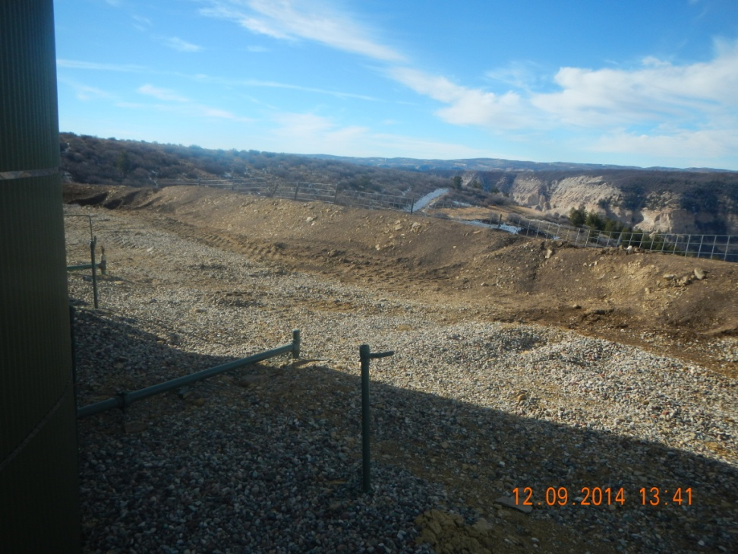
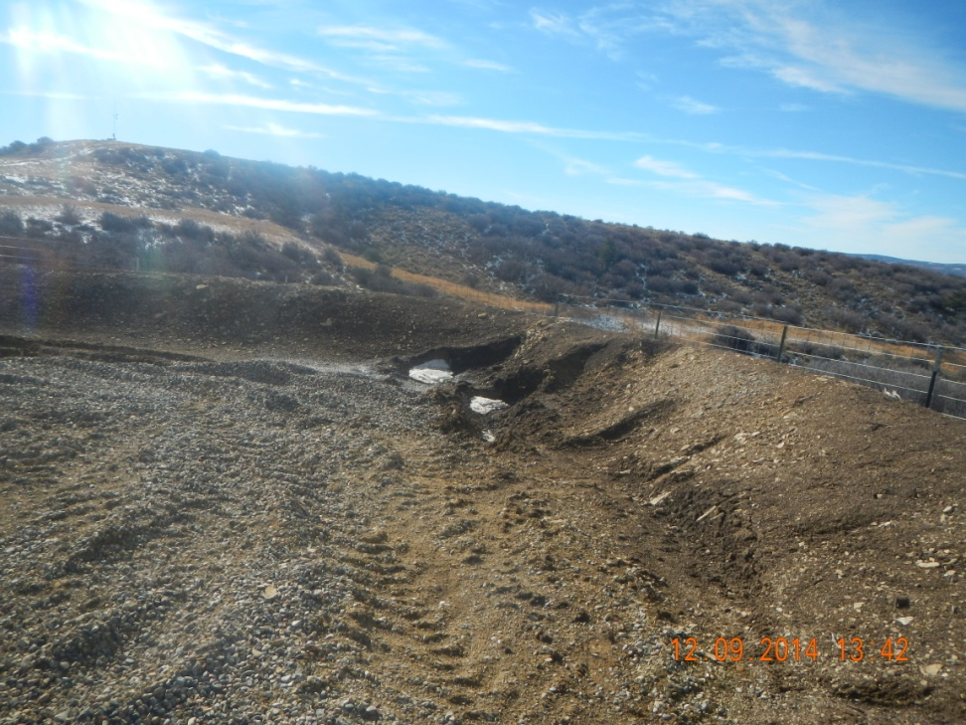
Damaged and soft compaction

Slide 3
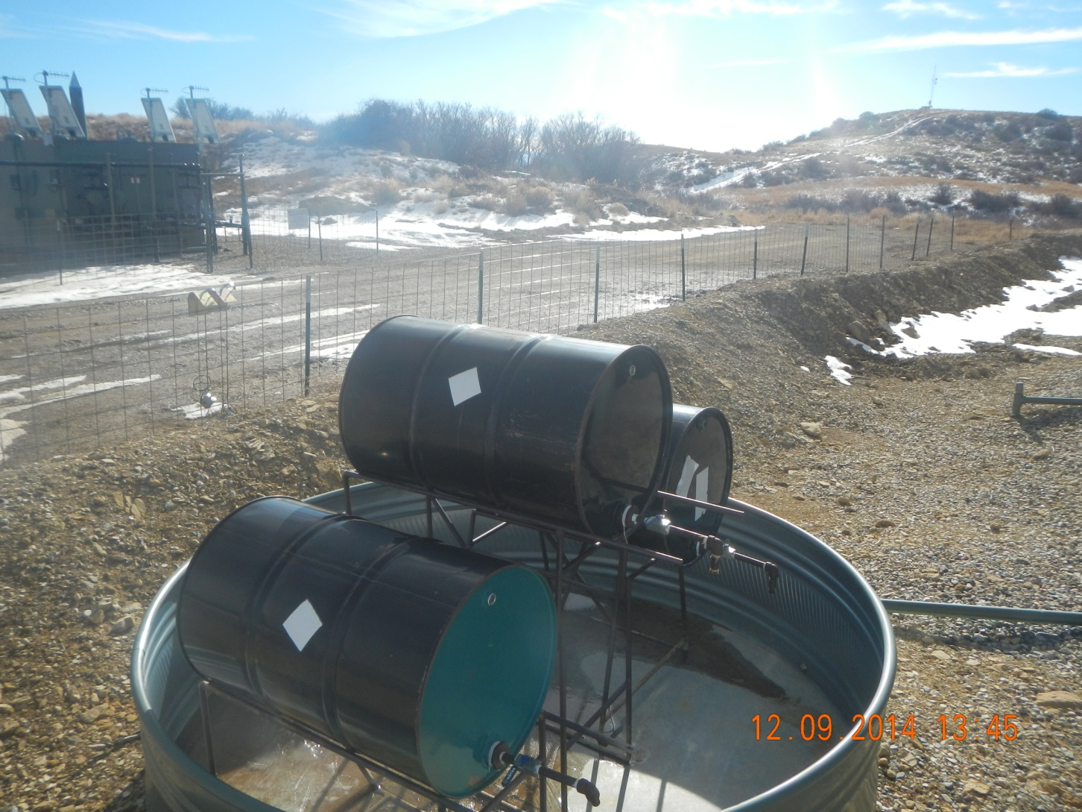
Unreadable labels

Slide 4
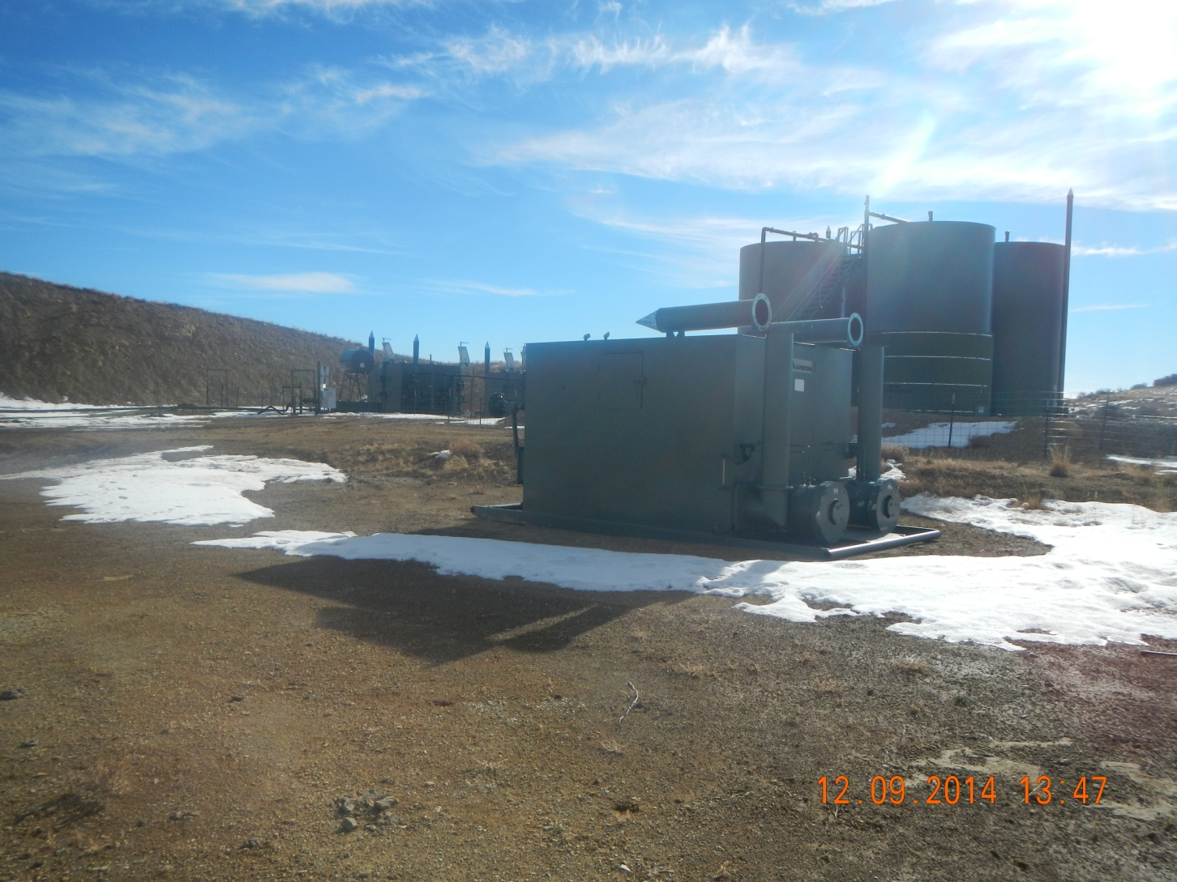
Unneeded equipment

