Slide 1
WPX Energy
AP 22-10-695 Pad
Location # 335661

Slide 2
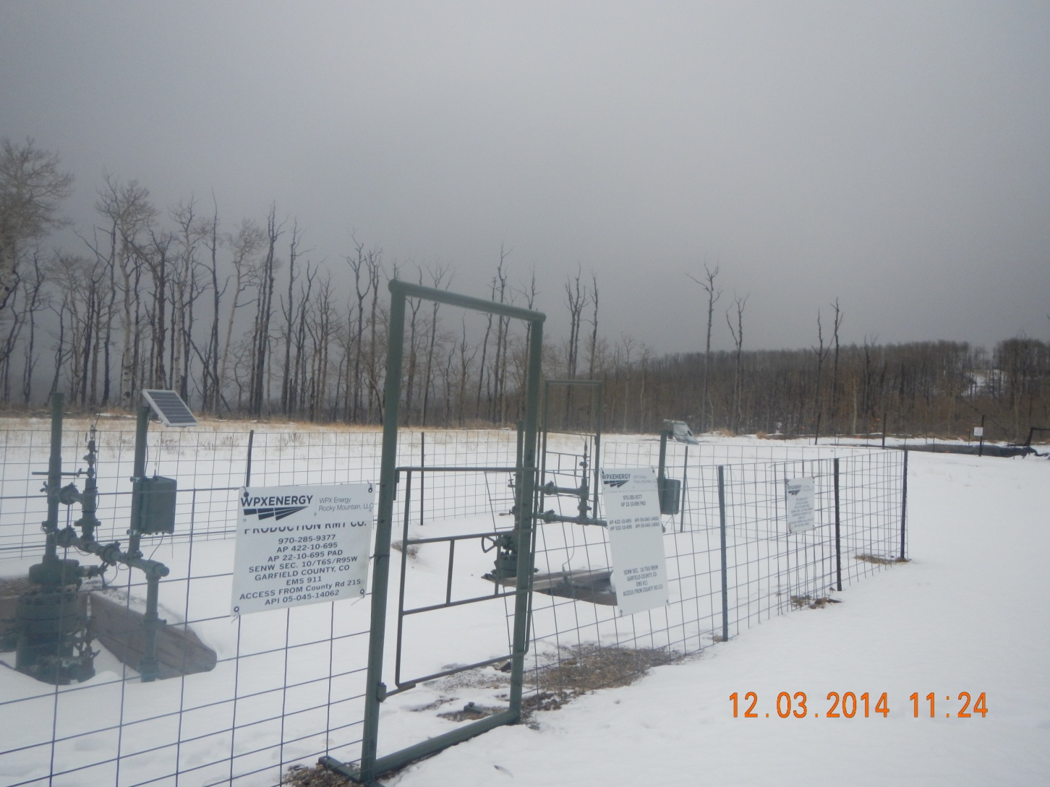
Wells

Slide 3
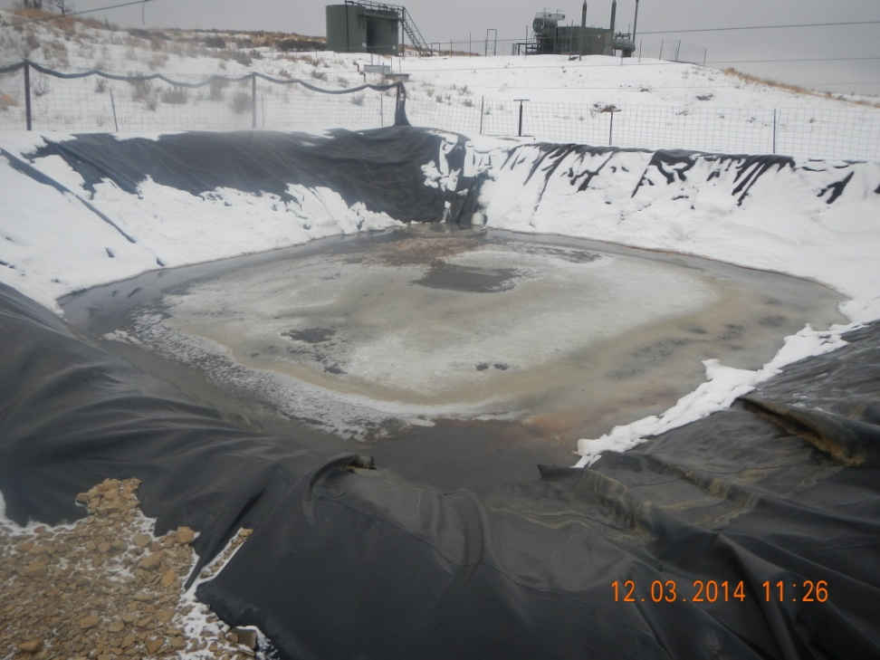
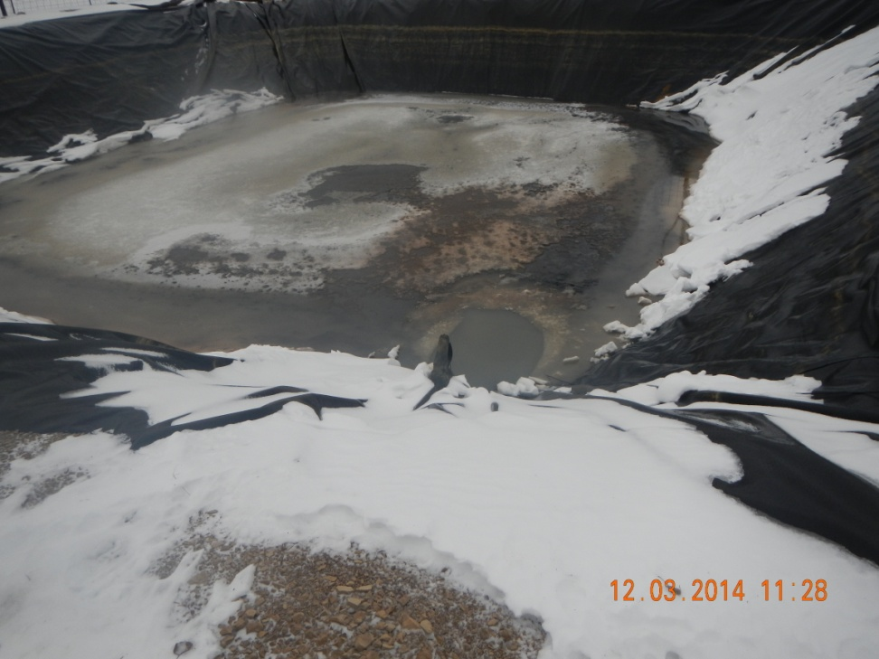
Pit is not netted with oil accumulation

Slide 4
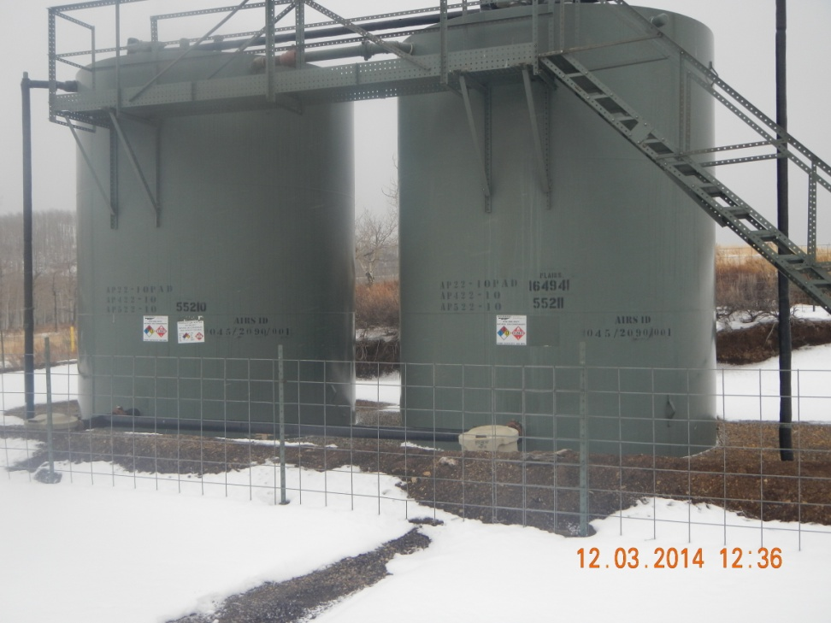
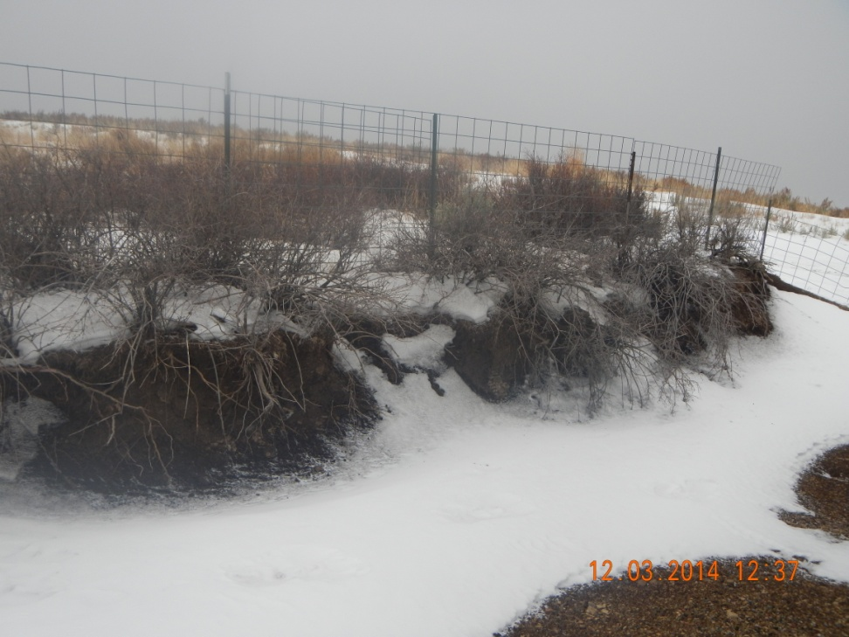
Cut slope wall used for berm wall

