Slide 1
WPX ENERGY
UNOCAL GM 31-1
Location # 324079

Slide 2
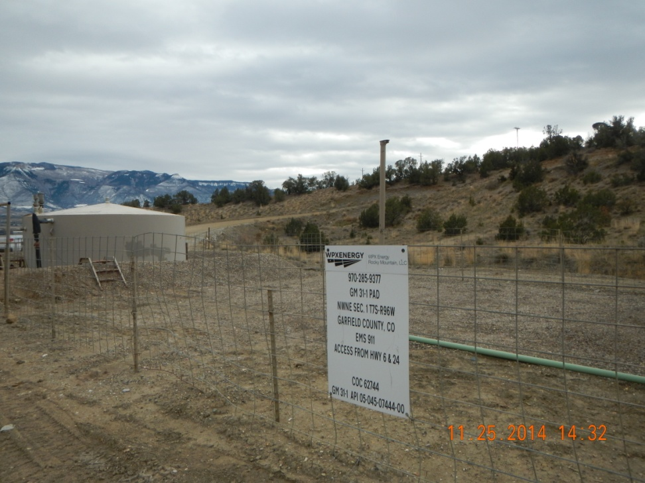
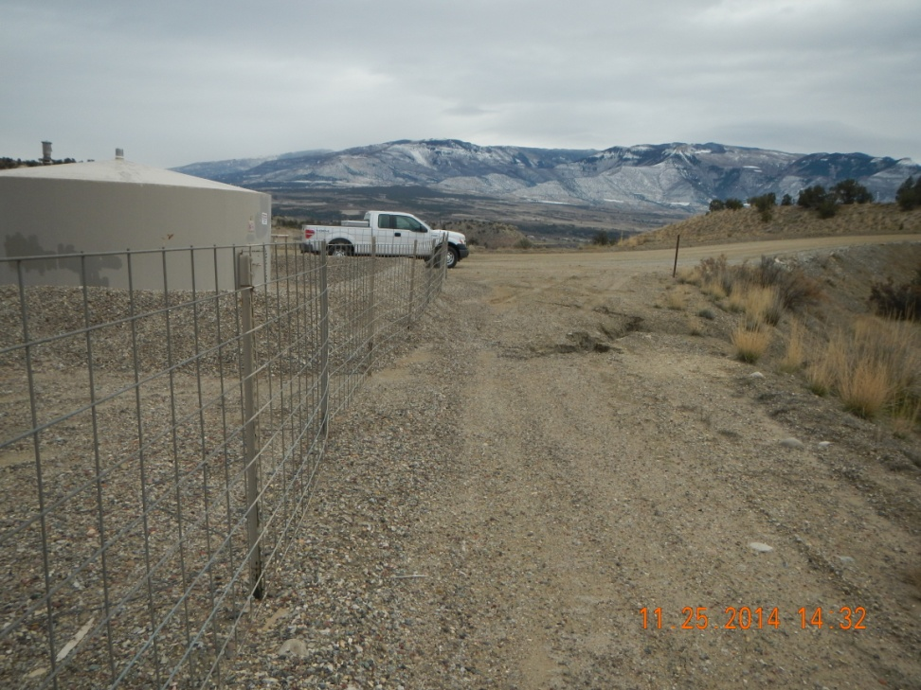
Battery sign and erosion behind tank.

Slide 3
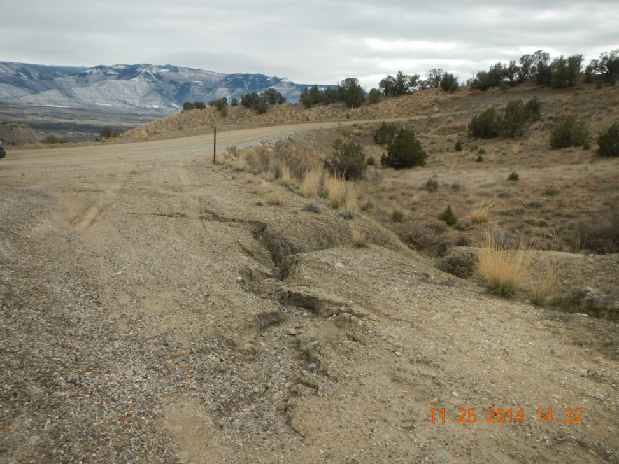
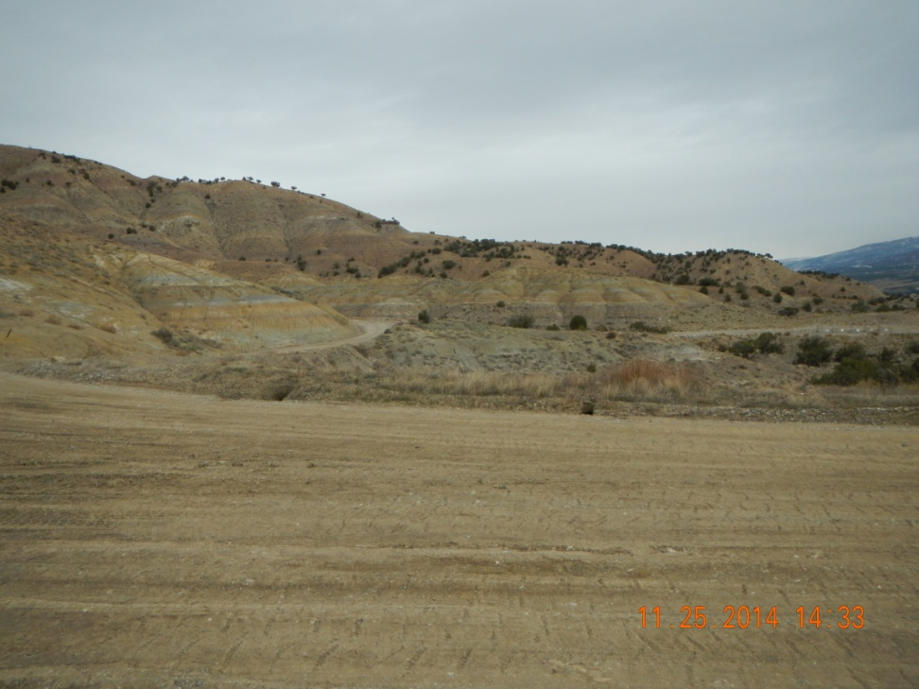
Erosion behind tank. Two erosion holes on road side

Slide 4
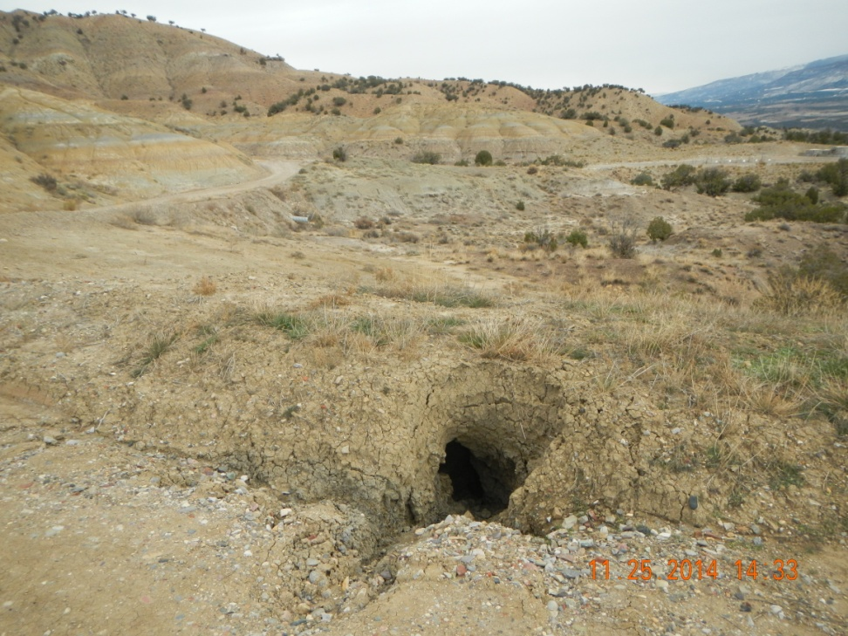
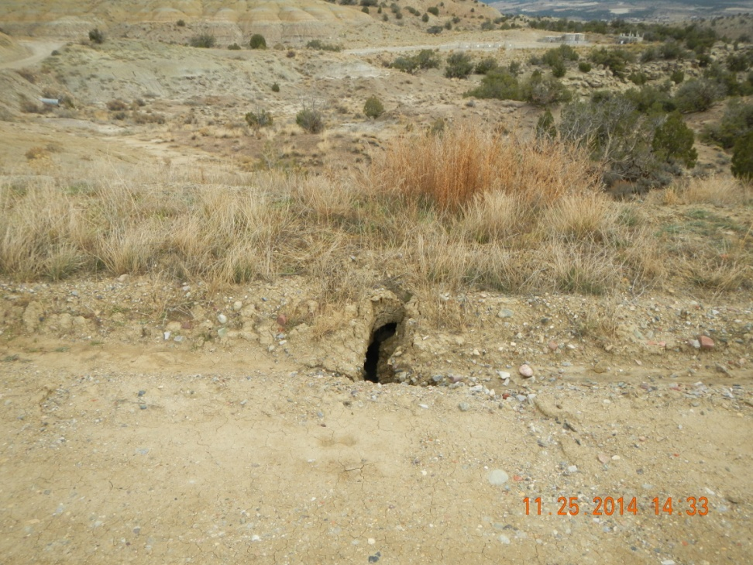
Erosion holes in ditch

