Slide 1
WPX ENERGY
PA14-6 PAD
Location # 335035

Slide 2
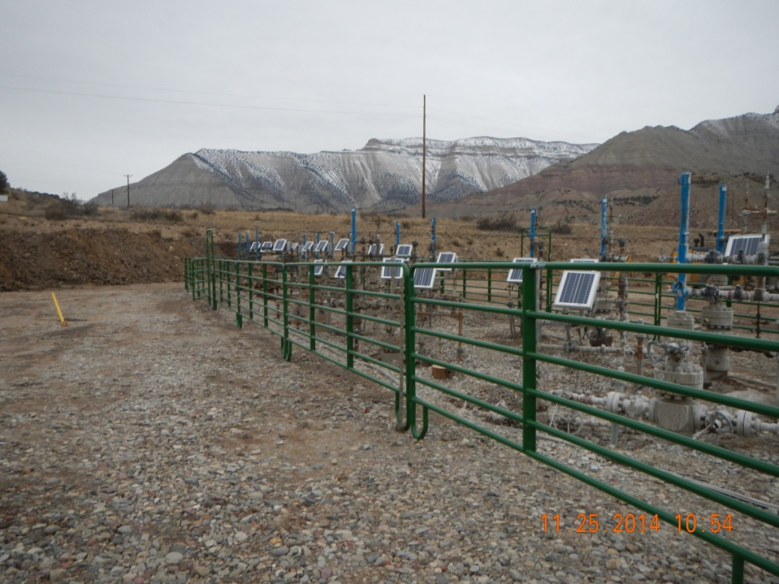
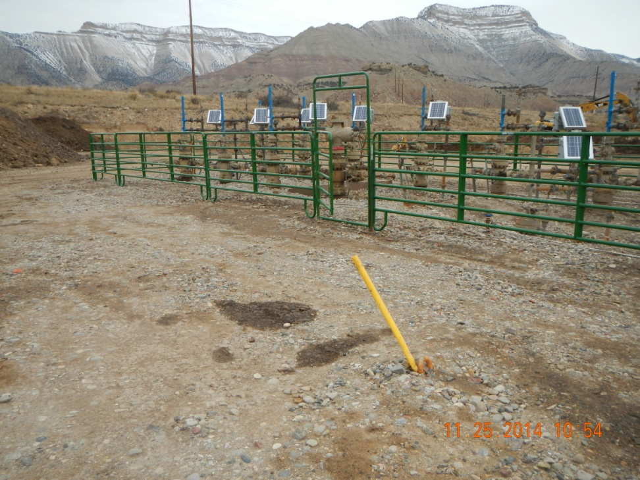
No signs on wells. Oil stains in front of well heads

Slide 3
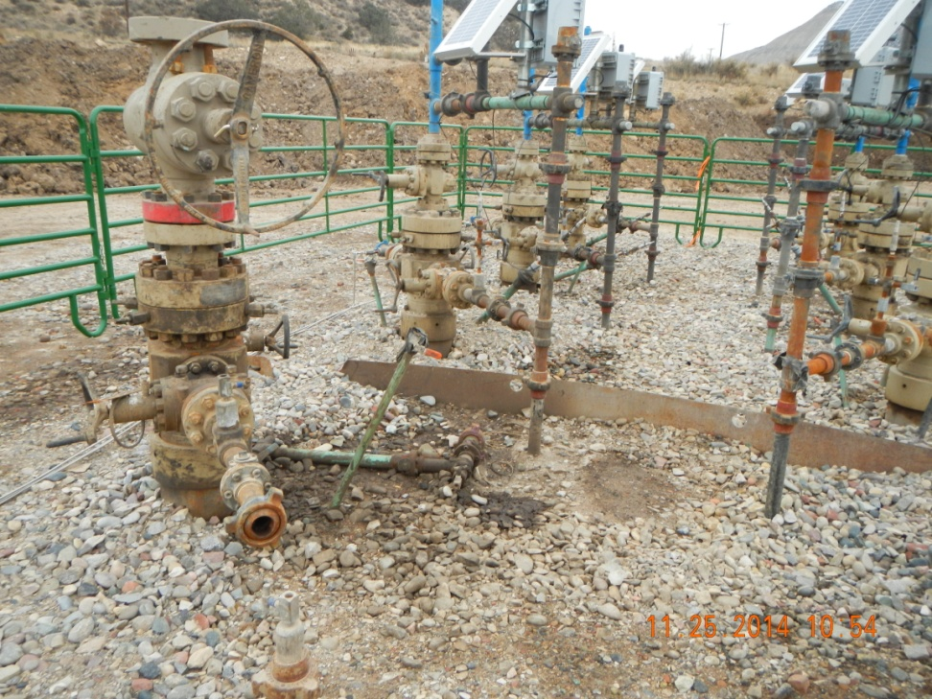
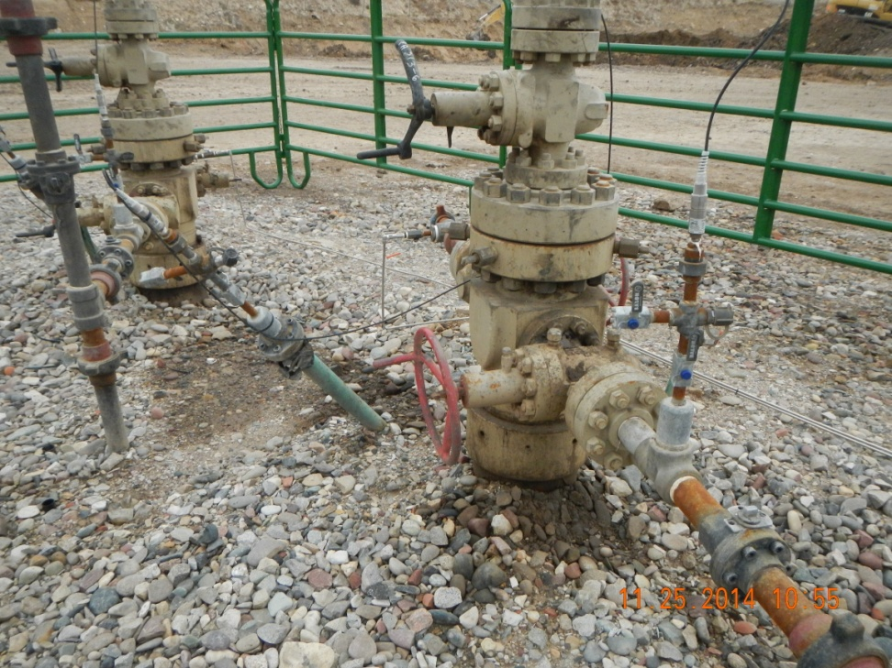
Spill stains at wells

