Slide 1
WPX Energy
Location# 335257
DOE 3-2-21 Pad

Slide 2
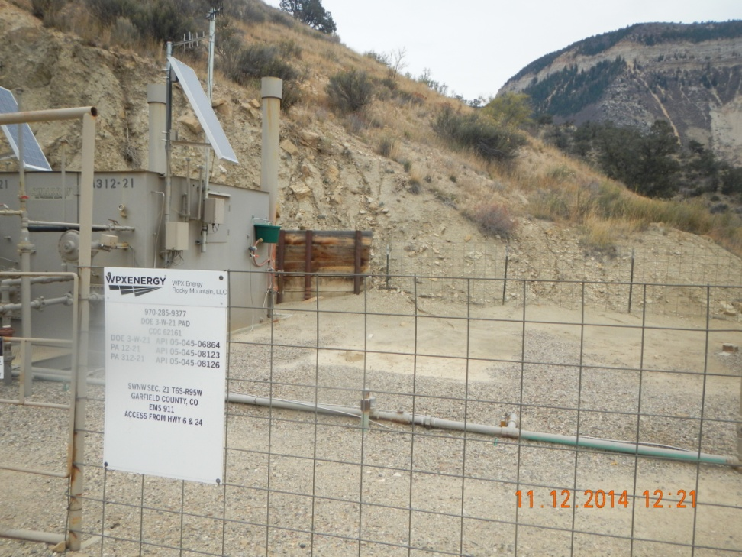
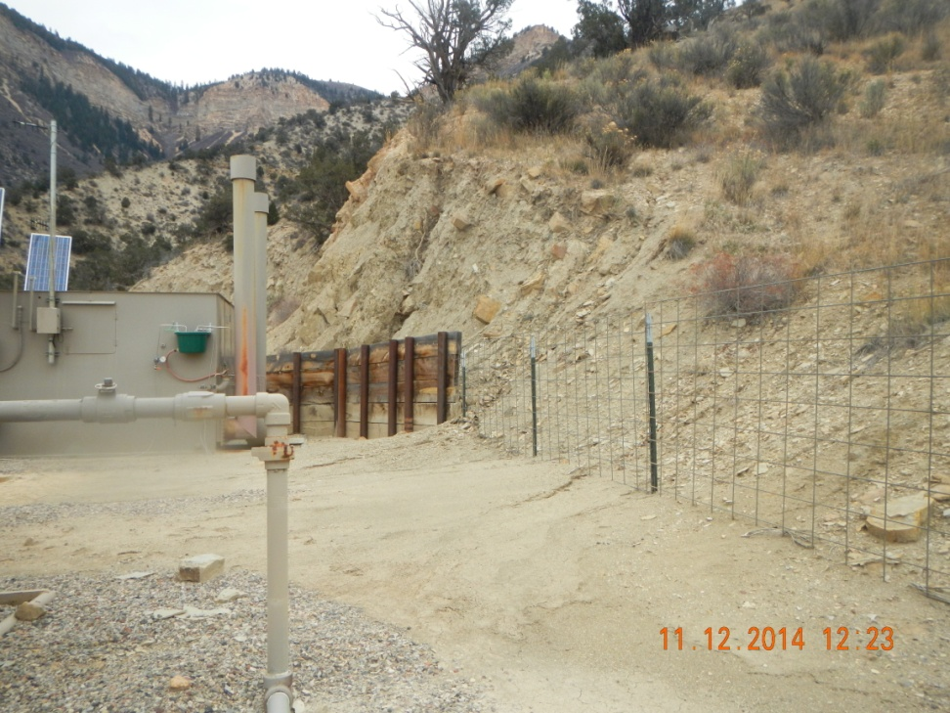
Erosion and moving of sediment

Slide 3
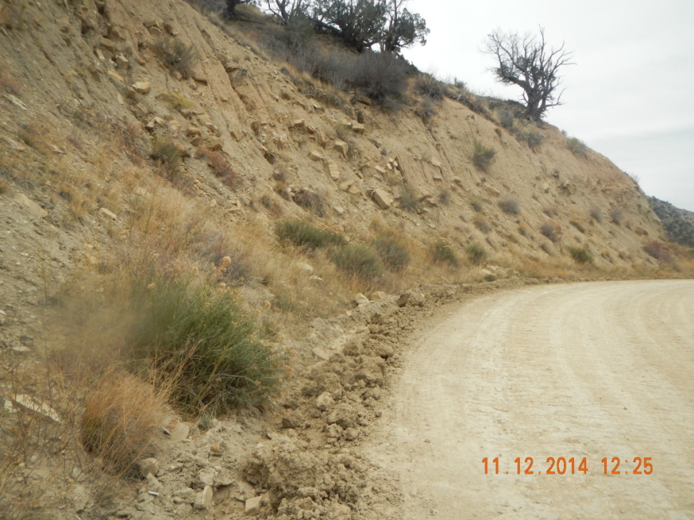
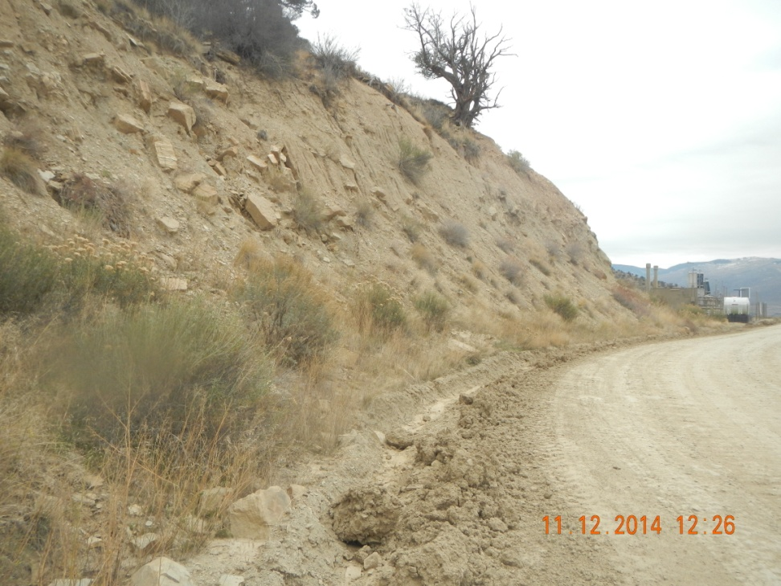
Ditch with mud clods and eroding cut wall

