Slide 1
Caerus Piceance LLC
Puckett 236-25
Location# 324203
Api. # 05-045-08217

Slide 2
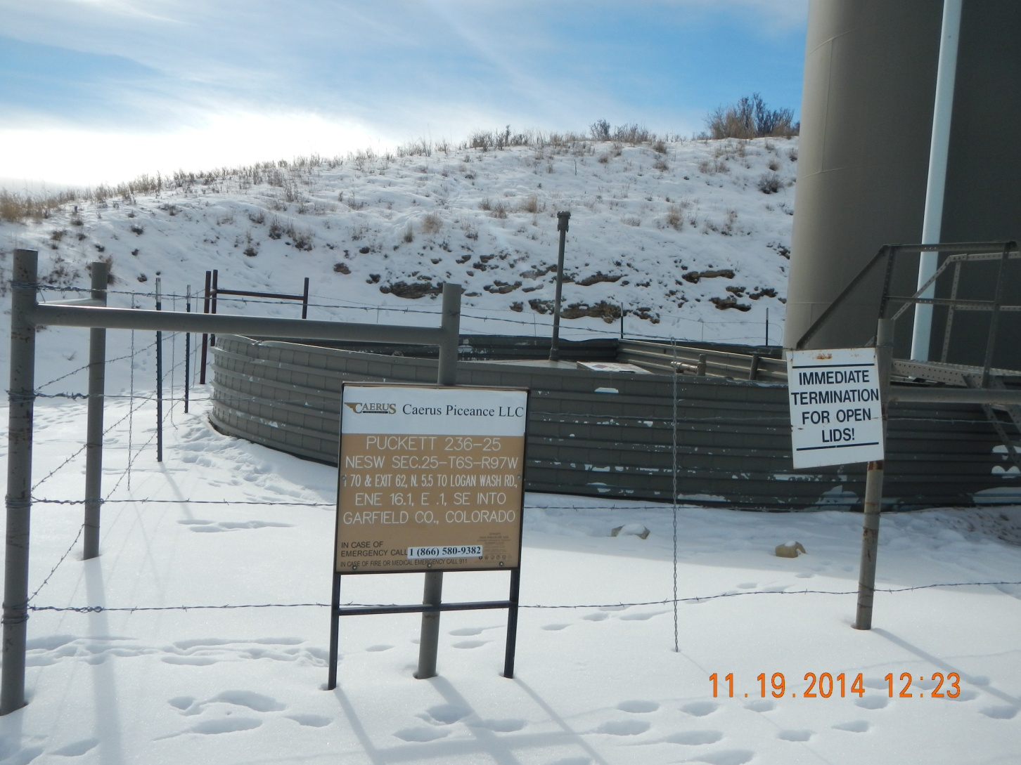
200 bbl partially buried tank

Slide 3
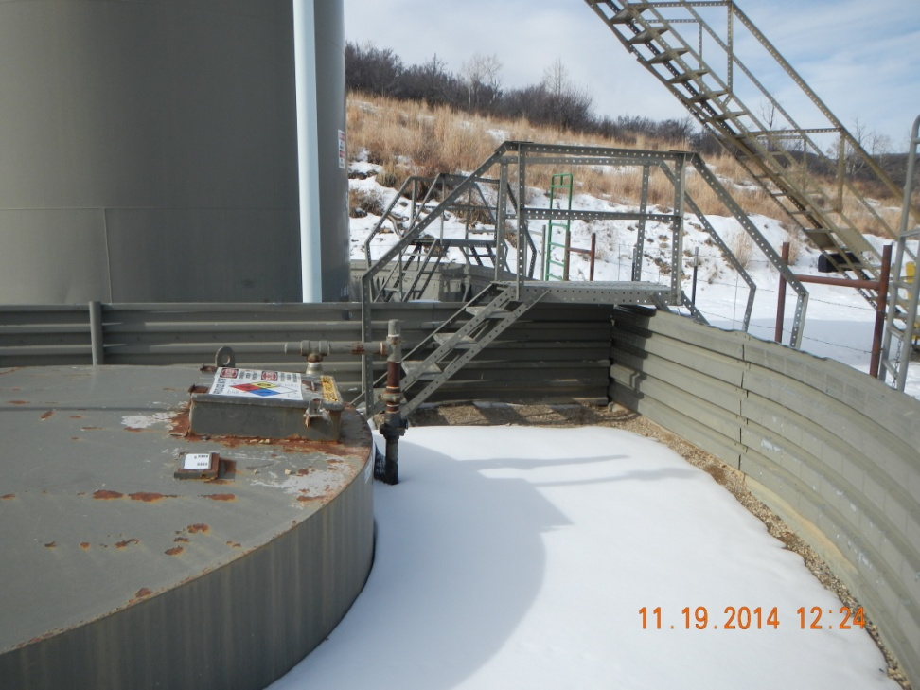
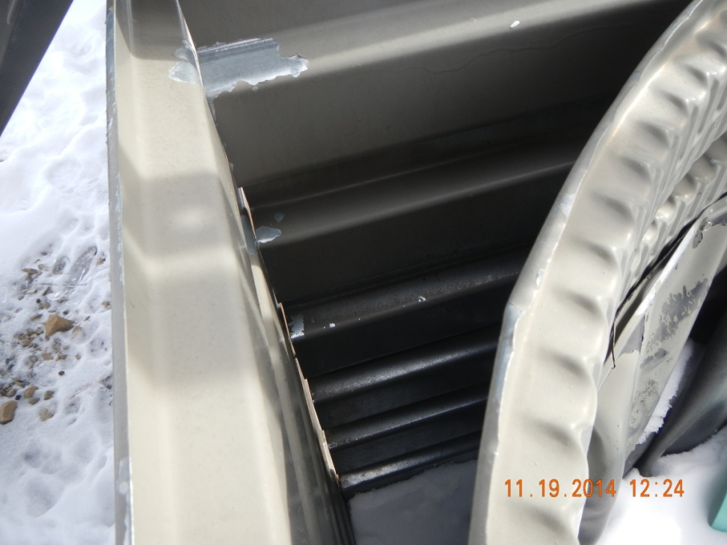
Unsealed gap in unlined berm

Slide 4
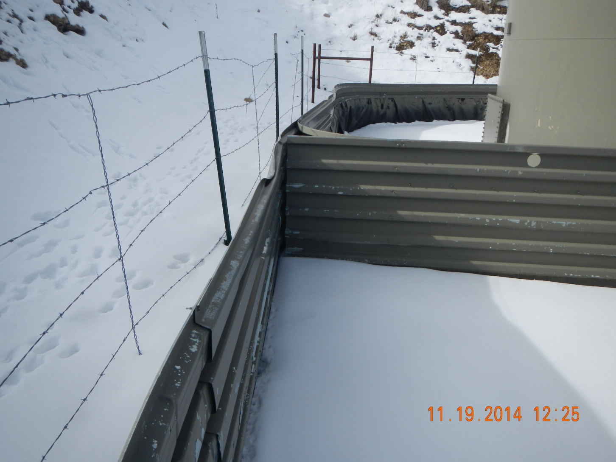
Unsealed gap in unlined berm

