Slide 1
WPX
UNOCAL-67S96W
1NWSW
Location 334925

Slide 2
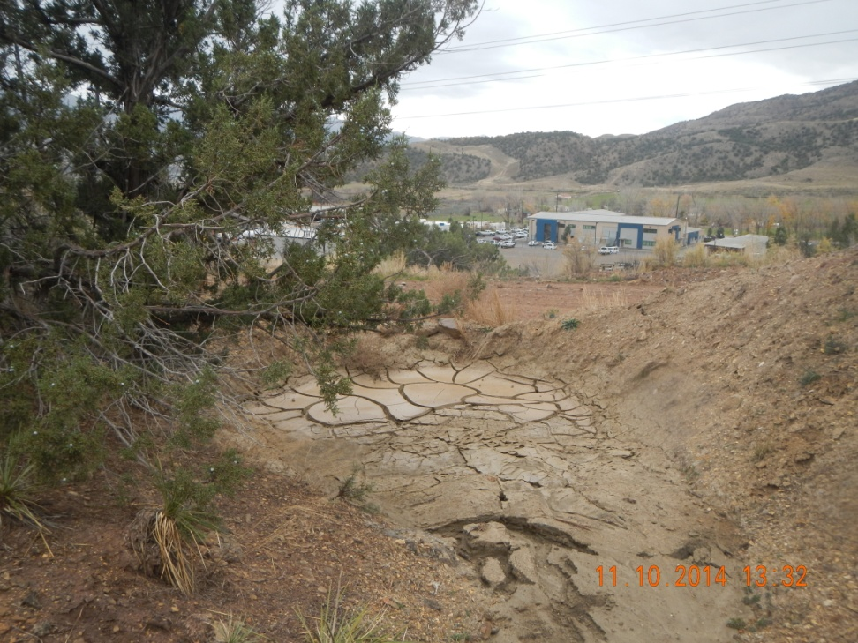
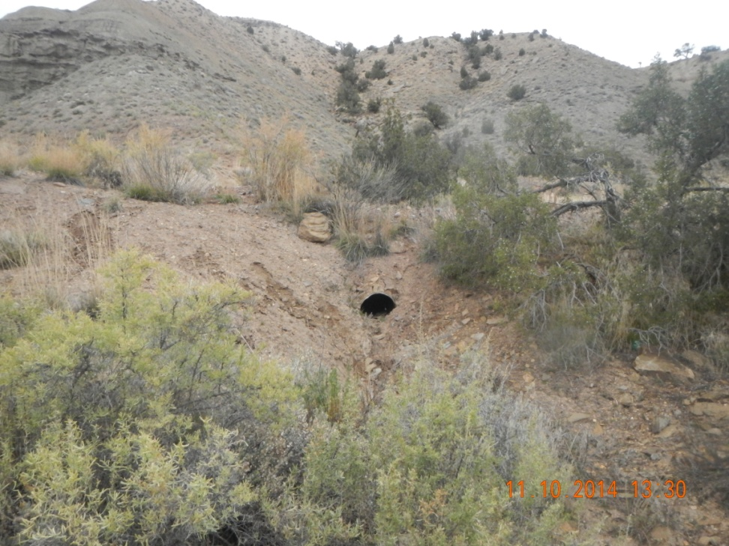
Culvert plugged with sediment

Slide 3
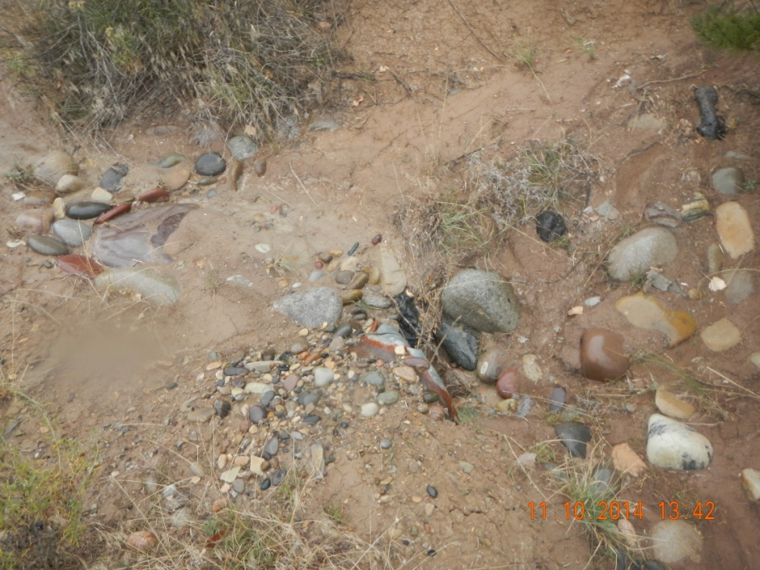
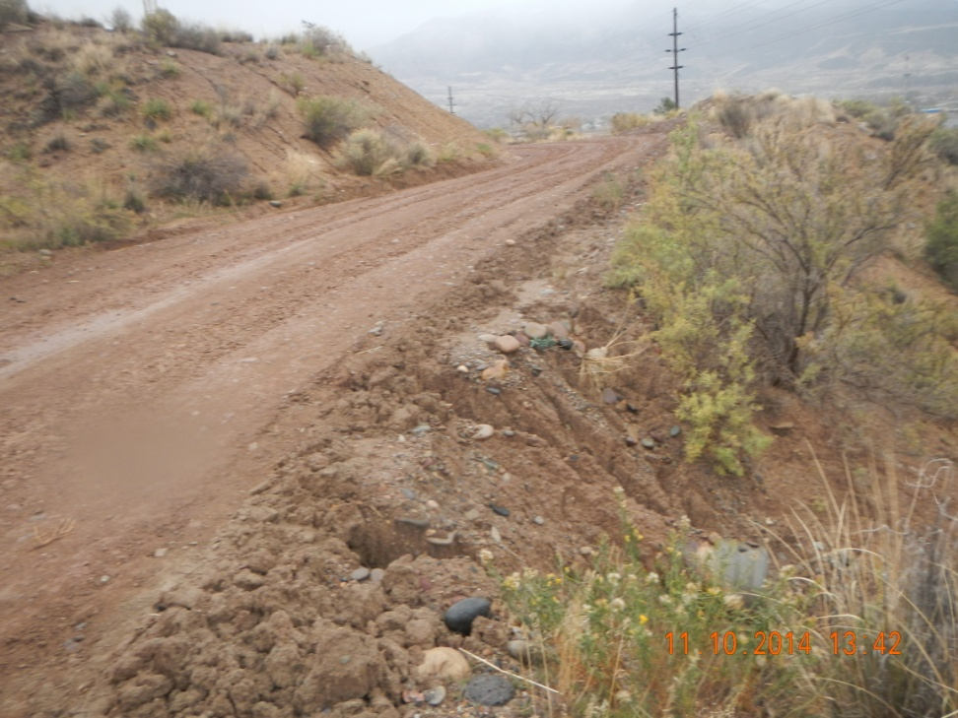
Partial plugged culvert

Slide 4
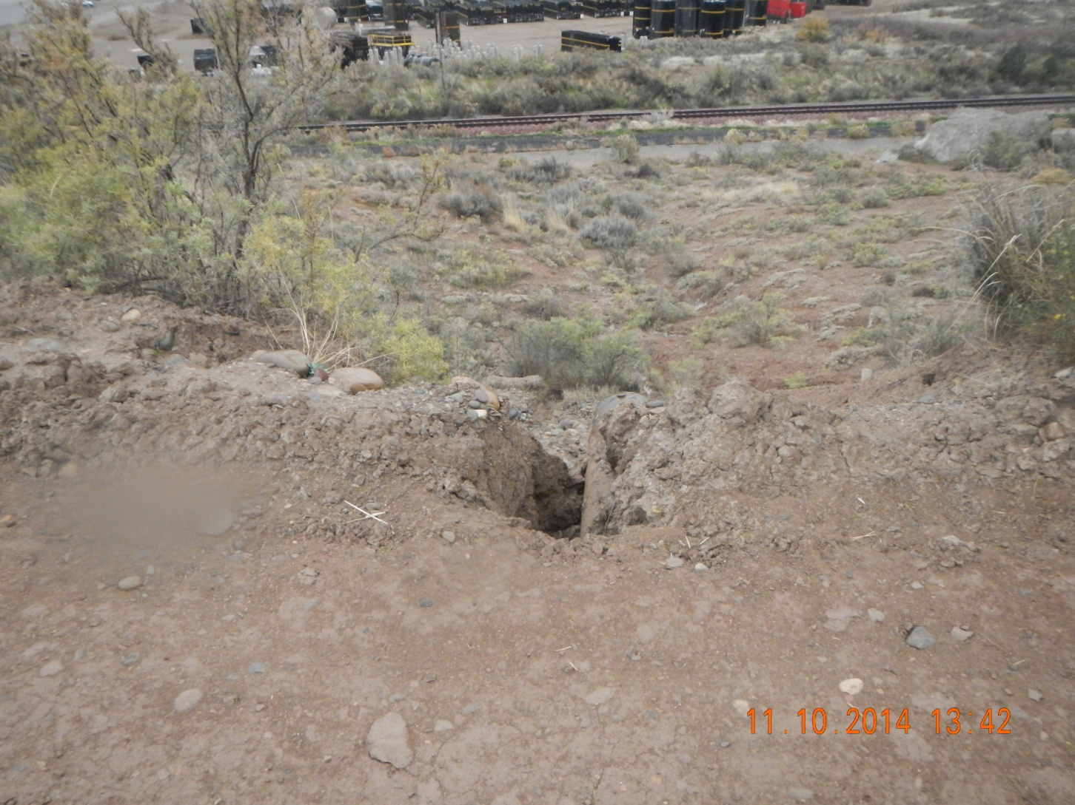
Erosion of road at culvert

Slide 5
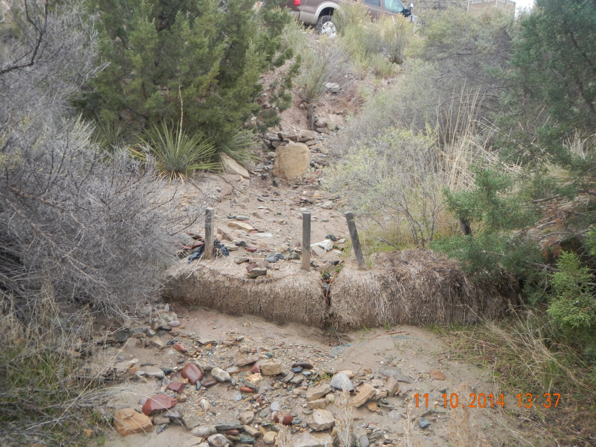
Sediment built up over Bails

