Slide 1
ENCANA OIL & GAS (USA) INC
Operator # 100185
Location # 426478
S.G. L24 496

Slide 2
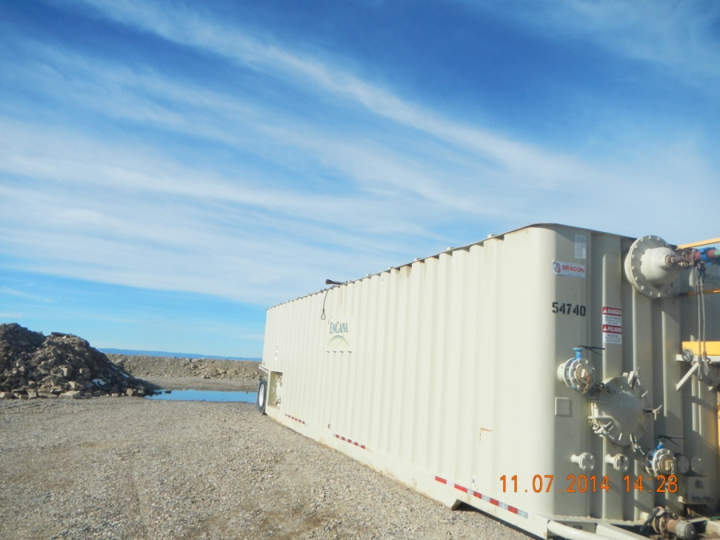
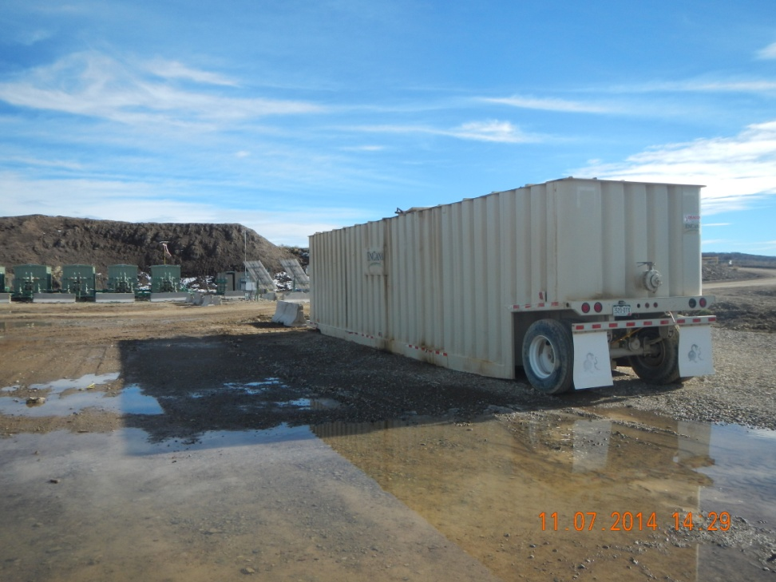
No labels and no berming

Slide 3
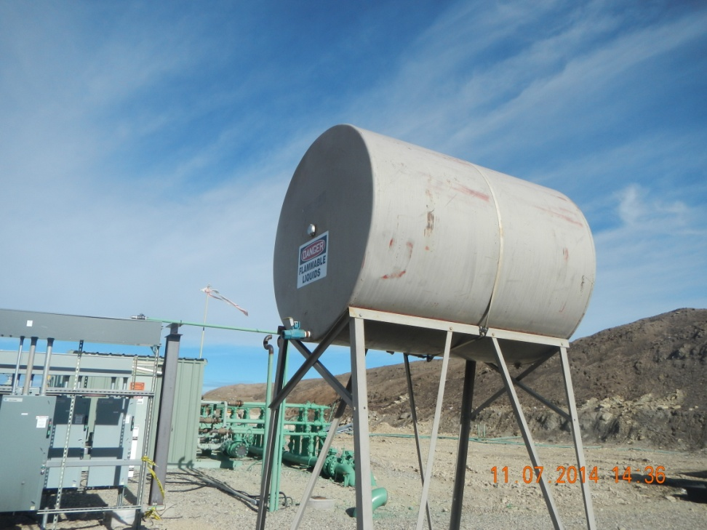
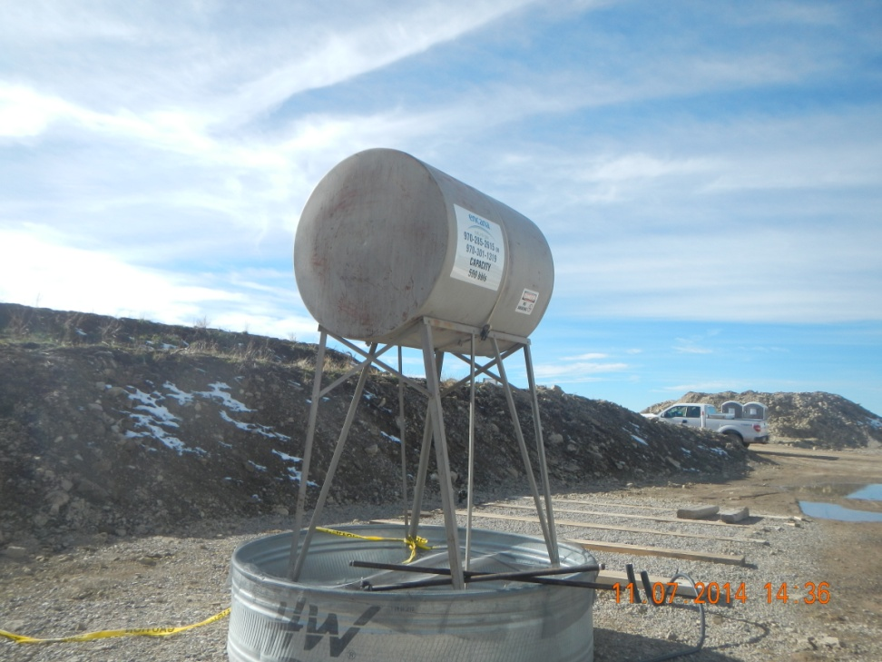
No Contents and no placarding

