Slide 1
WPX
CTR 41-22-597 Pad
Location # 335936

Slide 2
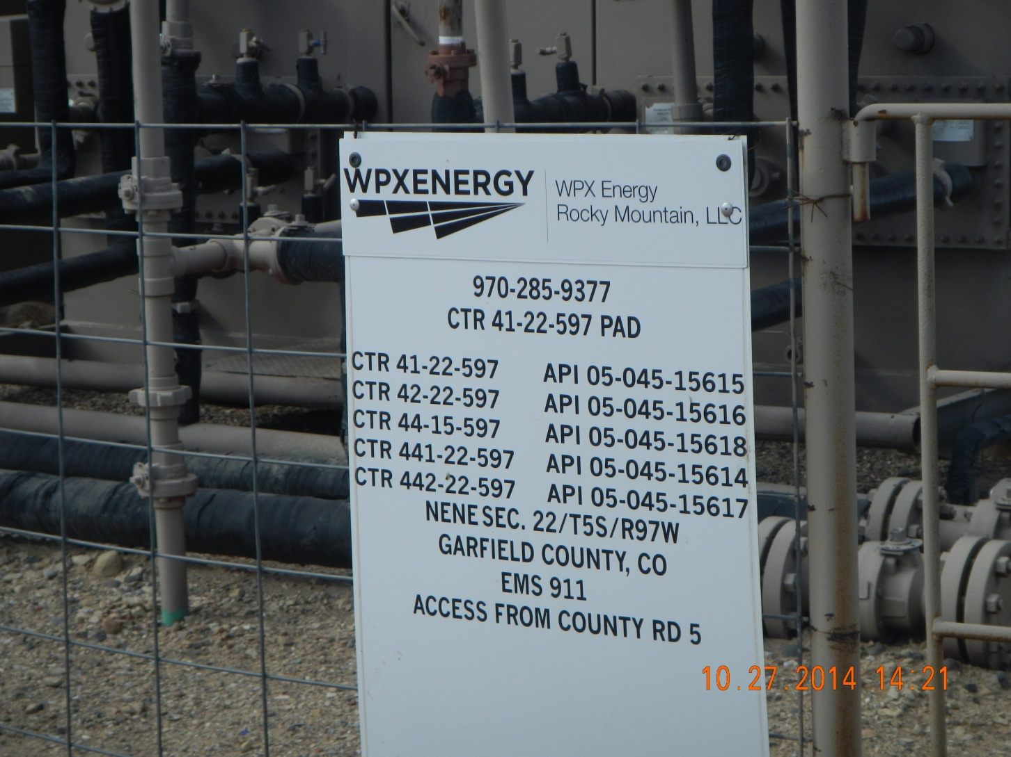

Slide 3
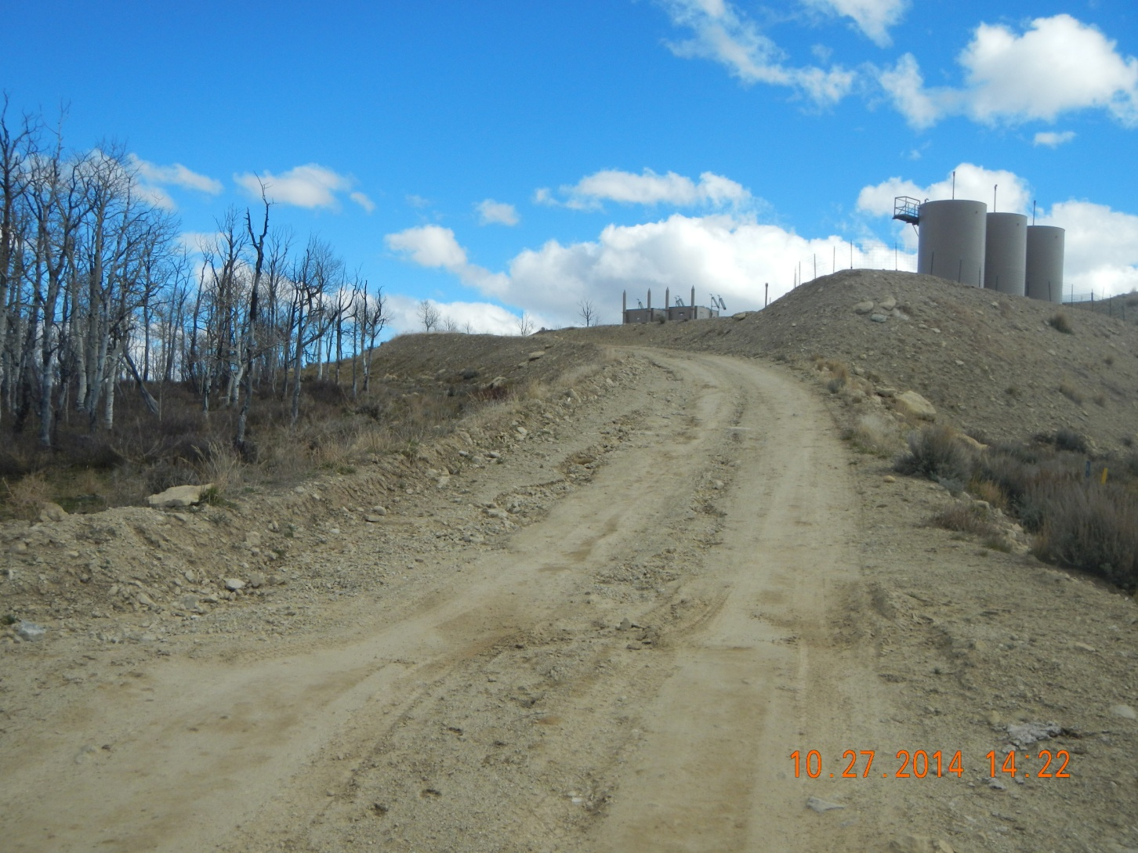
Erosion down access road

Slide 4
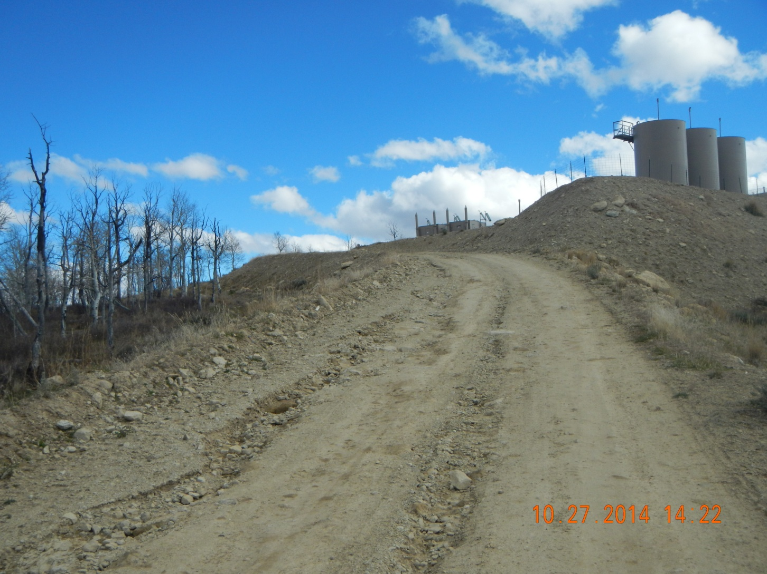
Erosion down access road

Slide 5
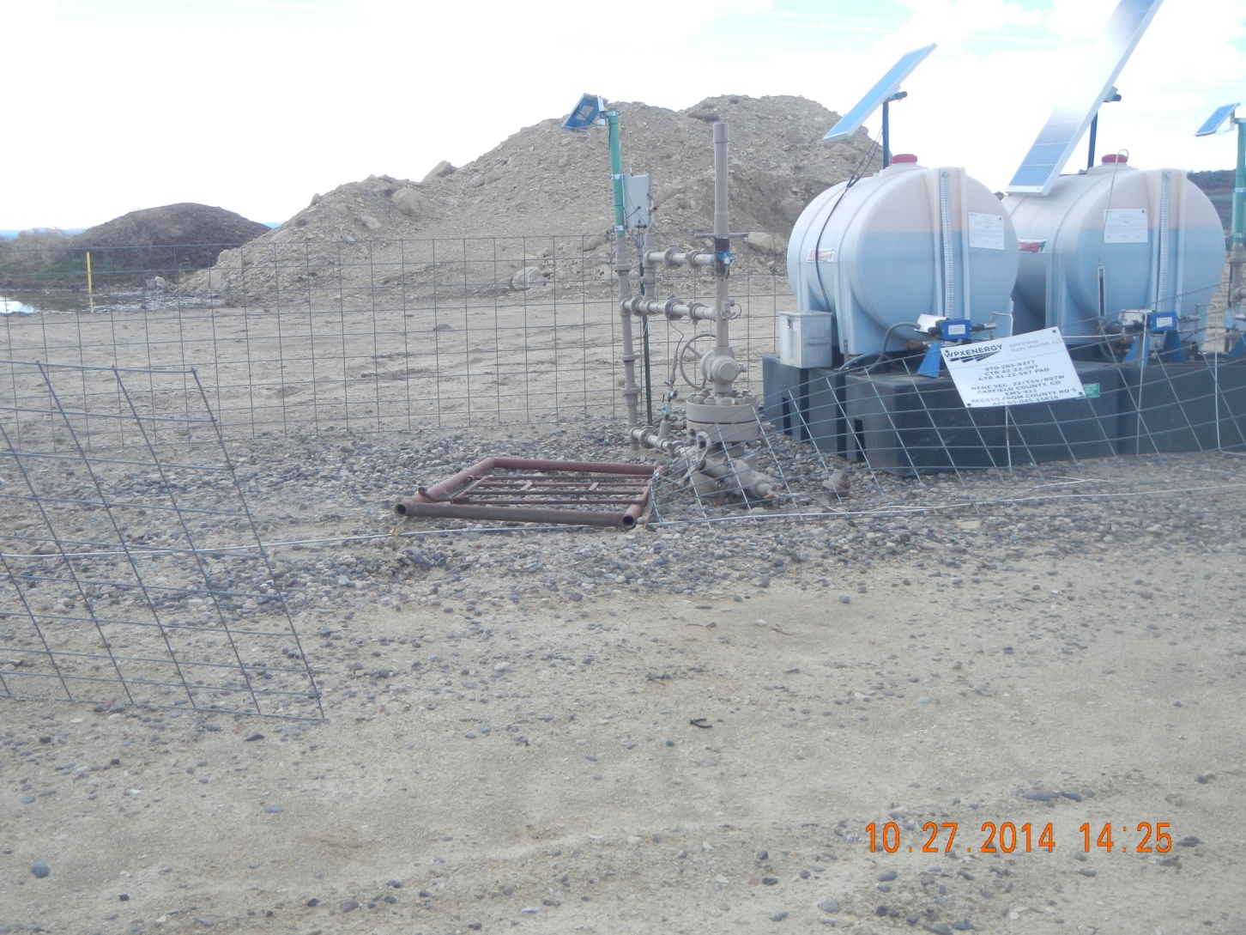
Well head fencing down

