Slide 1
EnCana
N.PARACHUTE WF03D O03 596 & N.PARACHUTE WF14D O03 596
Loc. # 335805

Slide 2
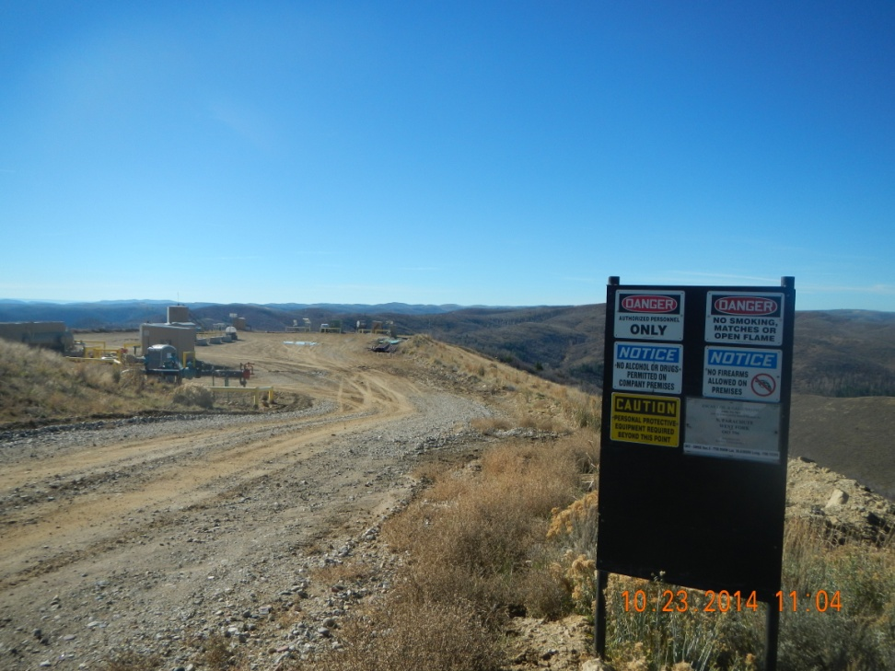
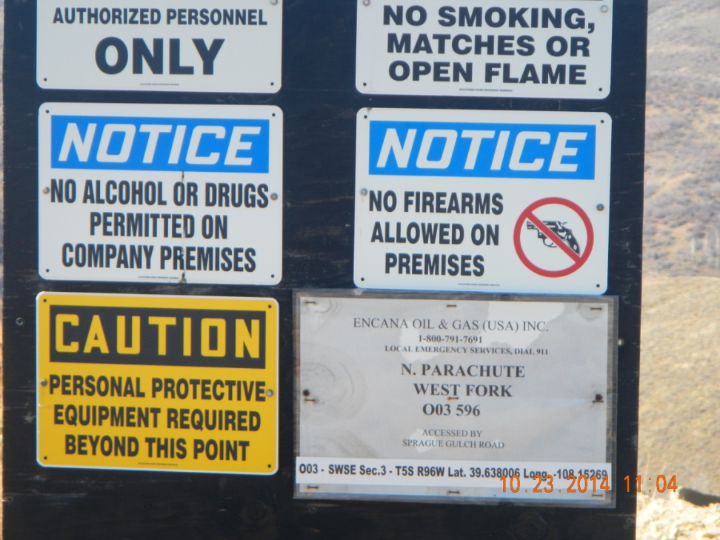
Over view of location from entrance sign

Slide 3
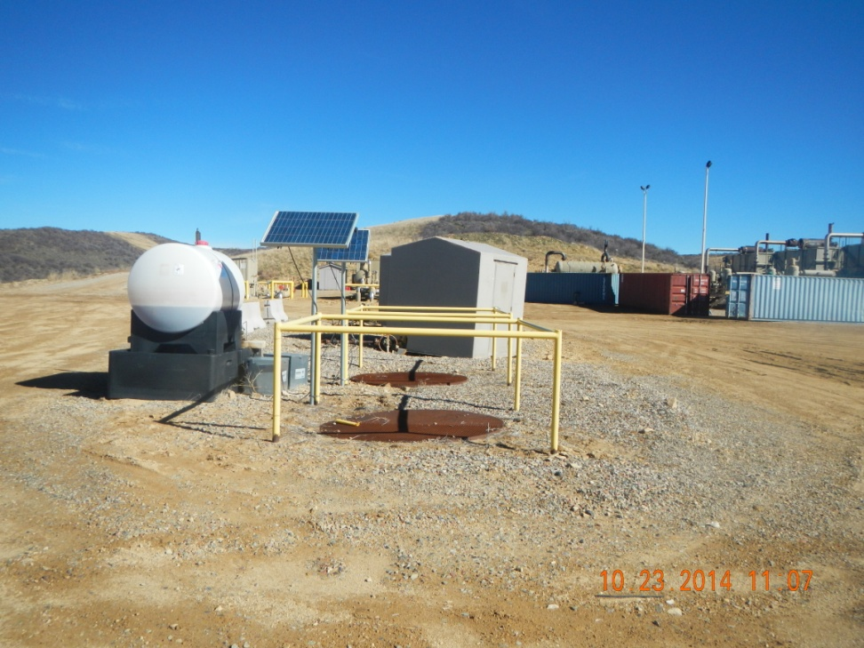
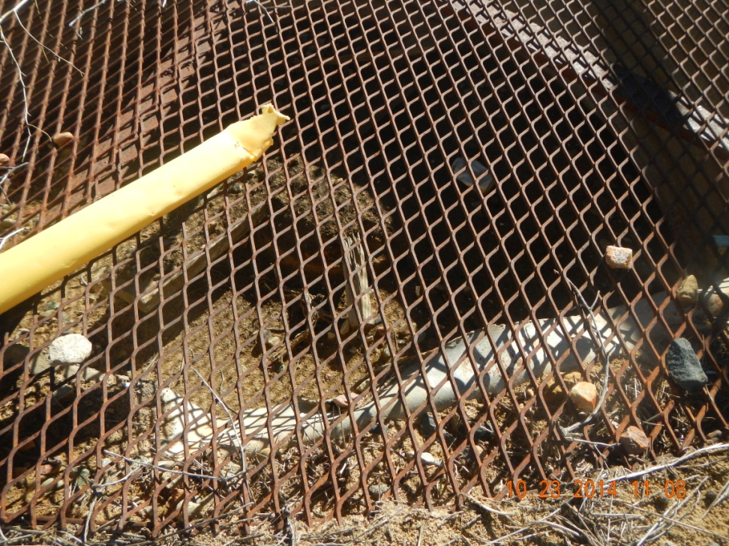
Open cellars and conductor set

