Slide 1
EnCana
SGU-64S96W34SWSW
Loc. #335927

Slide 2
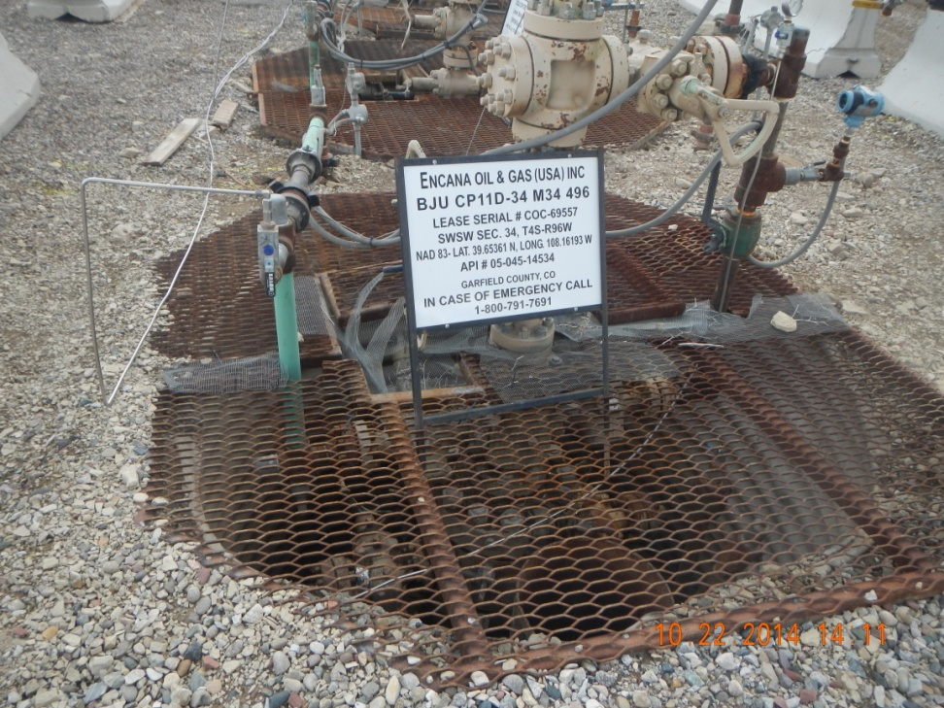
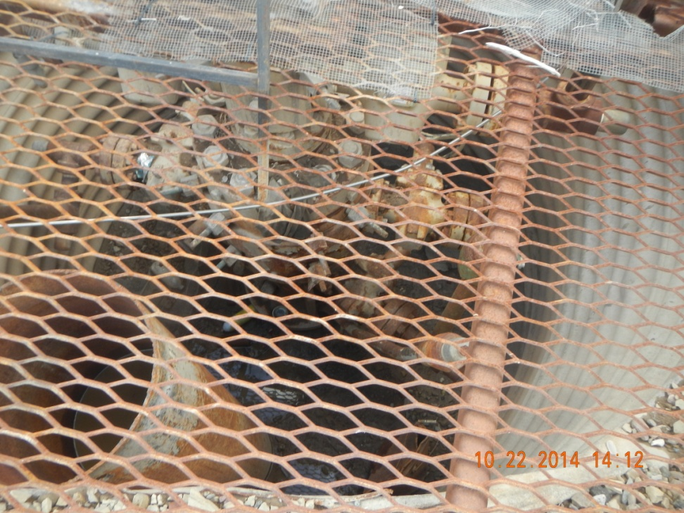
Trash (5 gallon bucket, spray can, bottlles)

Slide 3
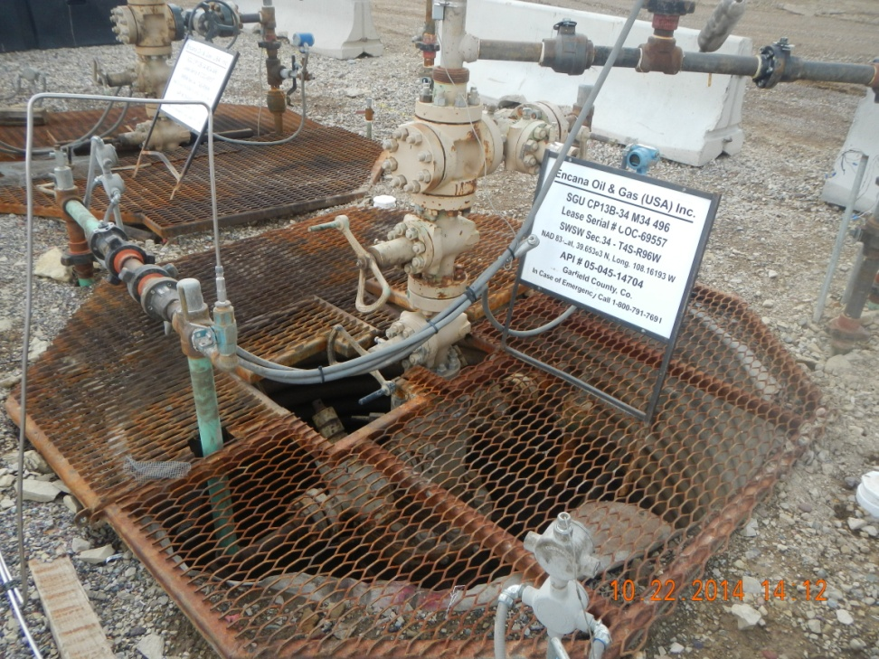
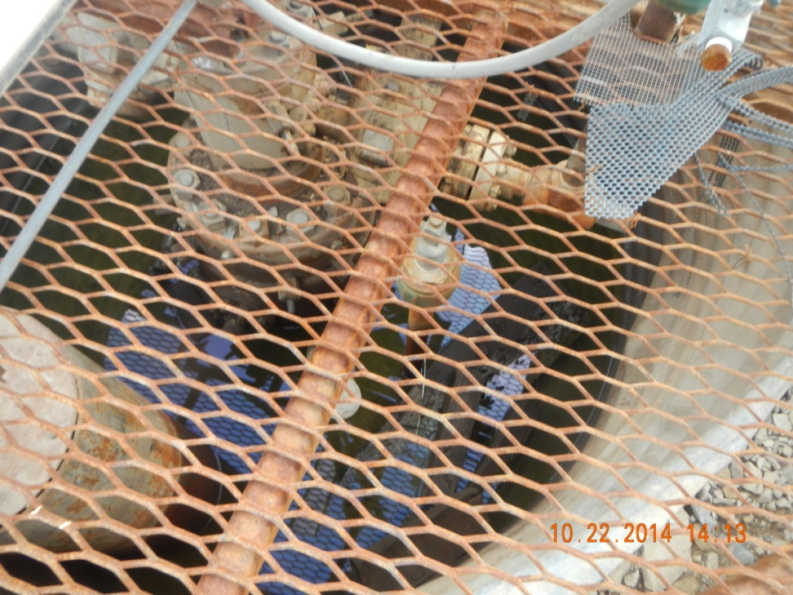
Trash and Stained ground in cellar

Slide 4
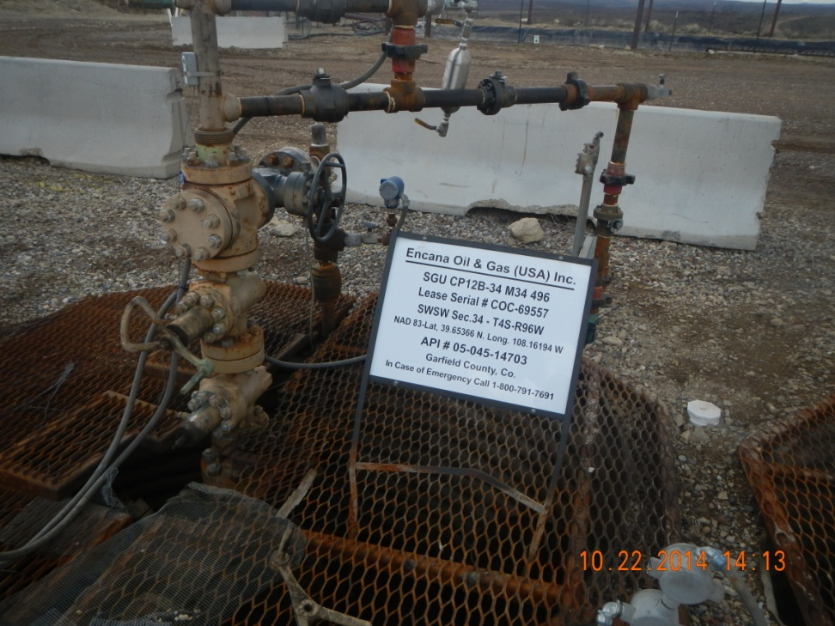
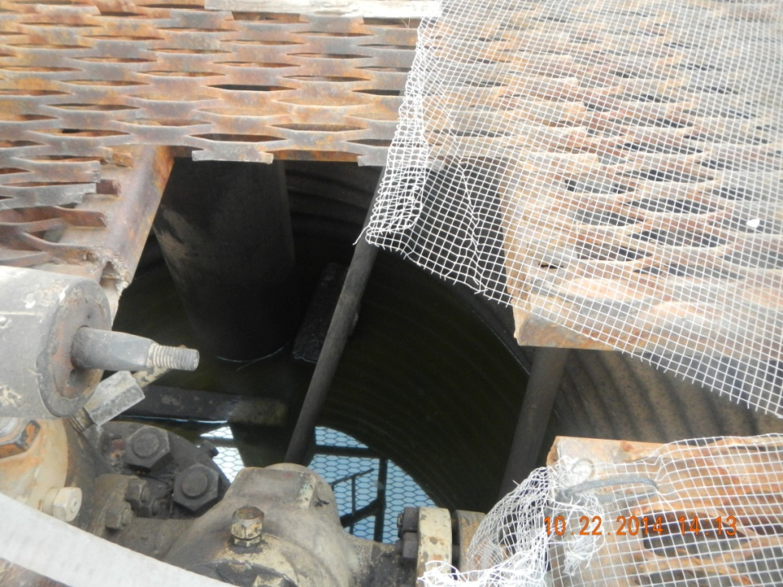
Trash and stained ground with oily storm water

Slide 5
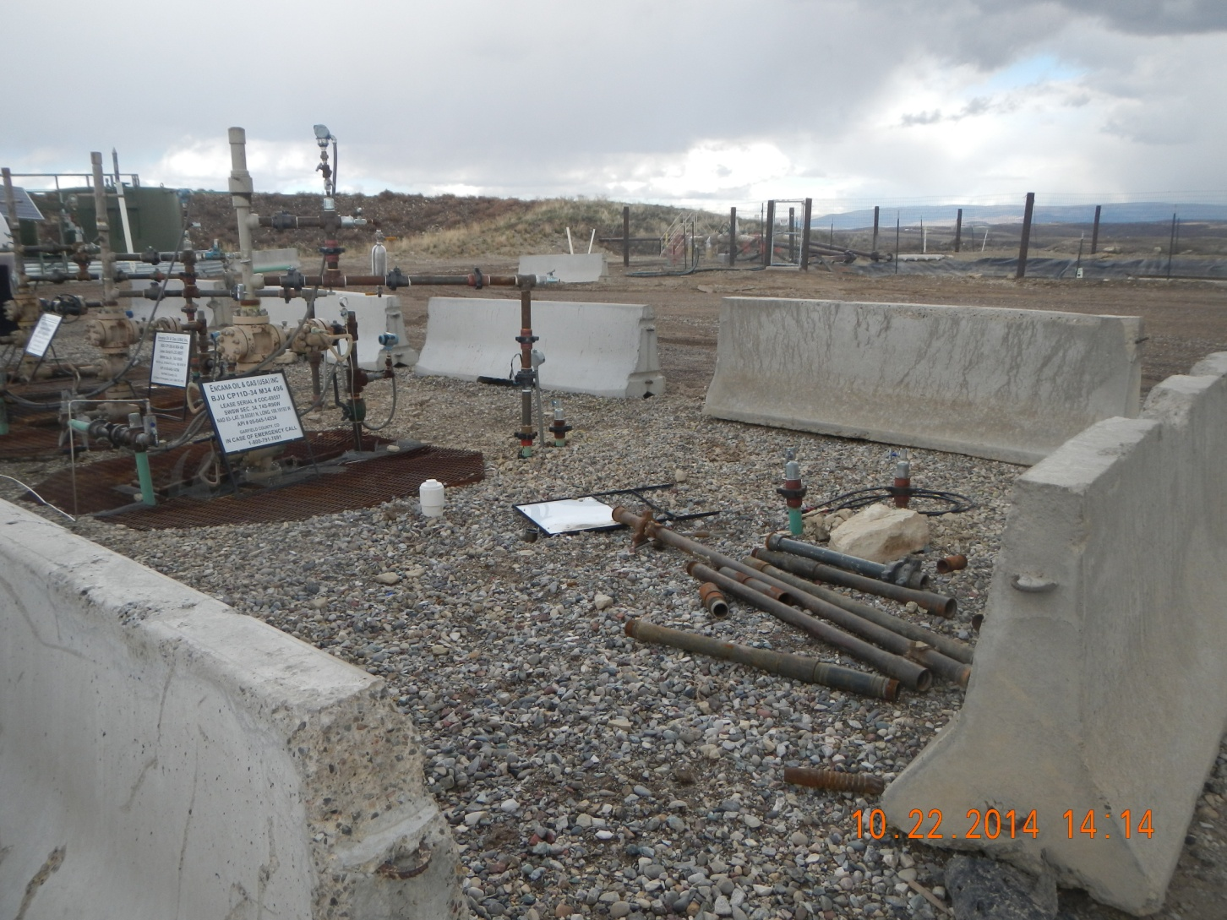
Junk at well heads

