Slide 1
WPX Energy
Loc #335097
FEDERAL-66S96W
25SWSW

Slide 2
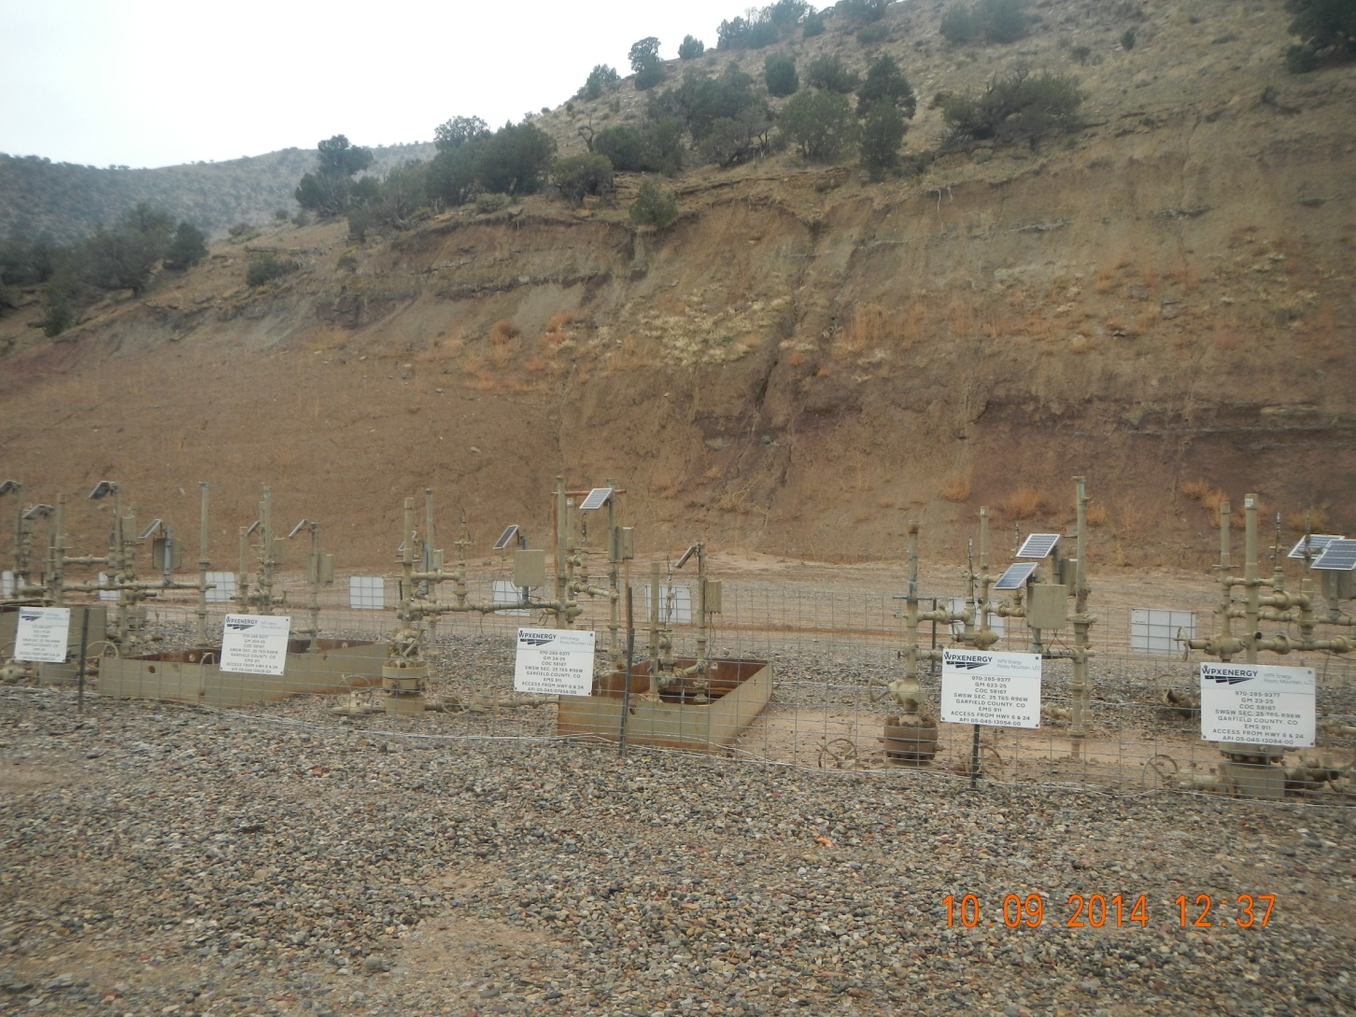
Cut wall eroding

Slide 3
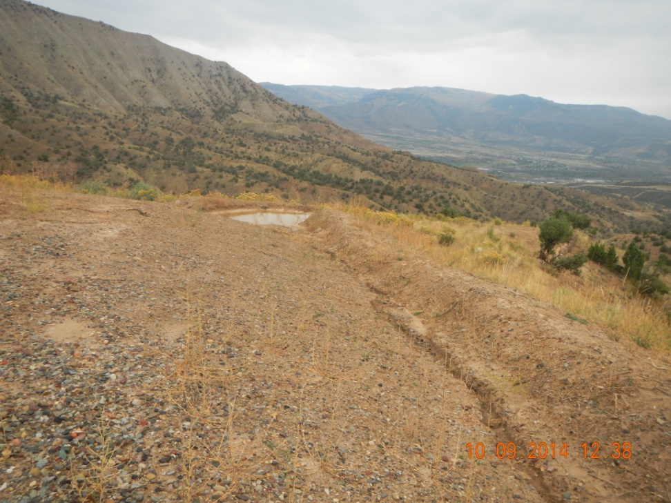
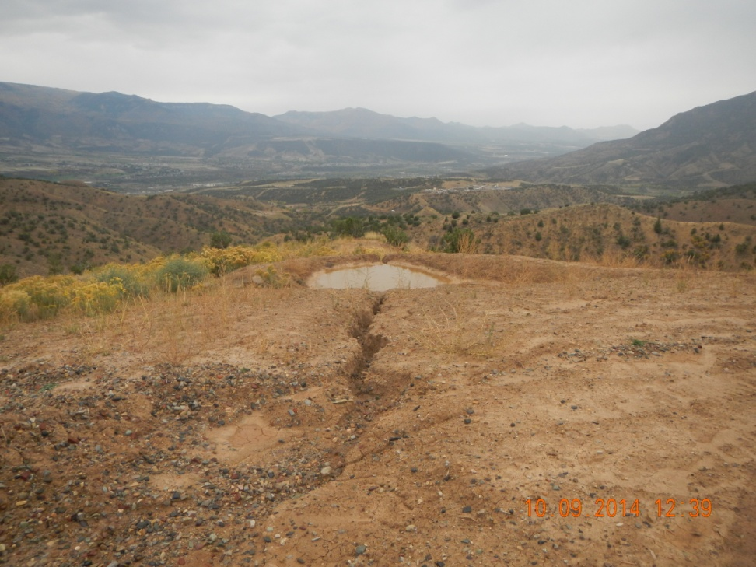
Erosion of ditches to check damn

Slide 4
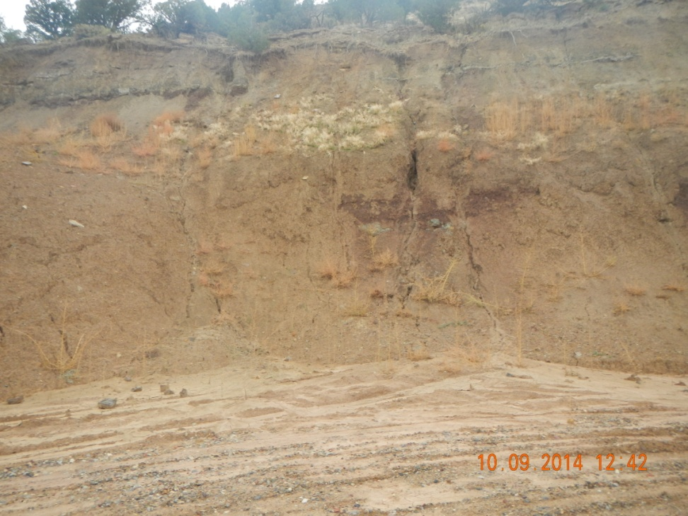
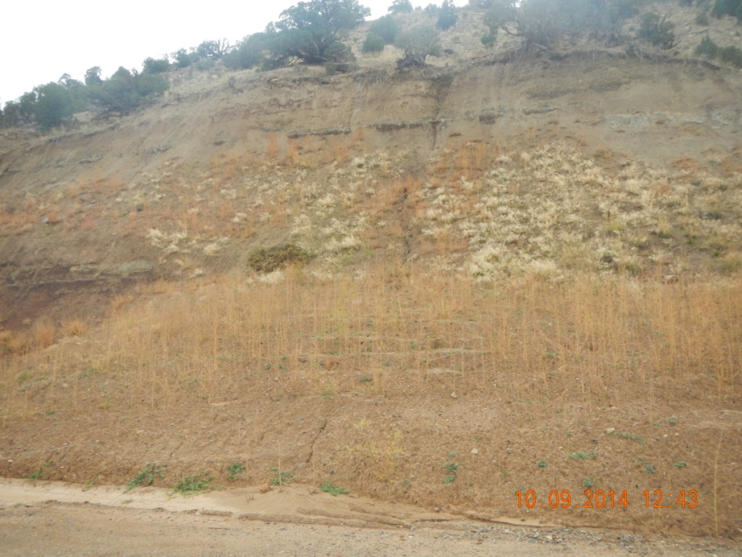
Cut wall erosion

Slide 5
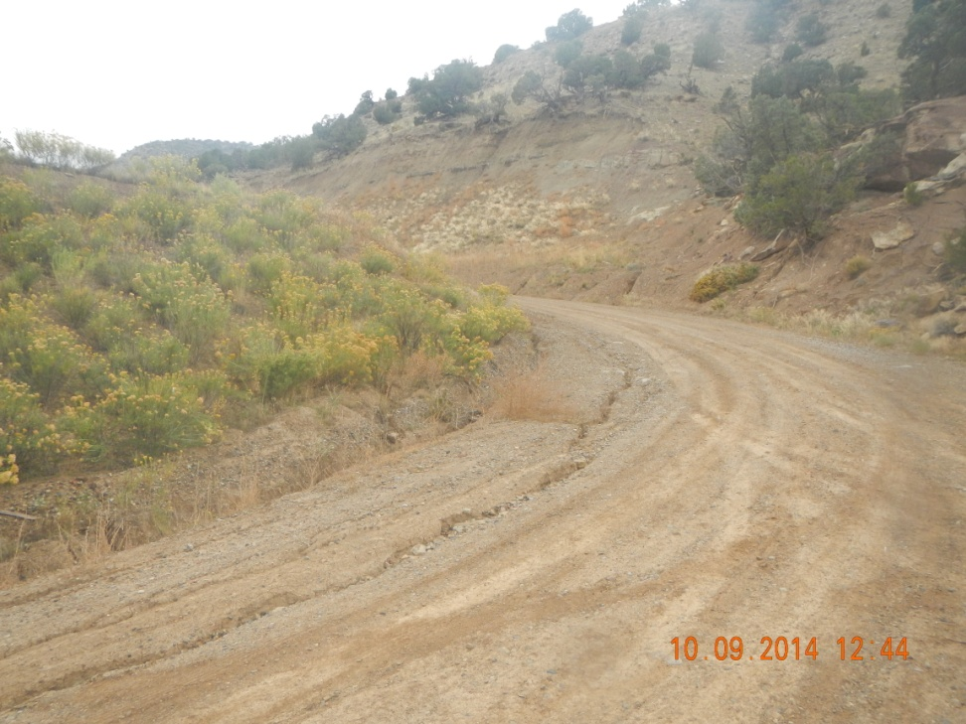
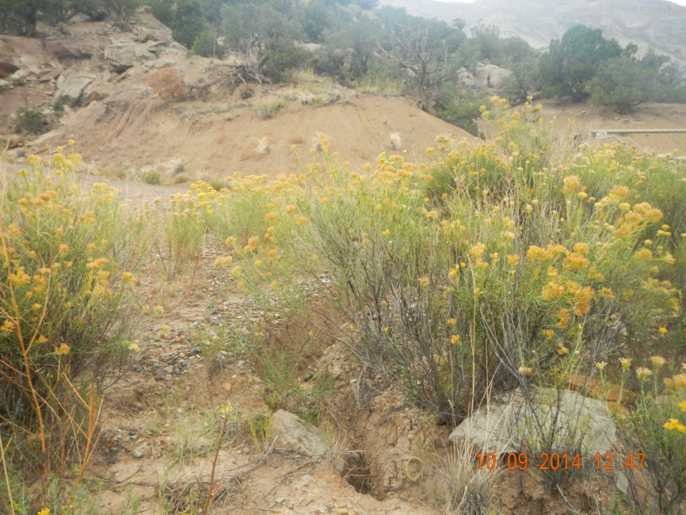
Erosion of road around corner of Location and battery.

Slide 6
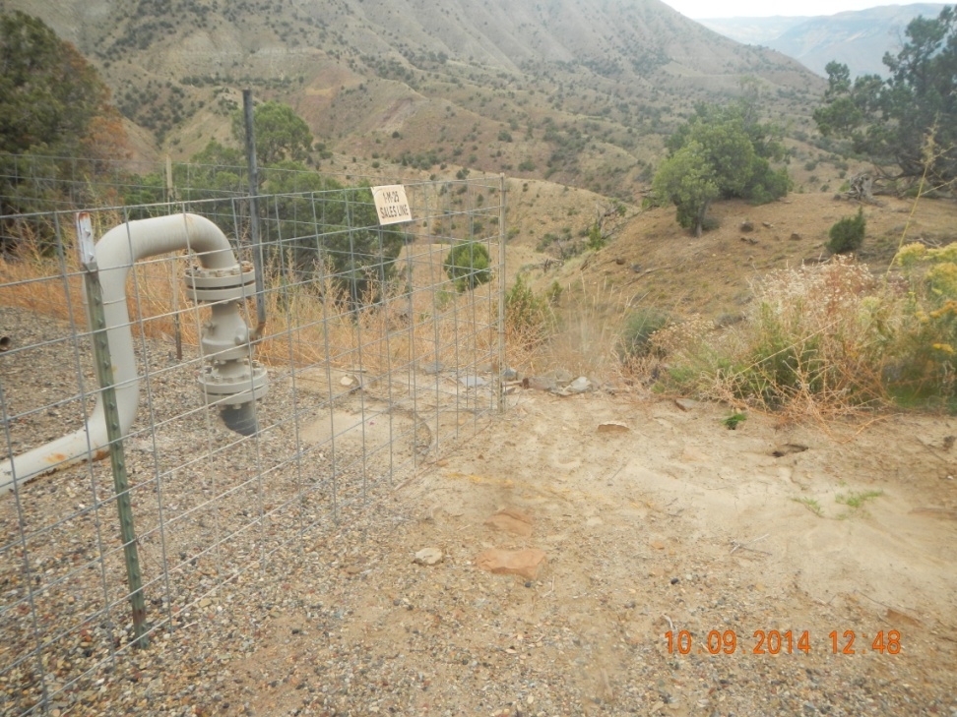
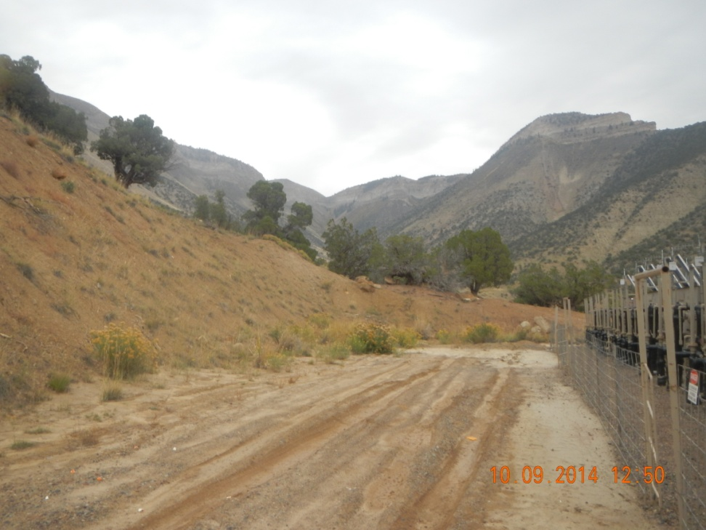
Erosion behind separators / Sediment stacking in front of serapators

