Slide 1
WPX Energy
GM 43-2
05-045-07129

Slide 2
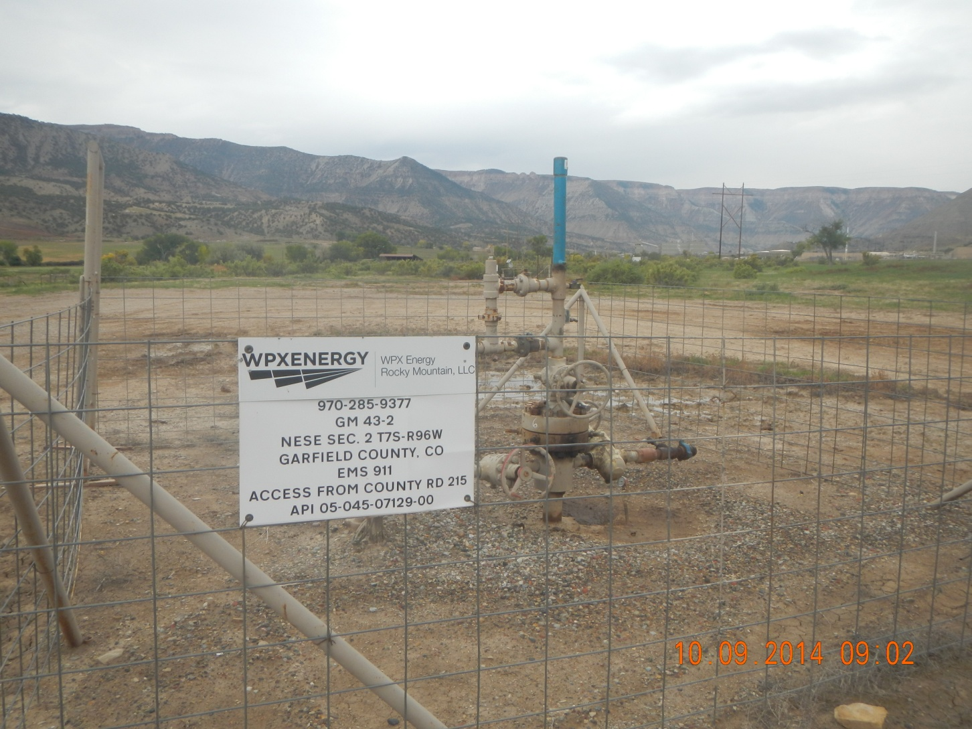
GM 43-2

Slide 3
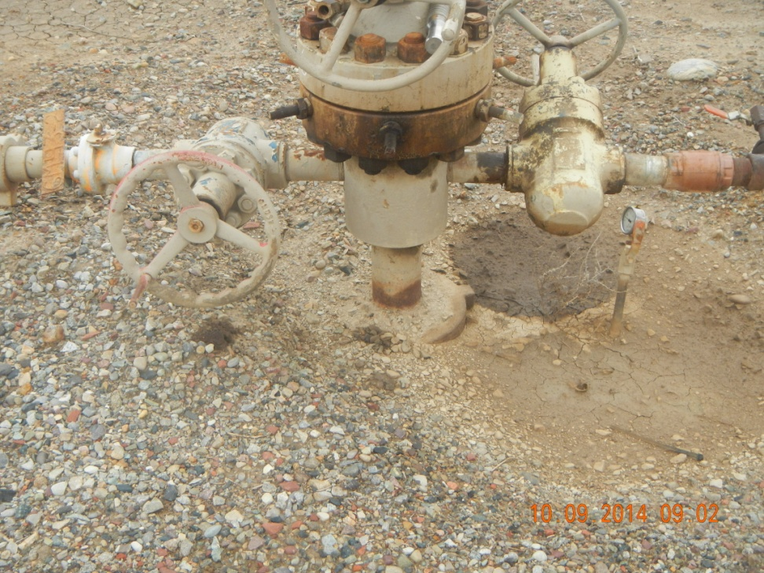
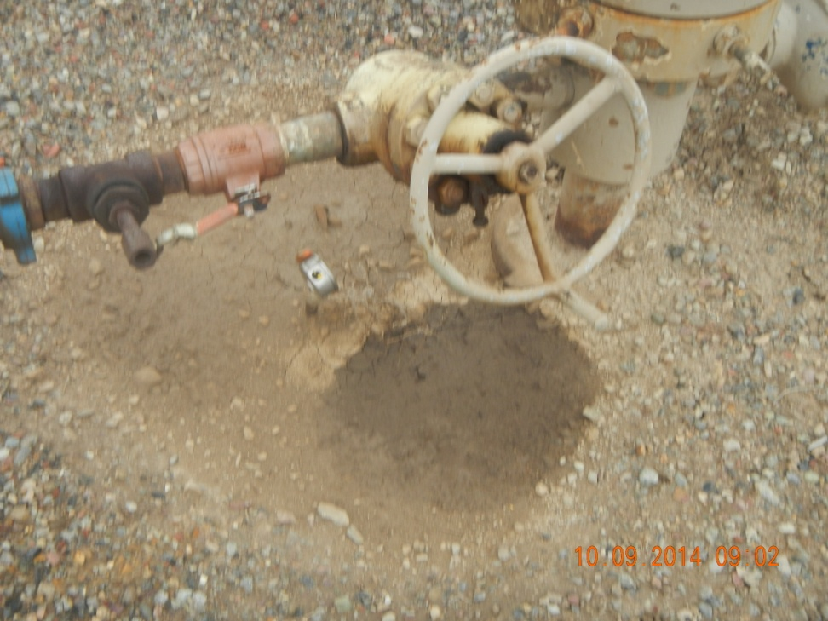
Spill at GM 43-2

