Slide 1
Non Such Natural Gas Inc.
Puckett 797-1-1 (045-07971)

Slide 2
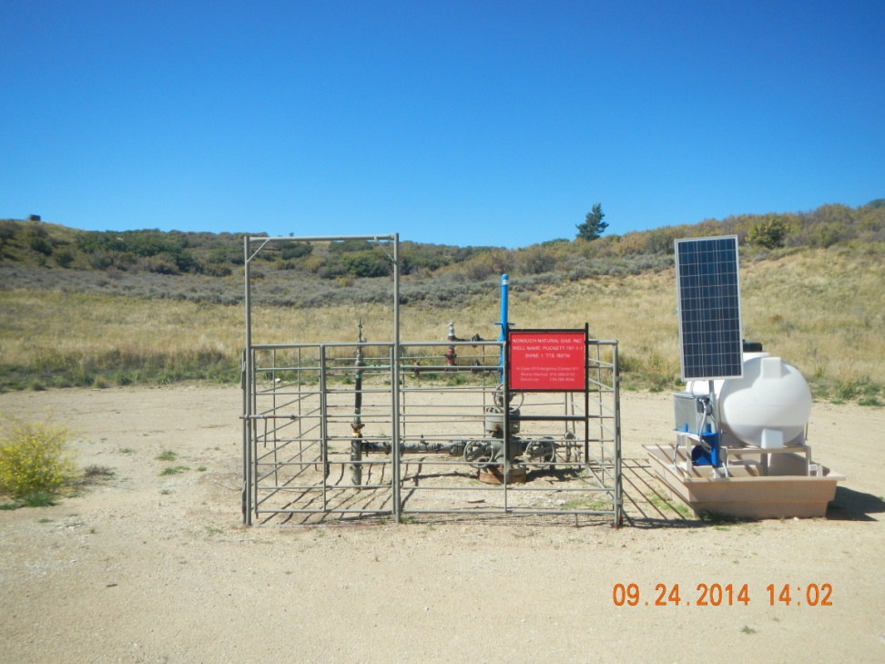
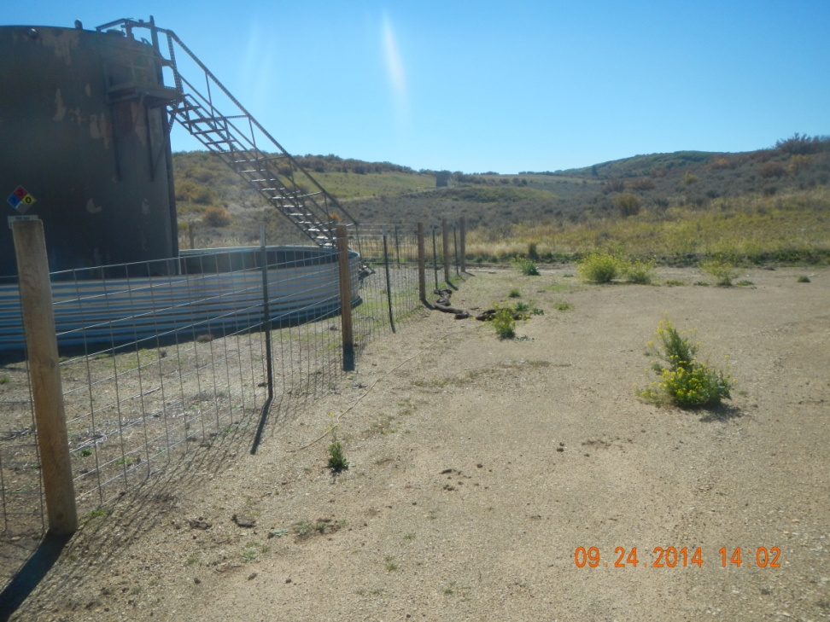
Oily booms lying by tanks

Slide 3
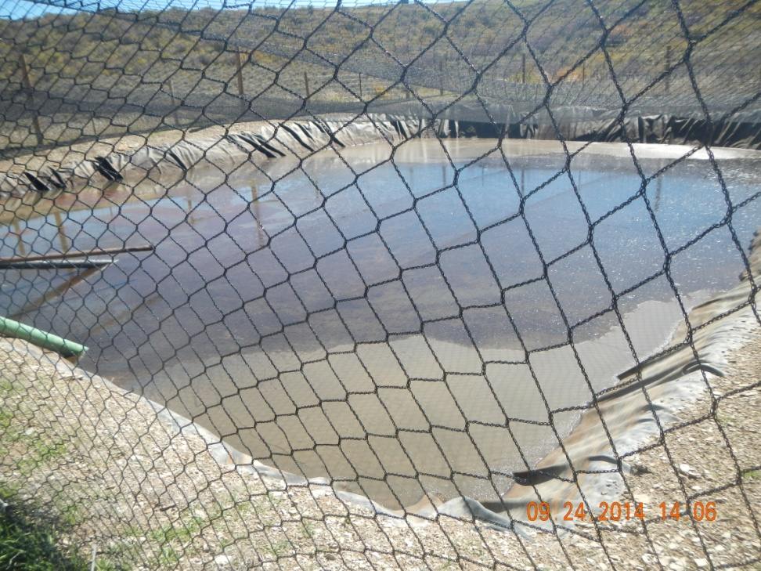
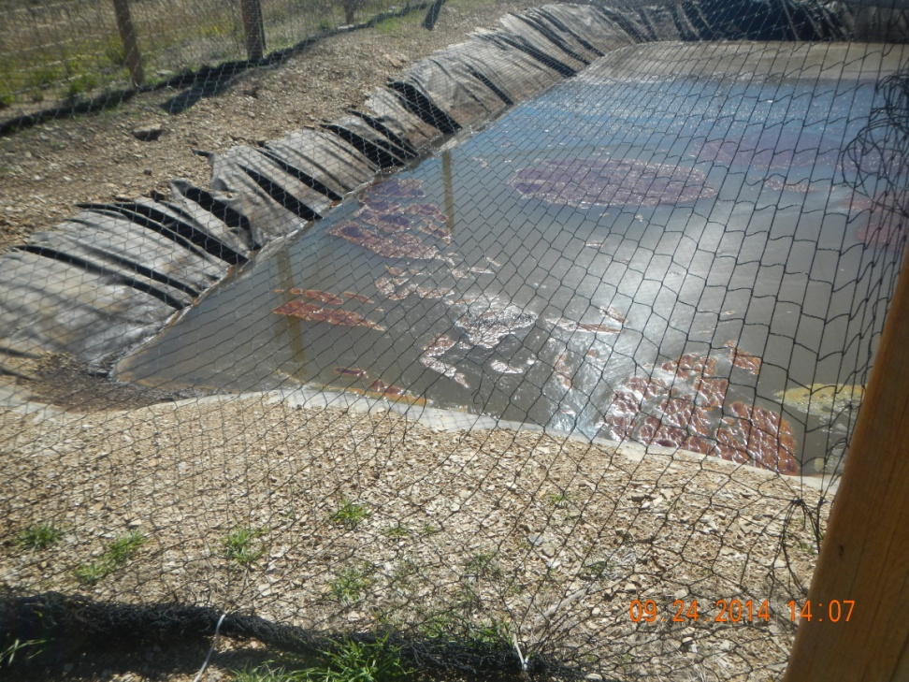
Oil on pit

Slide 4
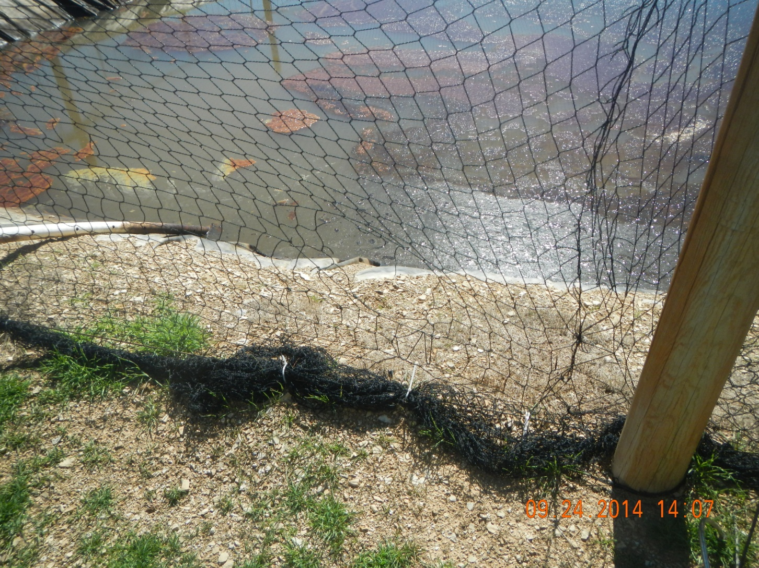
Hole in netting

