Slide 1
Non Such Natural Gas, Inc
CSOC 697-12-1 (045-08120)

Slide 2
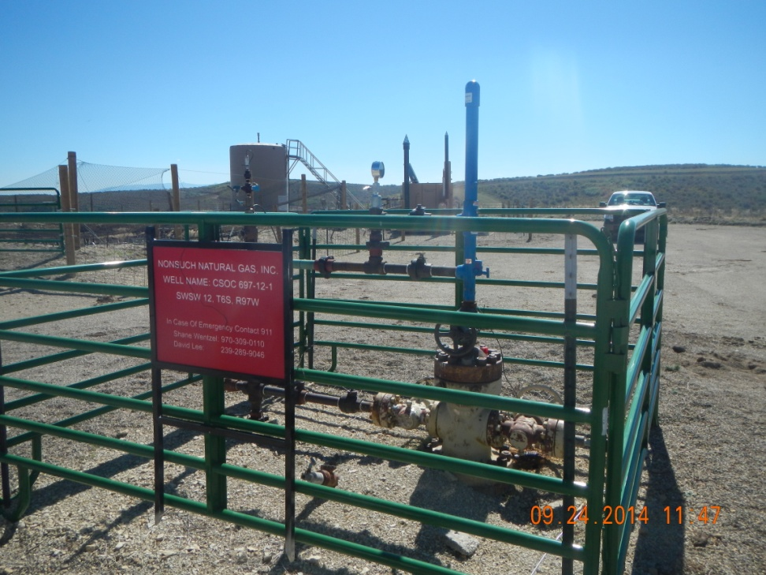
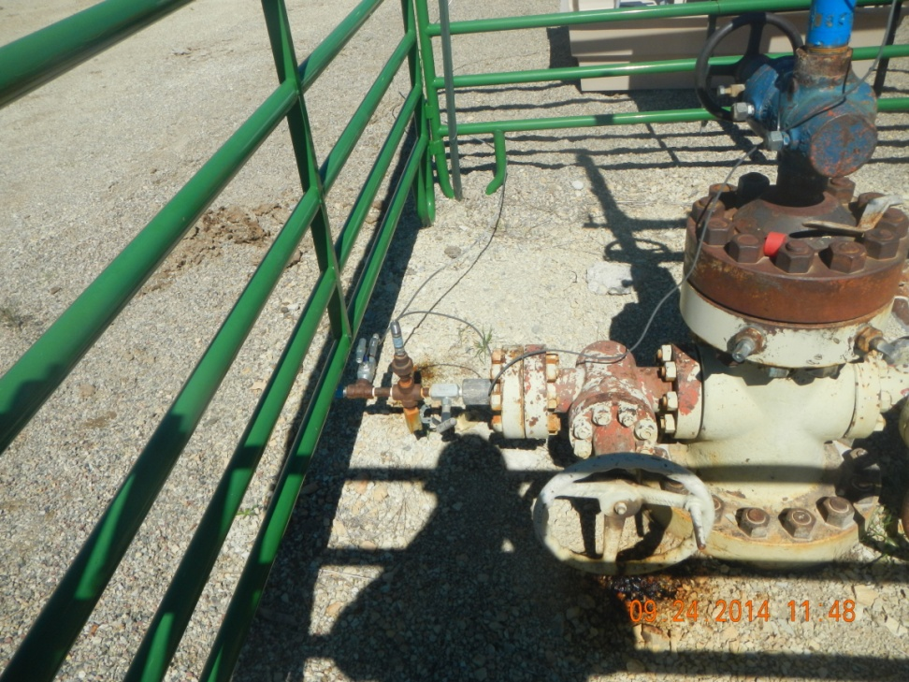
Spills at well

Slide 3
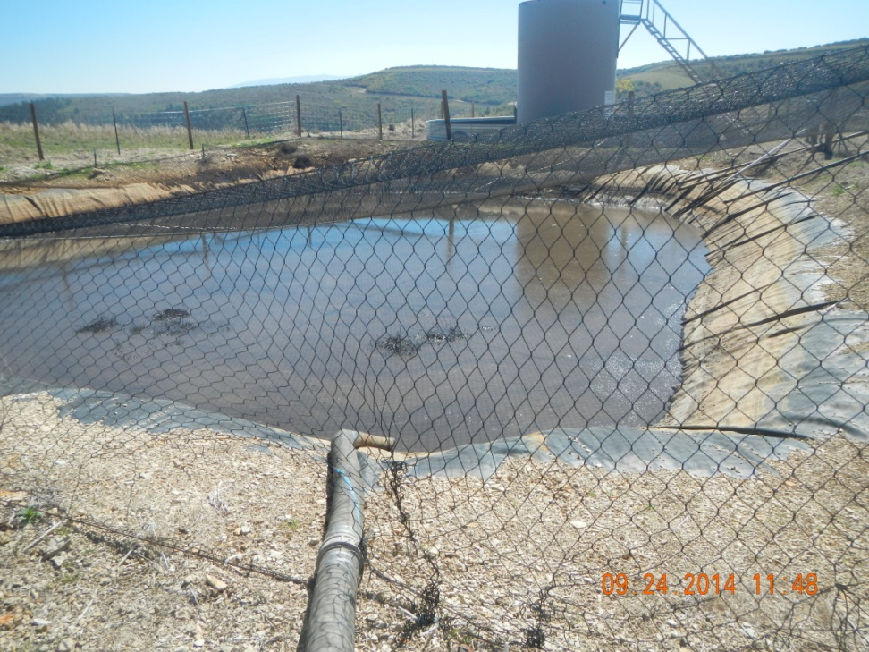
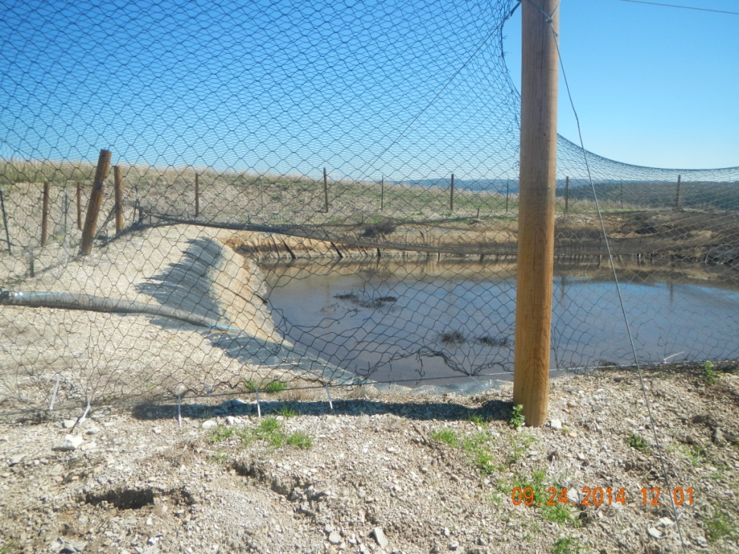
Oil on pit, weed debri, holes and gaps in netting

Slide 4
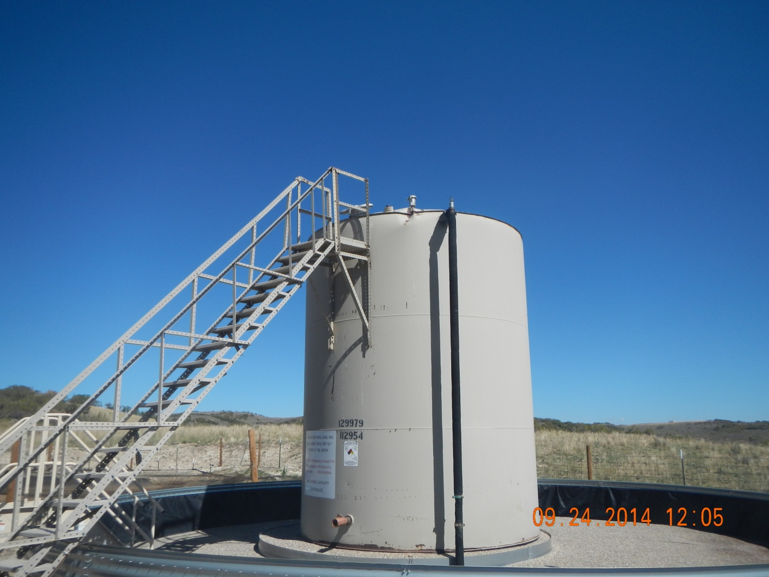
Top of tank dented and bulging

