Slide 1
Non Such Natural Gas, Inc
CSOC 697-14-1

Slide 2
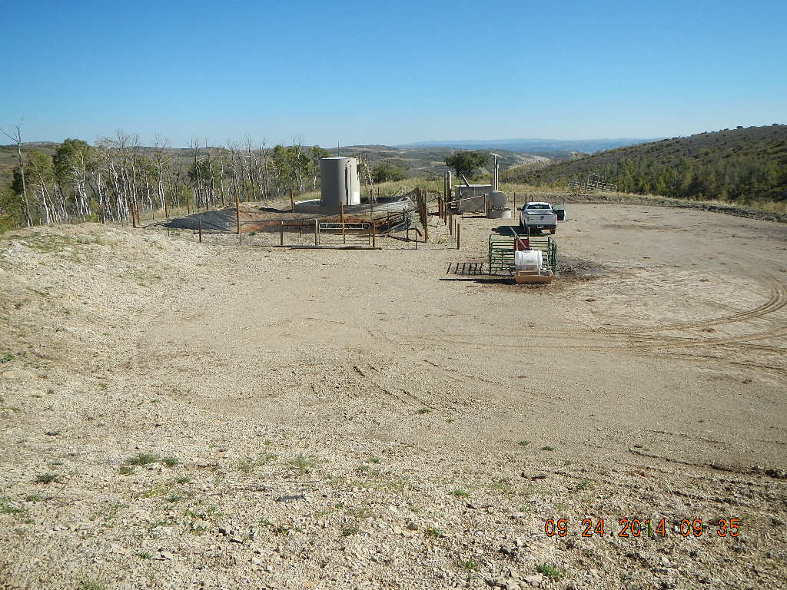
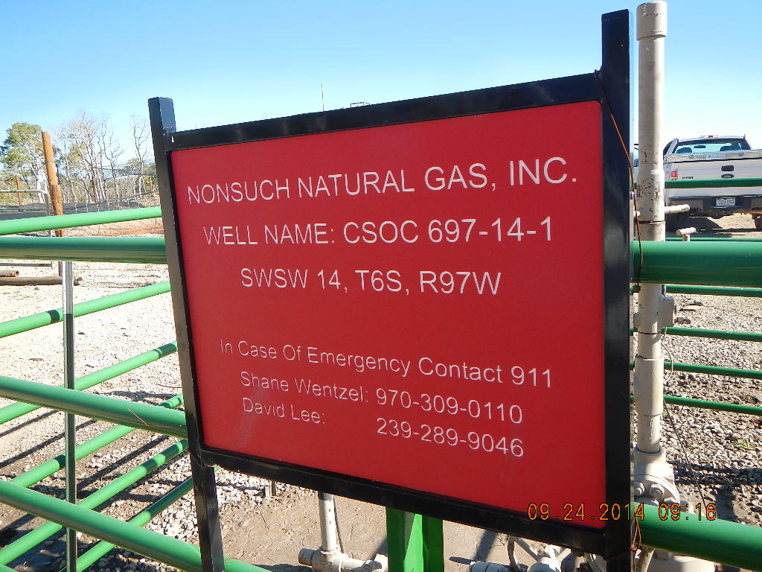

Slide 3
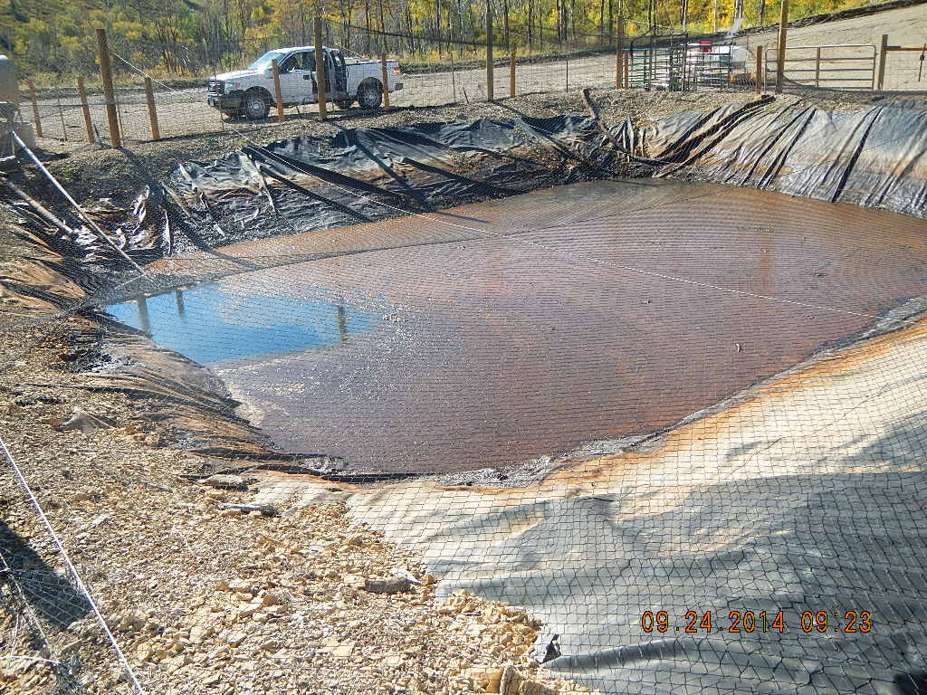

Slide 4


