Slide 1
WPX
PA 14-36 Pad
Location id. # 323993

Slide 2
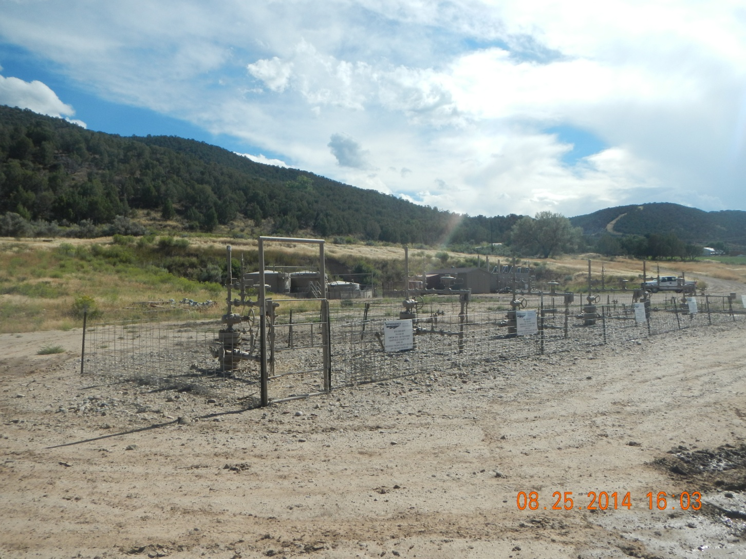
Wells

Slide 3
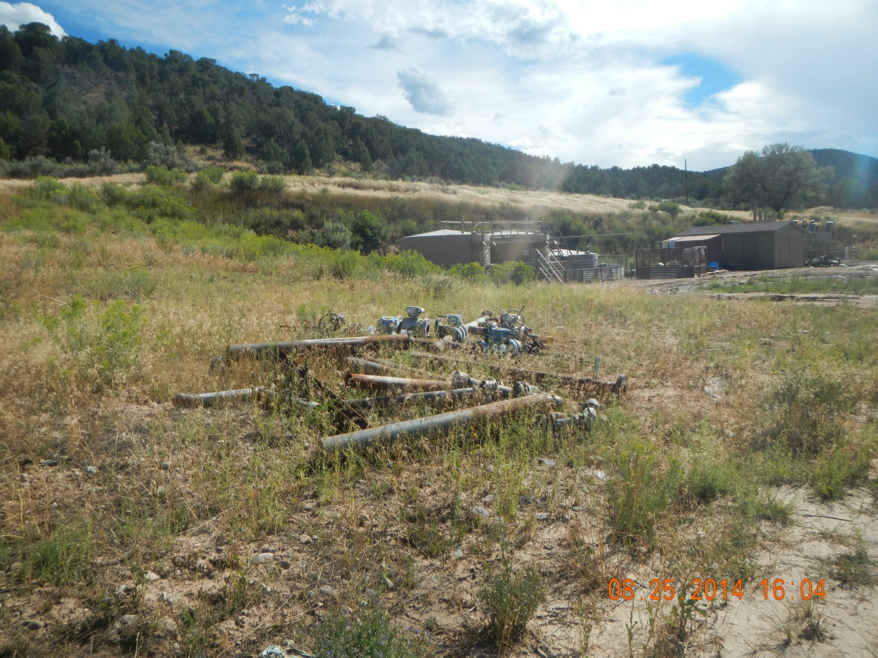
Junk

Slide 4
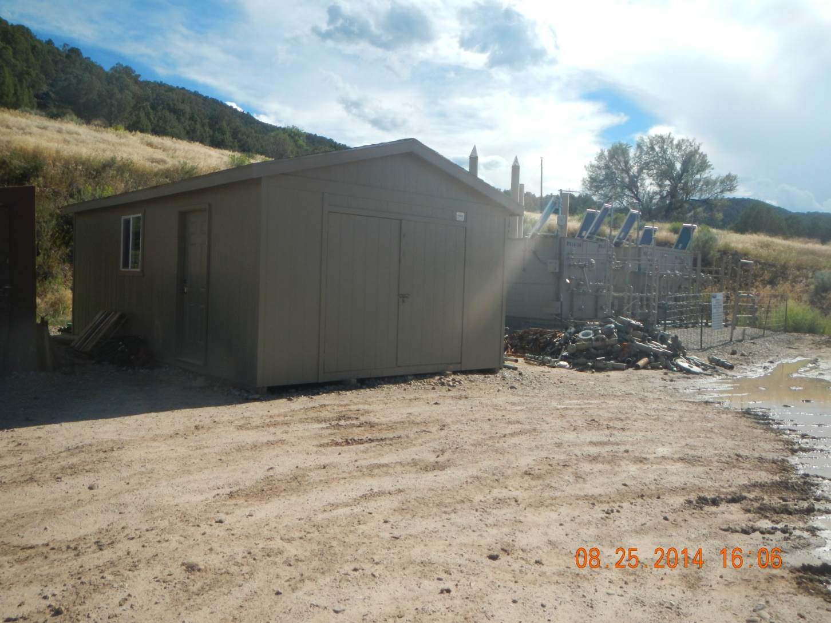
Storage and junk

Slide 5
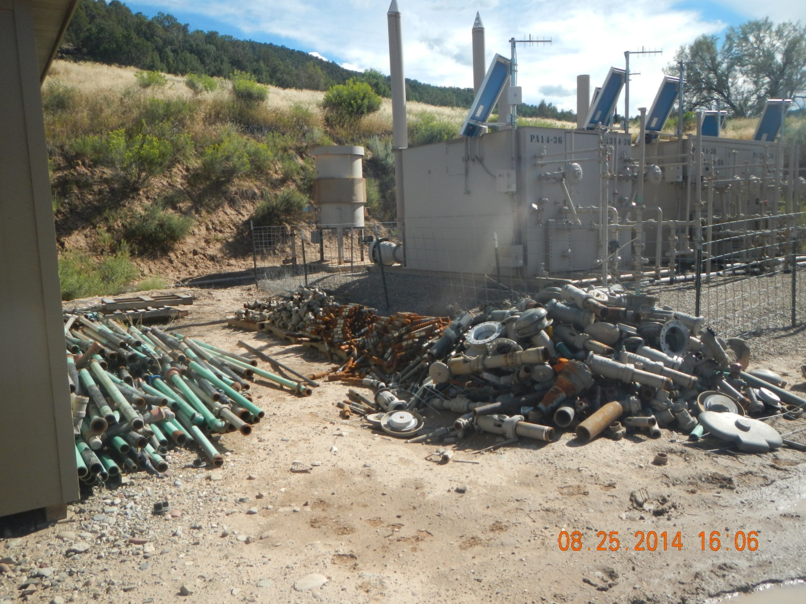
Junk

Slide 6
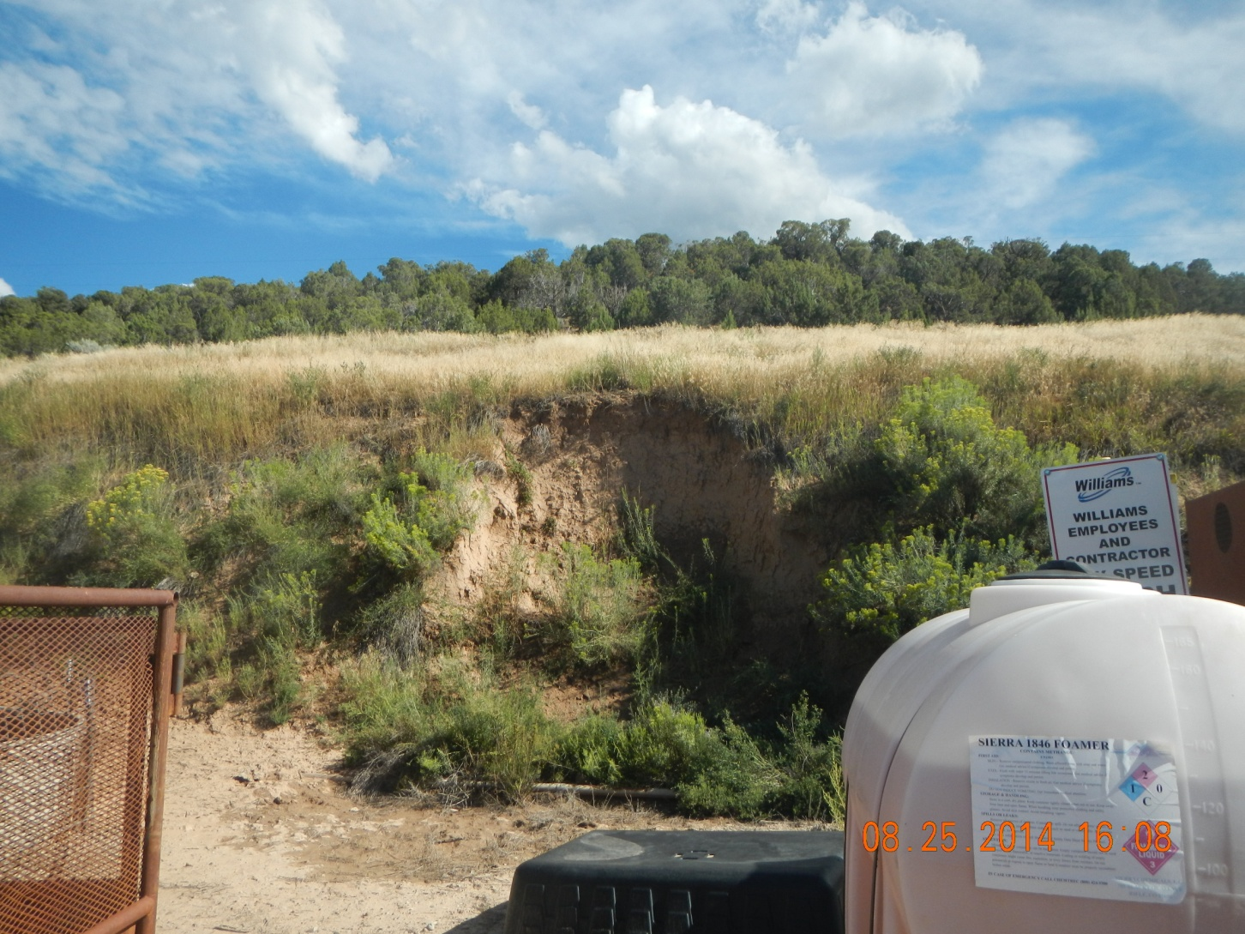
Cut in Cut slope

Slide 7
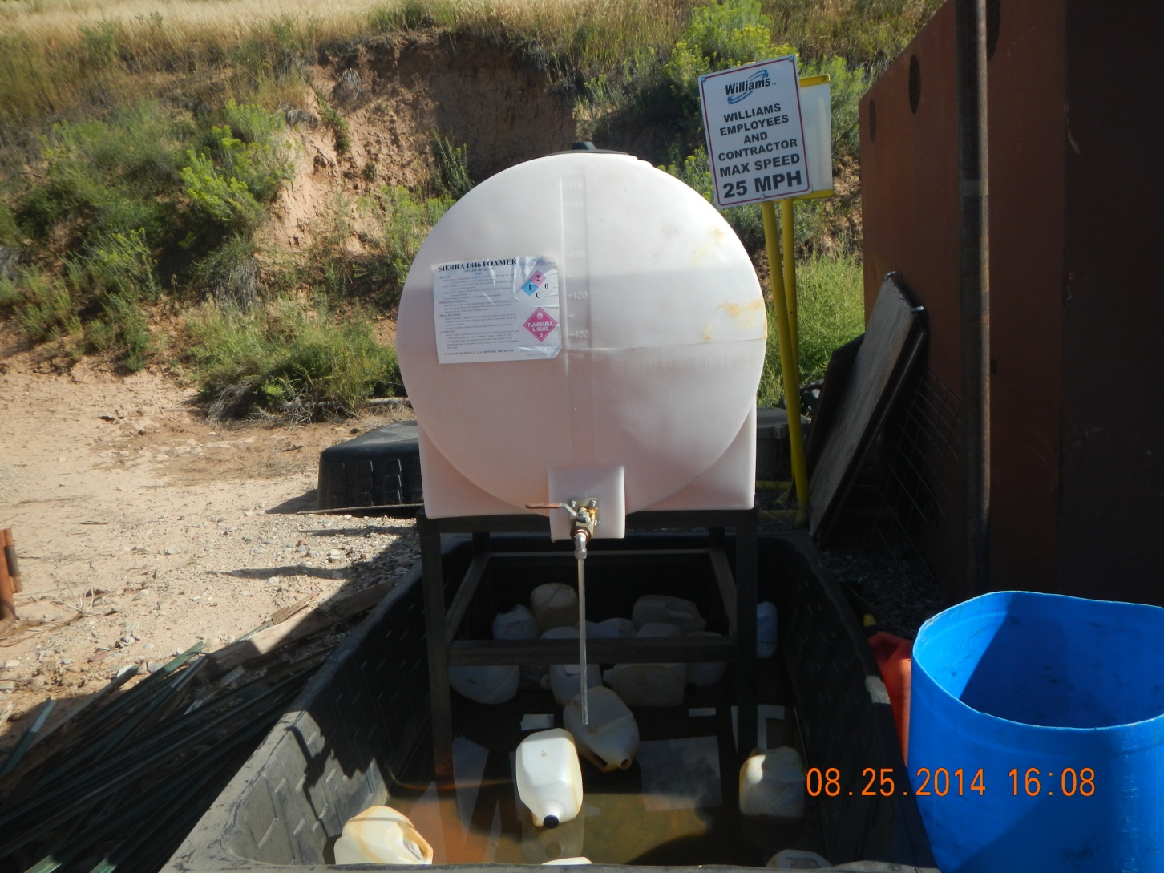
Chemical container with gallon jugs floating in secondary containment

