Slide 1
WPX
GV 58-36 Pad
Loc. Id # 334597

Slide 2
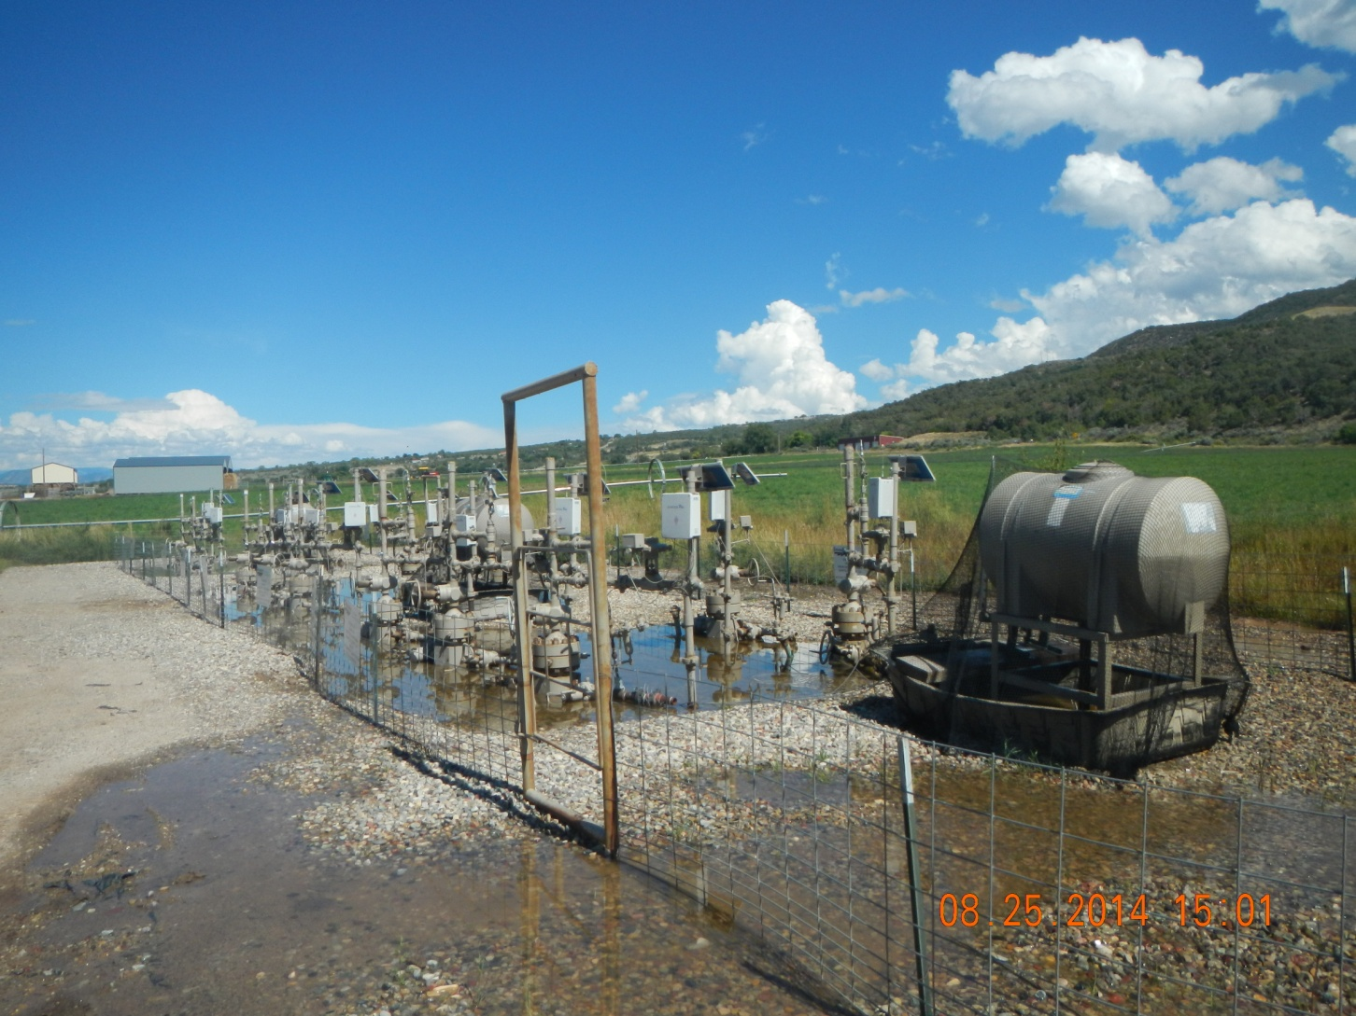
Standing water at wells

Slide 3
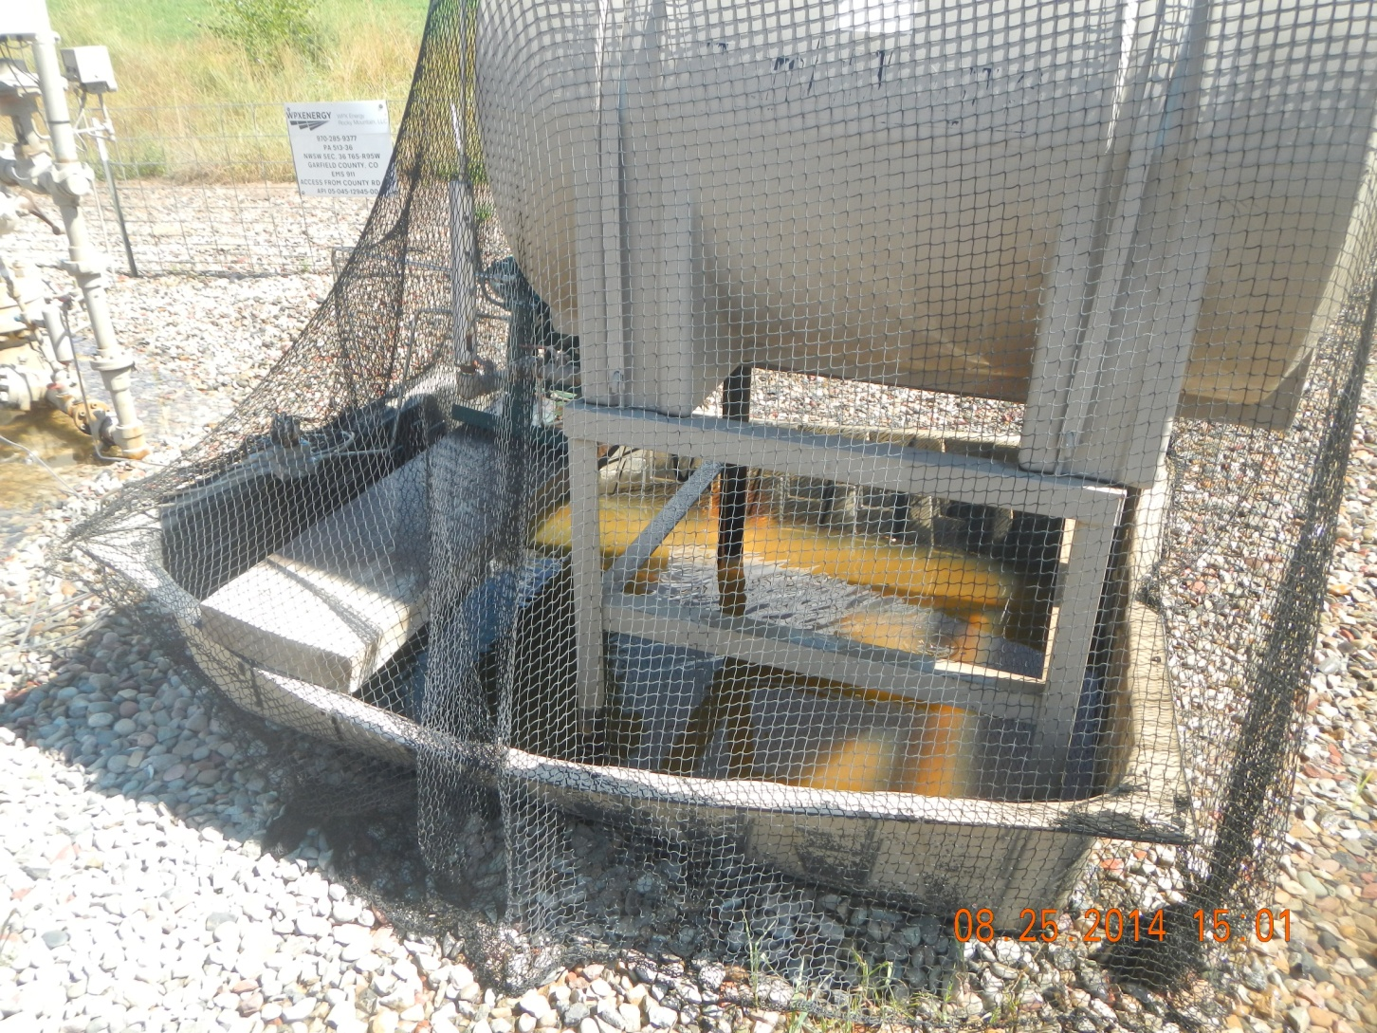
Containment filling from sprinklers

Slide 4
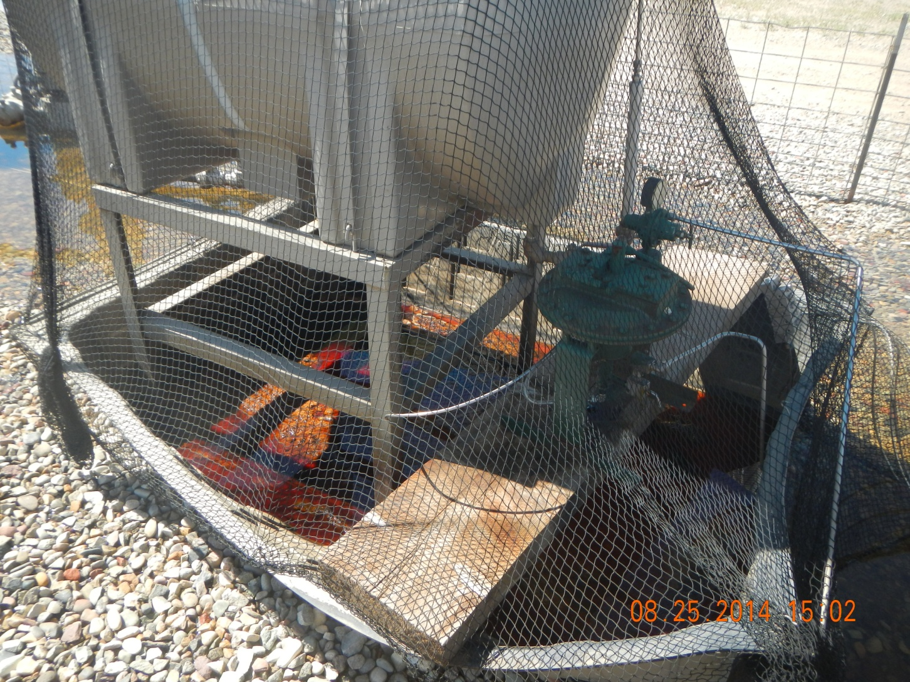
Containment filling from sprinklers

Slide 5
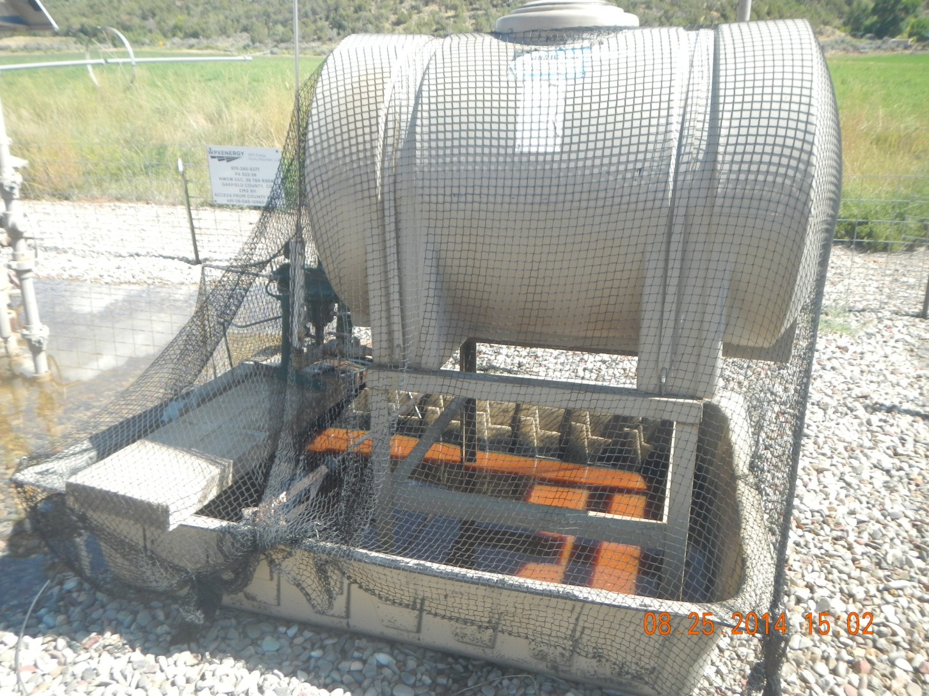
Containment filling from sprinklers

Slide 6
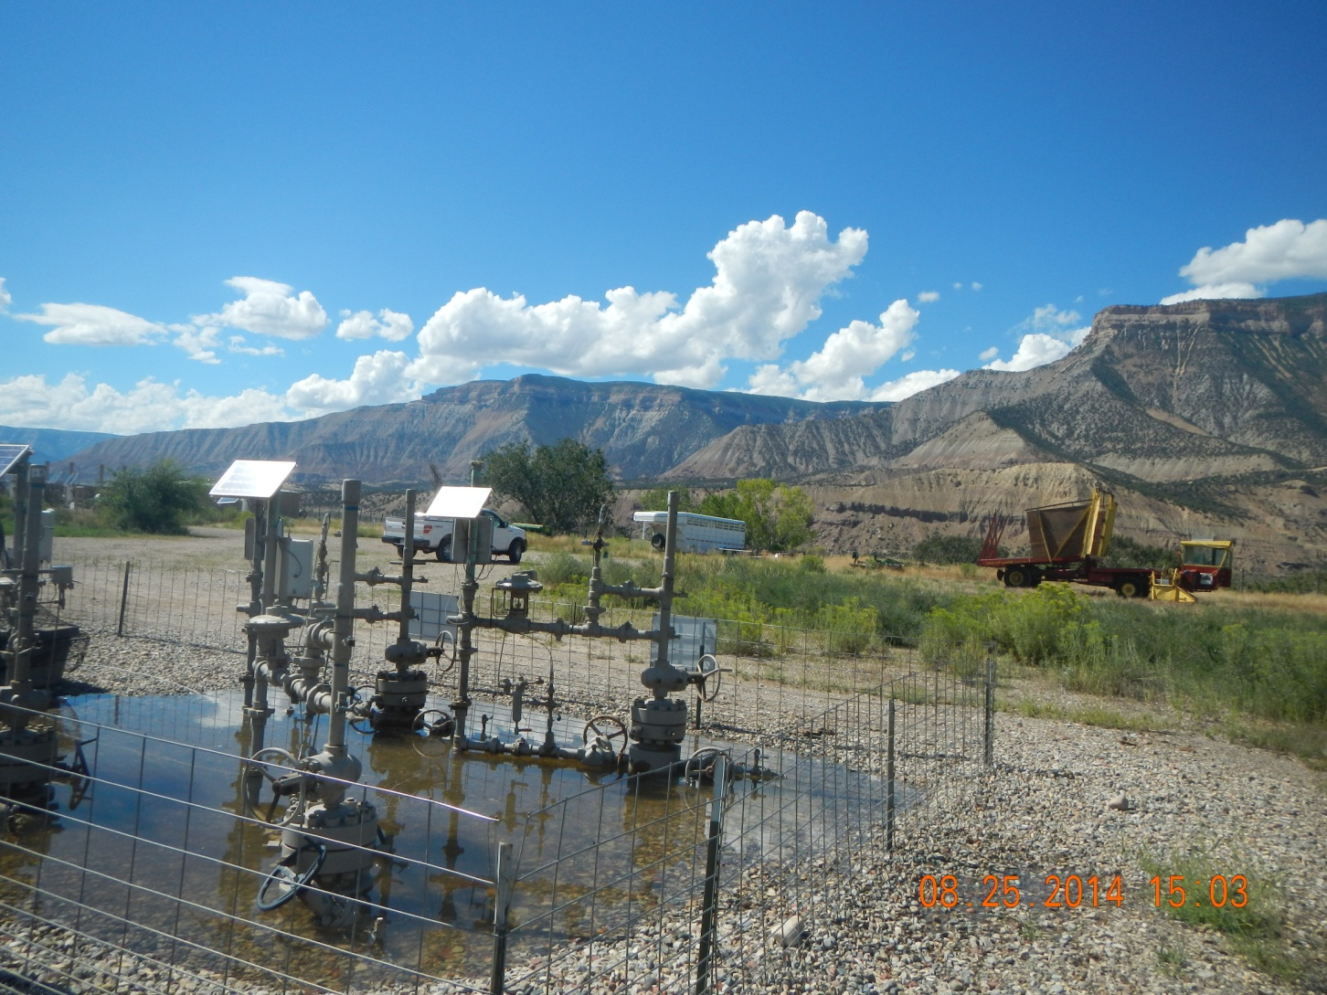
Farm equipment stored on location

Slide 7
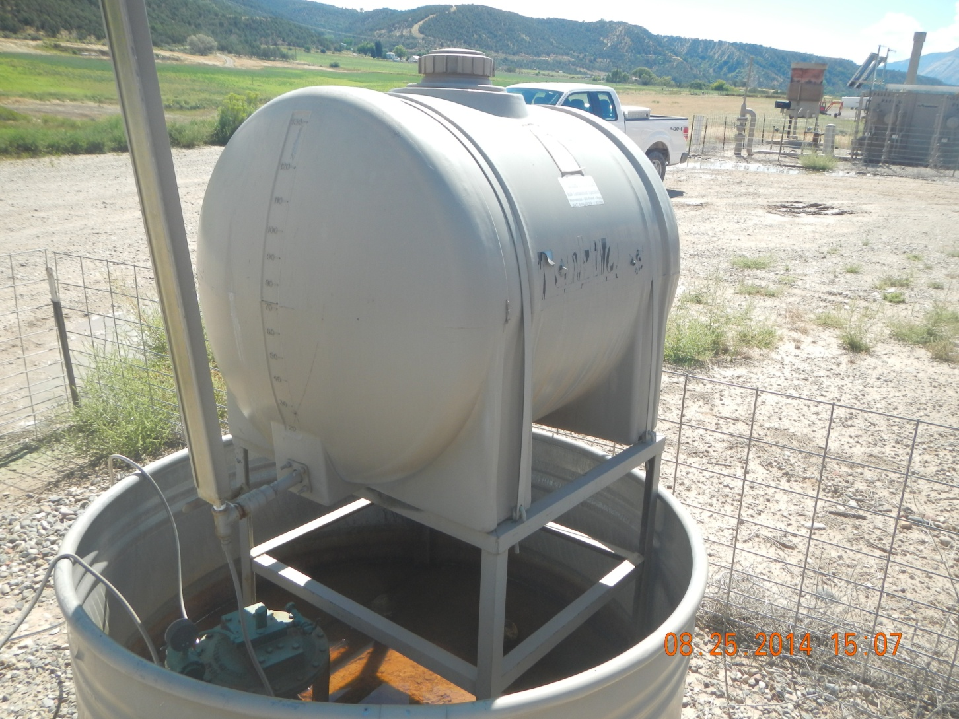
Labels need replaced

Slide 8
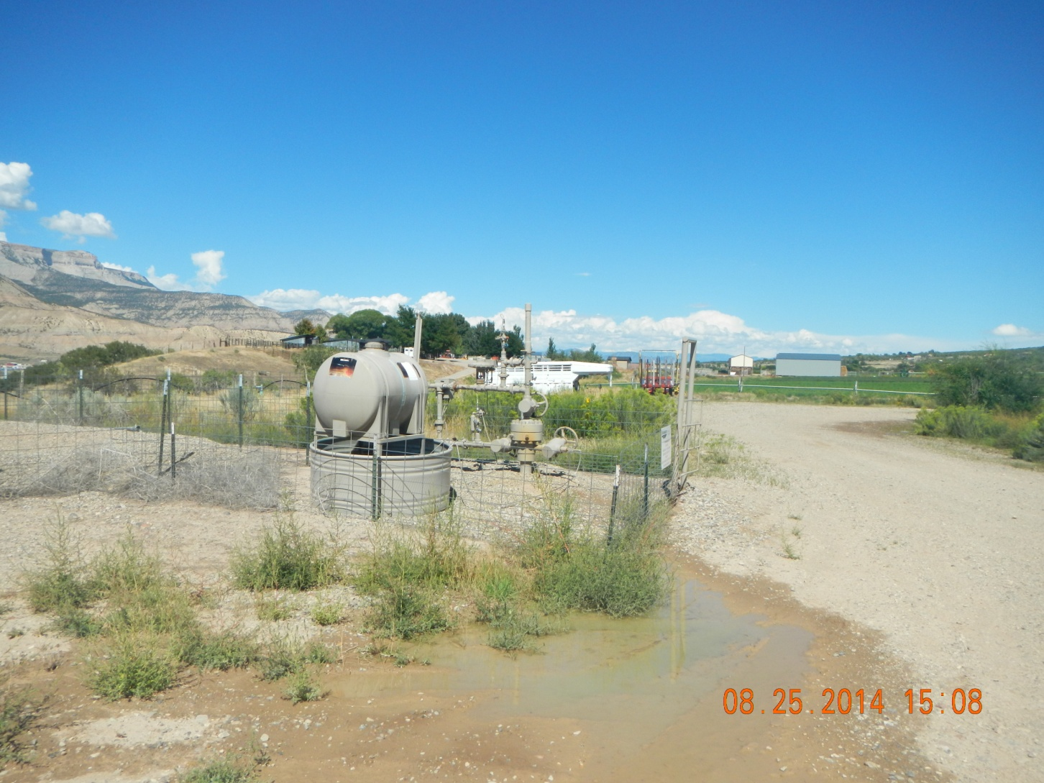
Labels need replaced

