Slide 1
WPX
PA 31-36 Pad
Loc. Id. # 335172

Slide 2
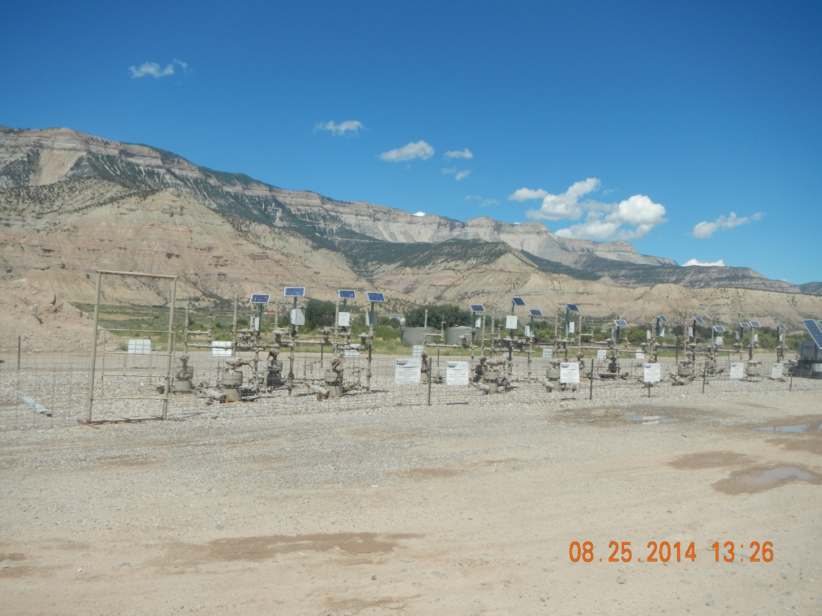
Wells

Slide 3
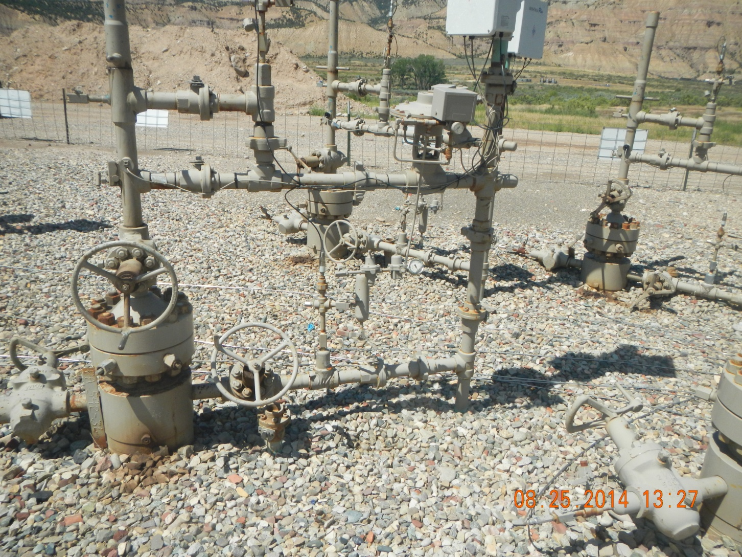
Oil and Grease stains

Slide 4
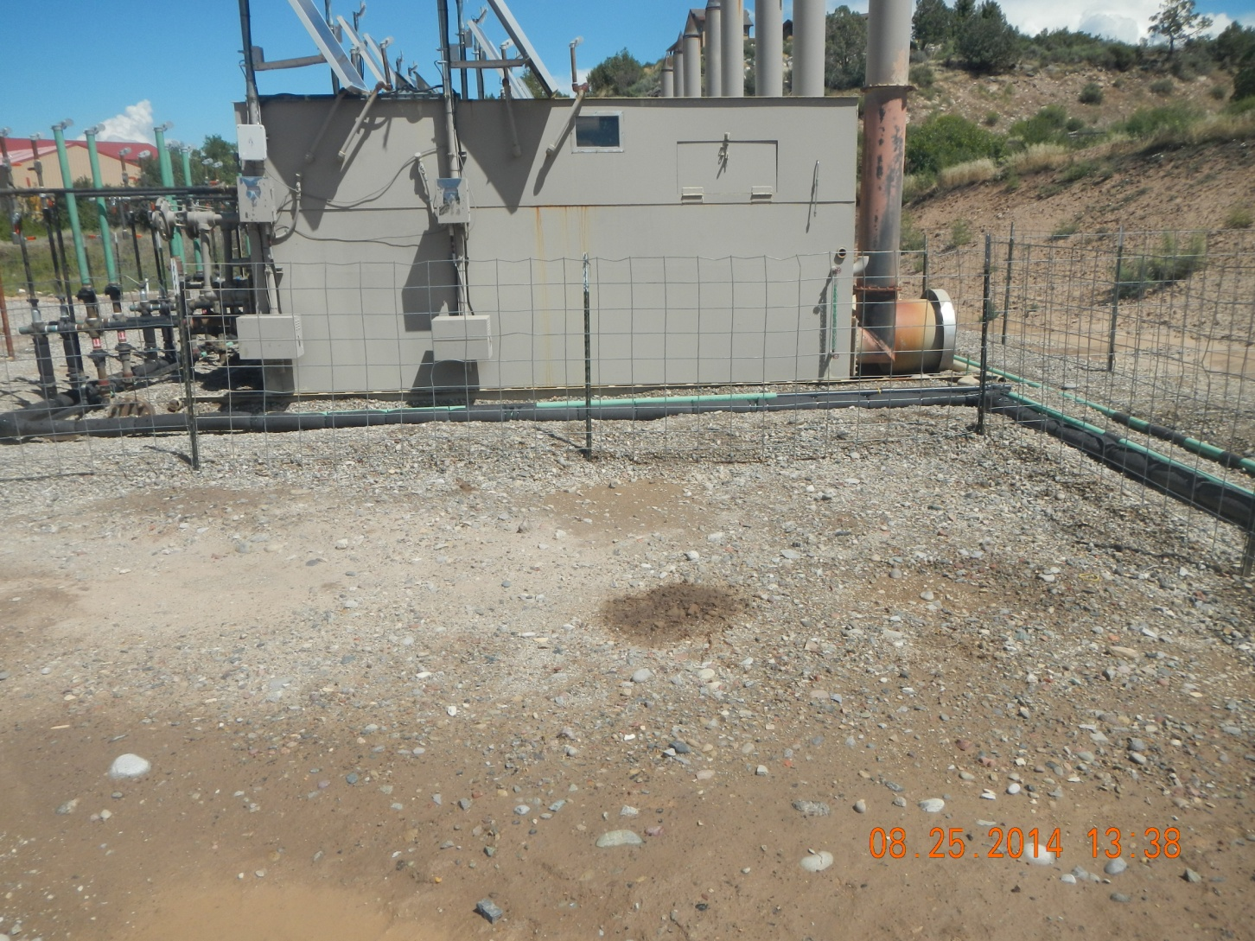
Oil staining at separators

Slide 5
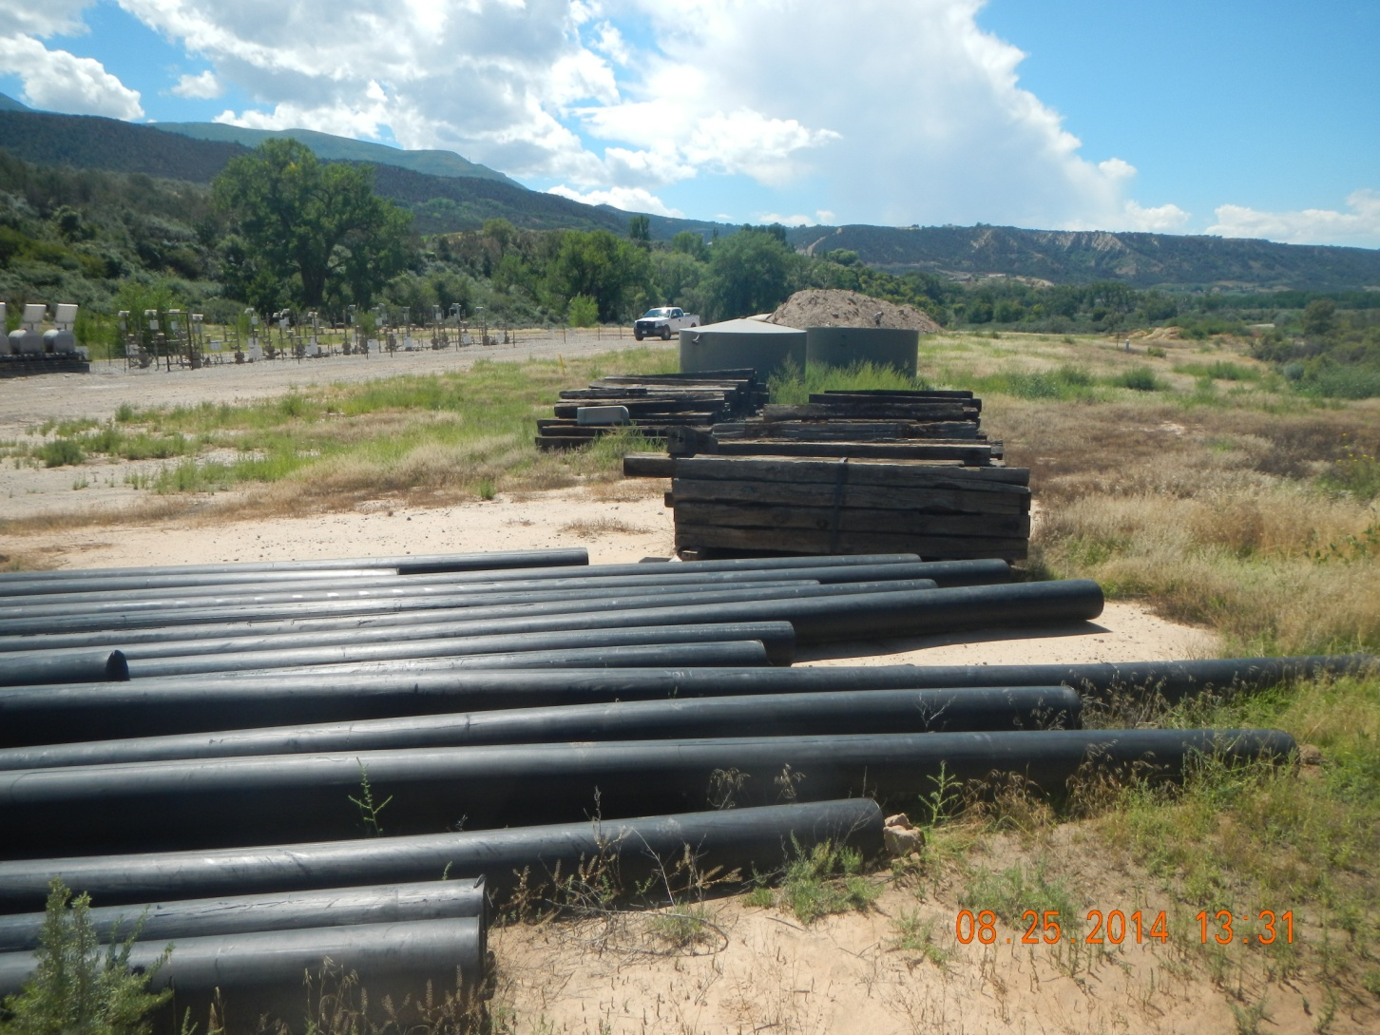
Unneeded equipment

Slide 6
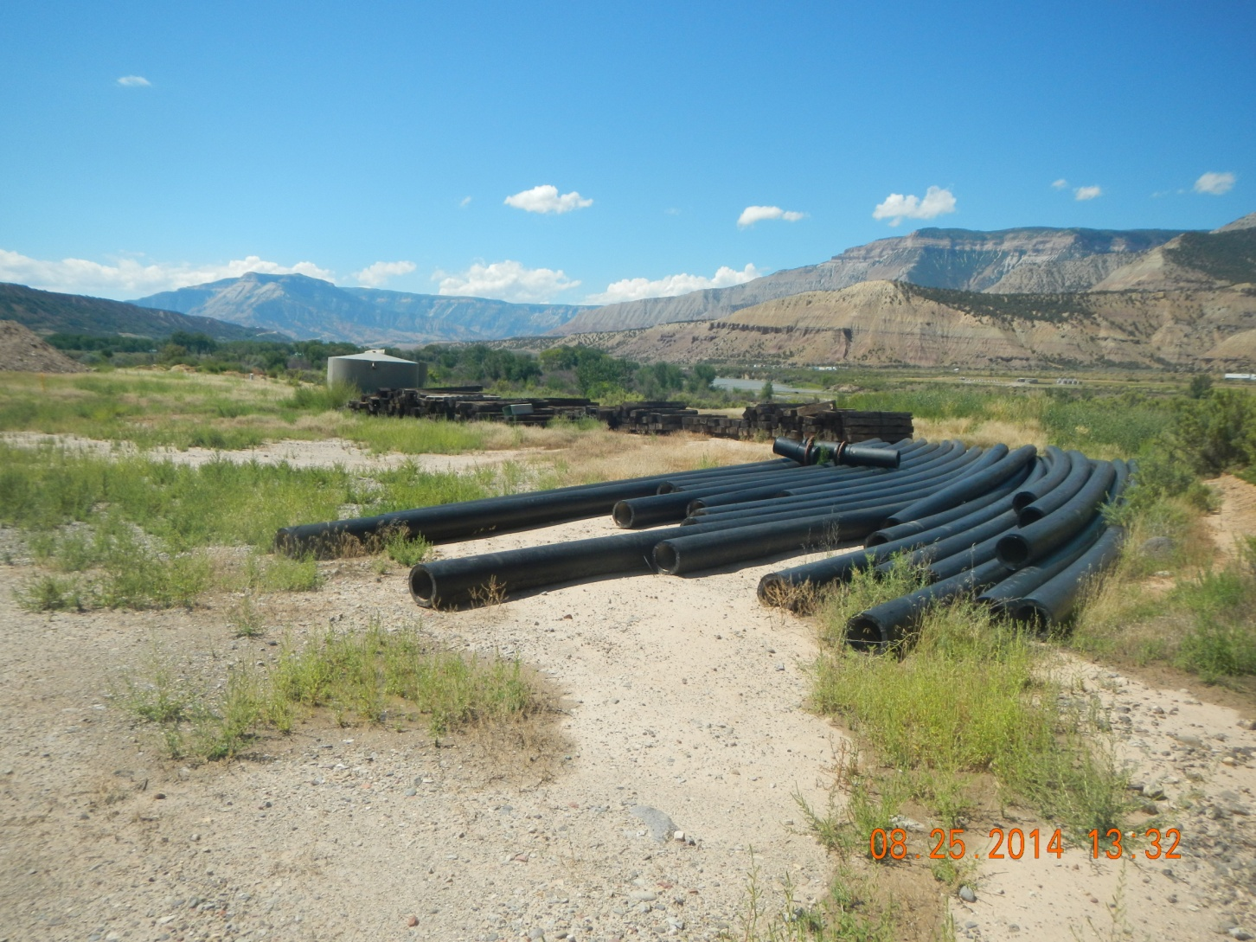
Unneed equipment

Slide 7
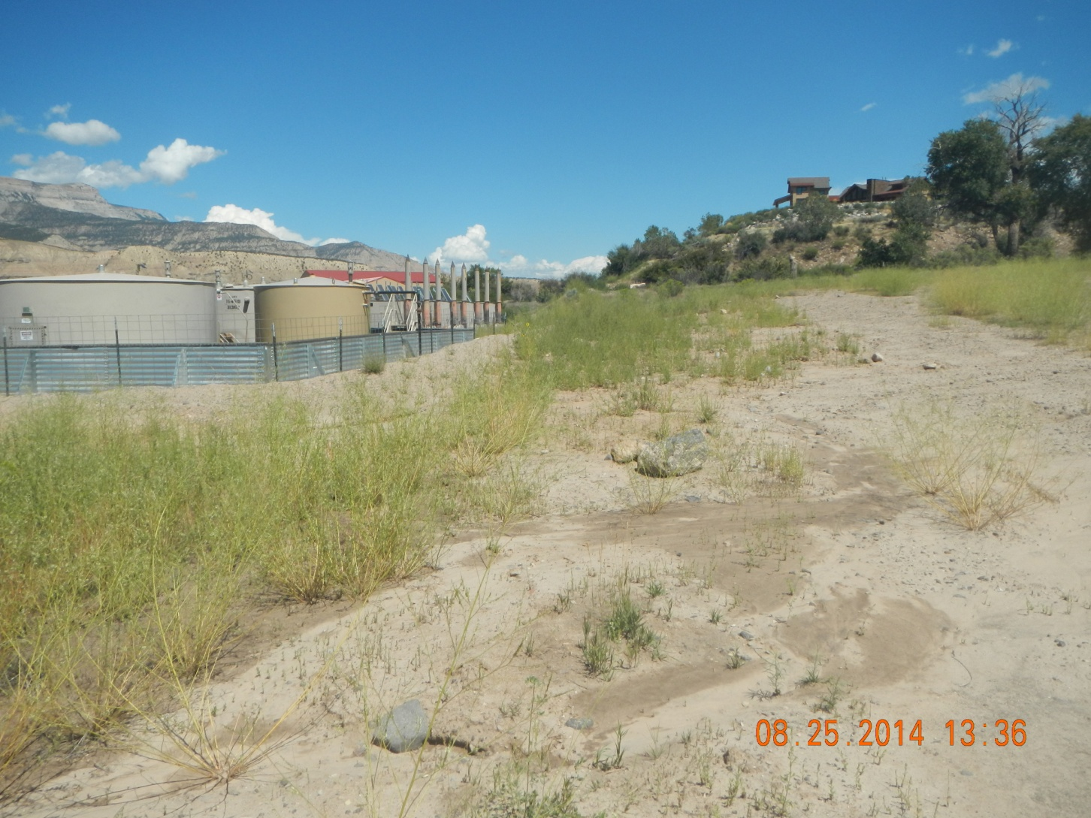
Washing and moved sediment

Slide 8
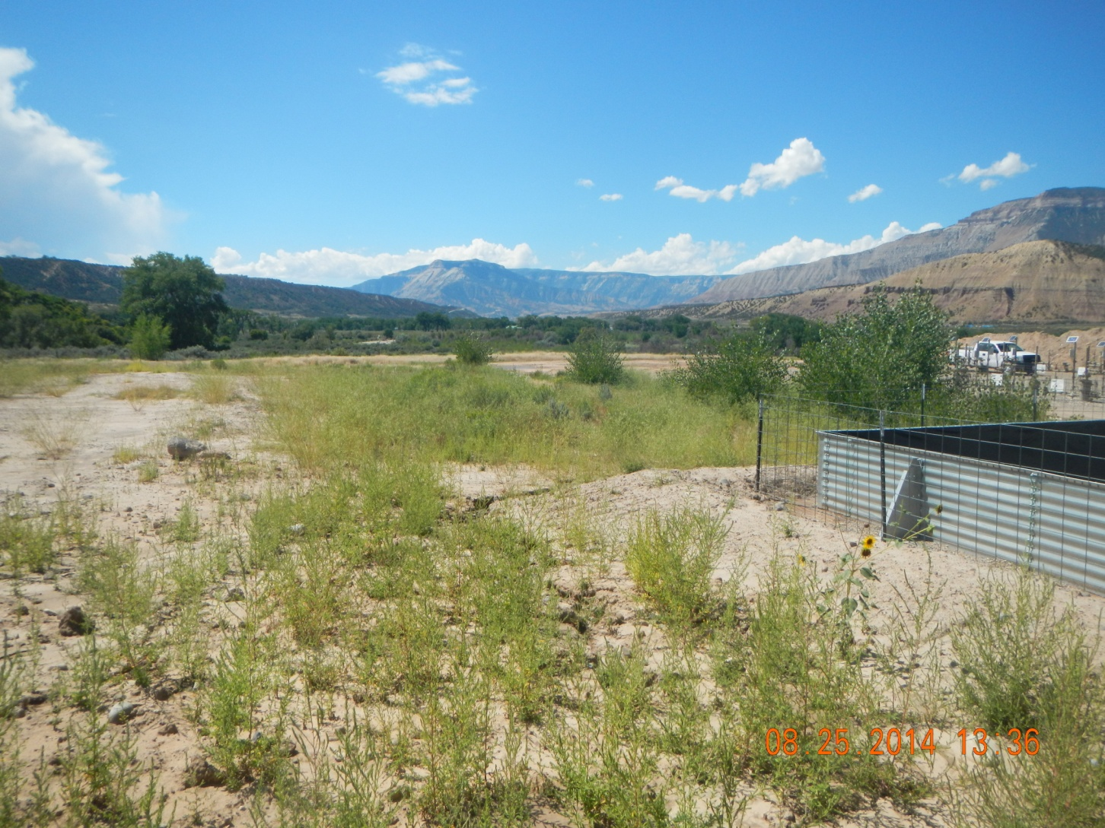
Washed cut around tank berm

Slide 9
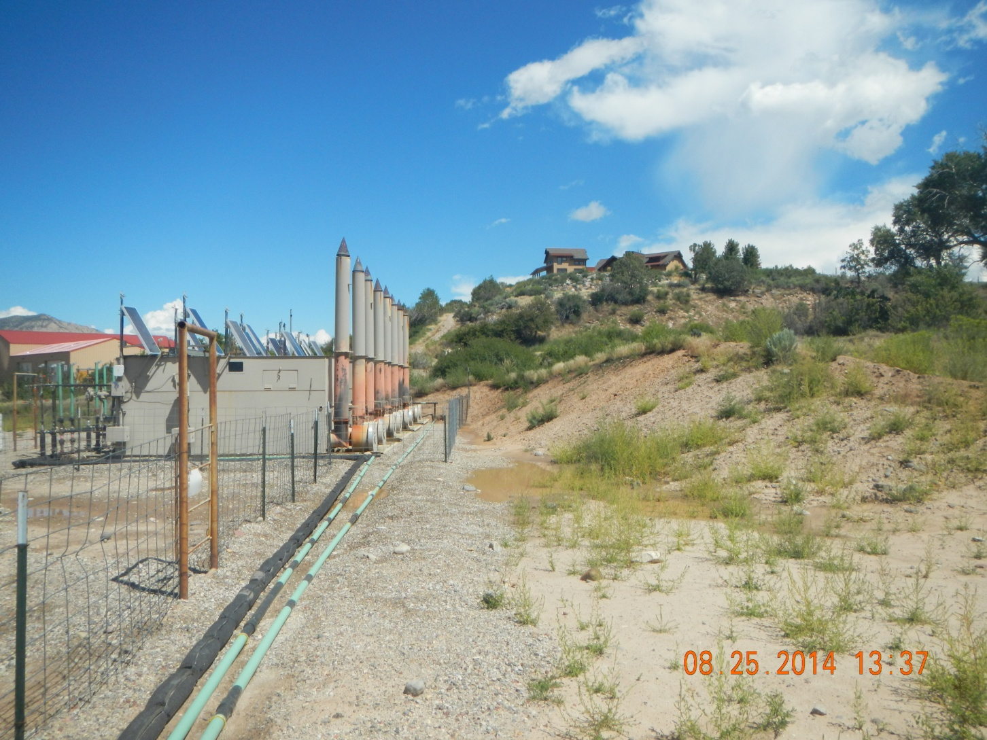
Unseeded cut slope washing

Slide 10
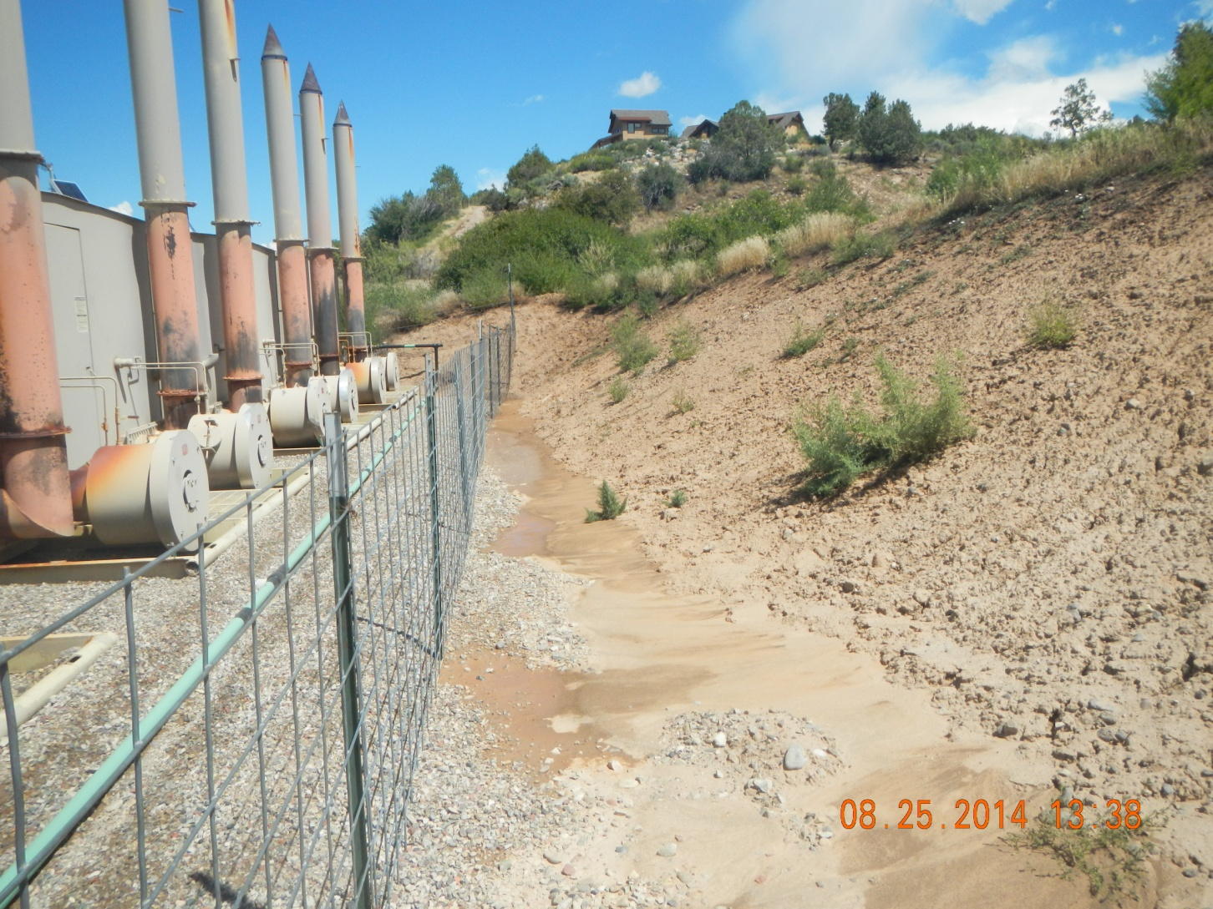
Unseeded cut slope washing

