Slide 1
Linn(Berry)
Loc. Id. #335673
Long Ridge
D21 595

Slide 2
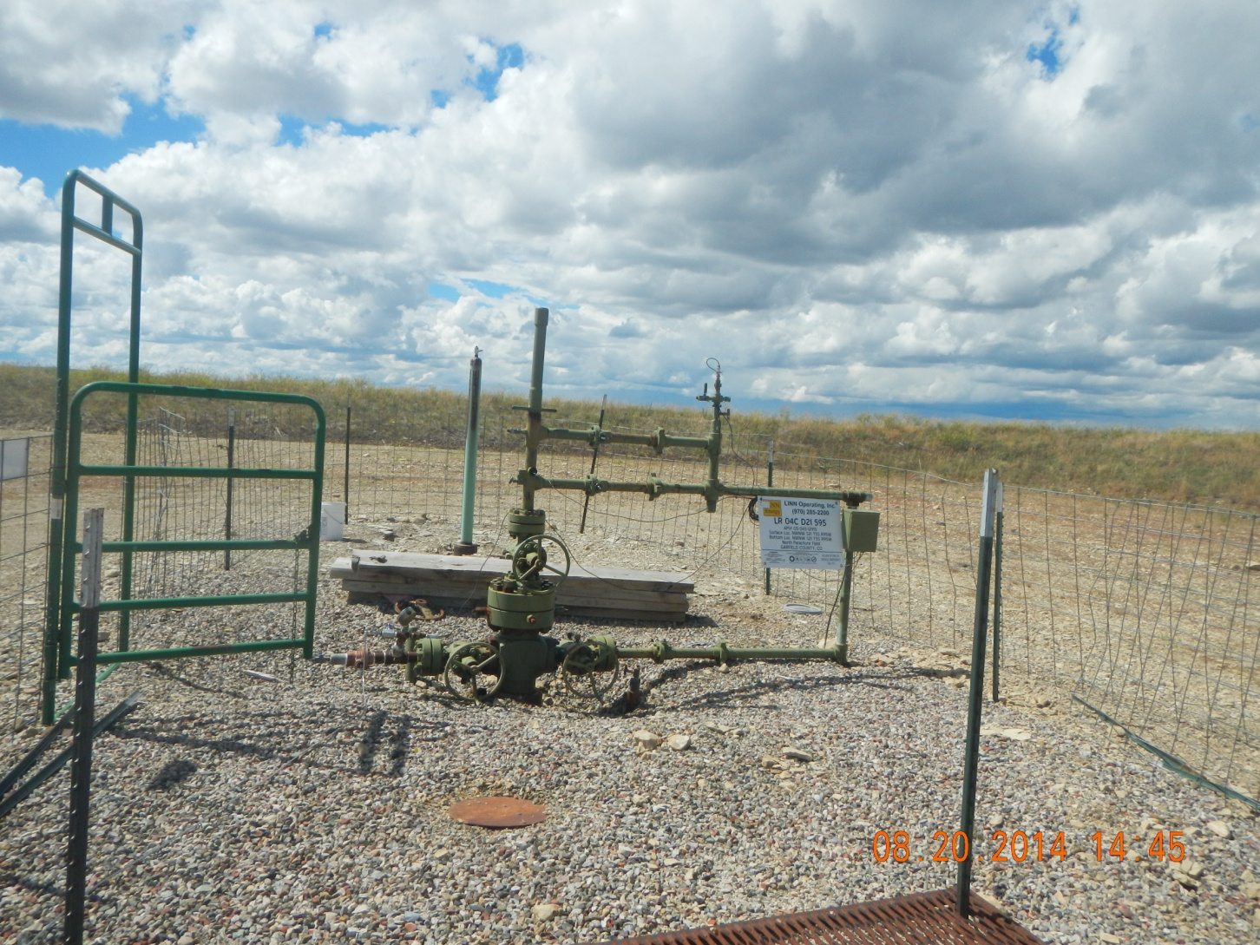
Rat hole cover needs welded

Slide 3
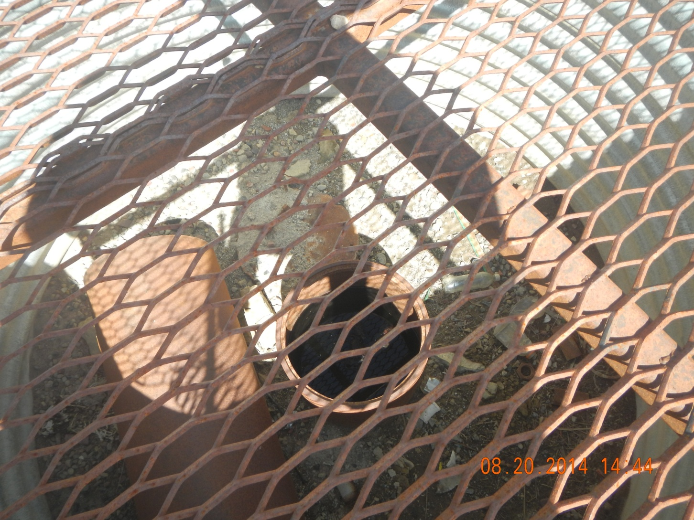
No cover on Conductor
Trash and extra pipe material in cellar

Slide 4
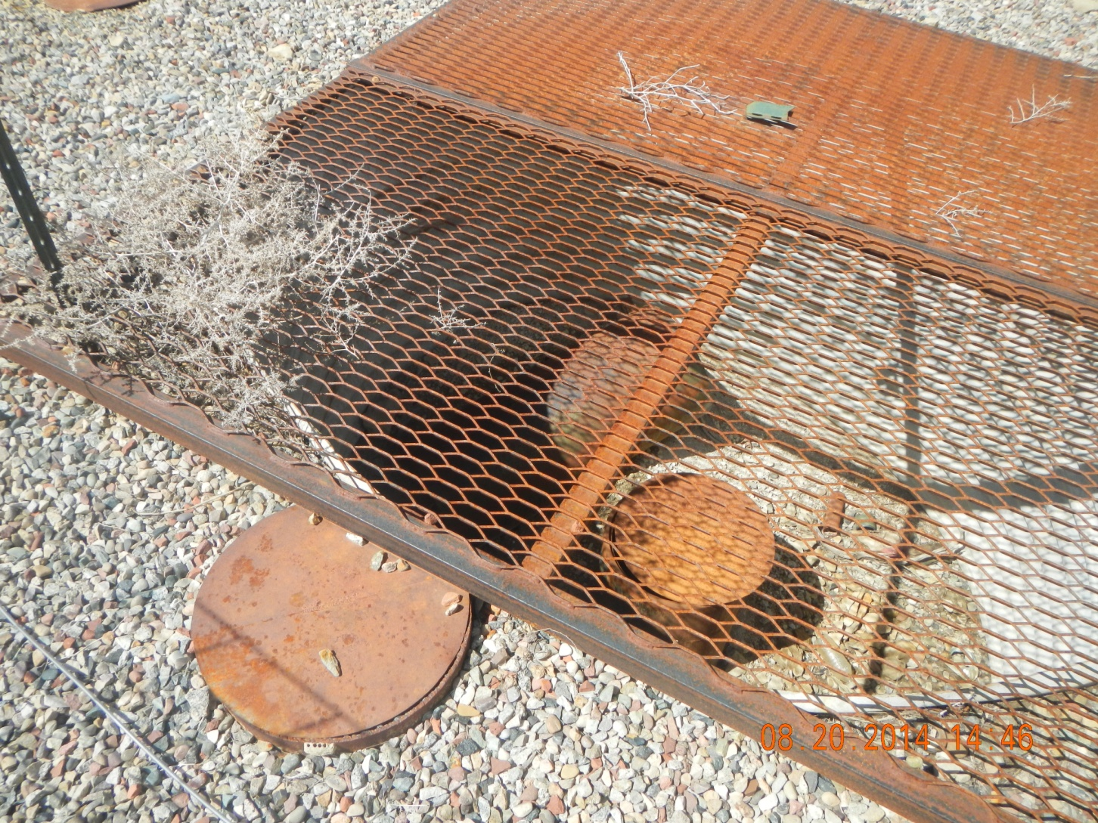
Covers not welded
Unused materials in cellar

Slide 5
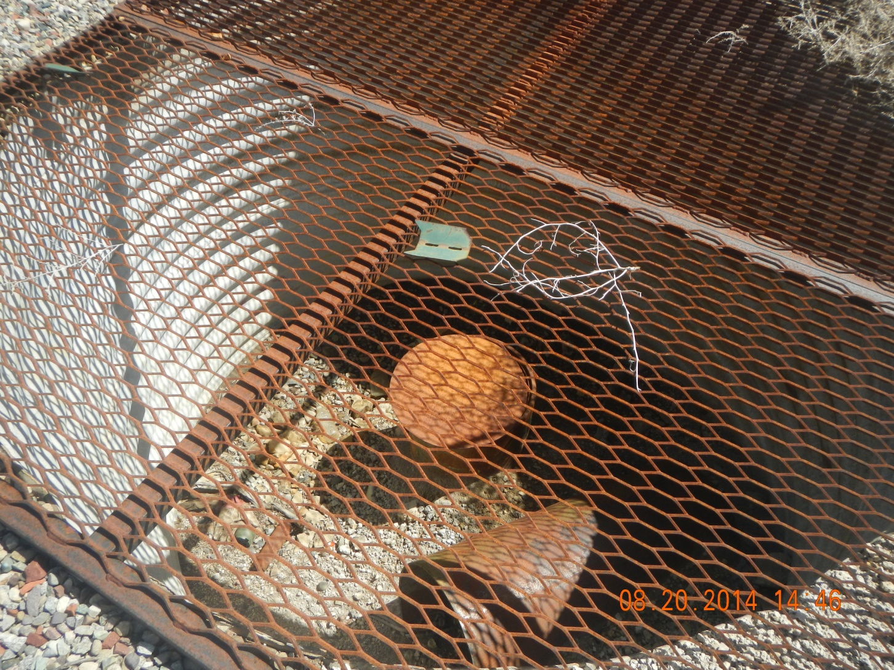
Covers not welded
Unused materials in cellar

Slide 6
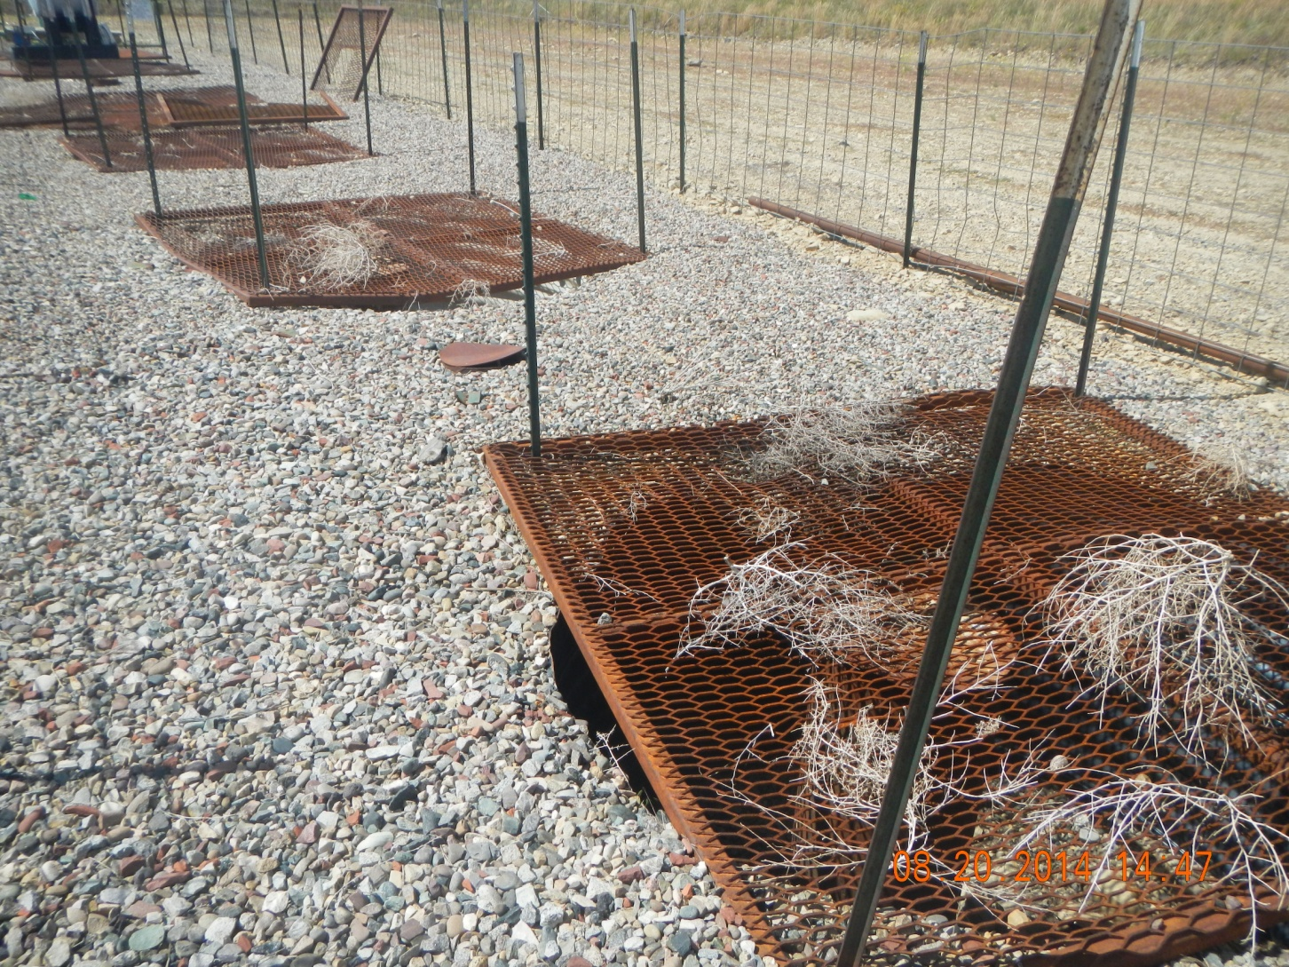
Covers not welded

