Slide 1
Linn Operating
(BERRY PETROLEUM COMPANY LLC)
10091
Loc. Id. #311634
LONG RIDGE
M16 595

Slide 2
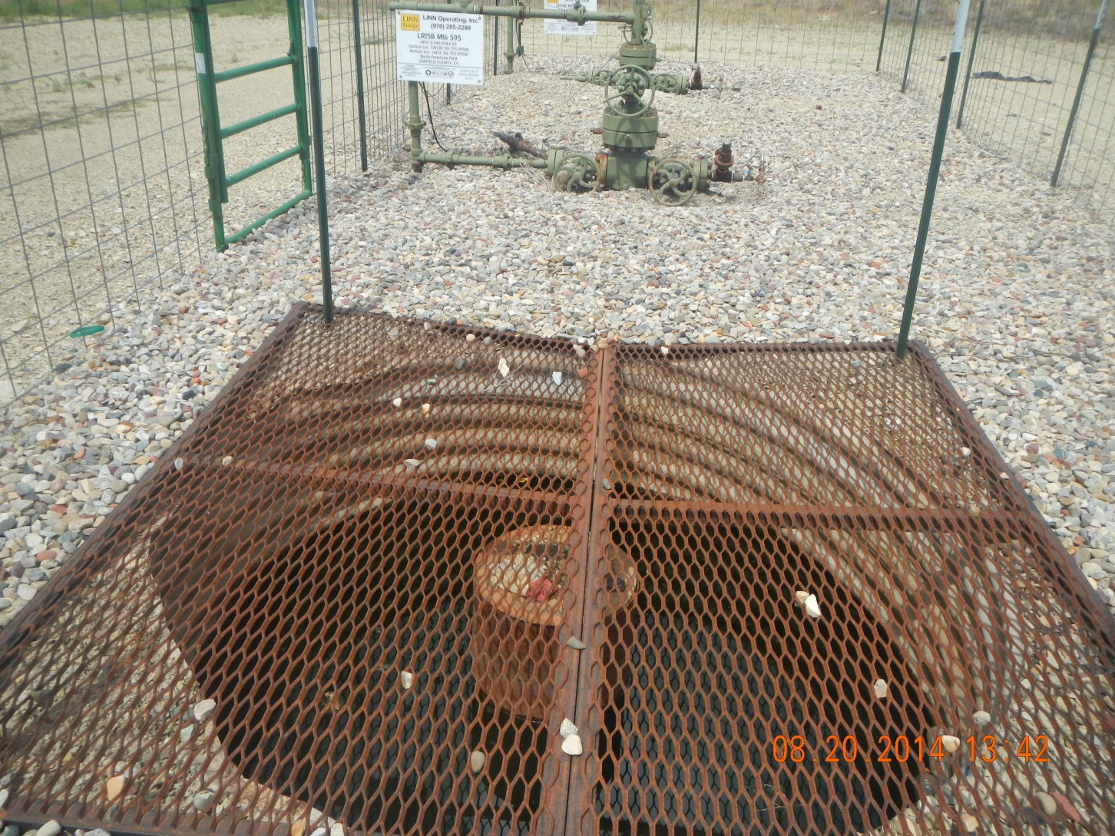
Black fluid in cellar

Slide 3
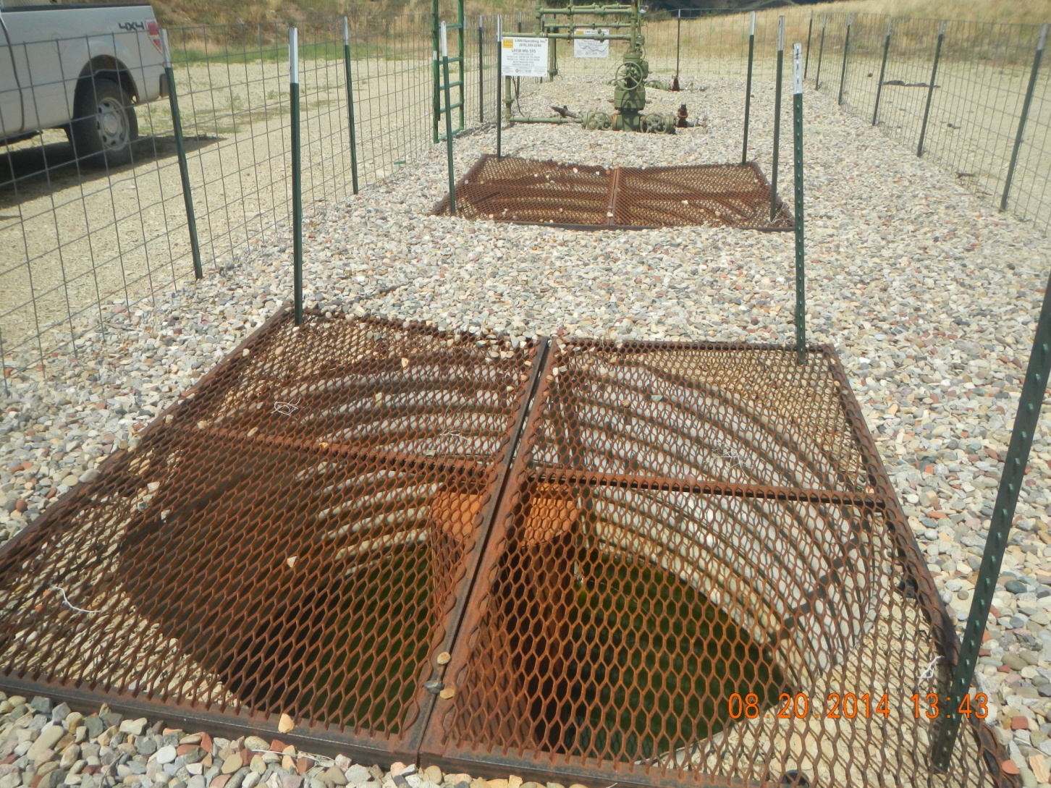
Water in cellar

Slide 4
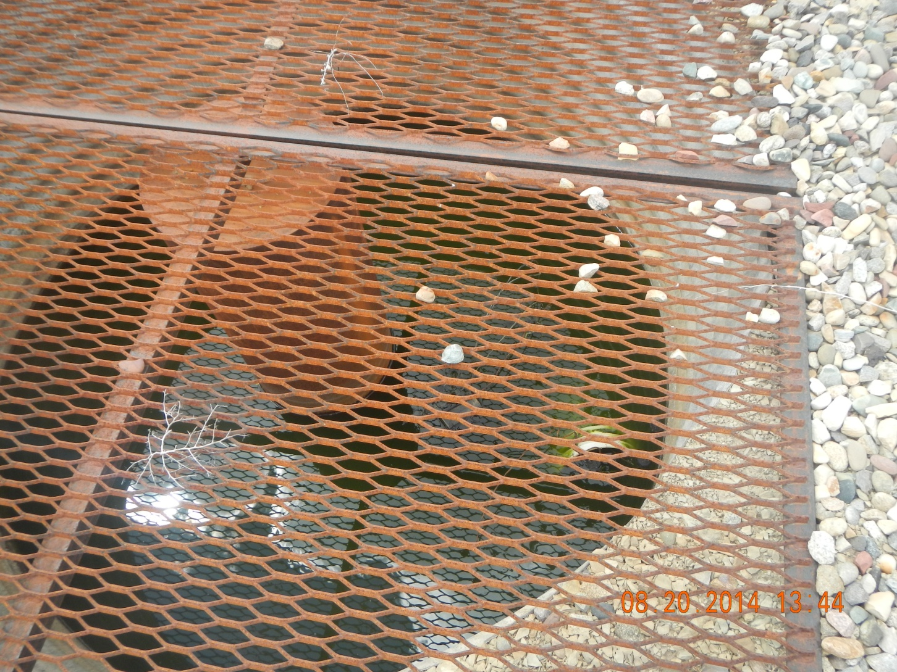
Water and 5 gallon bucket in cellar

Slide 5
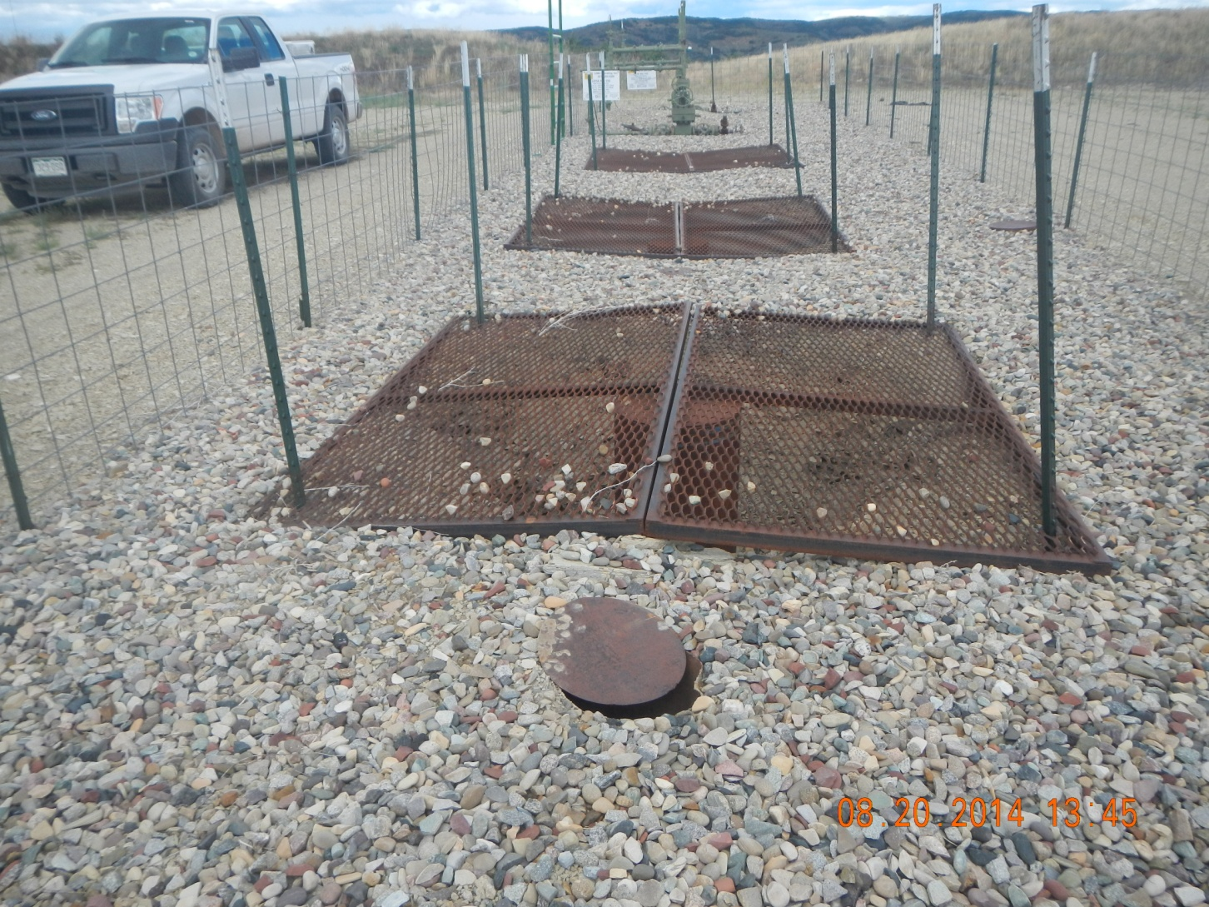
Rat Hole Cap needs welded

Slide 6
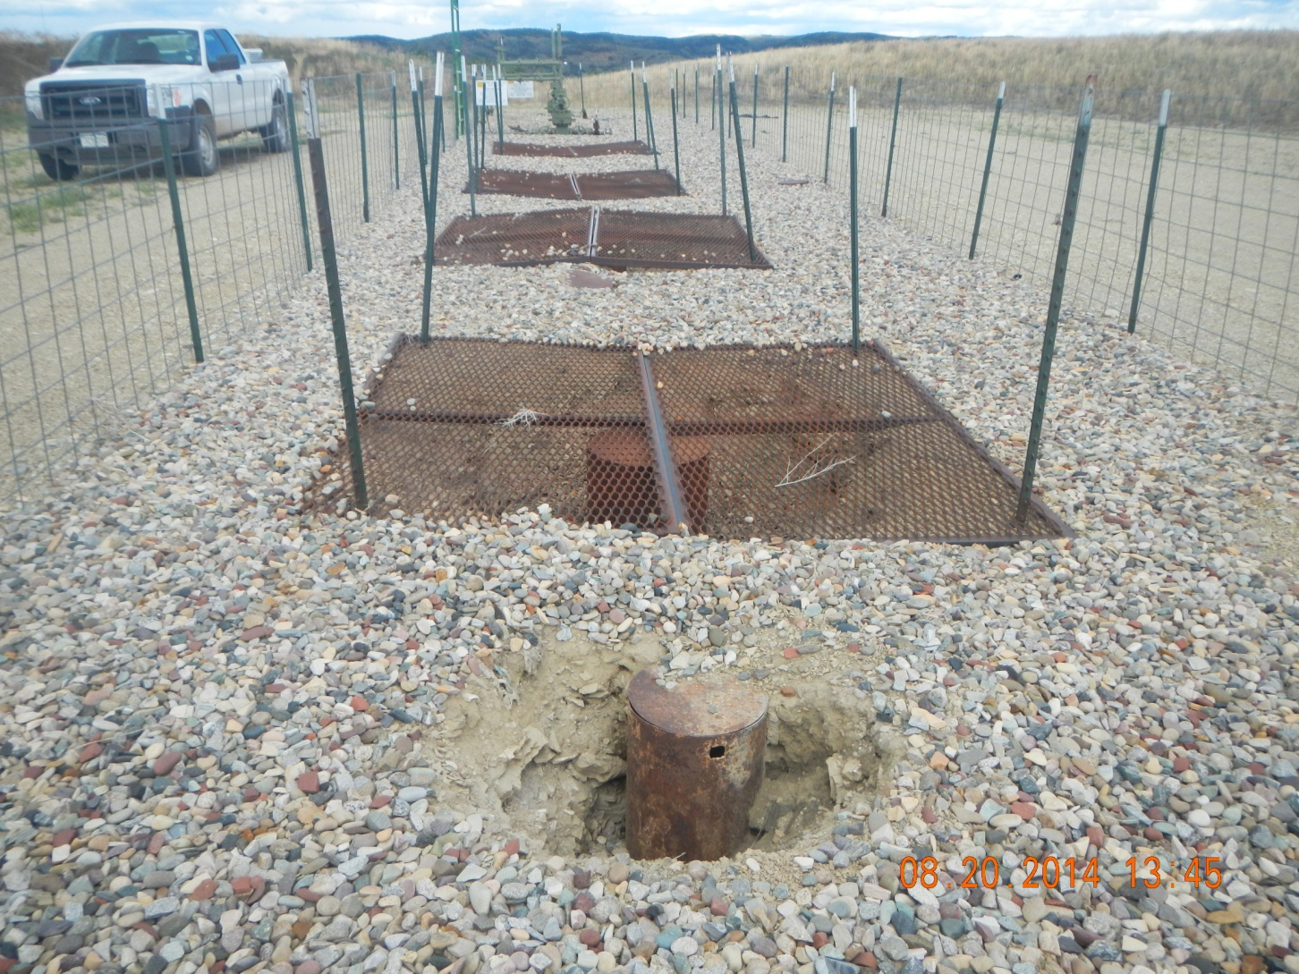
Rat hole cap needs welded

Slide 7
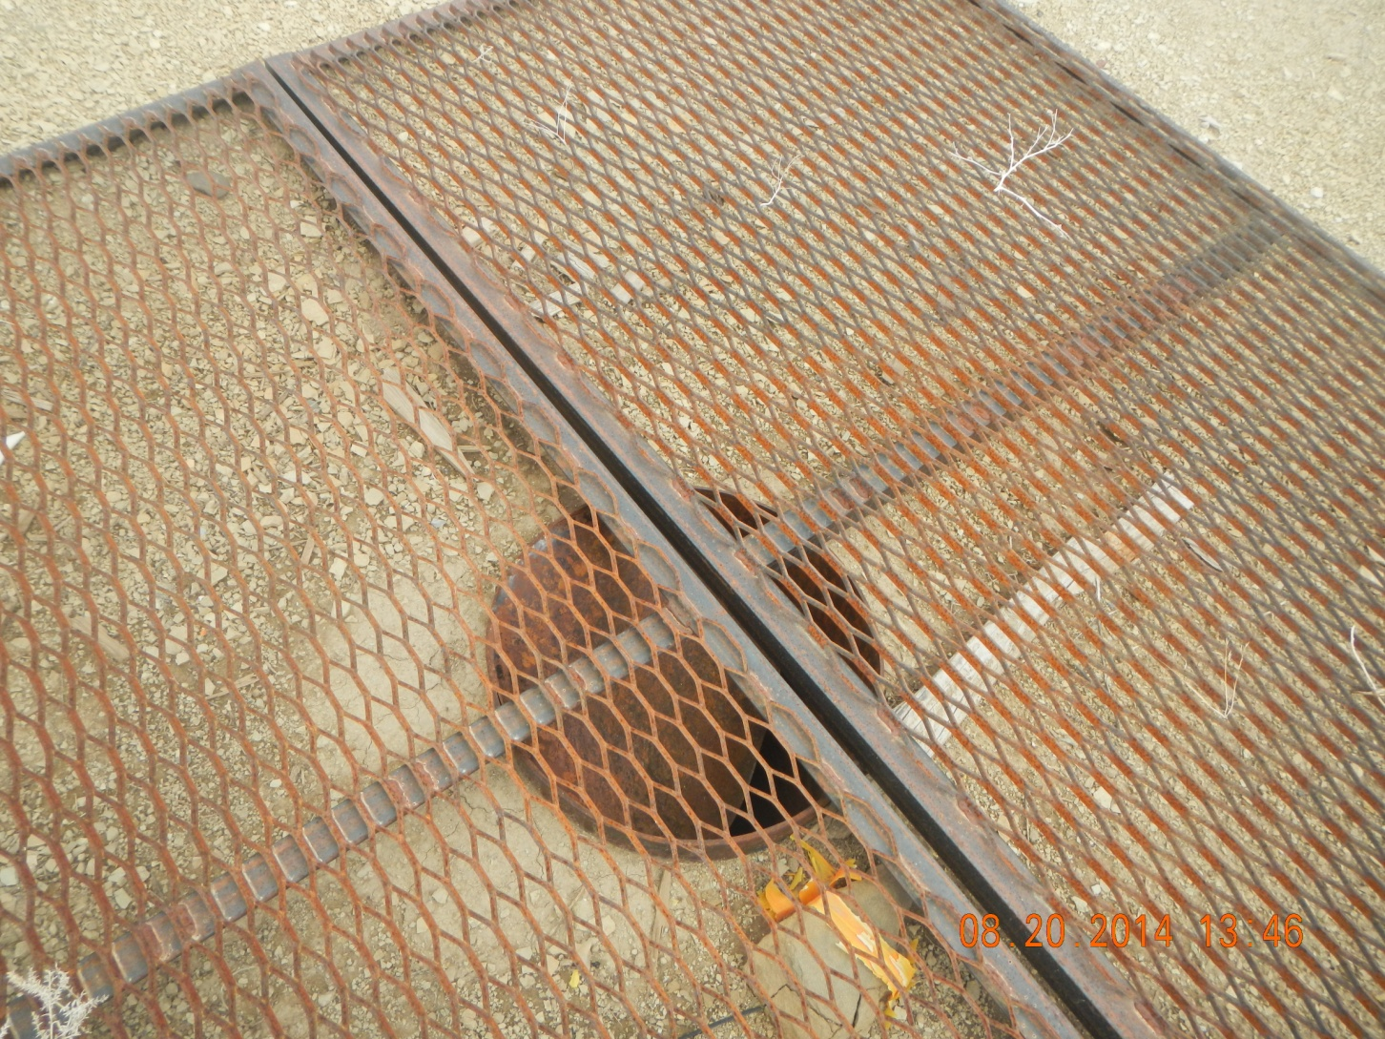
Conductor cap has clasped into pipe

Slide 8
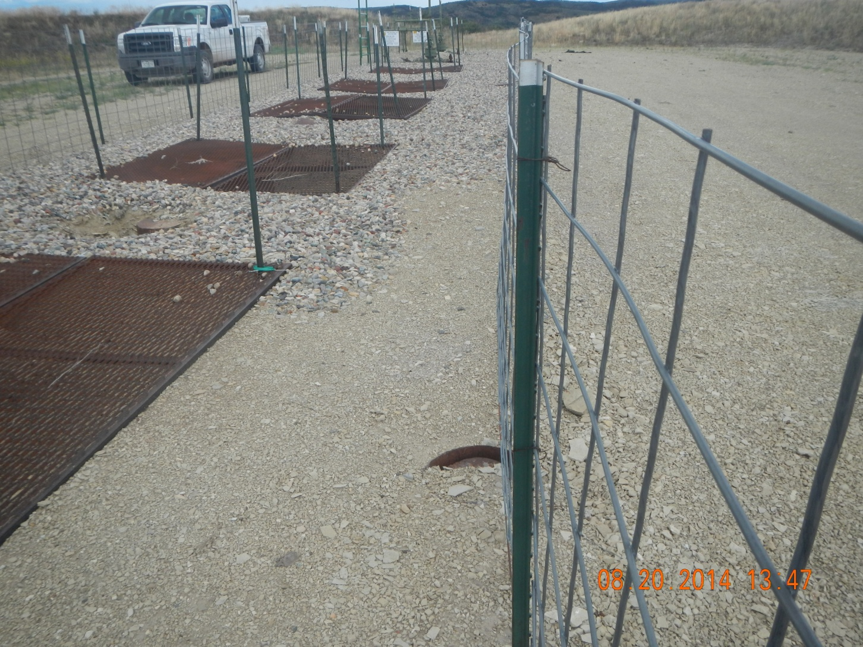
Rat hole cap damaged

