Slide 1
OXY USA WTP LP
Operator # 66571
Cascade Creek
604-12-13 Annex
Location id. # 424970

Slide 2
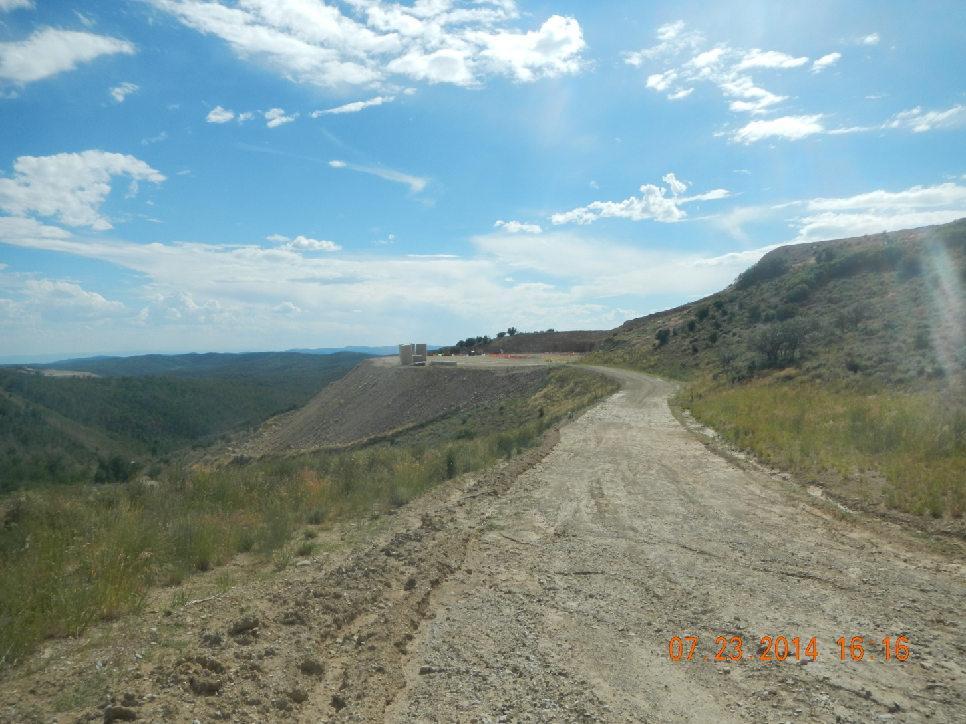
Lease Road

Slide 3
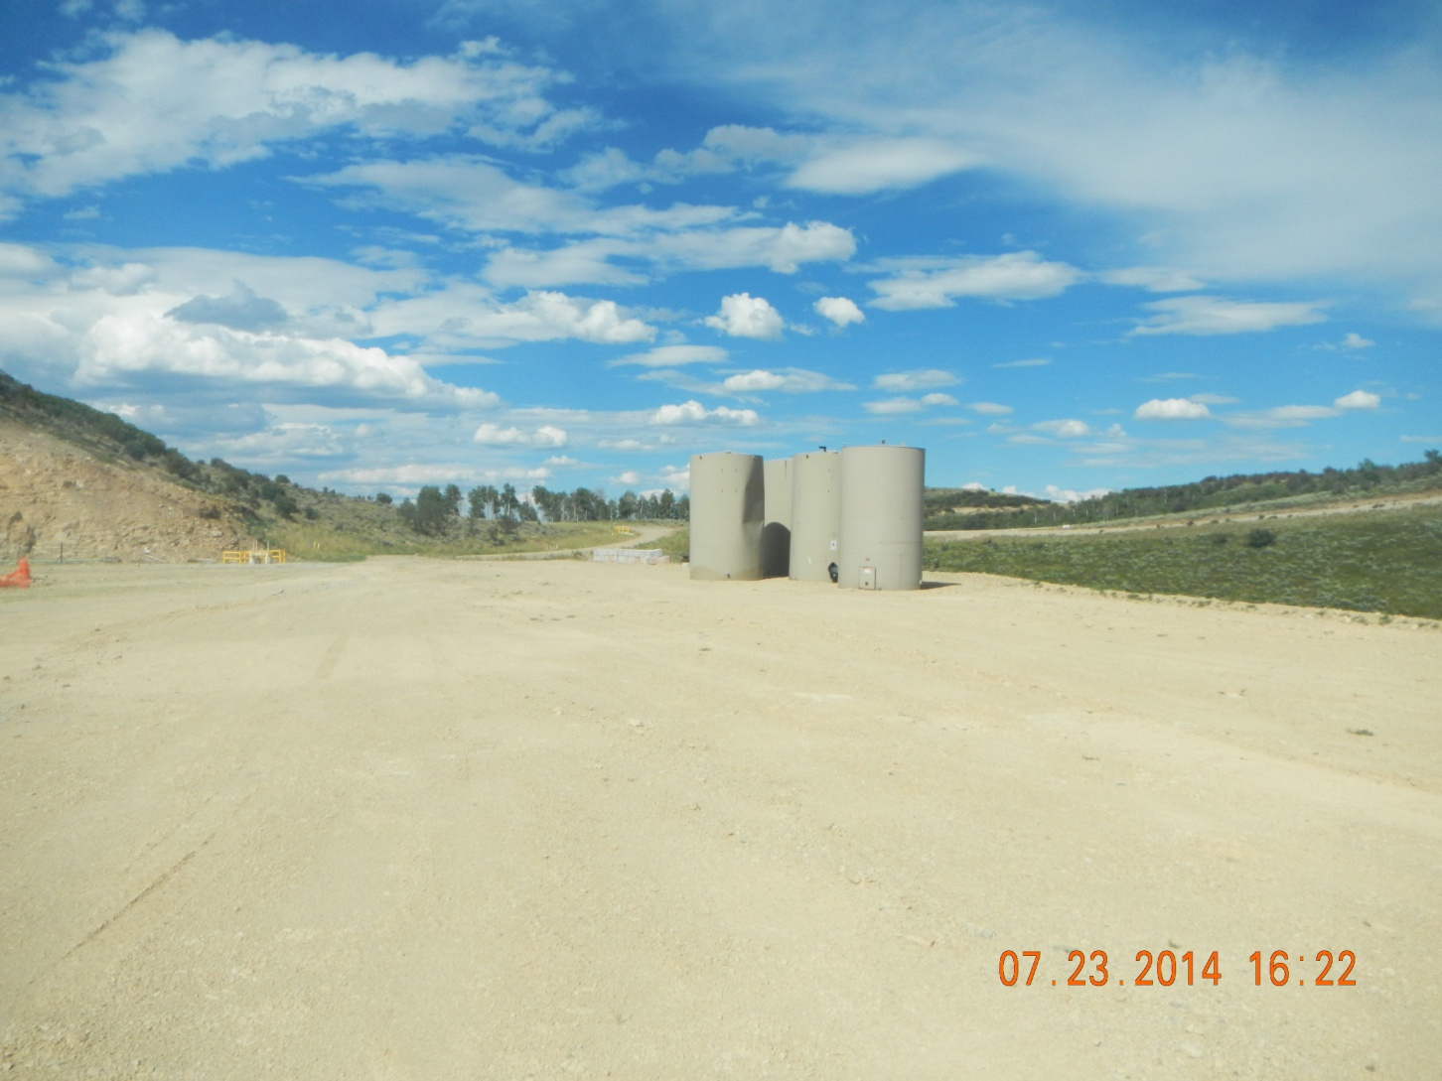
Unused Equipment

Slide 4
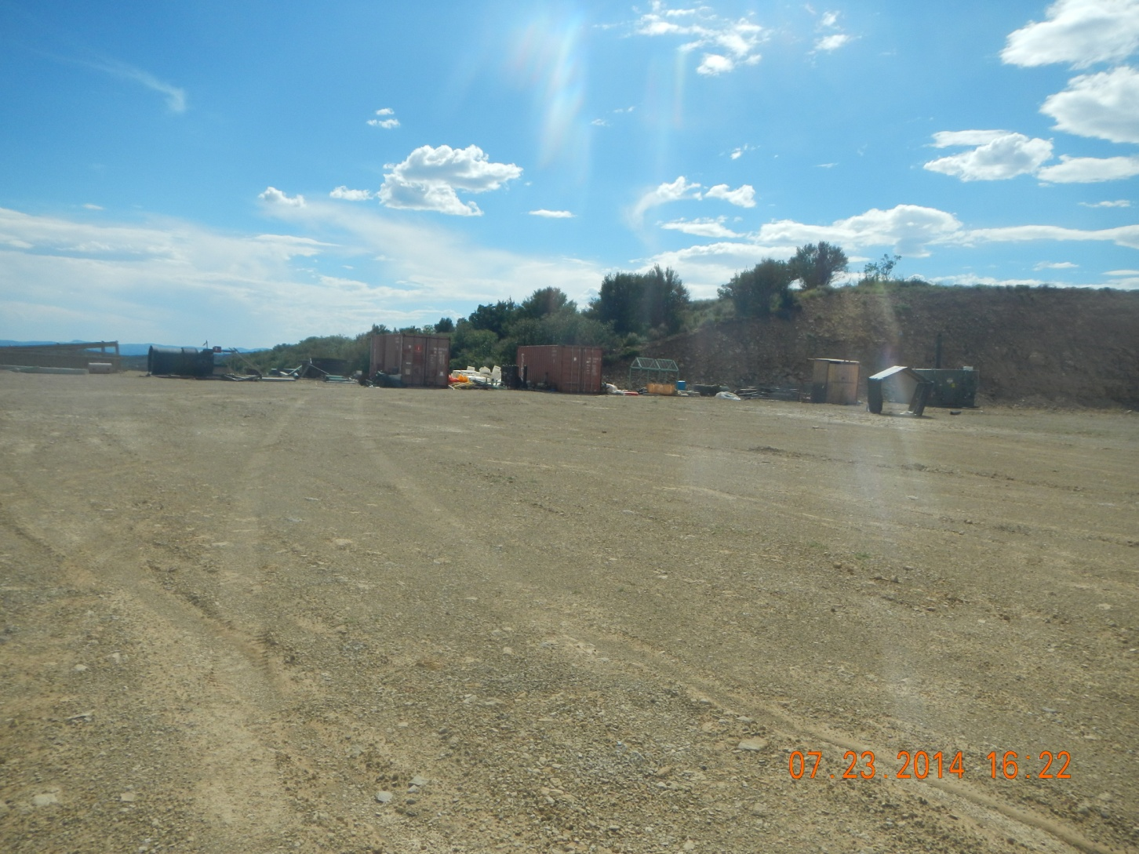
Unused equipment

Slide 5
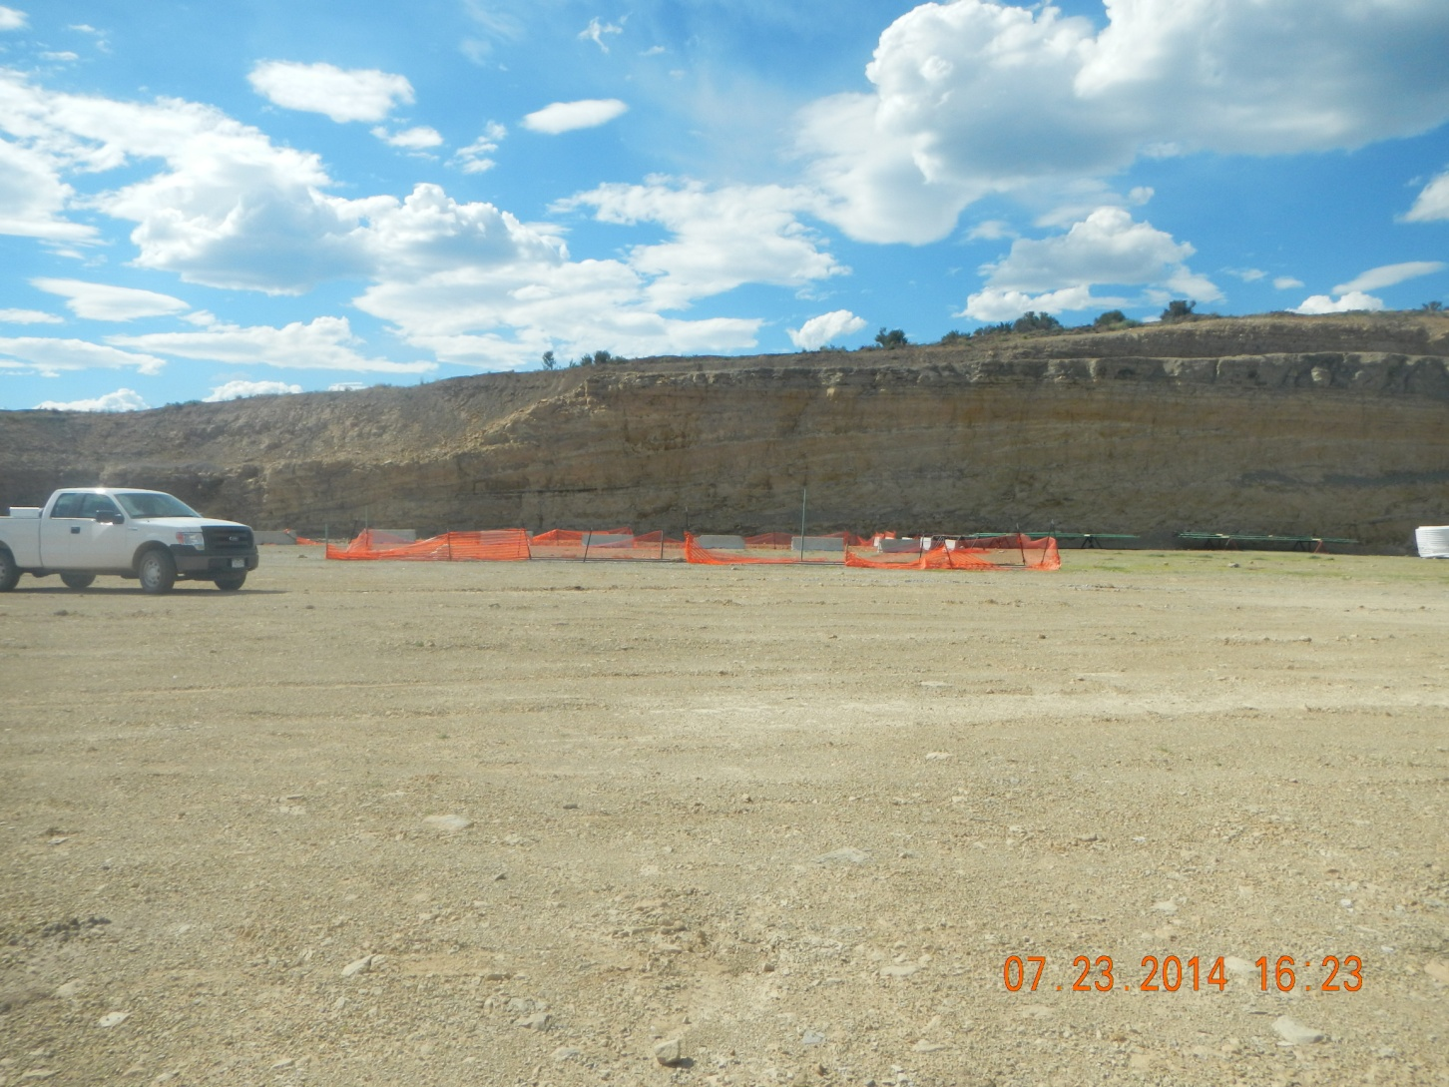
Open cellar and Conductors Open pit Unused equipment

Slide 6
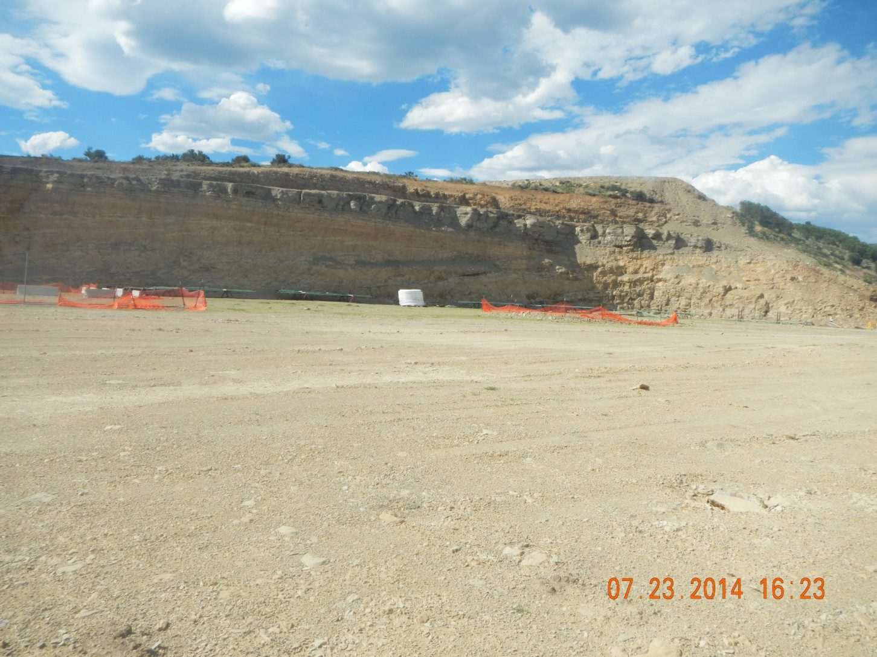
Unused equipment, Open trench, Open Cellar with Conductors

Slide 7
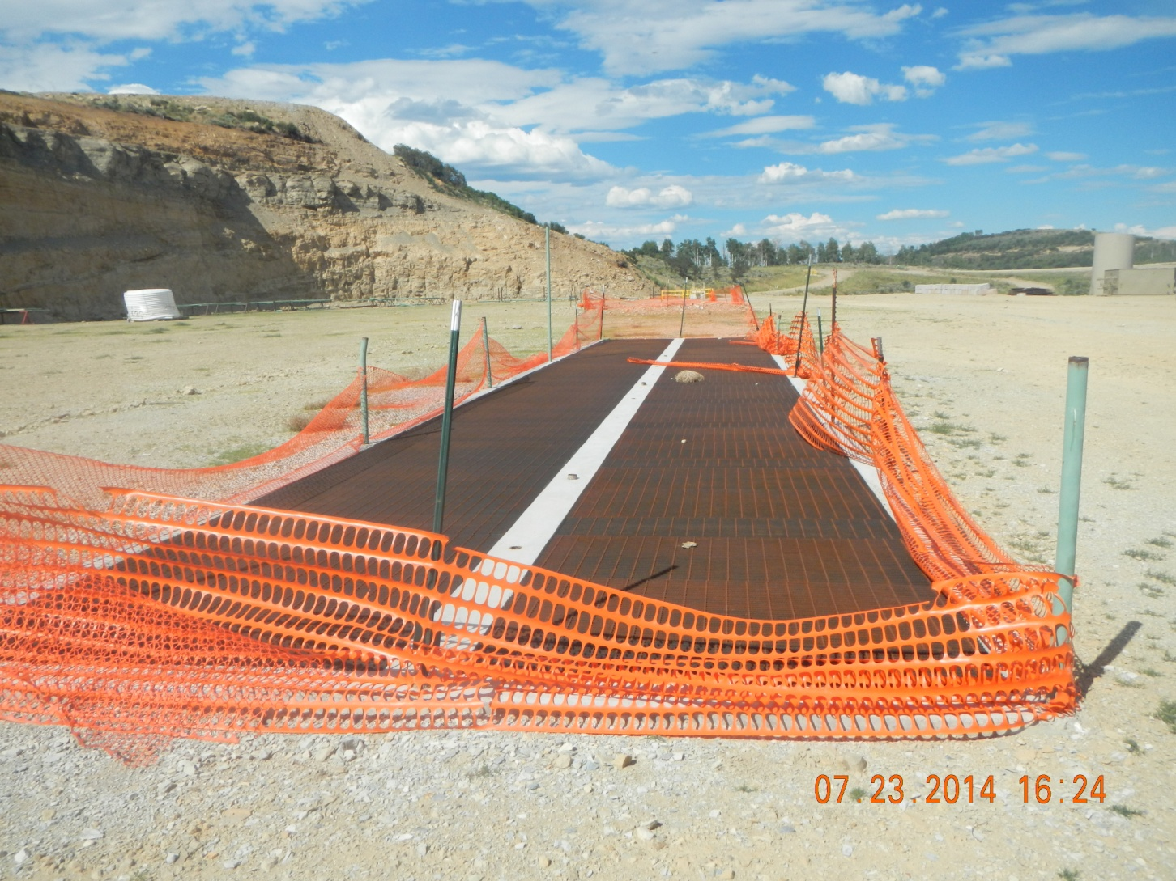
Open Cellar and Conductors with unmaintained fence

Slide 8
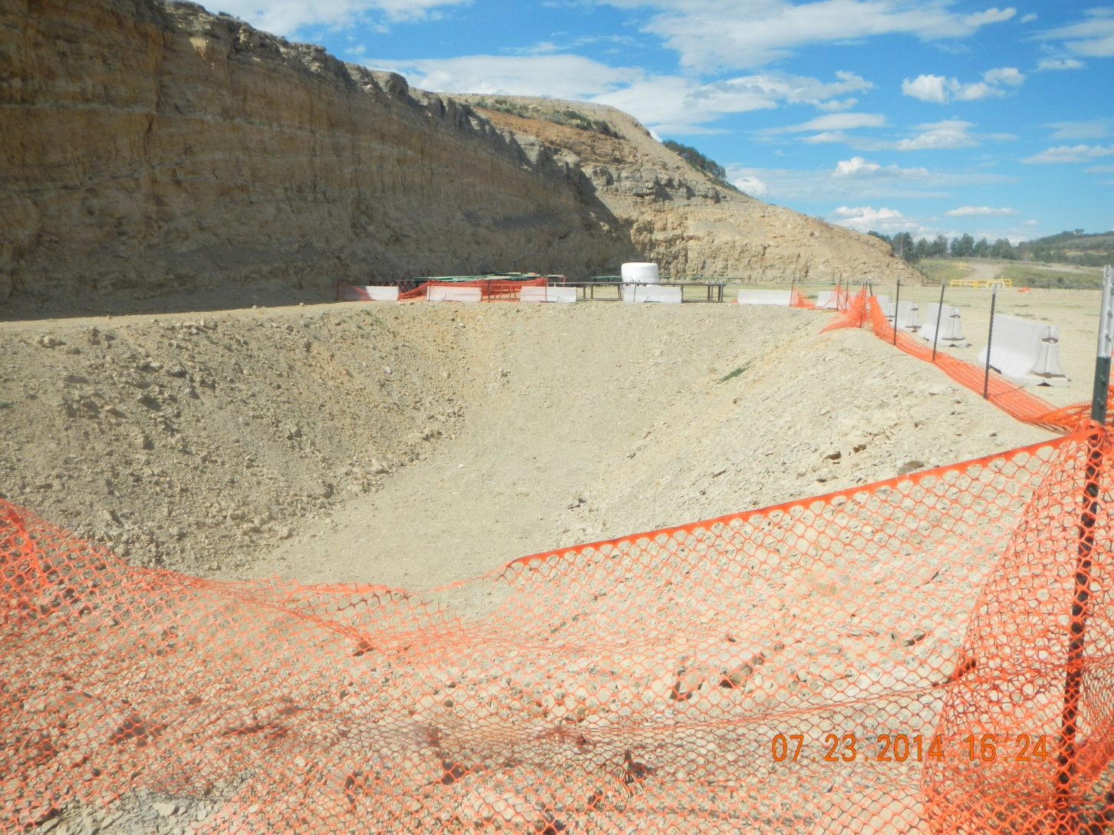
Open Pit with unmaintained fence

Slide 9
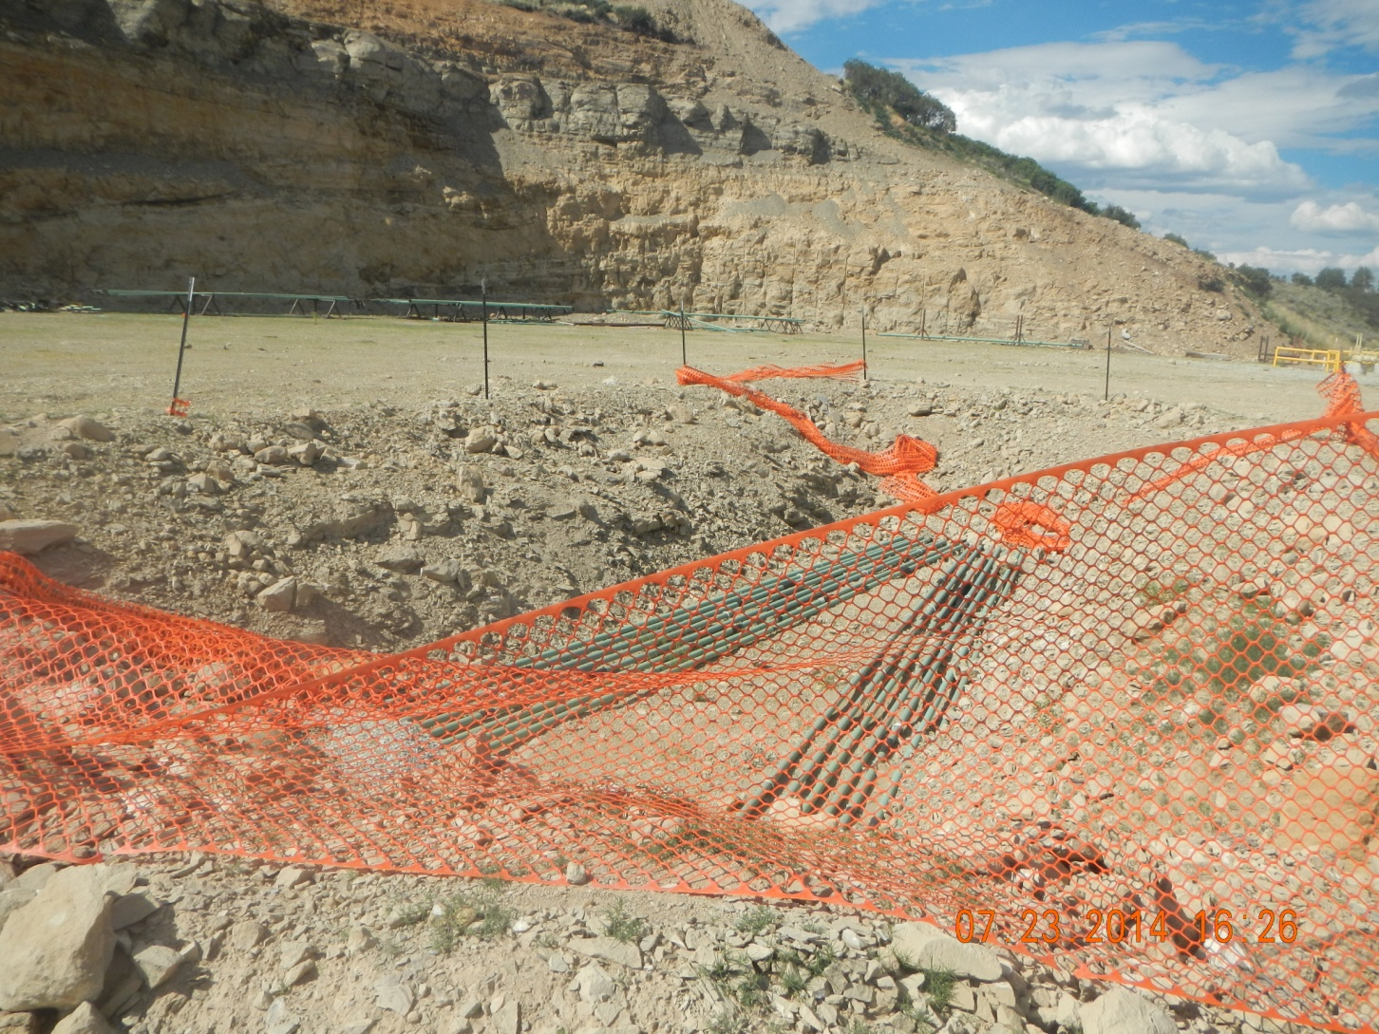
Open trench for Production Lines with unmaintained fence

