Slide 1
Oxy
CASCADE CREEK 617-41

Slide 2
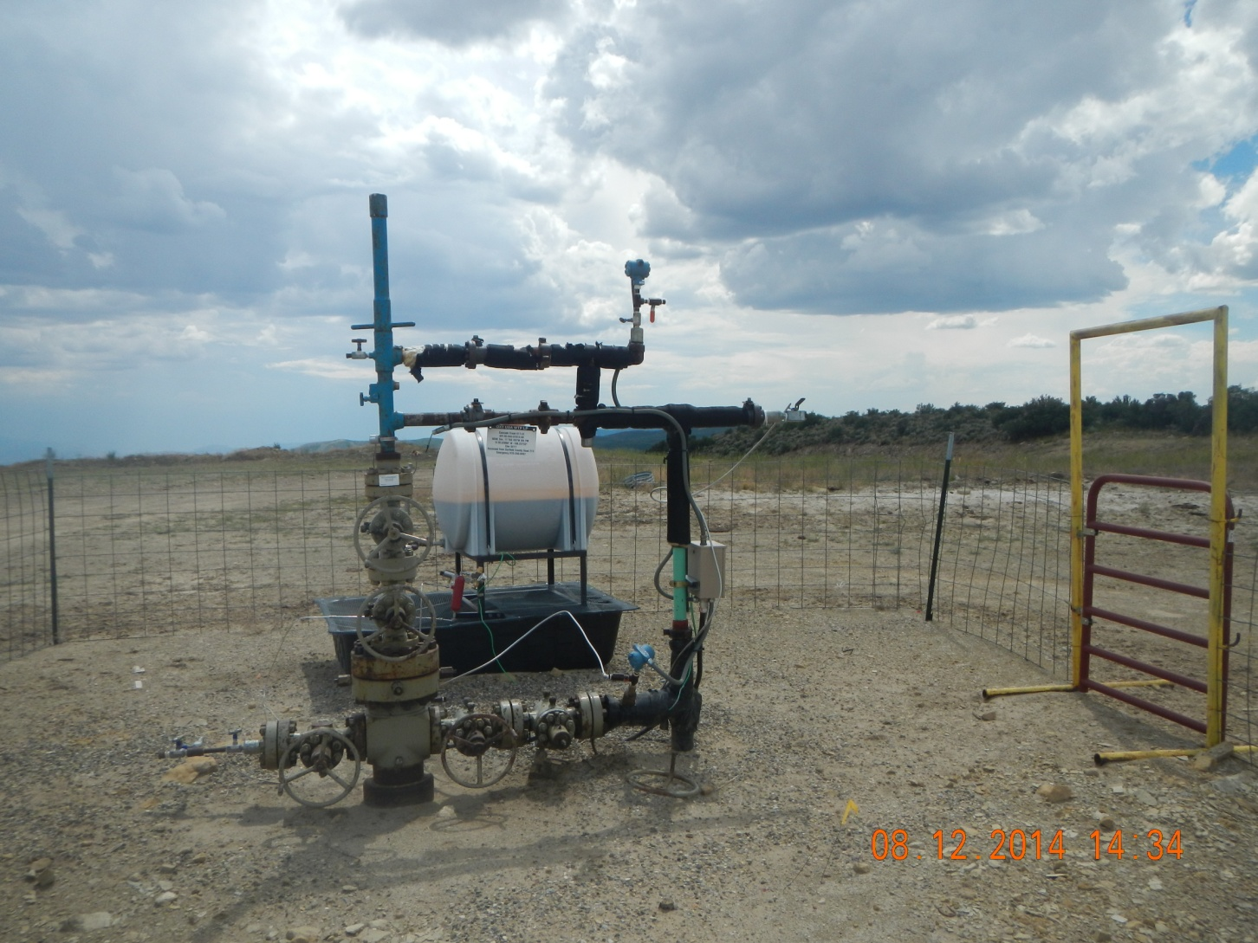

Slide 3
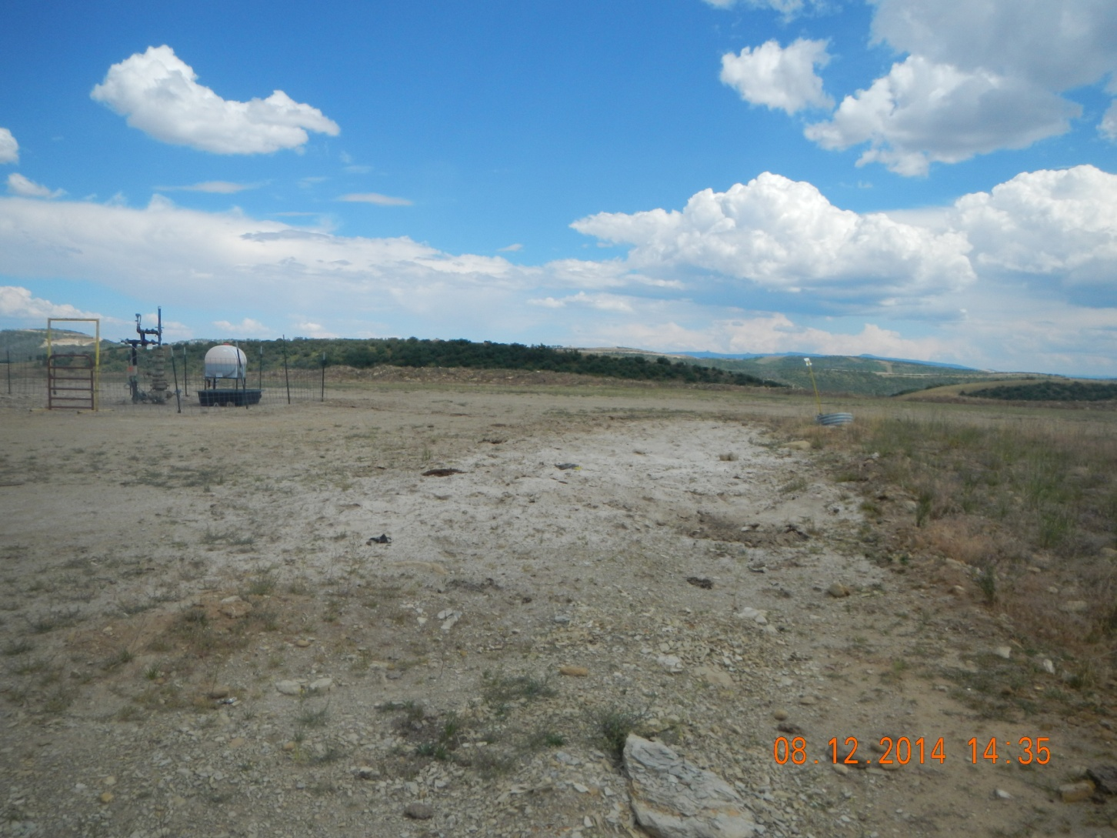

Slide 4
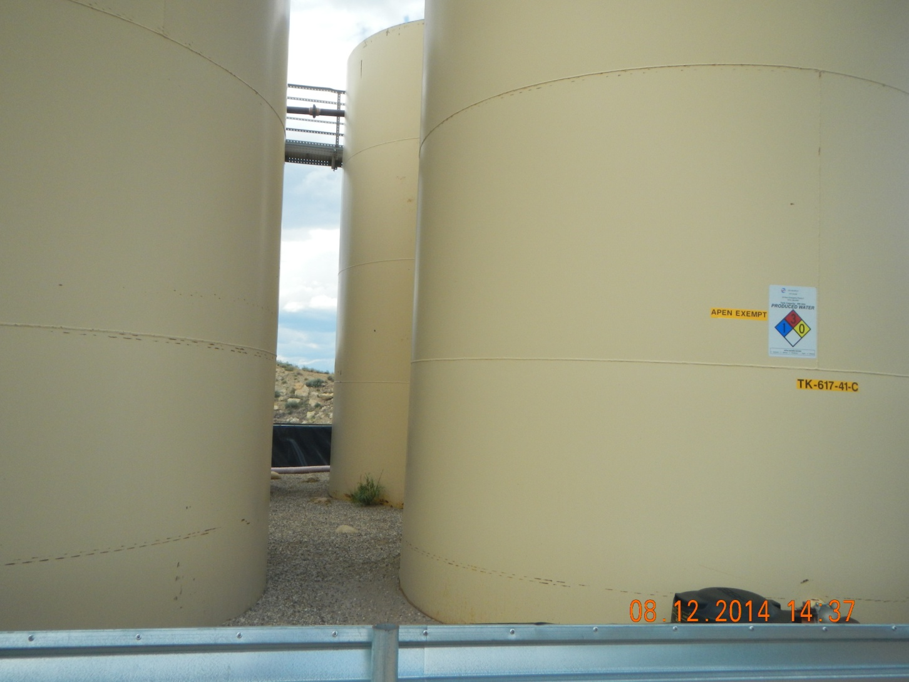
Weeds in berm

Slide 5
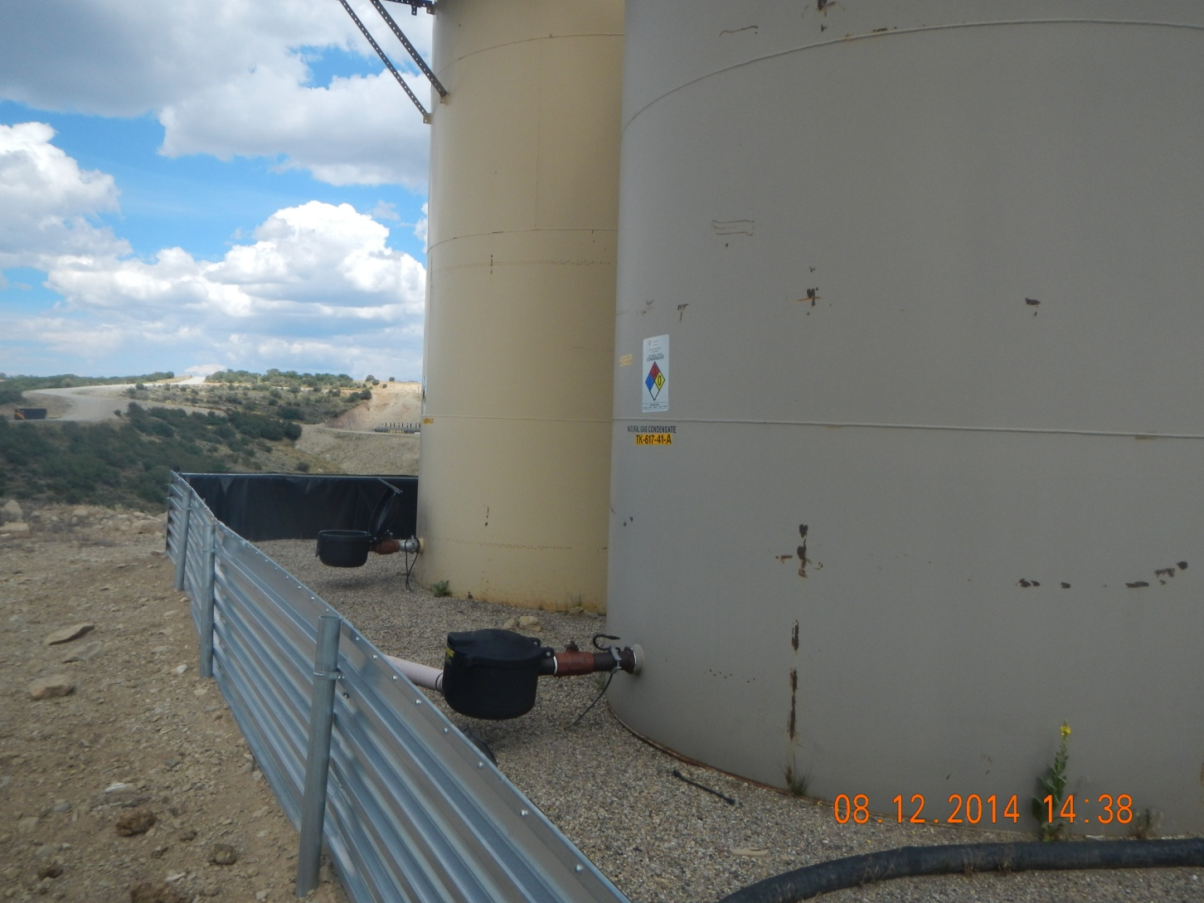
Weeds in berm

