Slide 1
PetroMex
Government 6

Slide 2
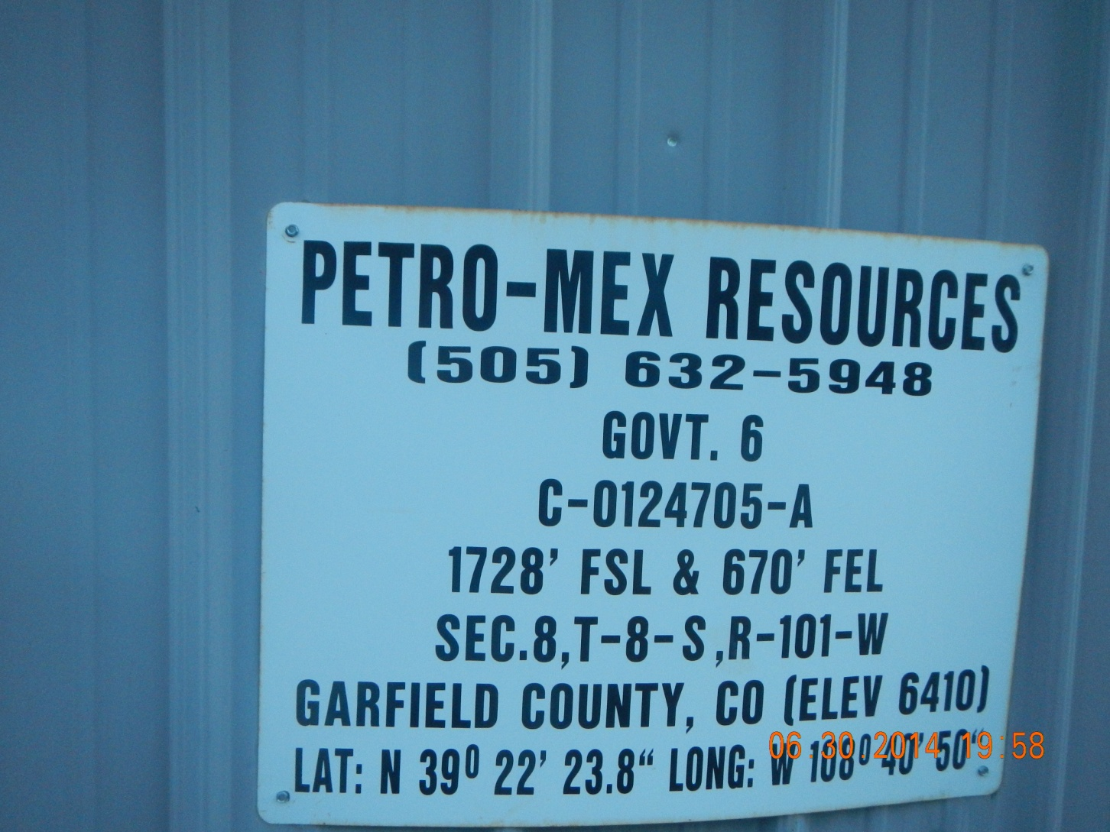

Slide 3
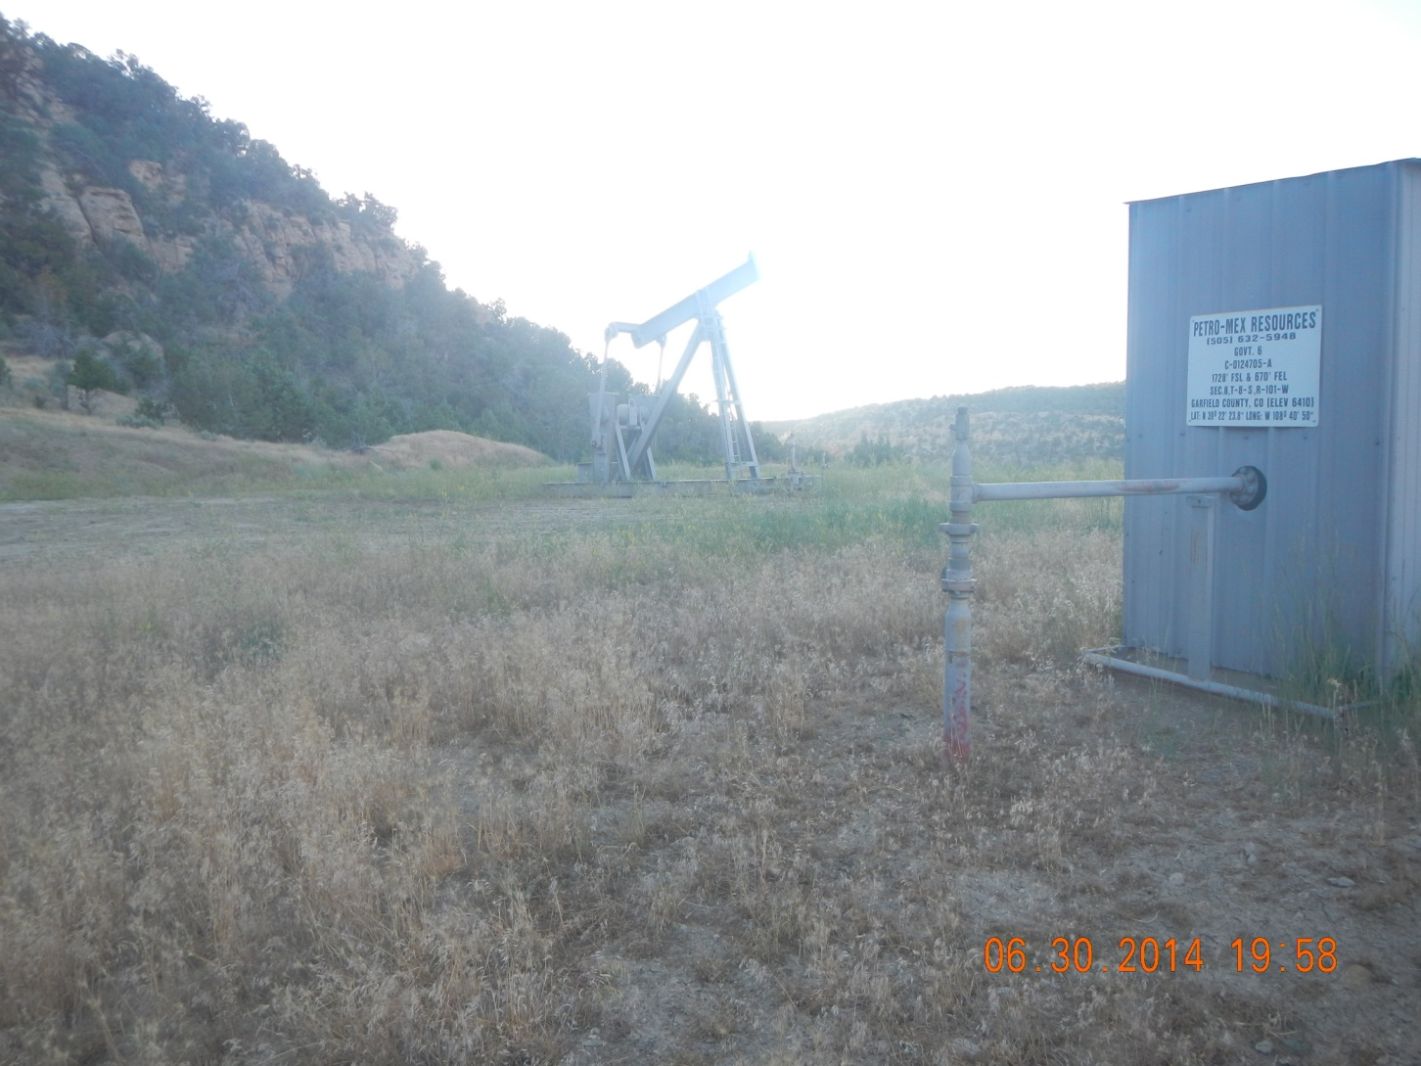

Slide 4
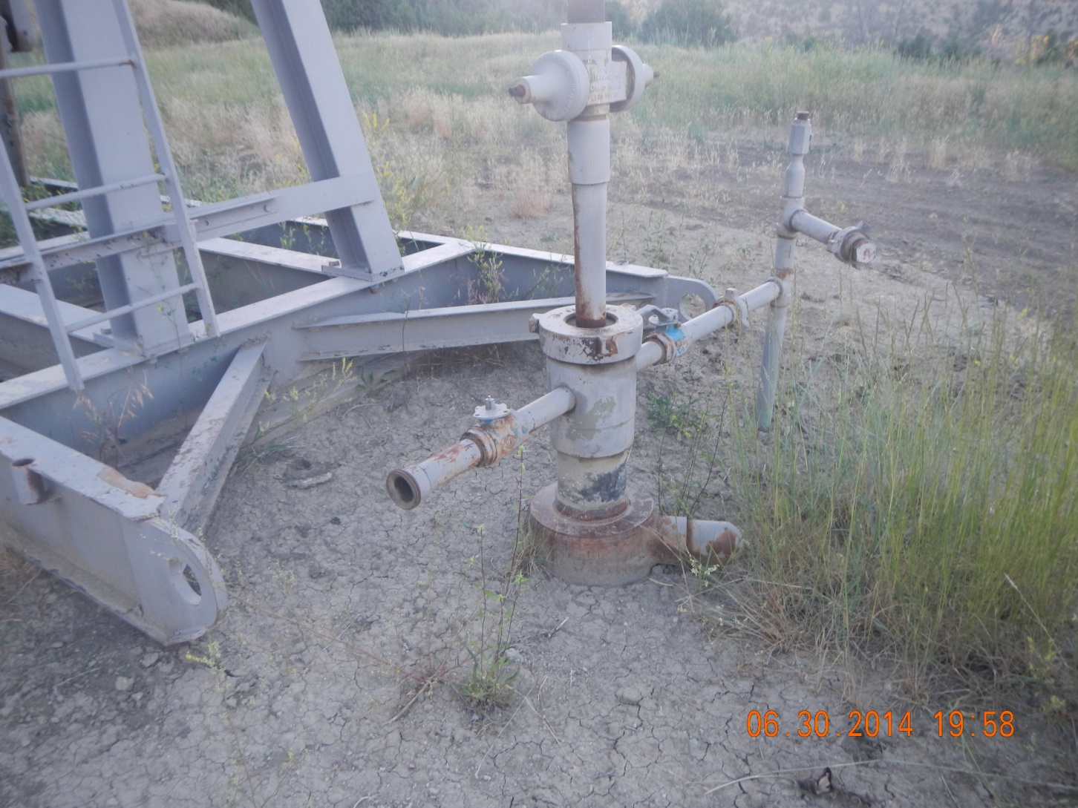

Slide 5


