Slide 1
Petro Mex
Coal Gulch #2
05-077-08012

Slide 2
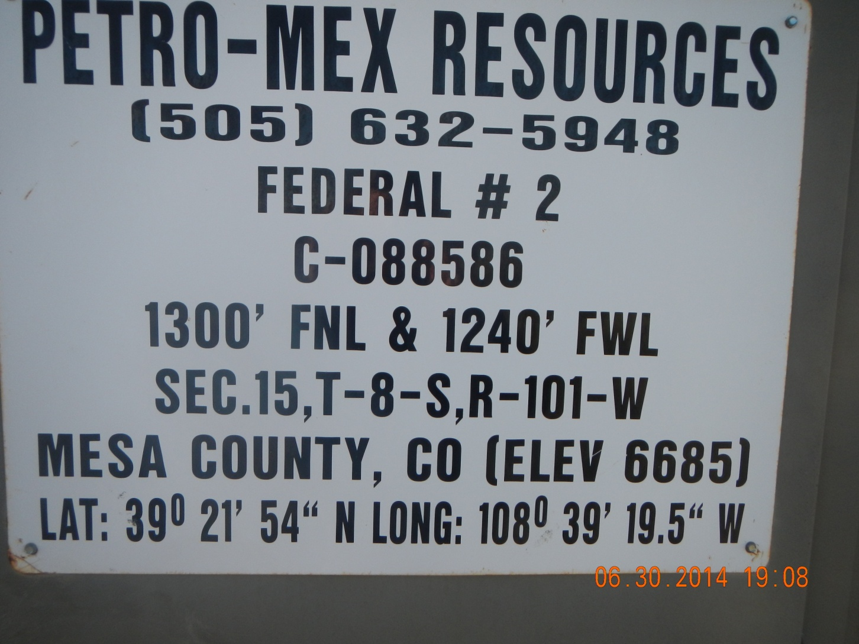

Slide 3
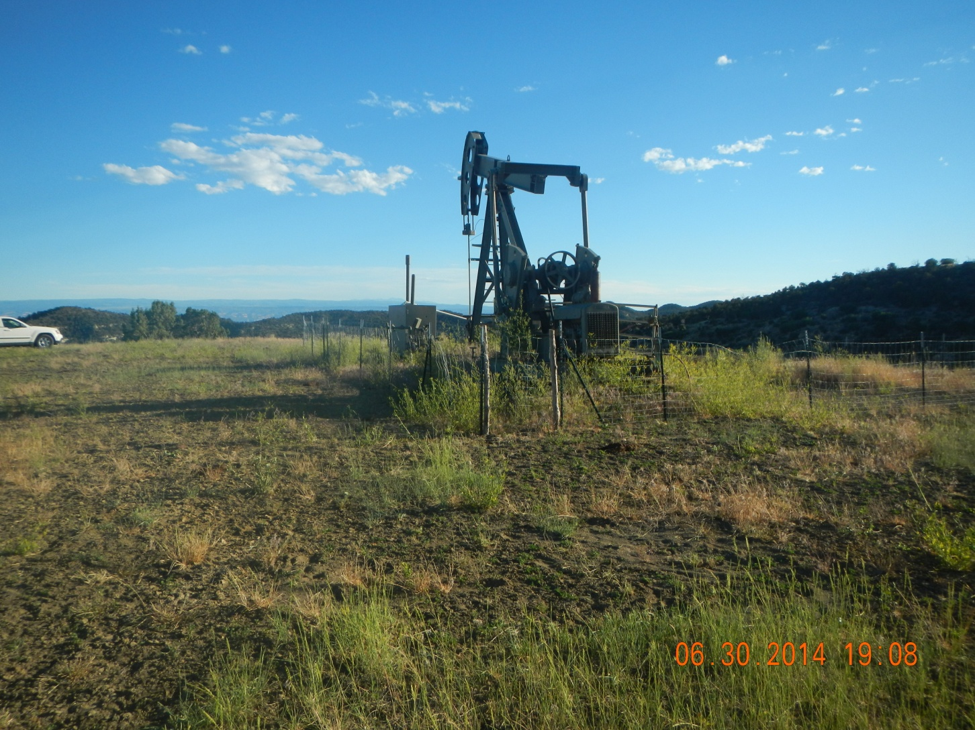
Pump jack, separator and tank berm covered with weeds

Slide 4
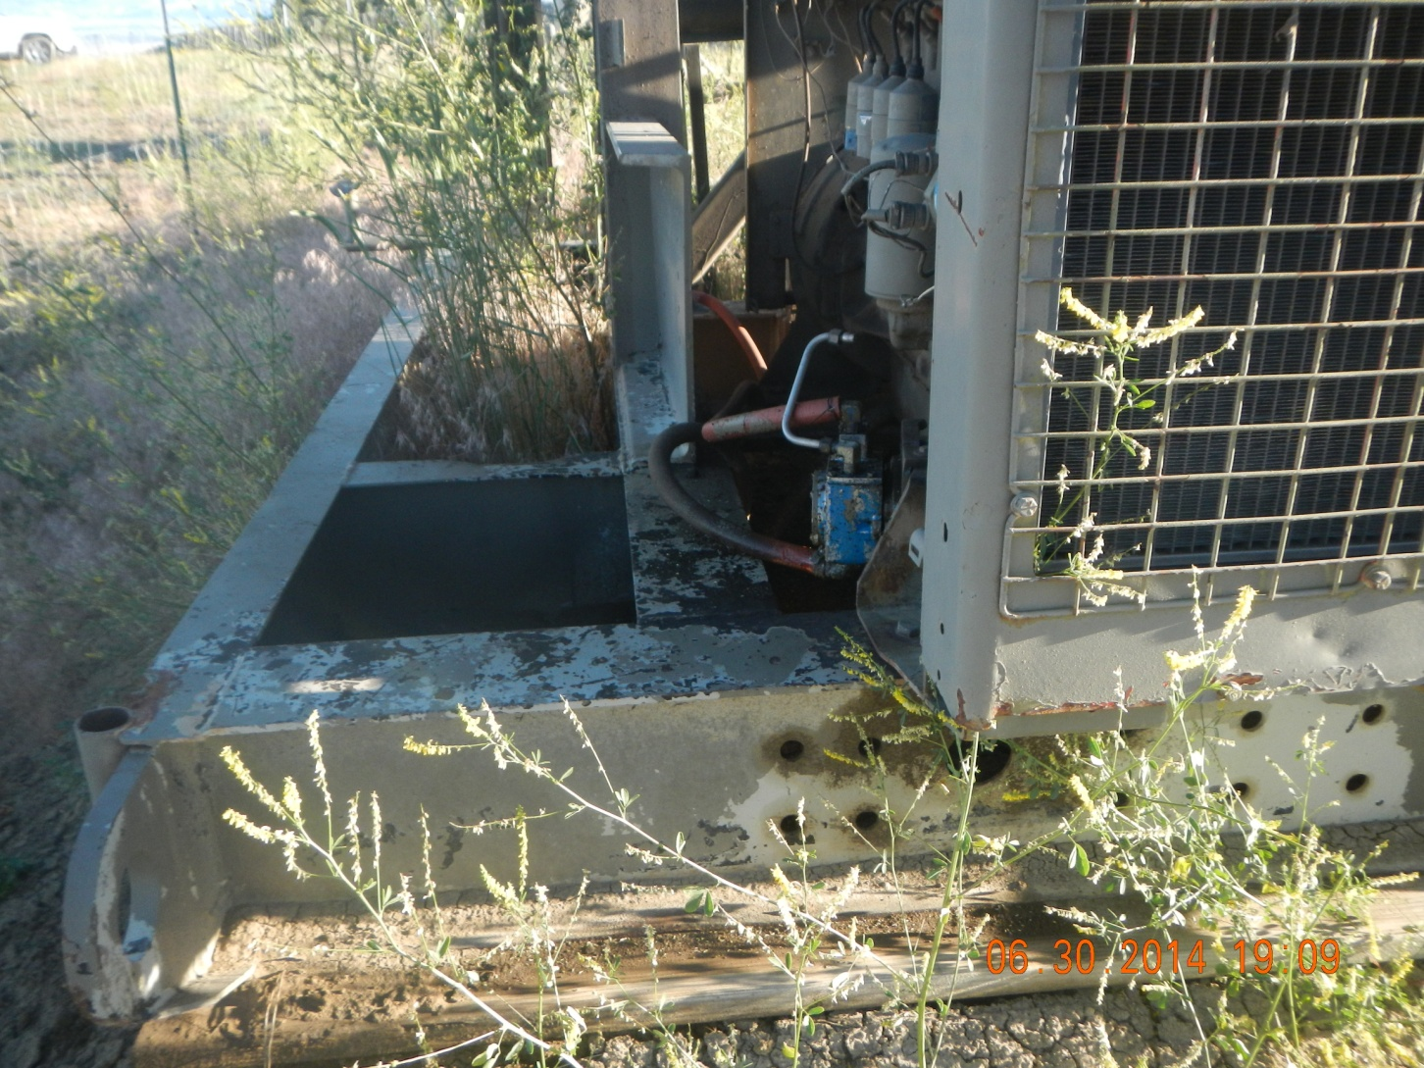
Oil Stain under Pump Jack Engine

Slide 5
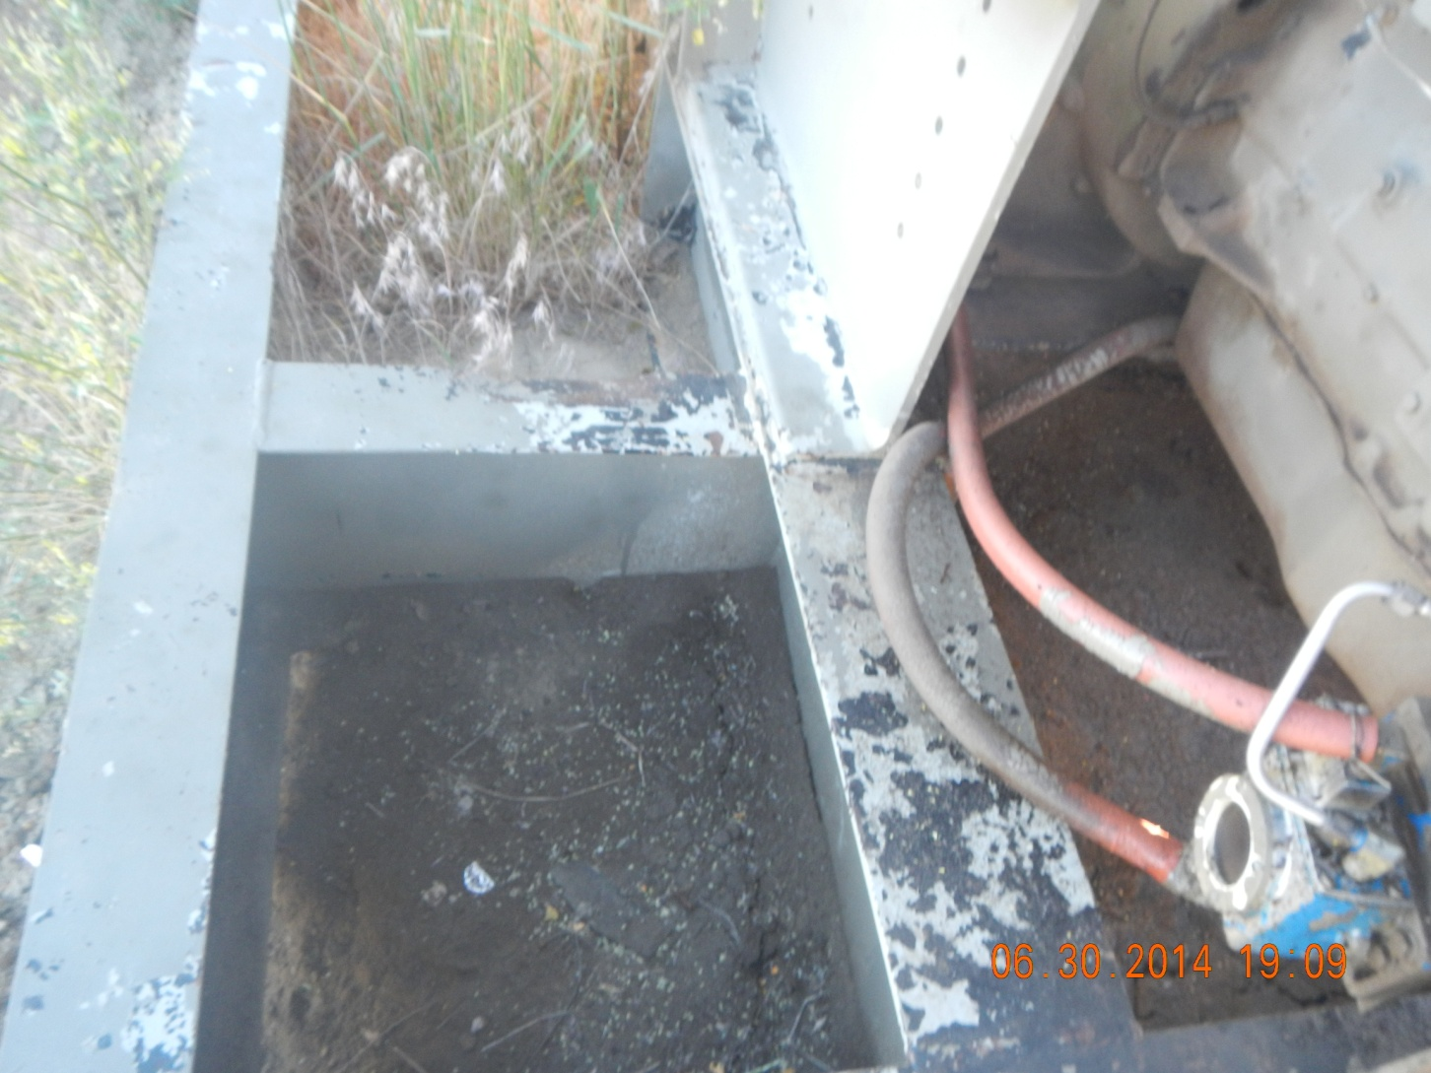
Oil Stain under Pump Jack Engine

Slide 6
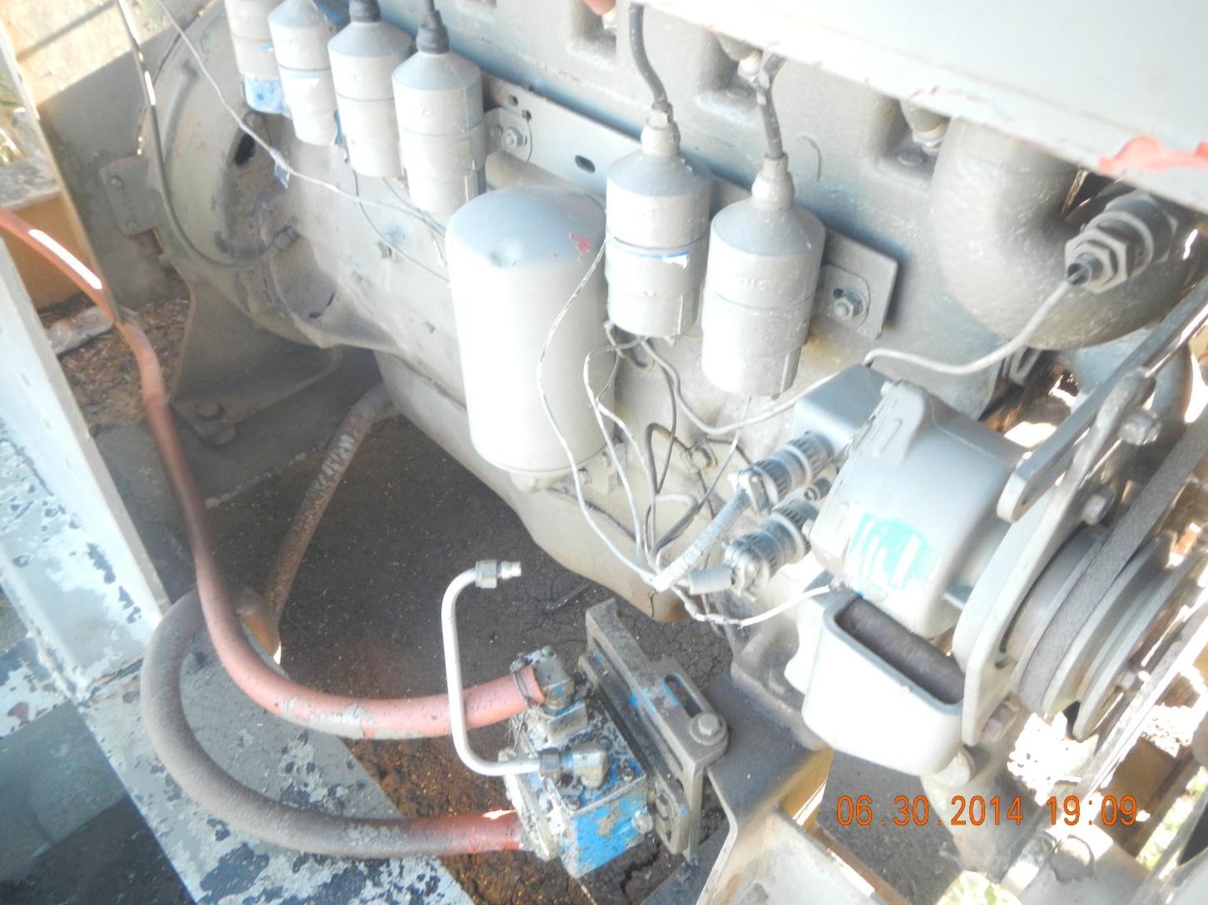
Oil Stain under Pump Jack Engine

Slide 7
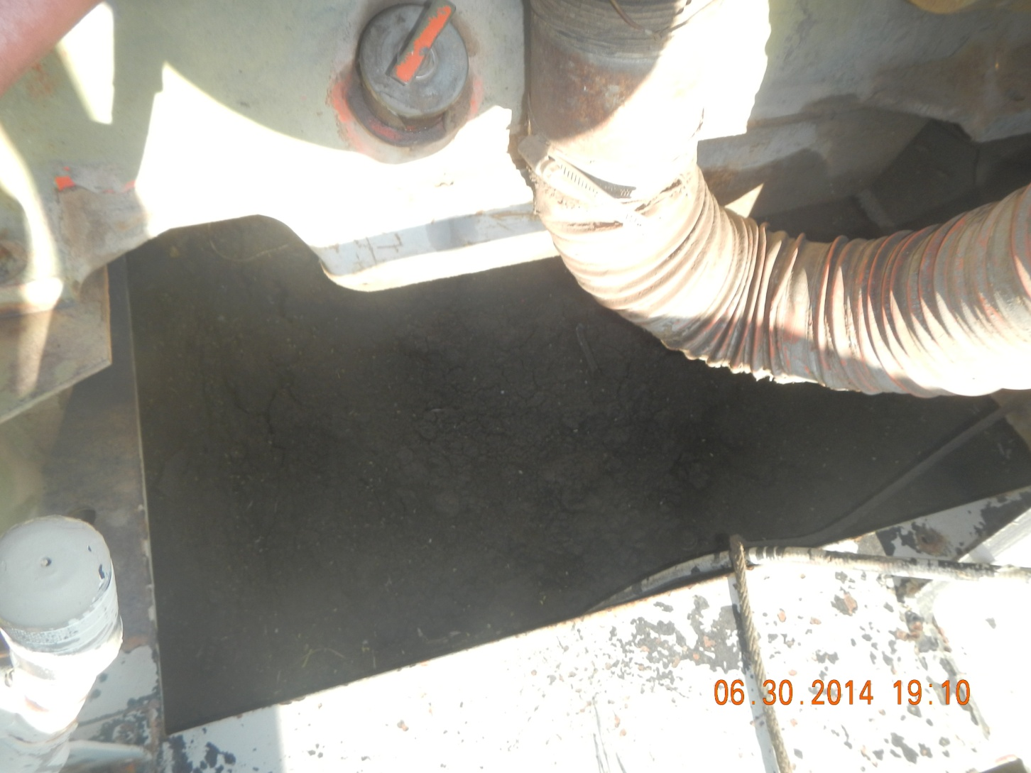
Oil Stain under Pump Jack Engine

Slide 8
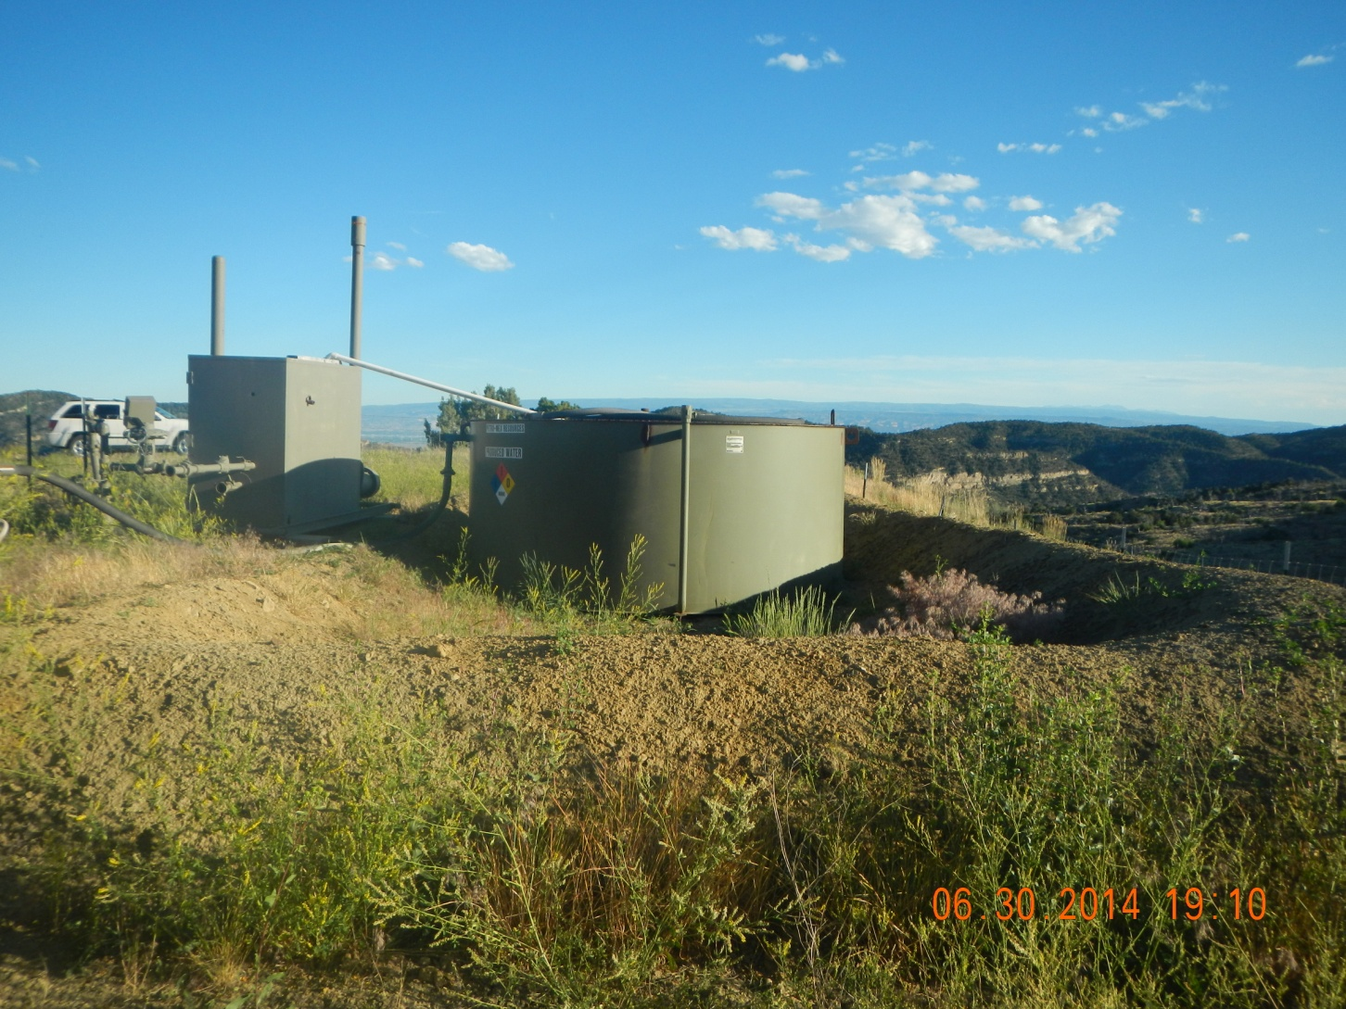
Poor Compaction and Weeds

Slide 9
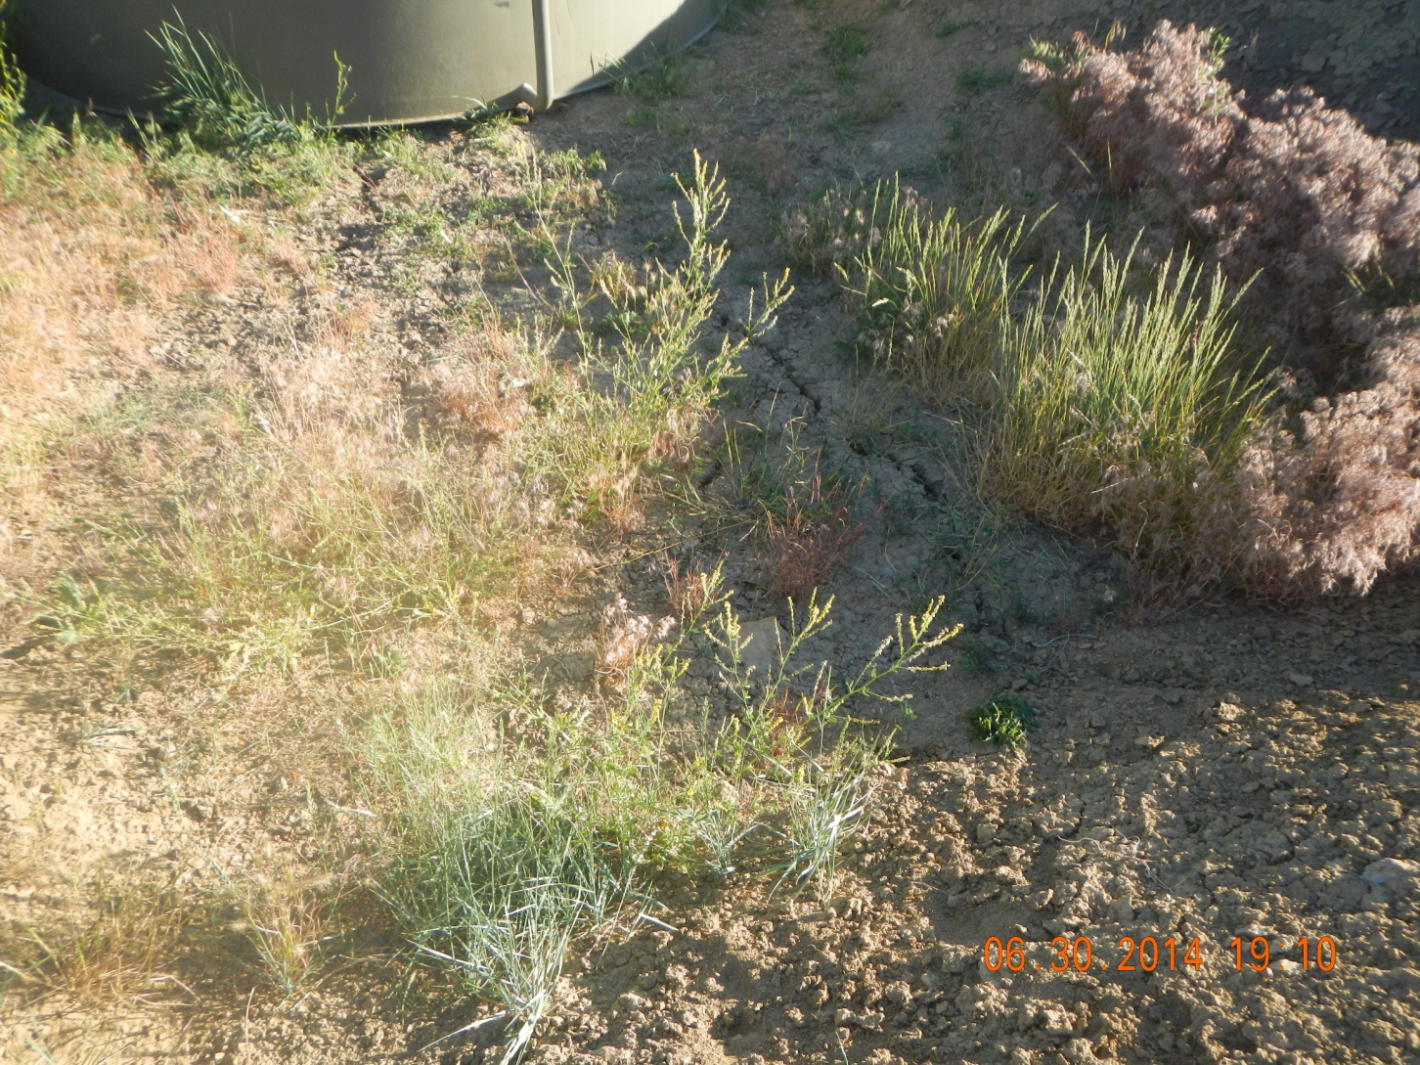
Poor Compaction and Weeds

Slide 10
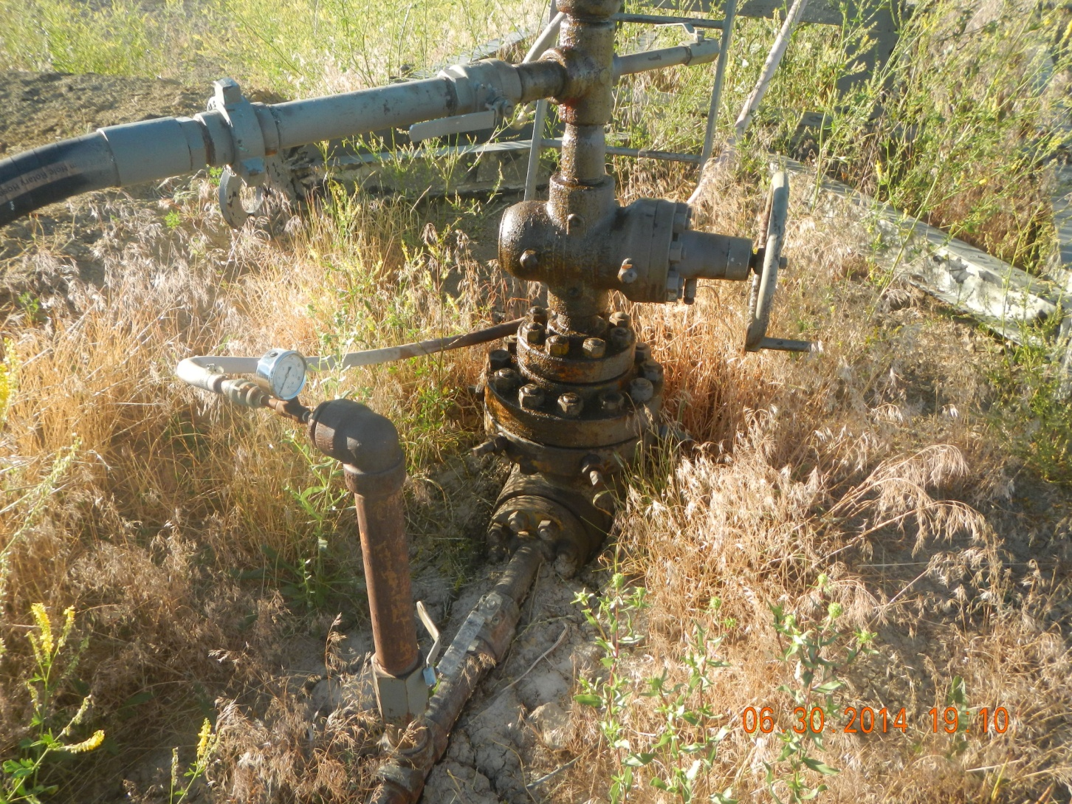
Oil Stained well head

Slide 11
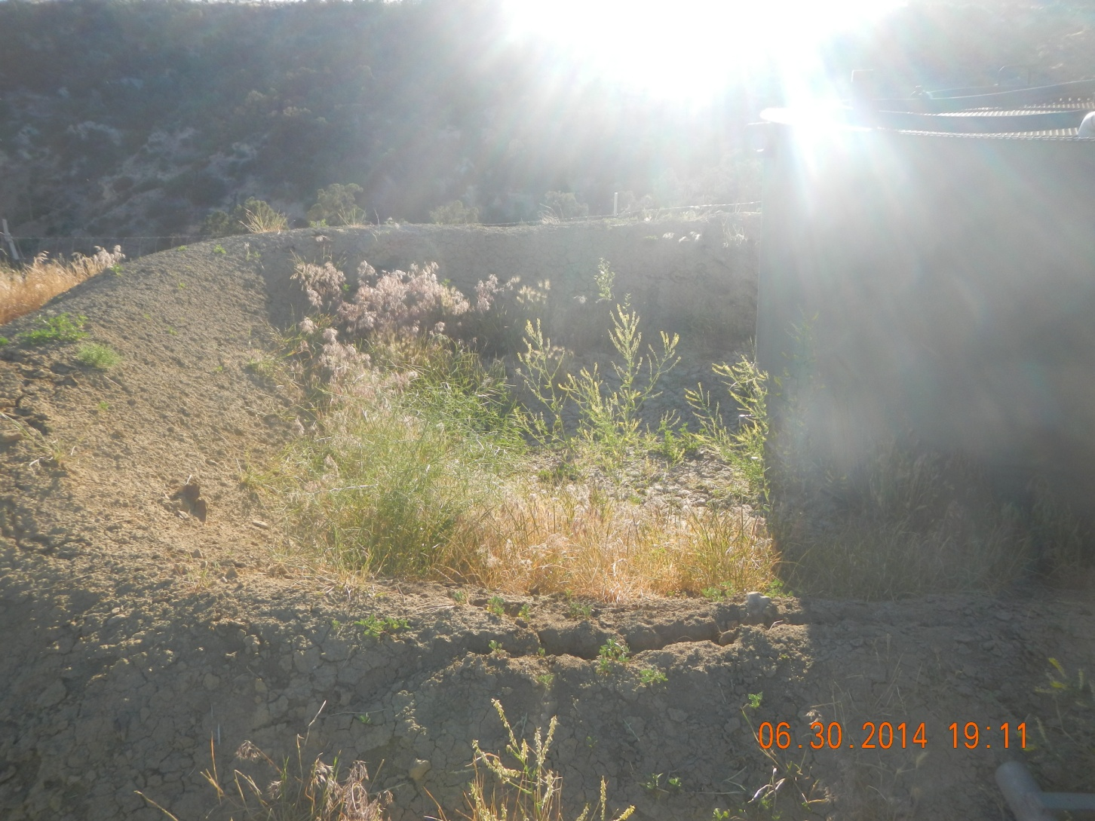
Poor Compaction and Weeds

Slide 12
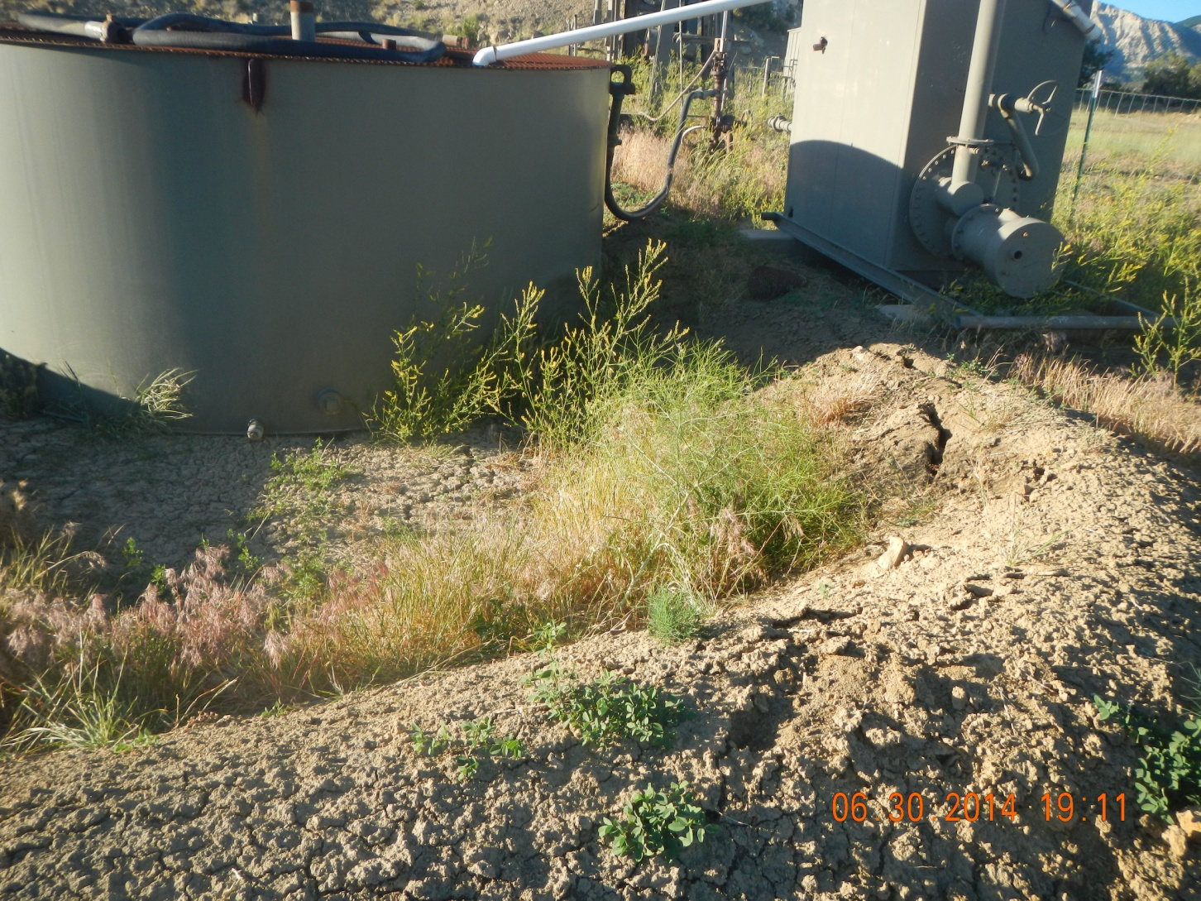
Poor Compaction and Weeds

Slide 13
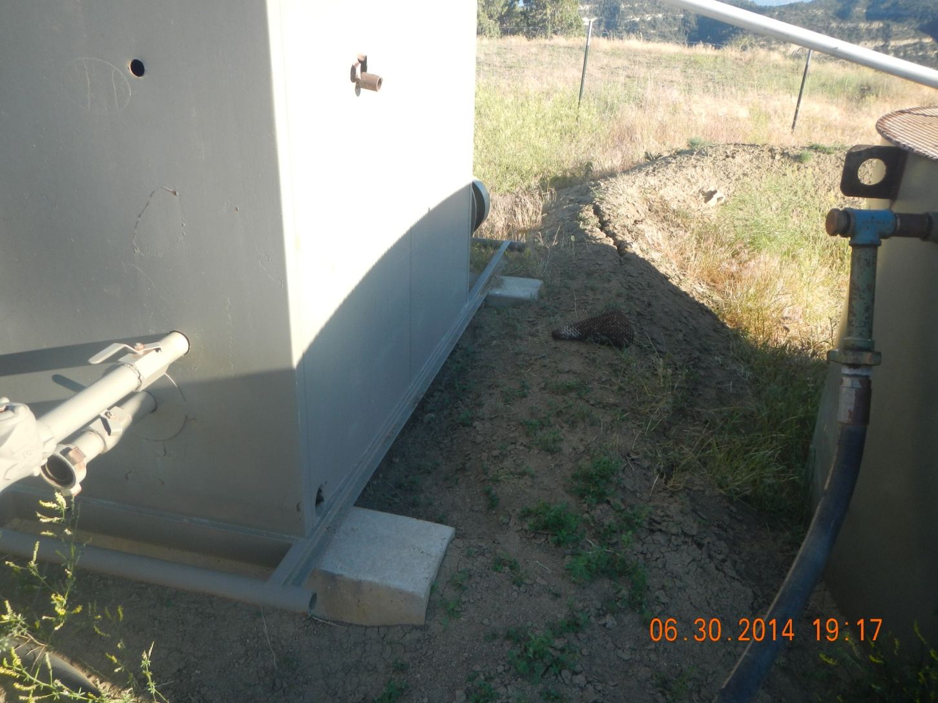
Bird Cone off of separator

