Slide 1
Petro-Mex Resources
Federal 1-15-8-101
Api# 05-077-08830

Slide 2
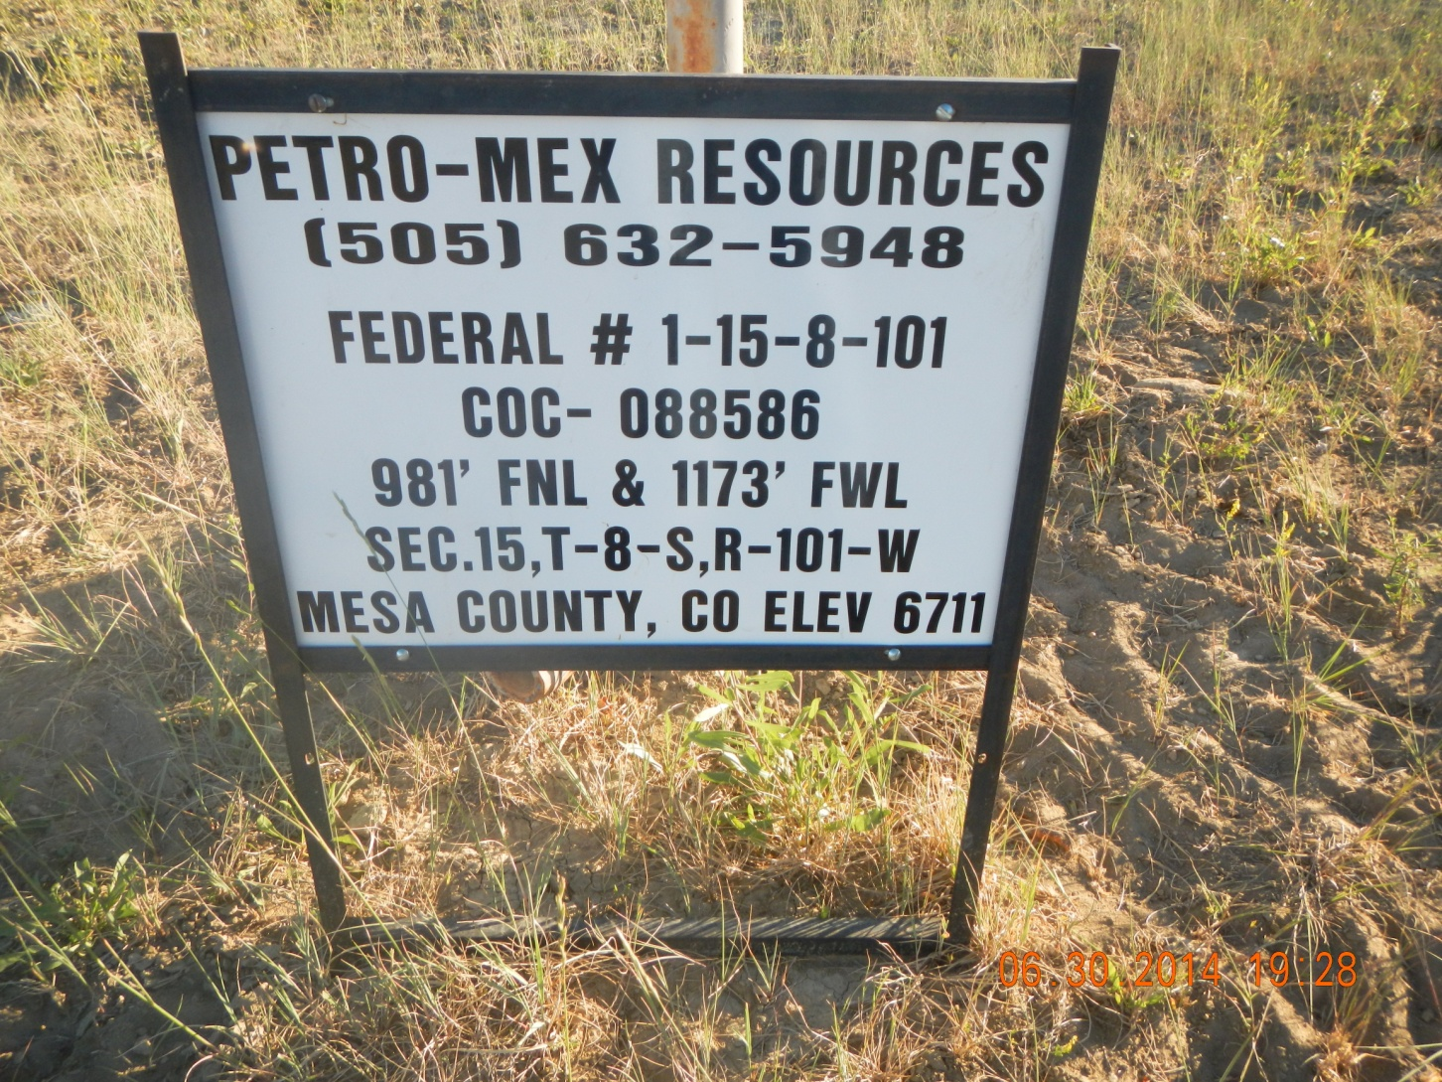

Slide 3
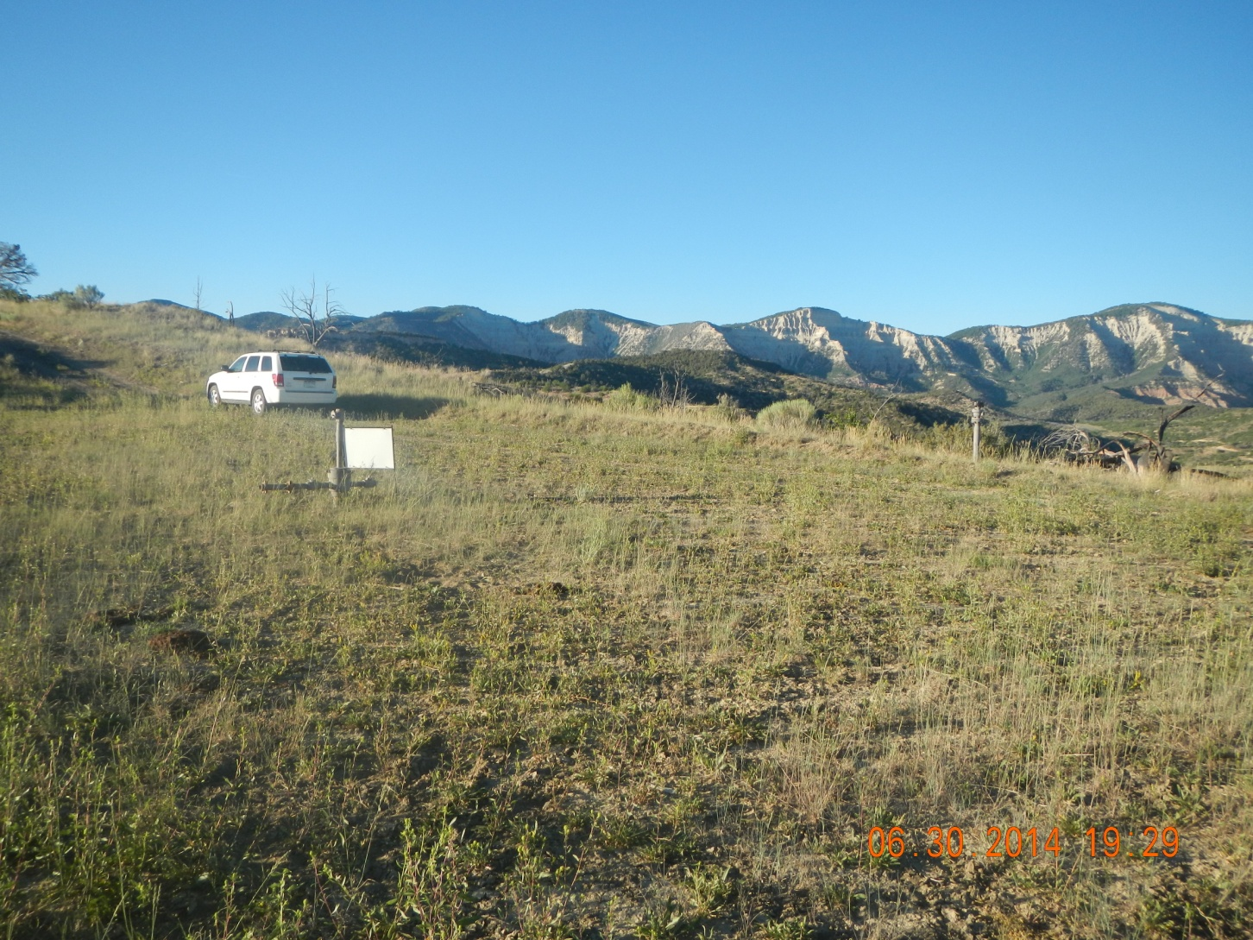

Slide 4
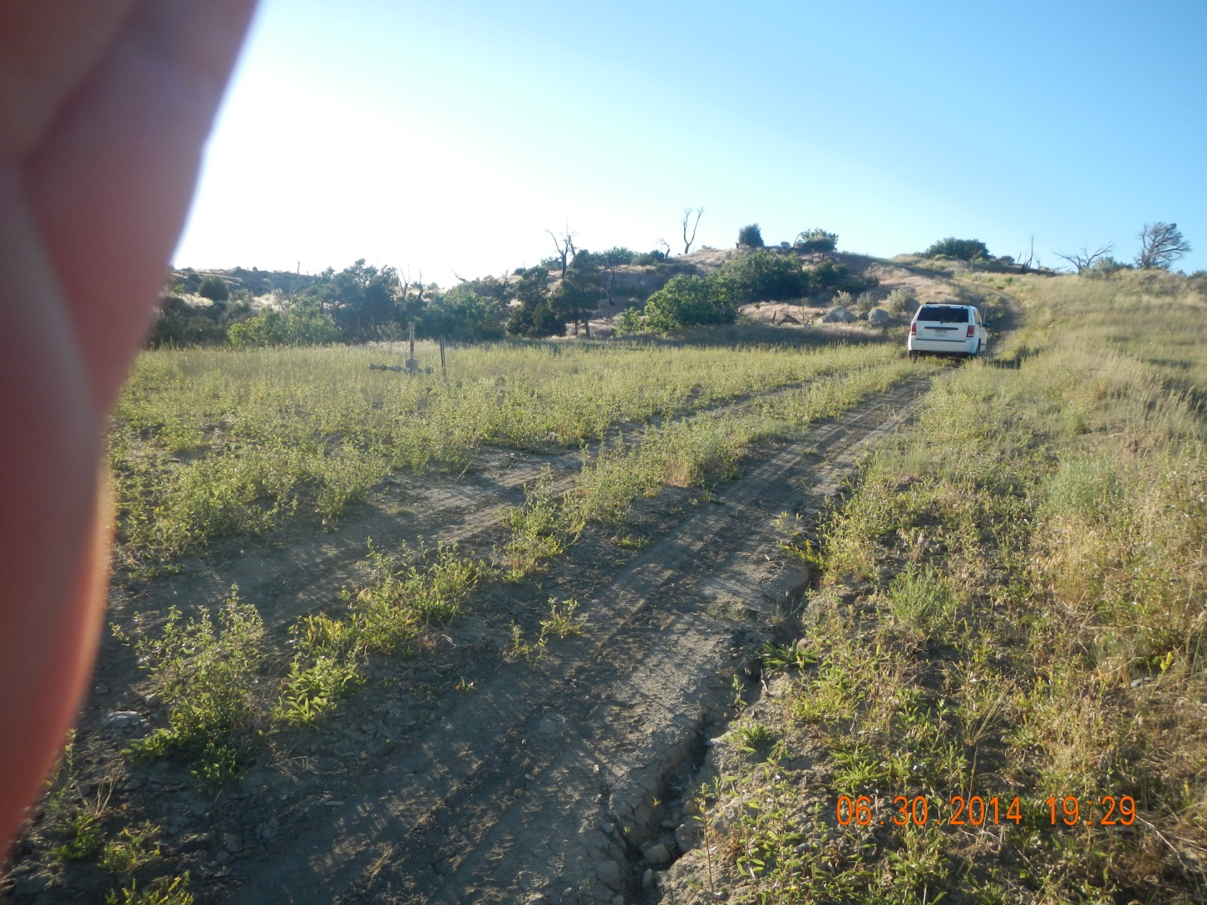

Slide 5


