Slide 1
Caerus
Puckett 14-6D
Loc Id 334977

Slide 2
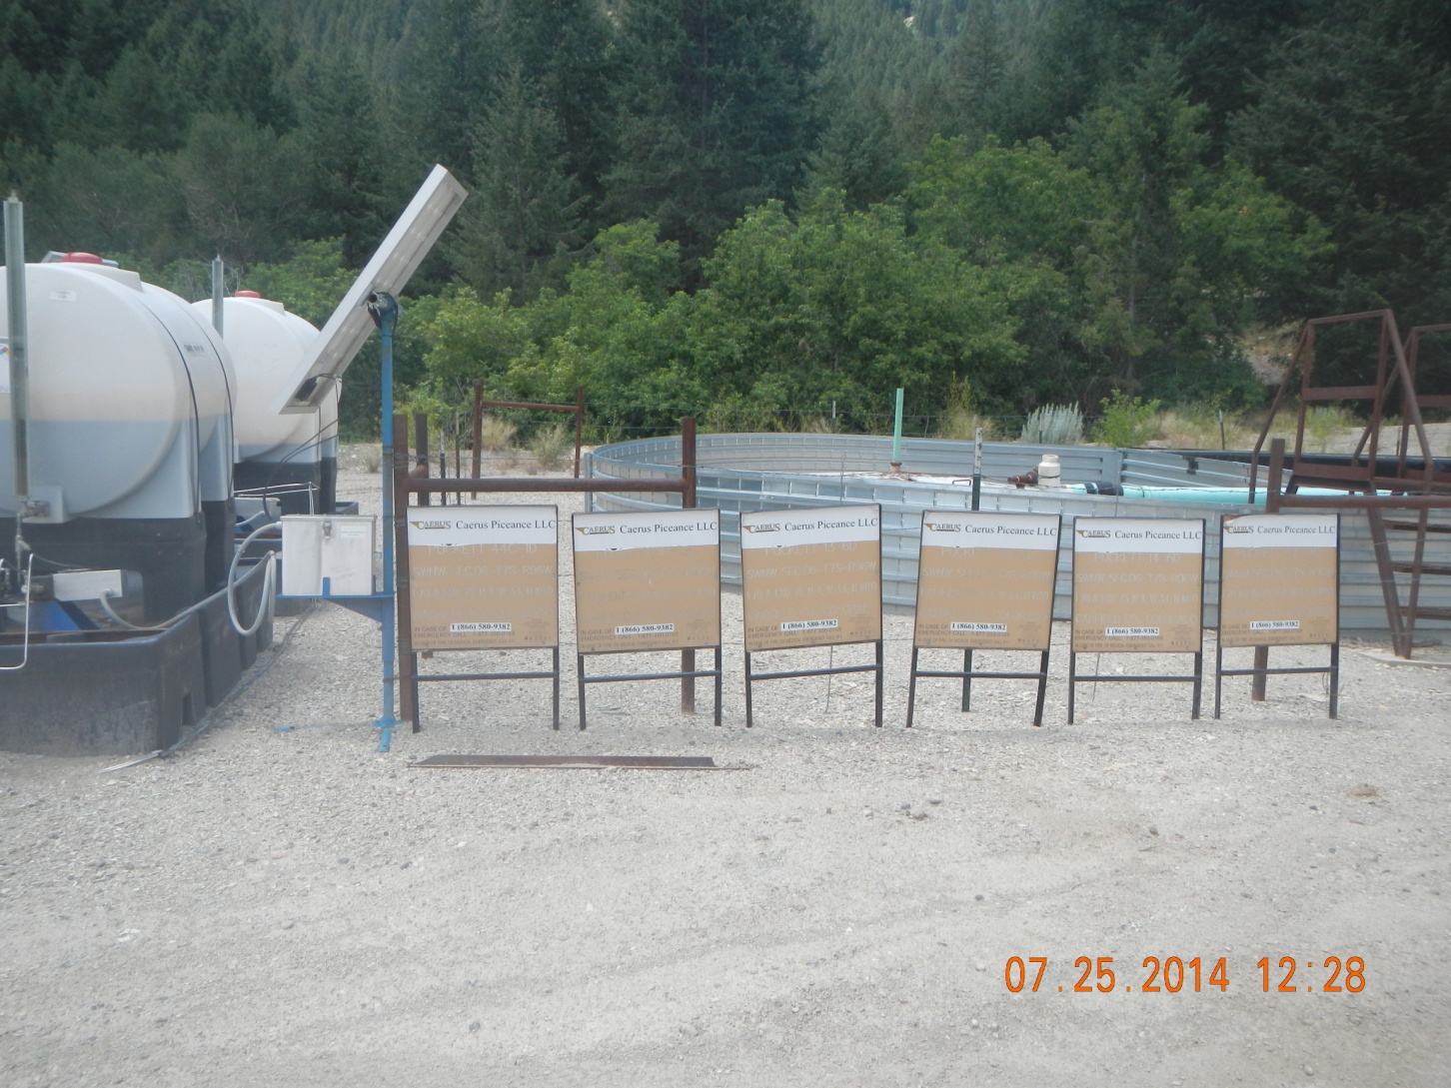
Battery signs

Slide 3
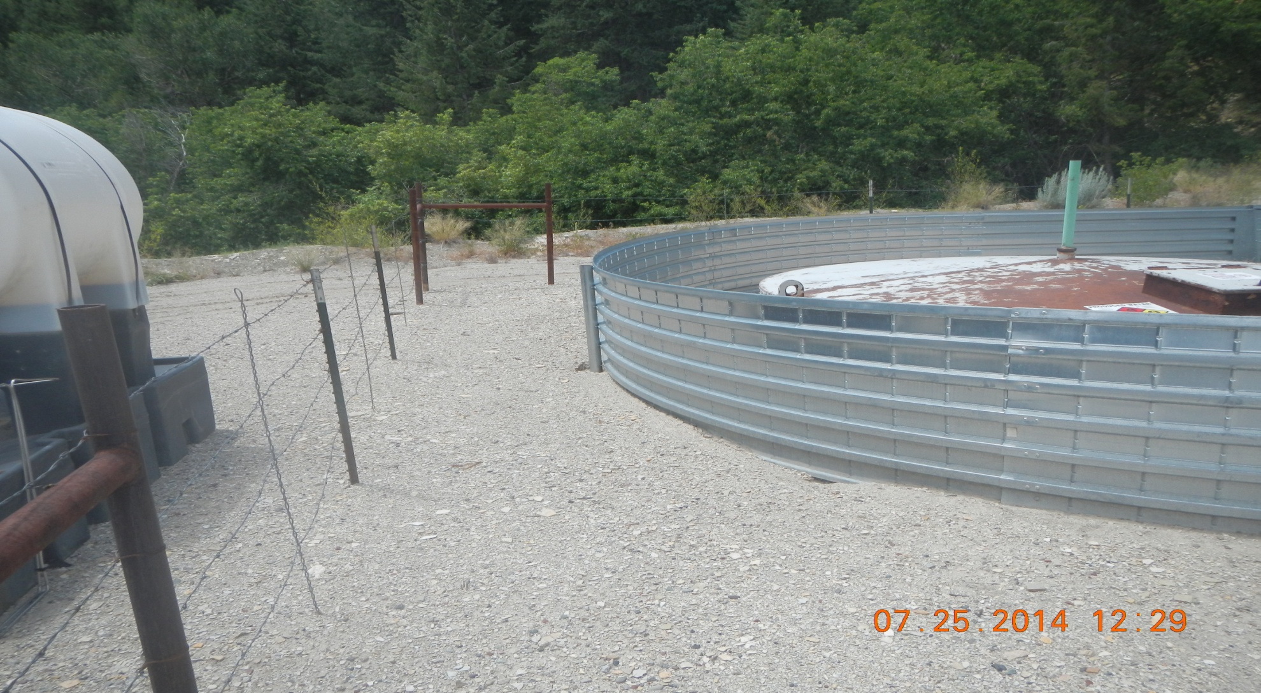
Burrow under berm

Slide 4
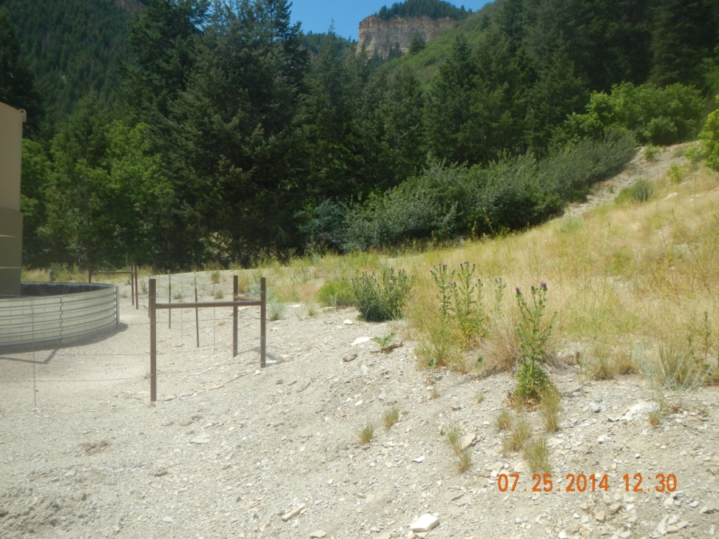
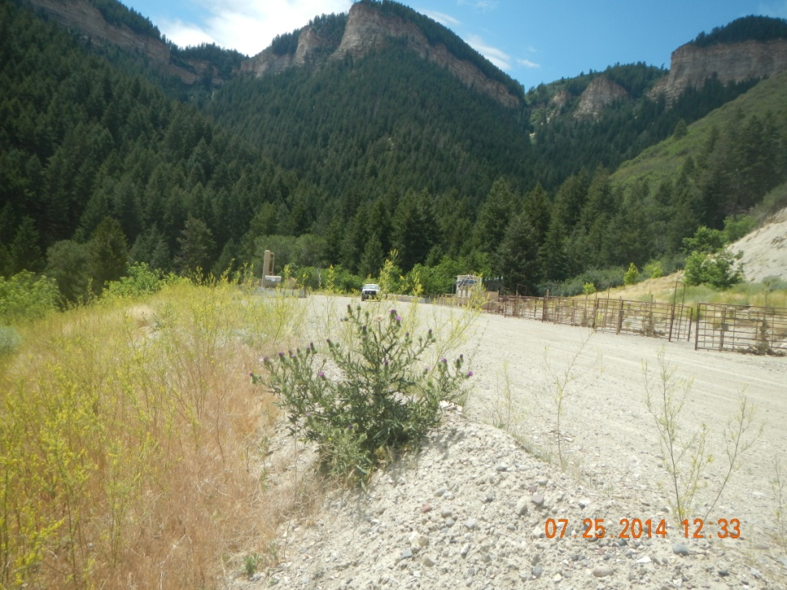
Weeds

Slide 5
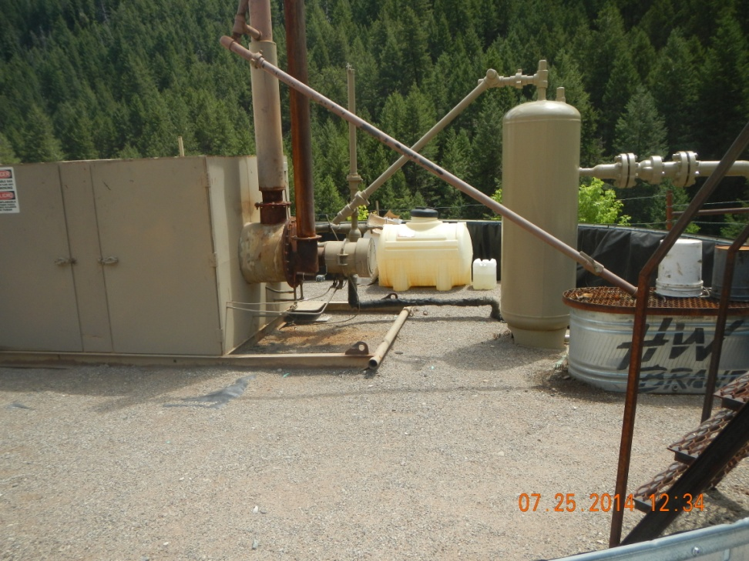
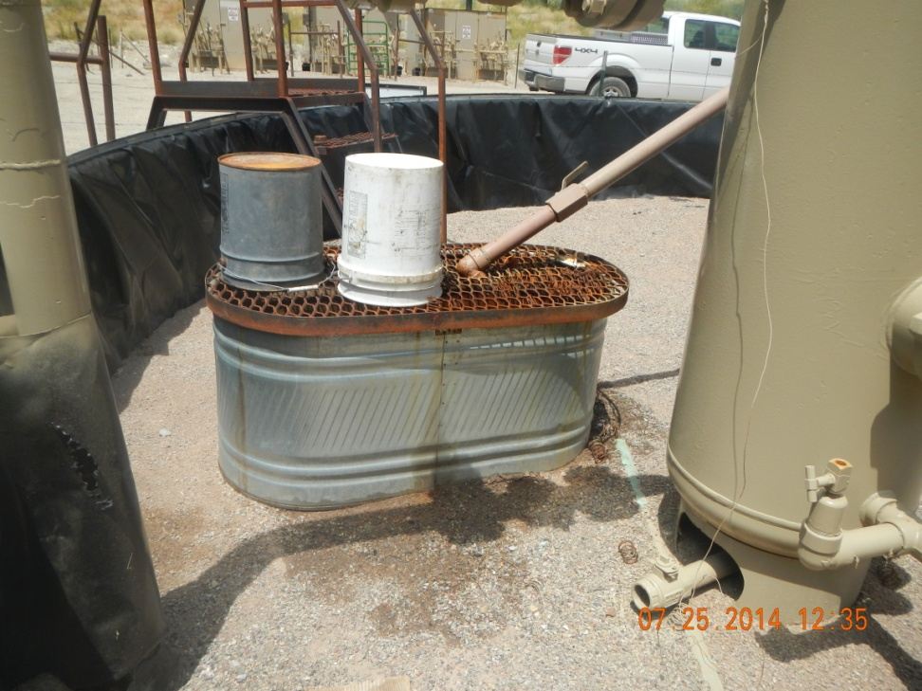
Spill in Dehydrator Berm

