Slide 1
EnCana
05-045-10604 N.PARACHUTE
WF14D A15 596

Slide 2
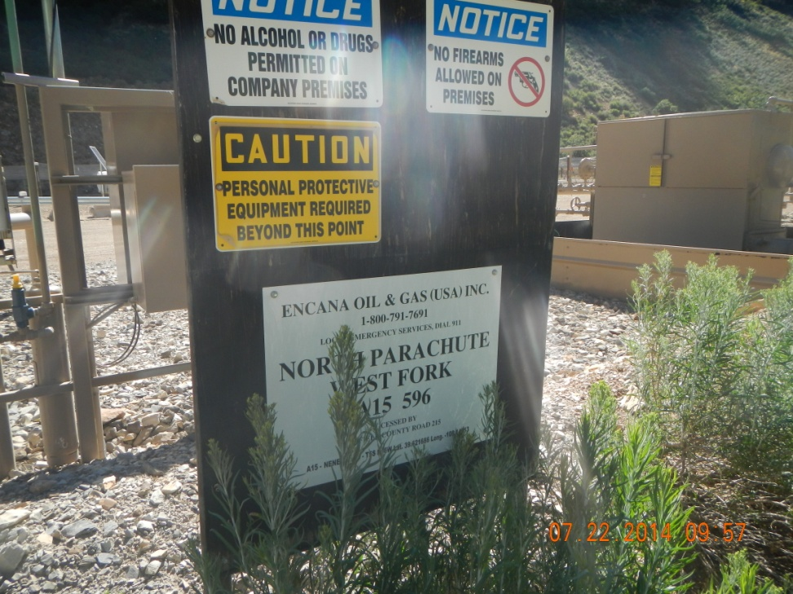
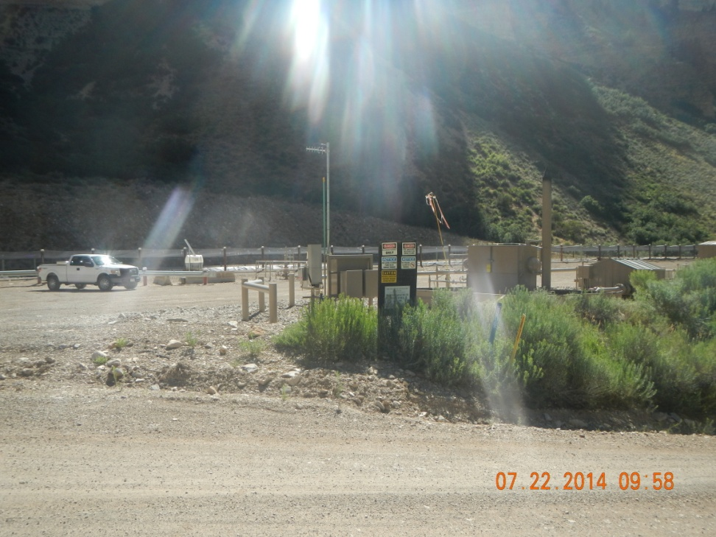
Sign and location

Slide 3
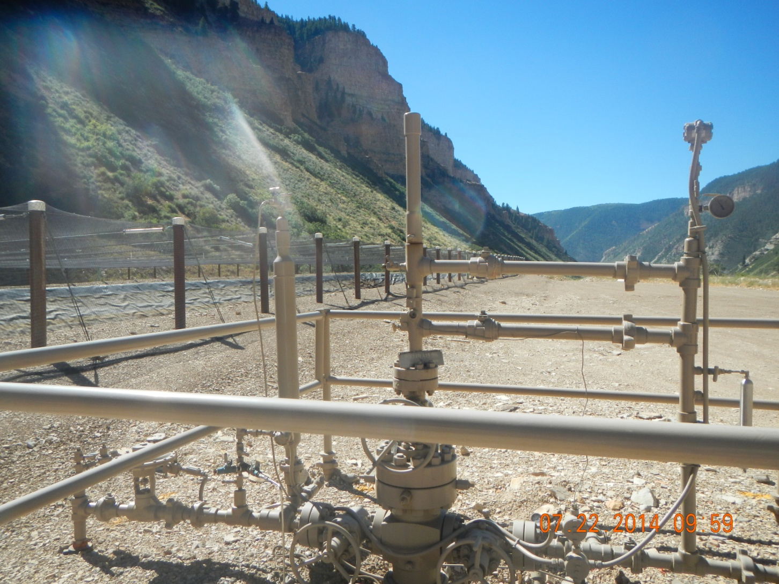
05-045-10604
N.PARACHUTE WF14D A15 596

Slide 4
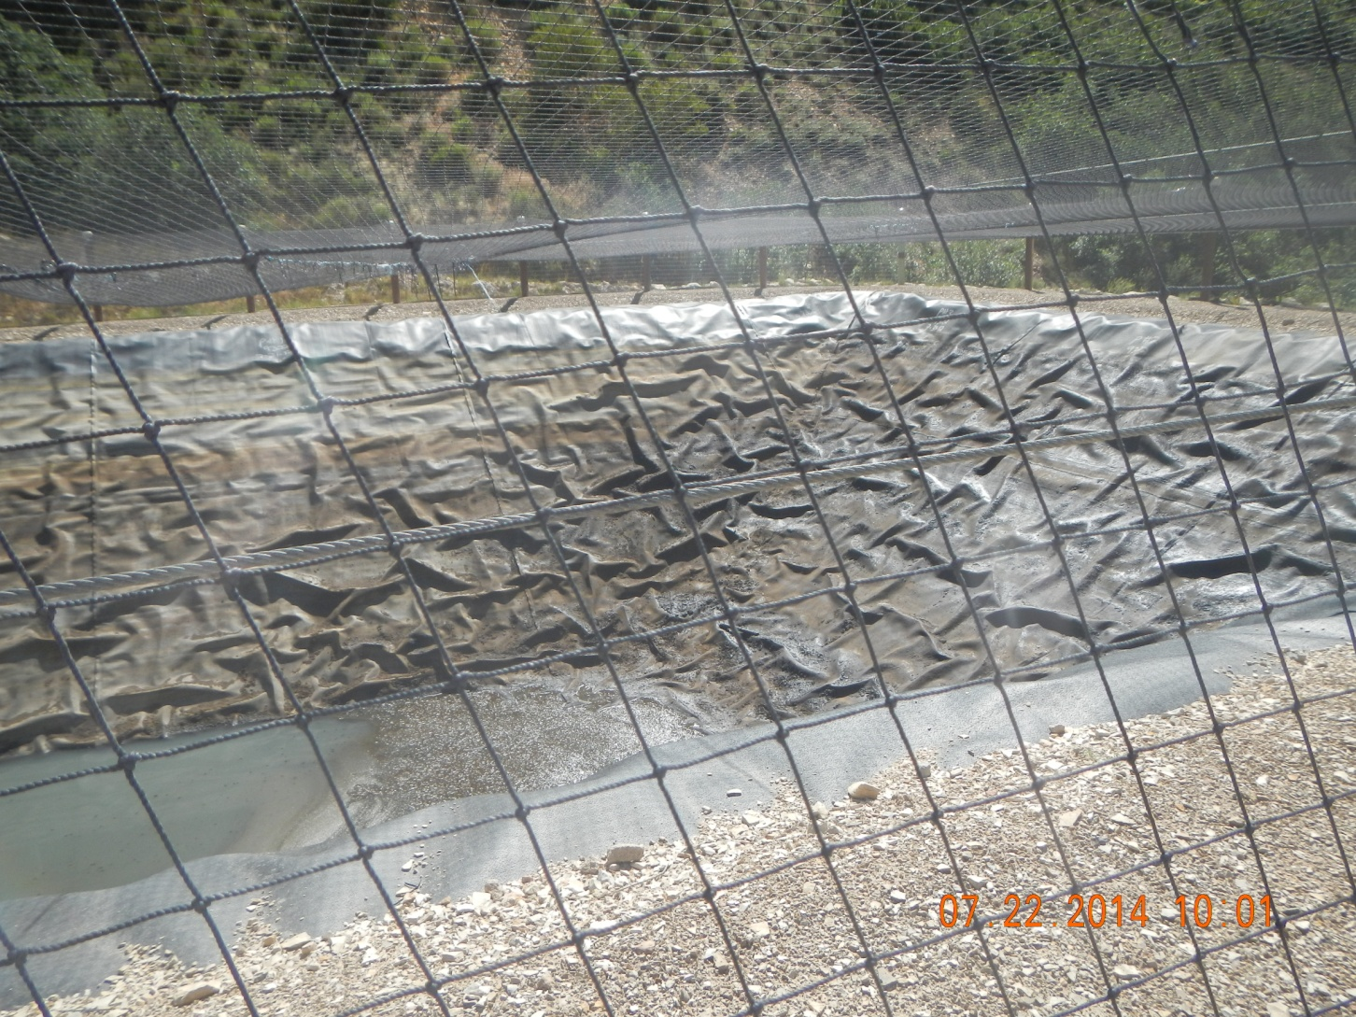
Pit Accumulation and oily stained walls

Slide 5
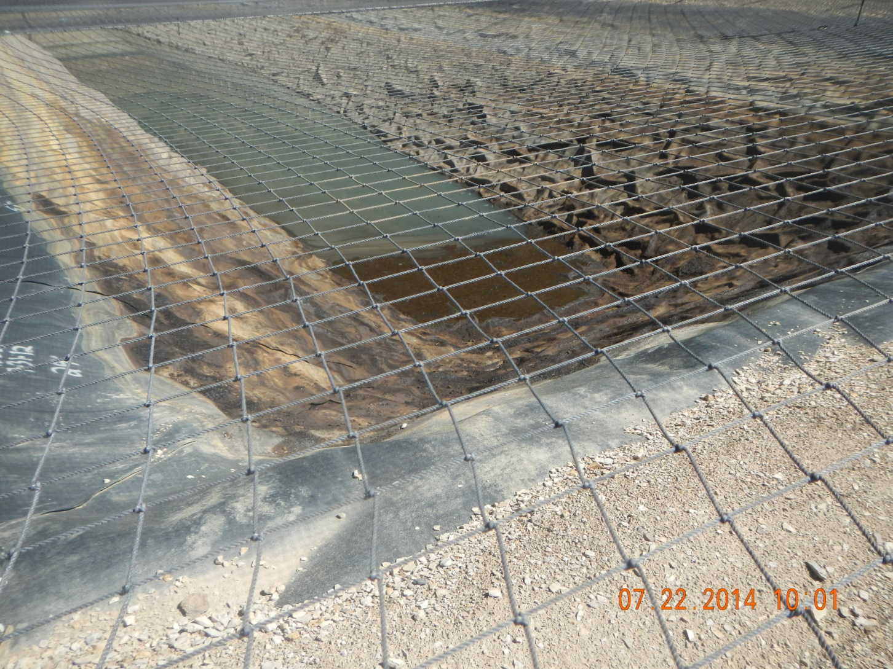
Pit Accumulation and oily stained walls

Slide 6
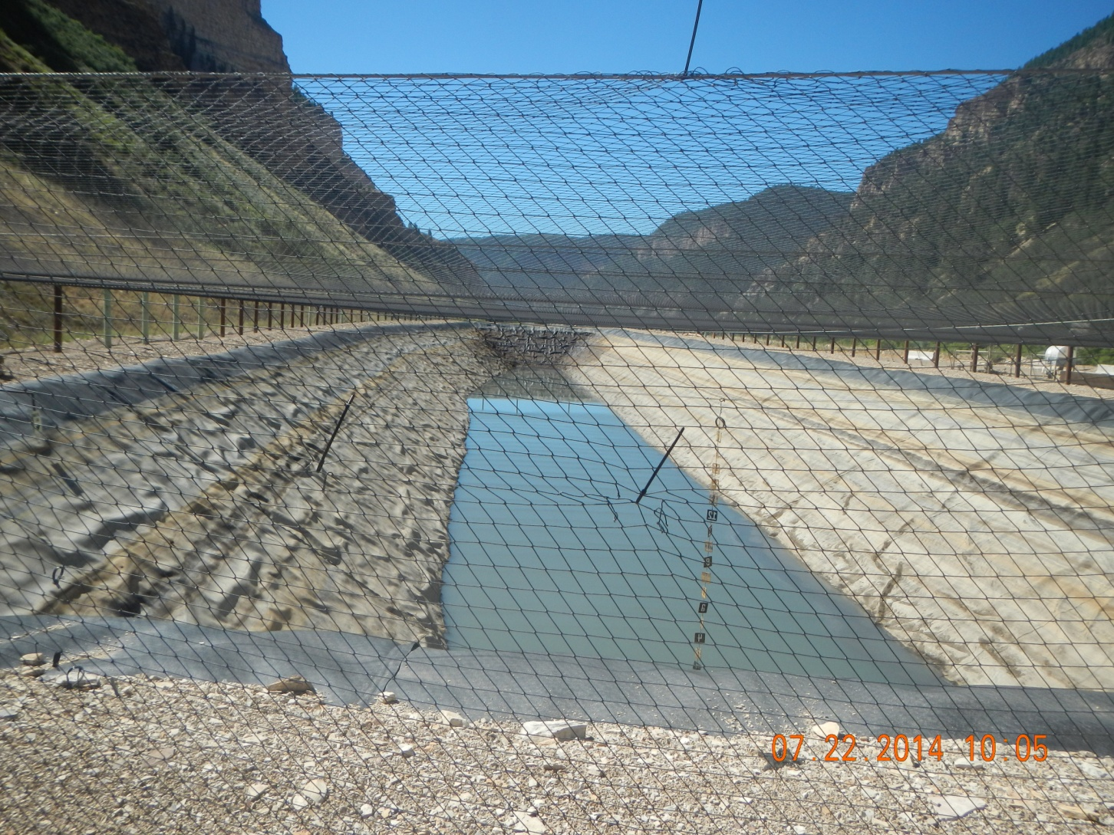
Pit

Slide 7
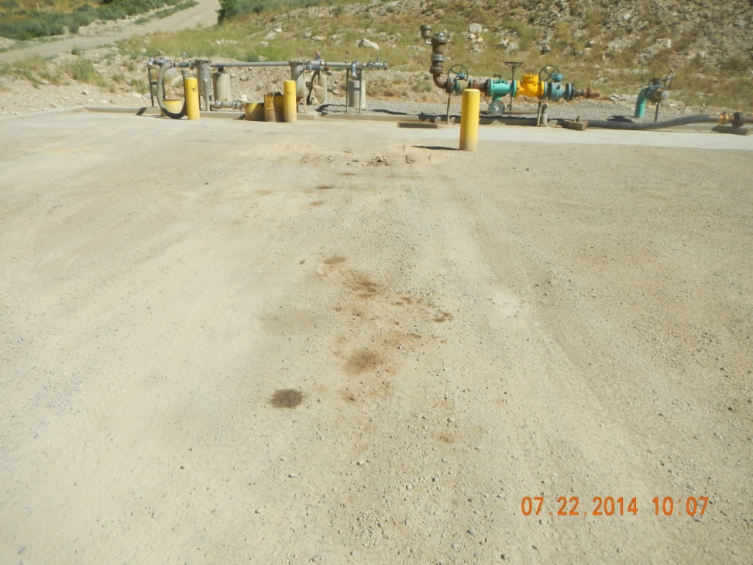
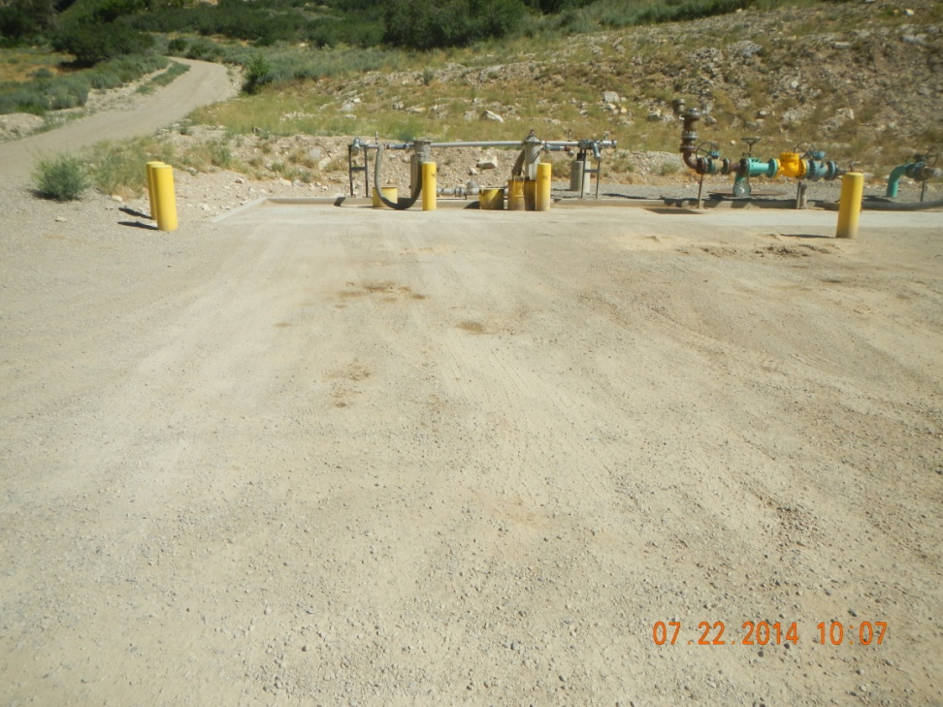
Stains on ground in front of load out

