Slide 1
Non Such Natural Gas Inc
Puckett 797-1-1
Api # 05-045-07971
Location Id. # 324176

Slide 2
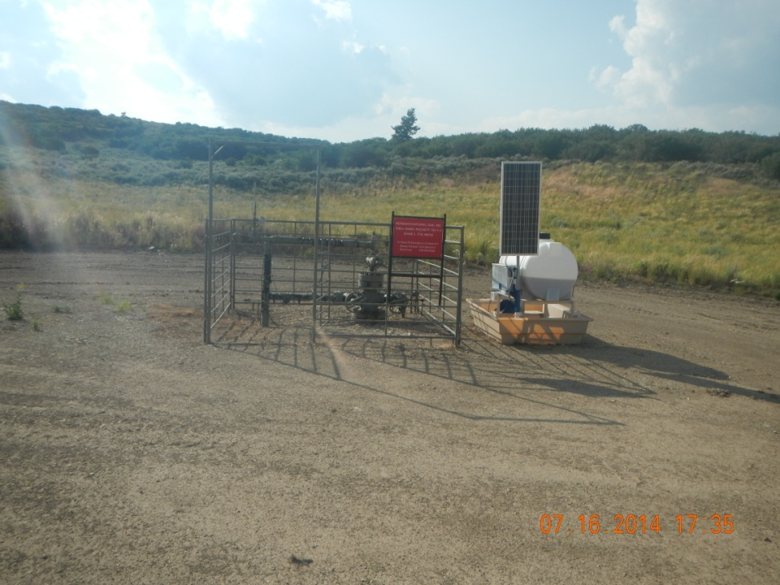
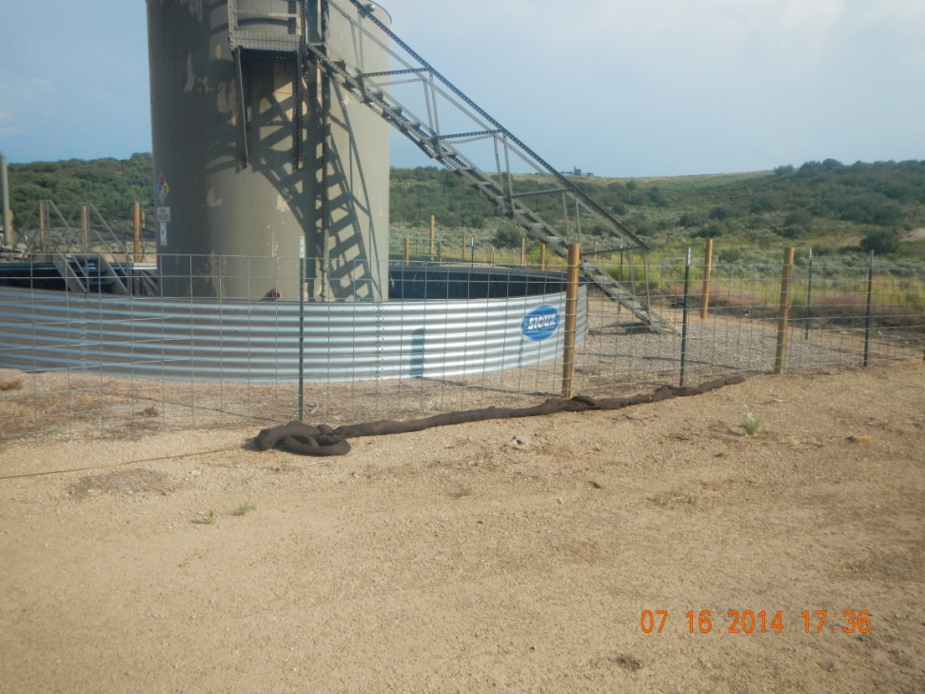
Oil Saturated Boom at tank battery

Slide 3
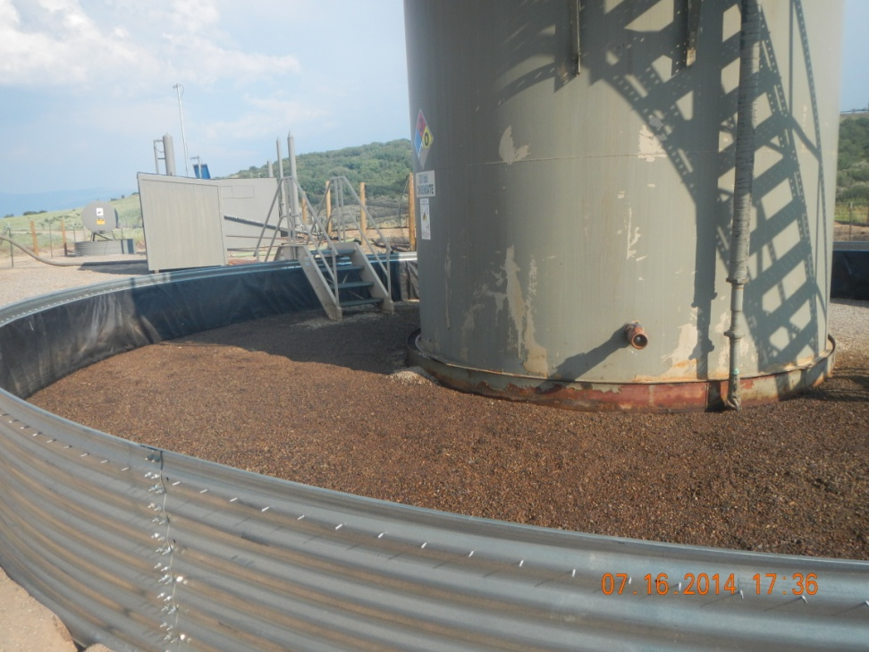
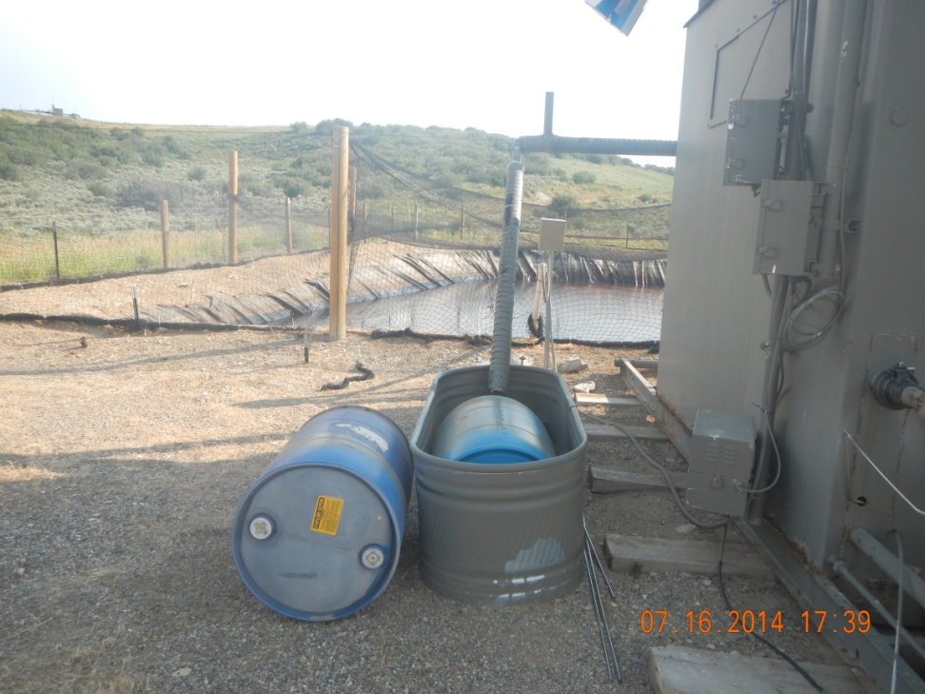
Condensate stained and saturated gravel base inside tank berm

Slide 4
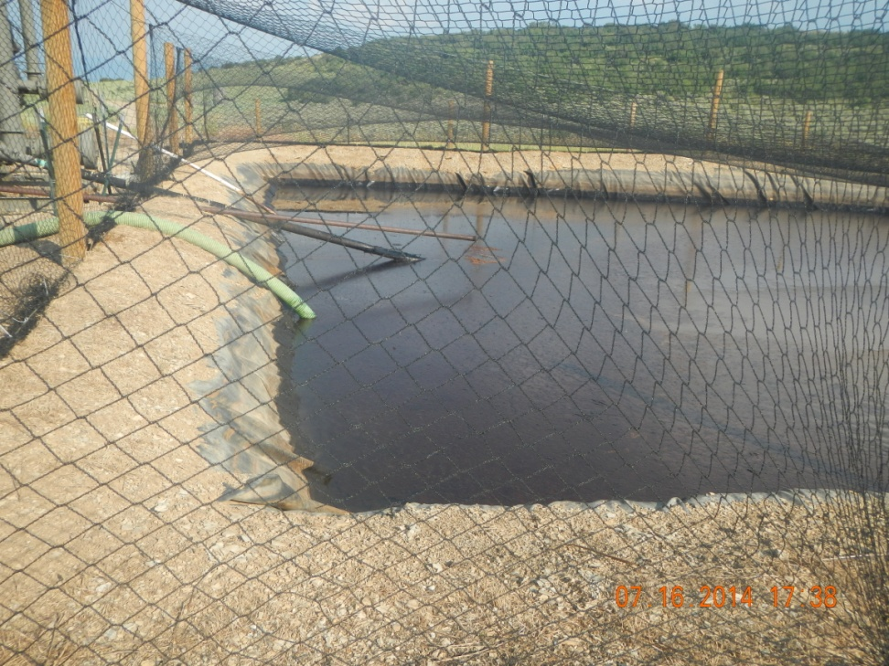
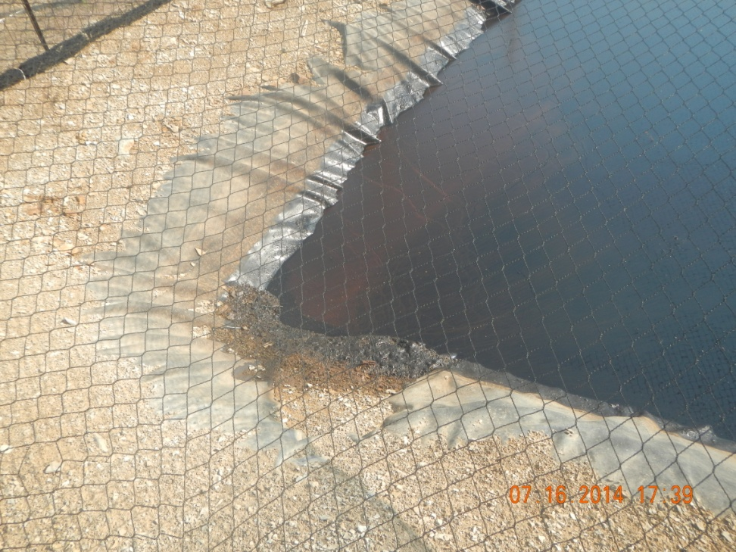
Oil accumulation on pit

Slide 5
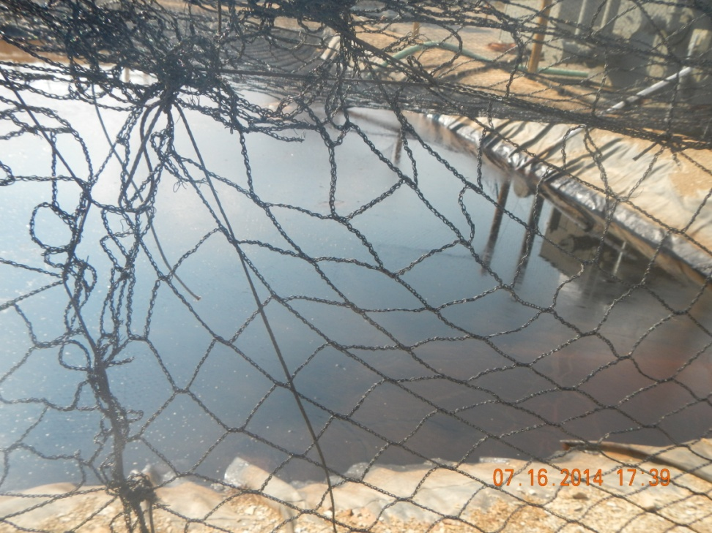
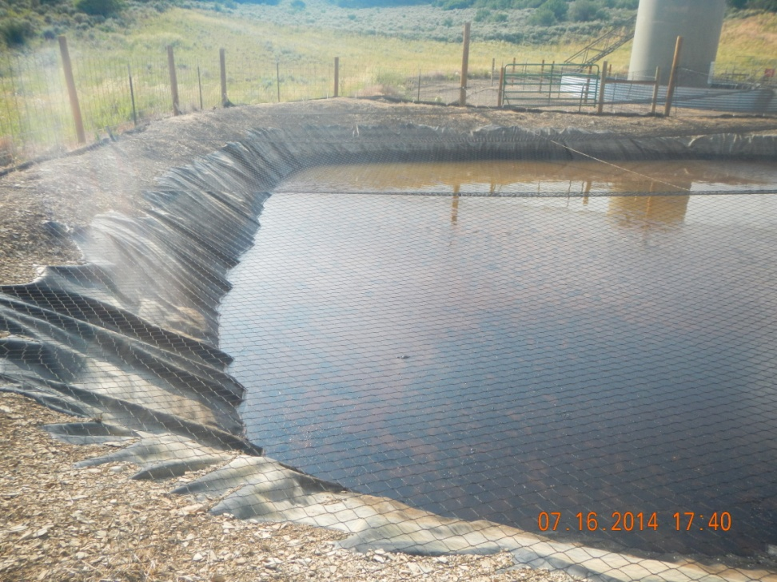
Oil accumulation on pit

Slide 6
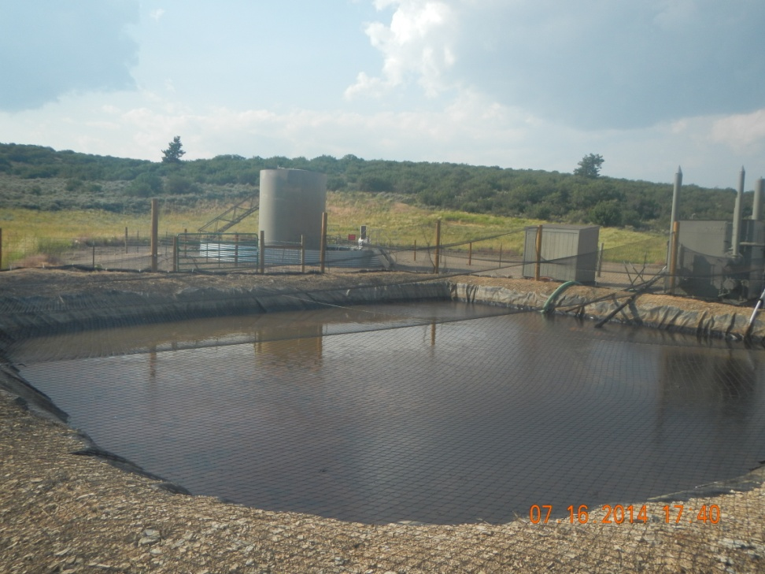
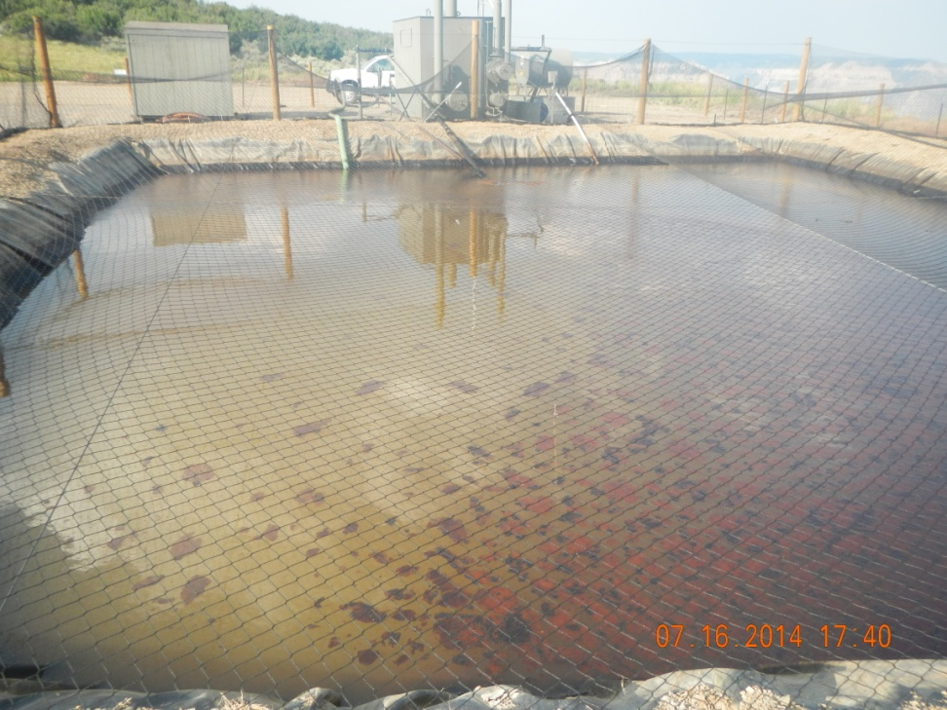
Oil accumulation on pit

Slide 7
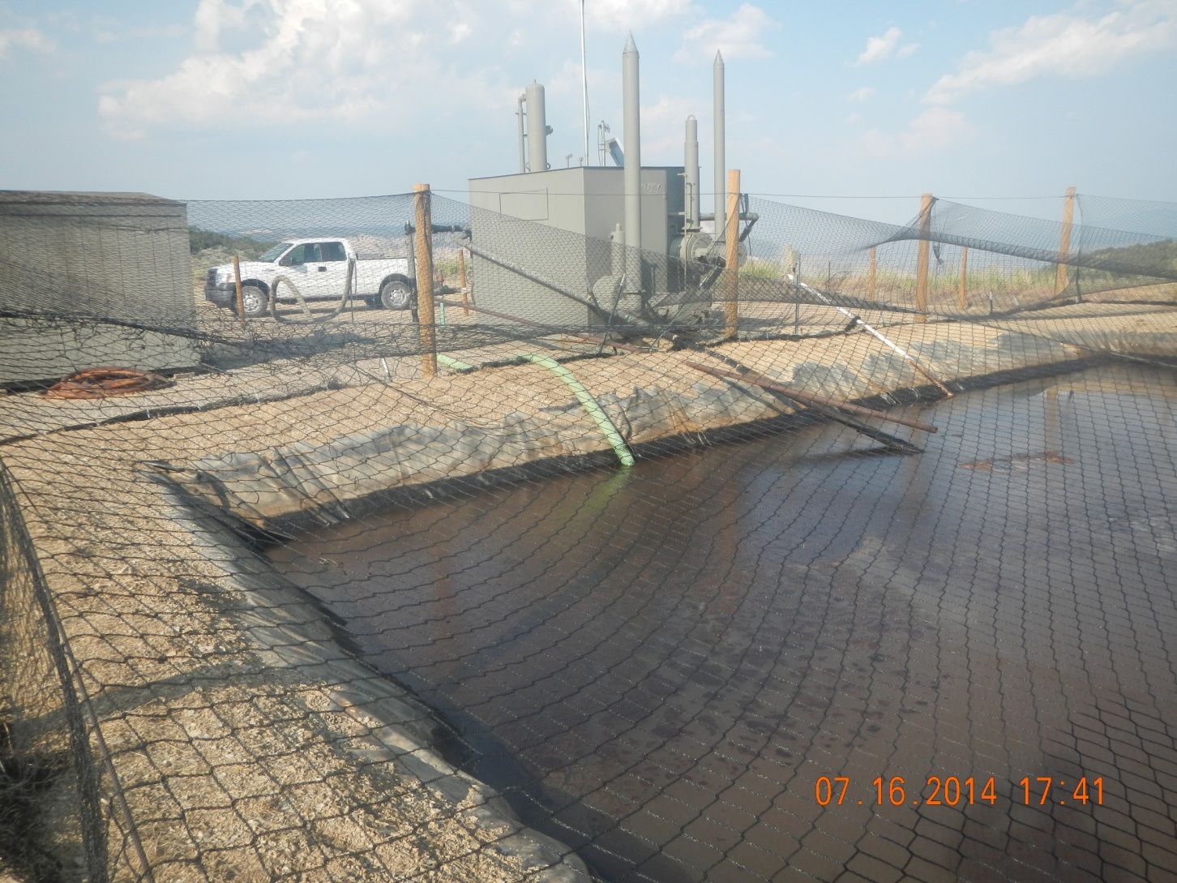
Oil accumulation on pit

Slide 8
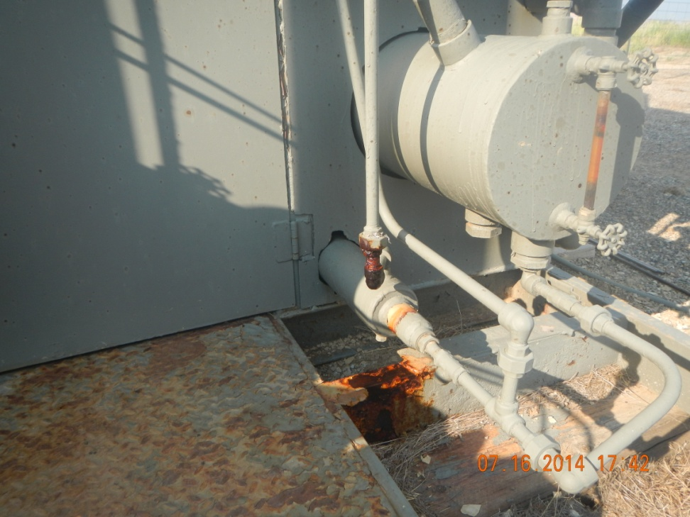
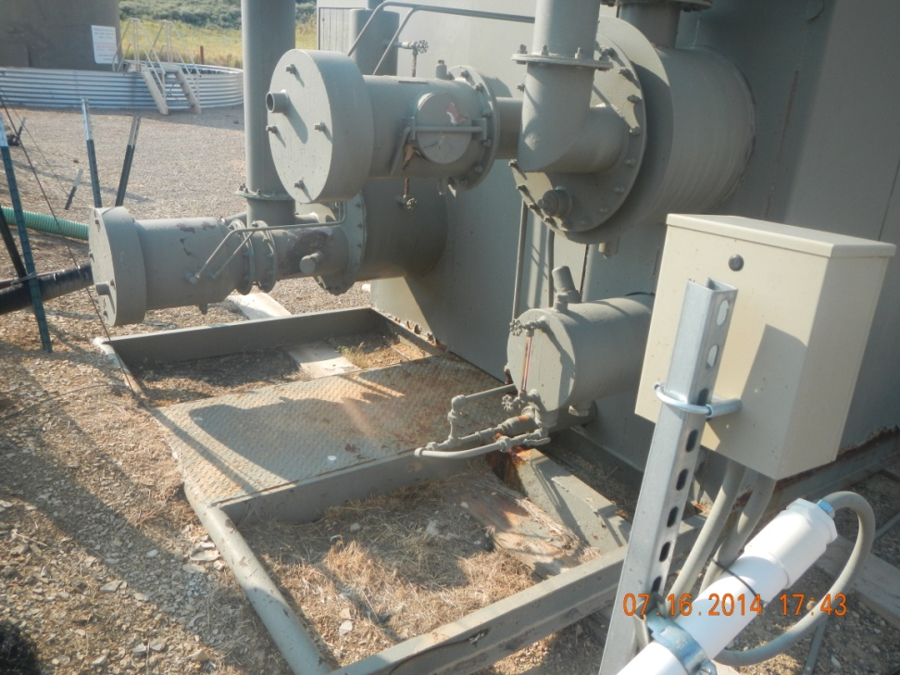
Leaking line Connection

