Slide 1
Petro Mex
Location 324392
Fed. 6-9-8-101
api. # 05-045-13342

Slide 2
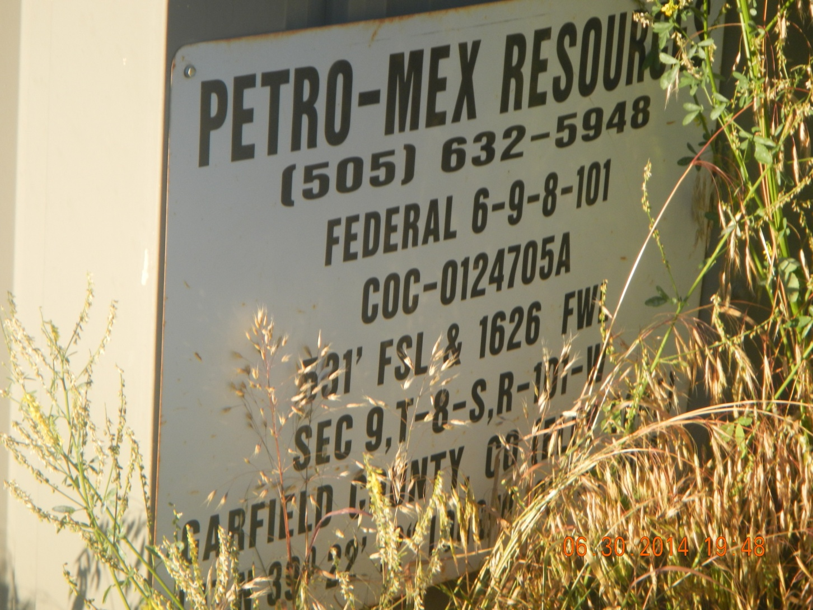

Slide 3
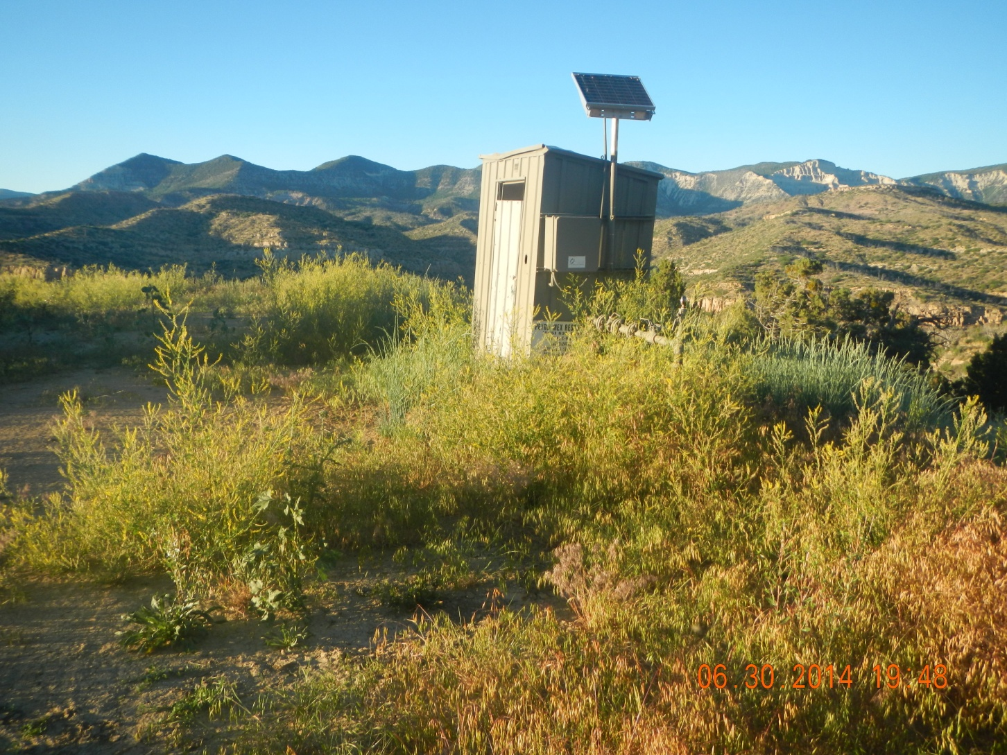
Meter house sign covered by weeds

Slide 4
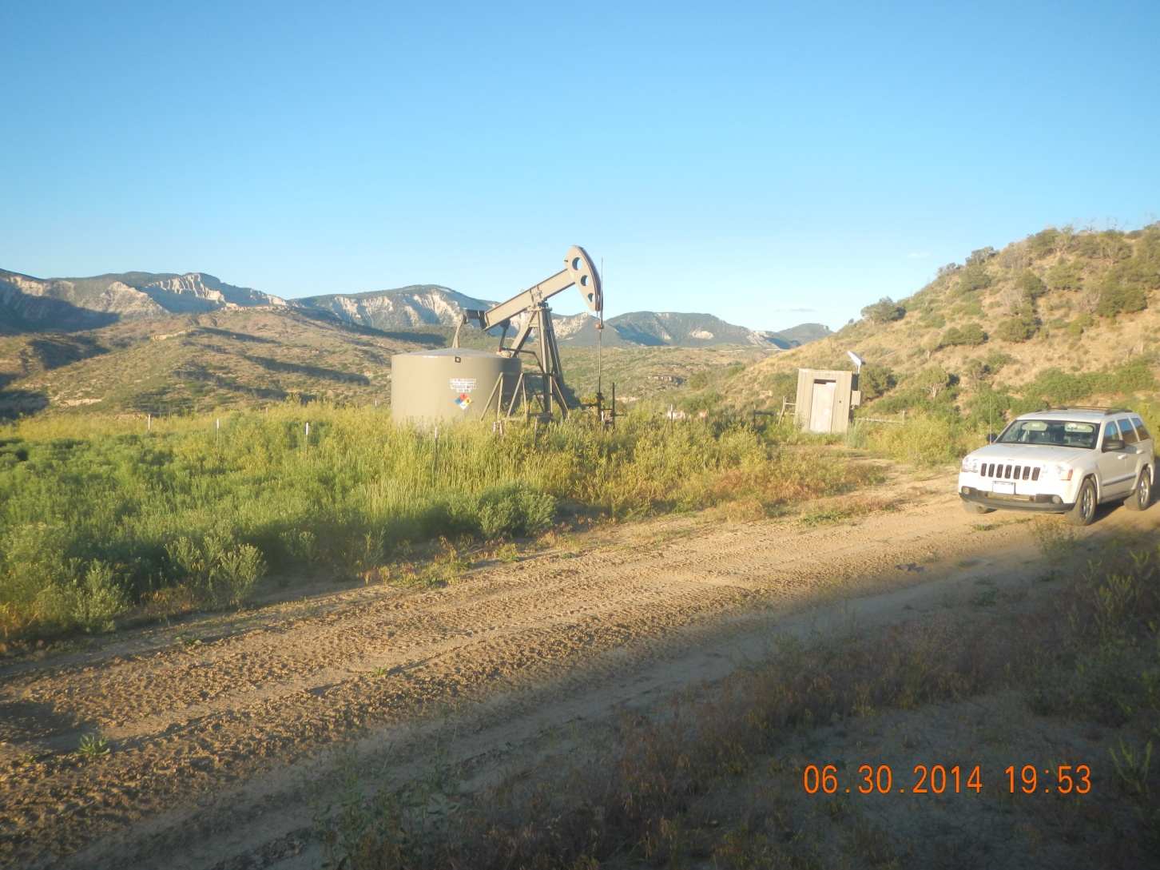
Location weeds

Slide 5
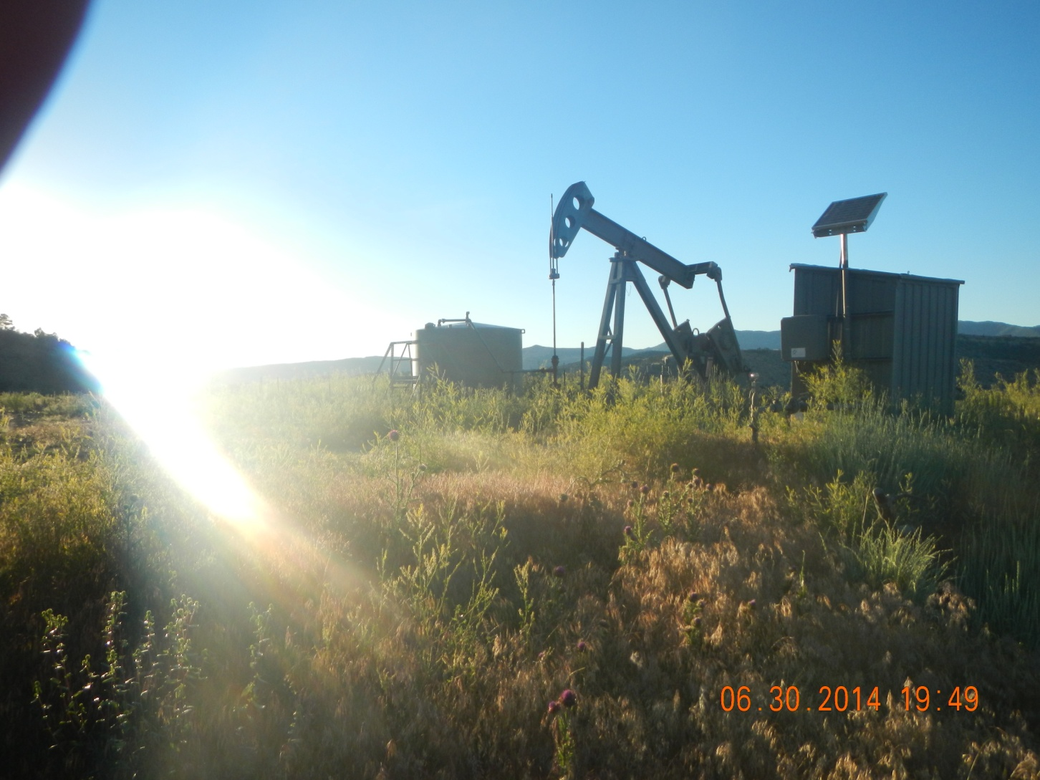
Weeds

Slide 6
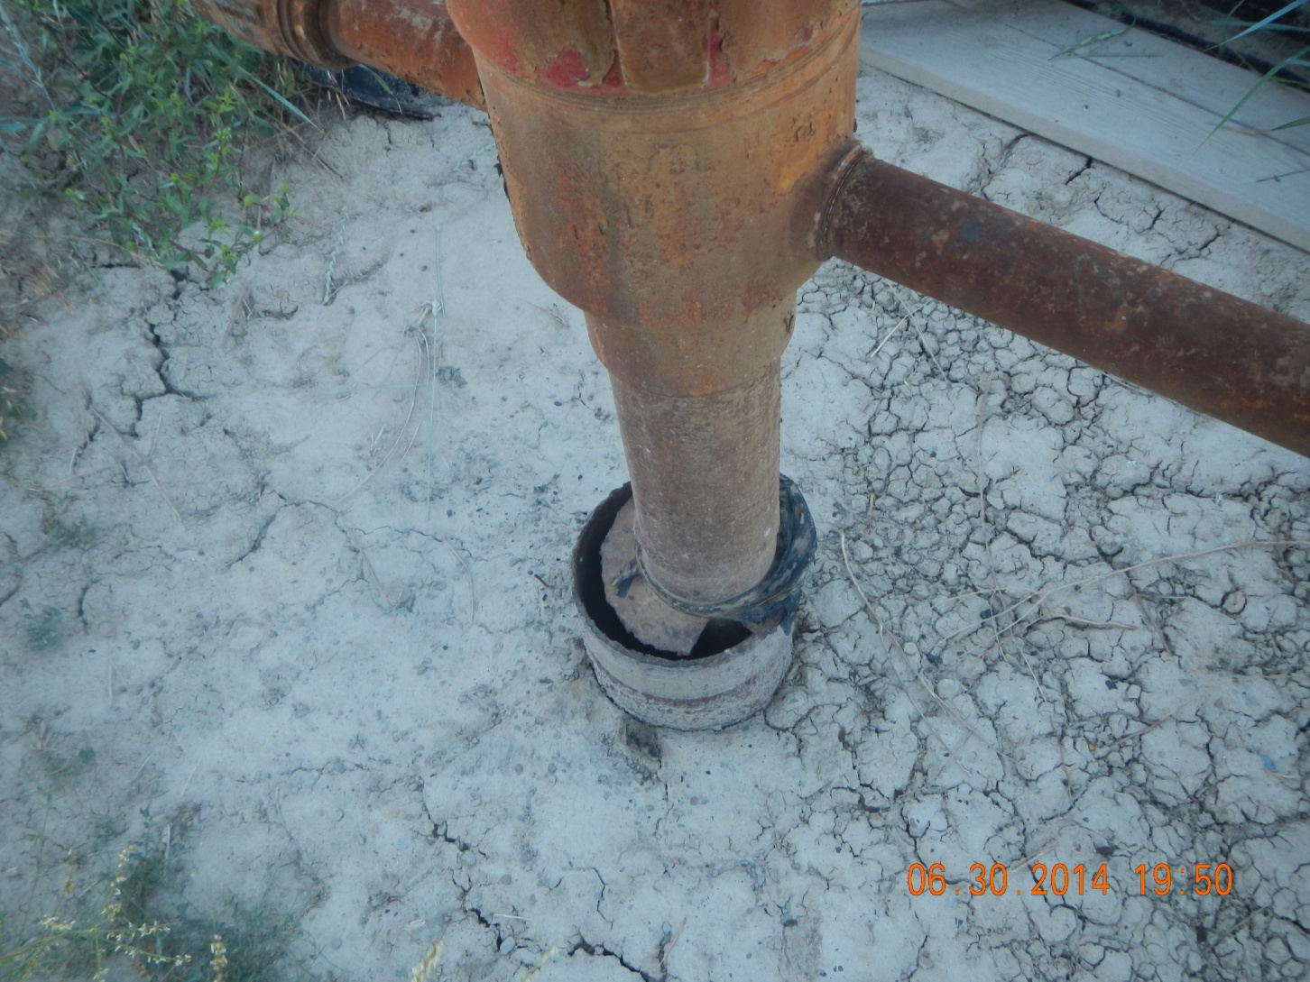
Open Annulus

Slide 7
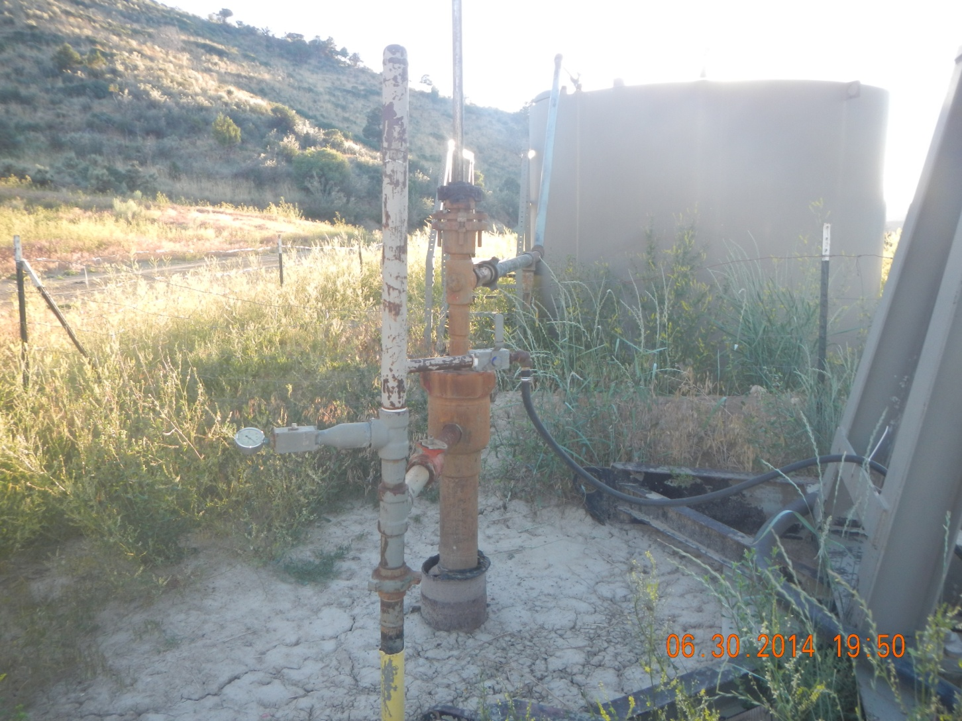
Well head with Open Annulus

Slide 8
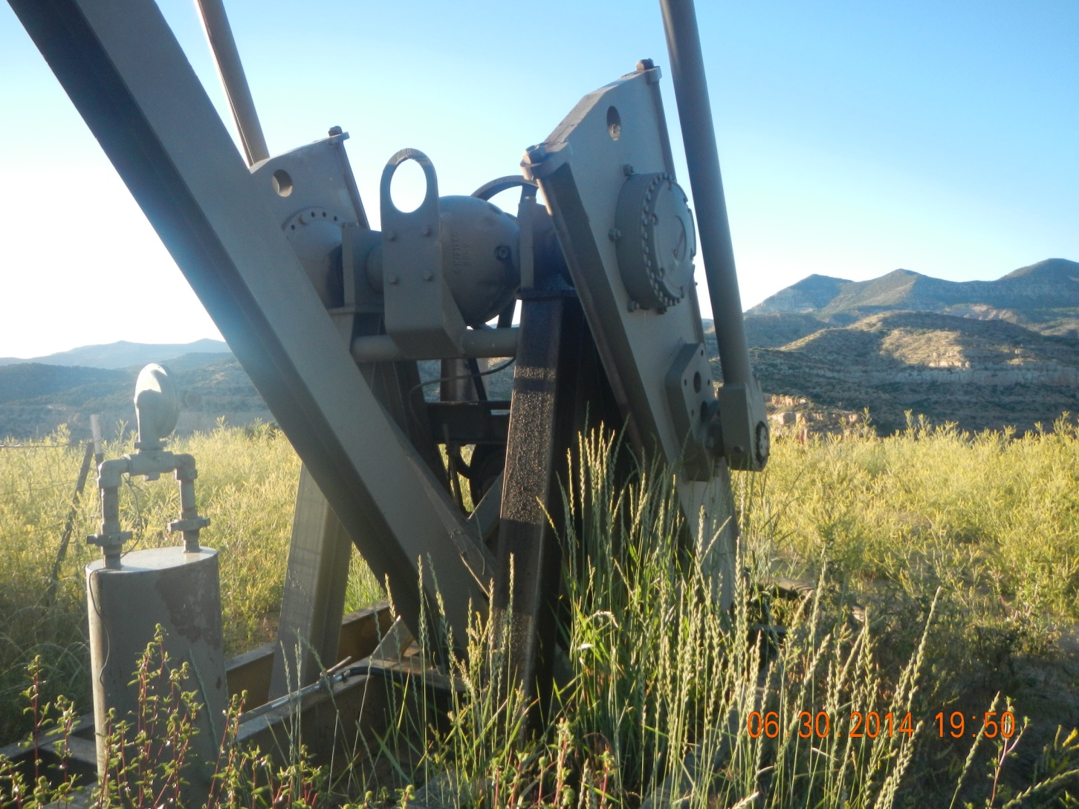
Oil stain on pump jack frame

Slide 9
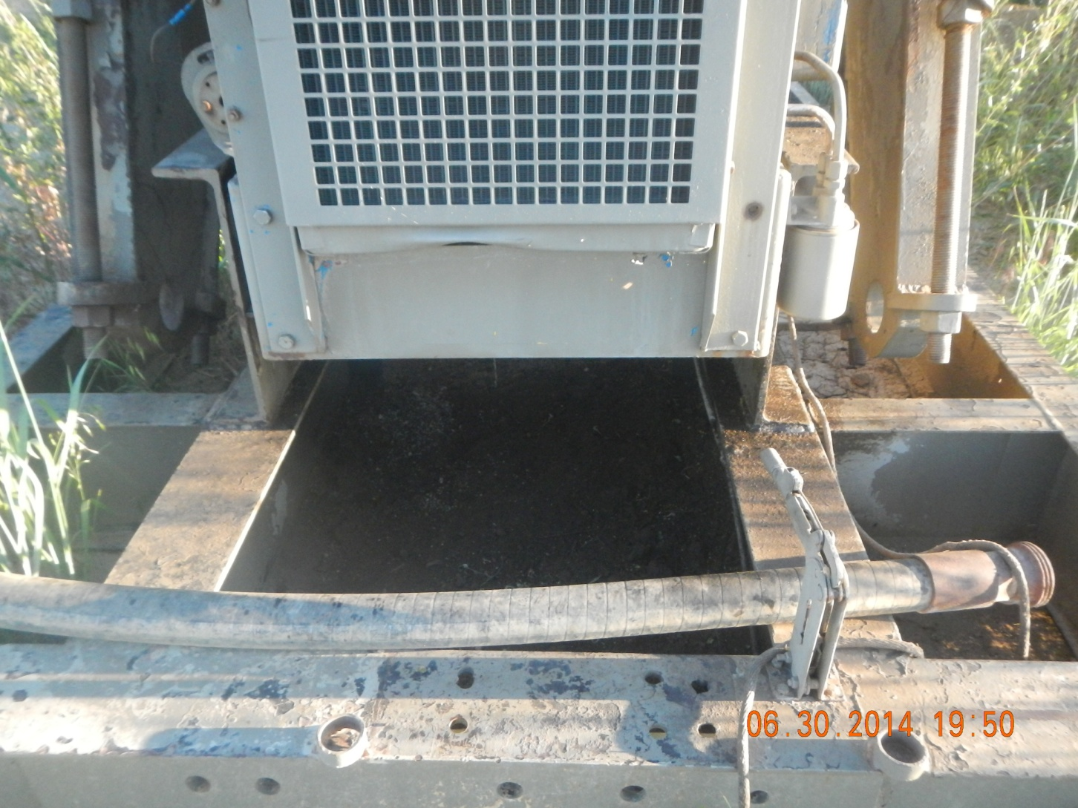
Oil Stain under Pump jack engine

Slide 10
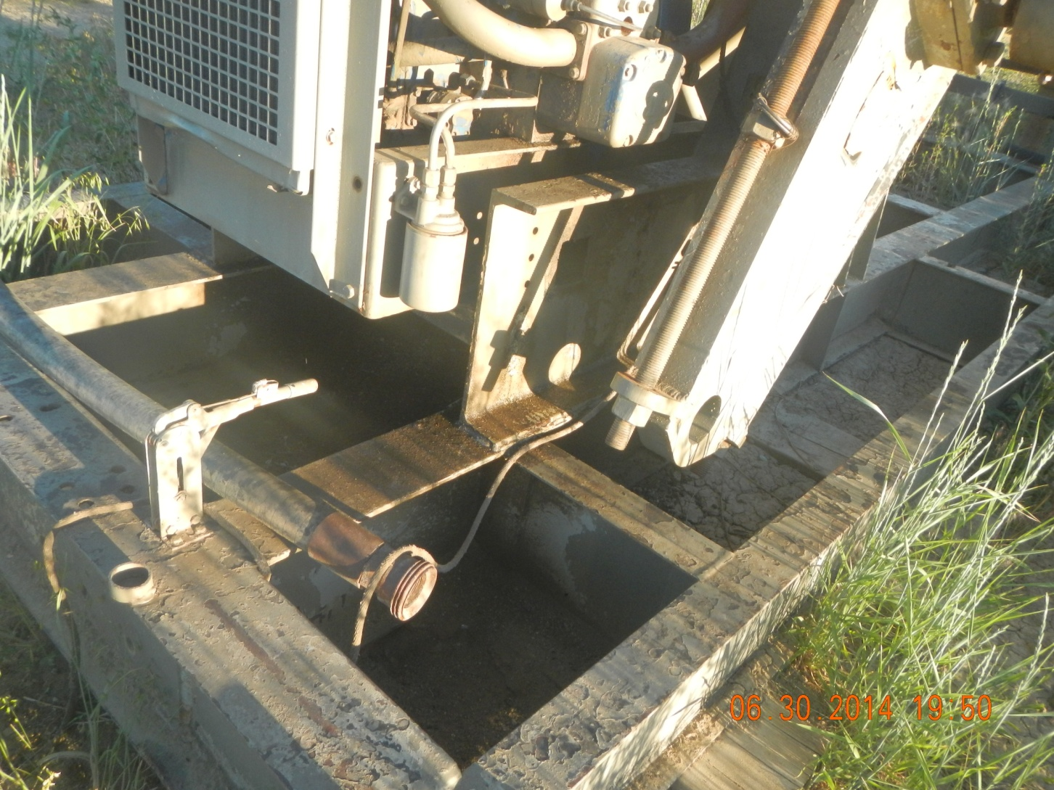
Oil Stain under Pump jack engine

Slide 11
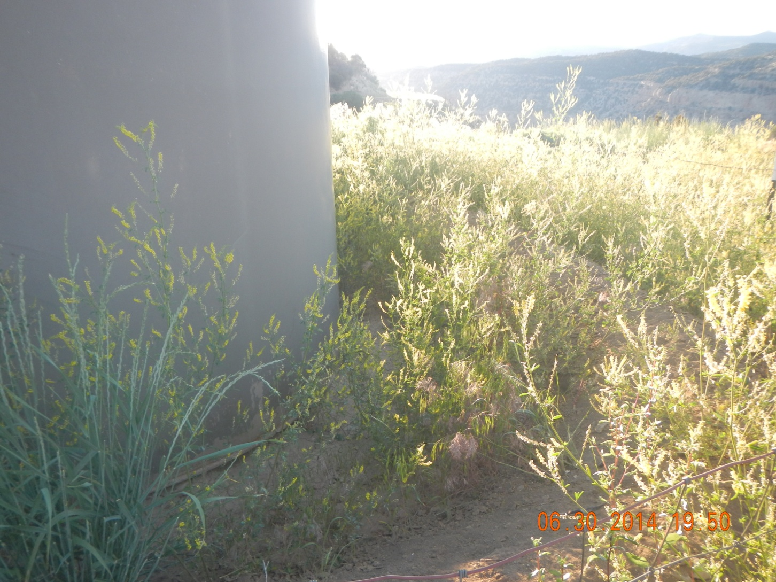
Weeds growing in tank berm

Slide 12
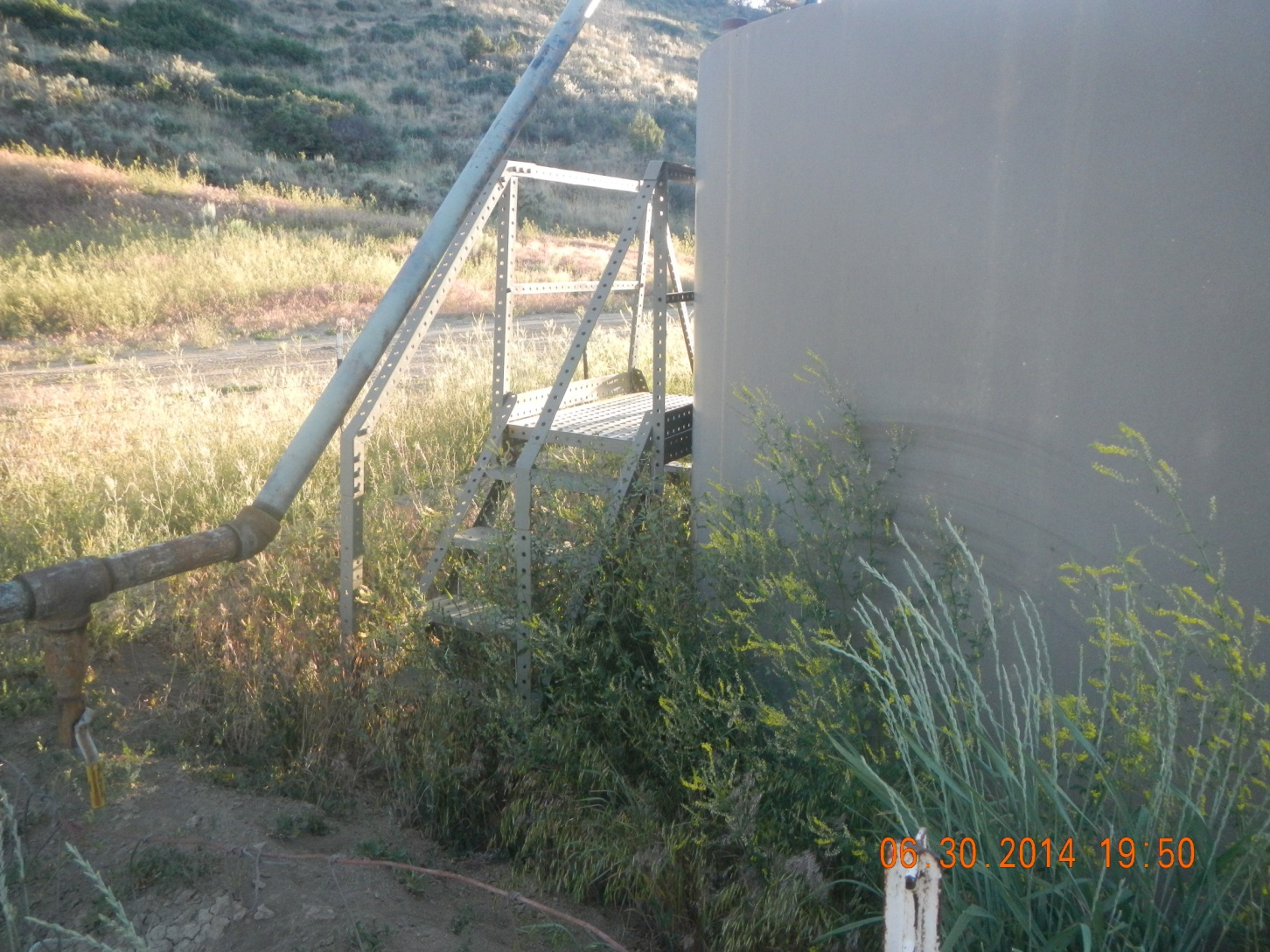
Weeds growing in tank berm

Slide 13
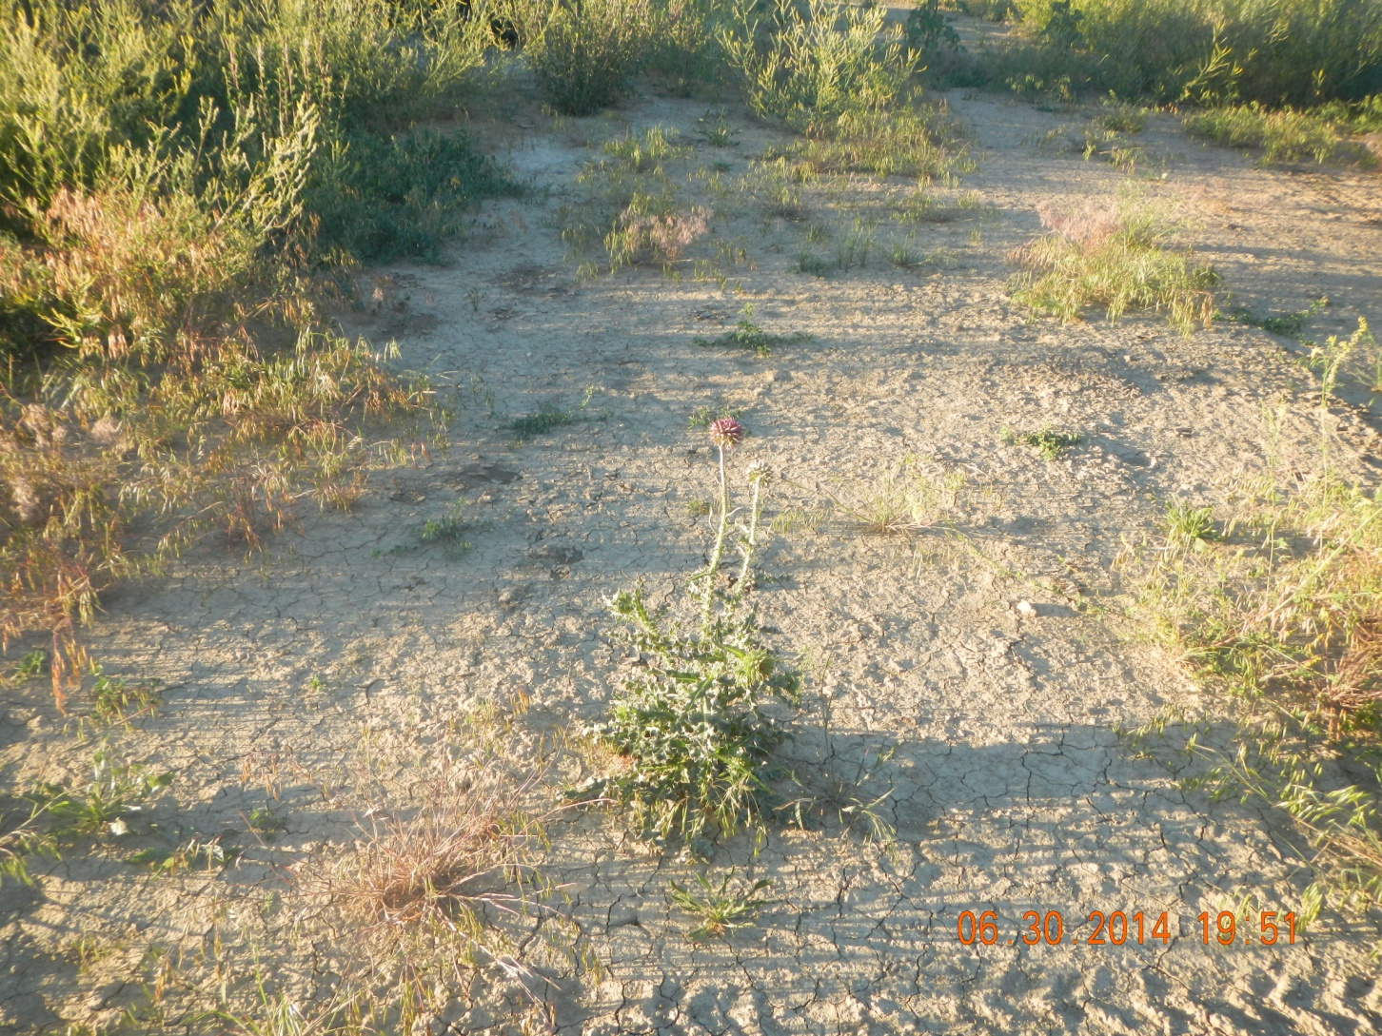
Musk Thistle

Slide 14
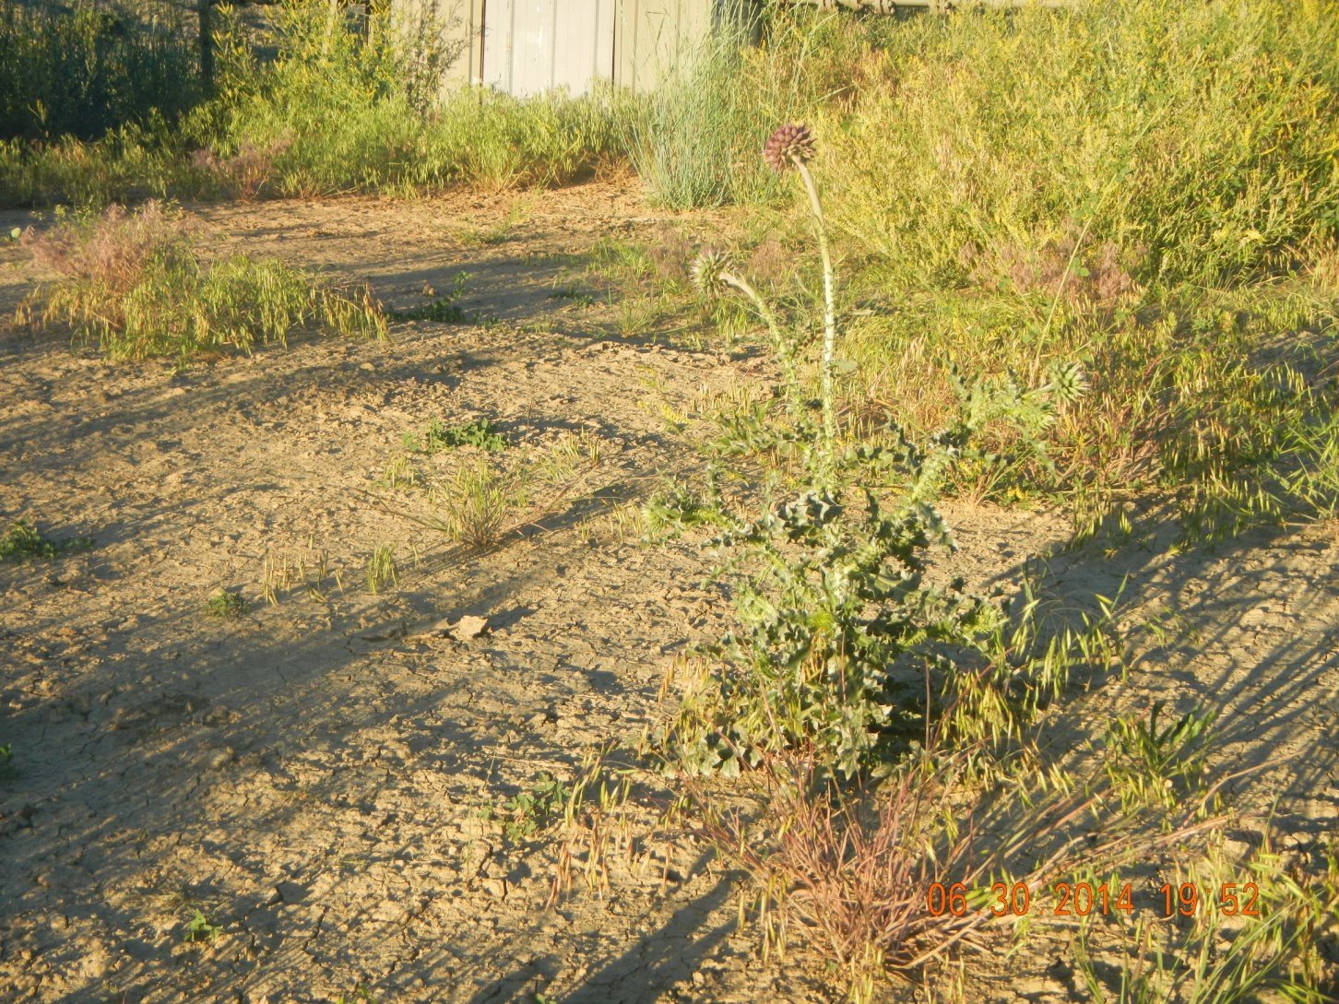
Musk Thistle

Slide 15
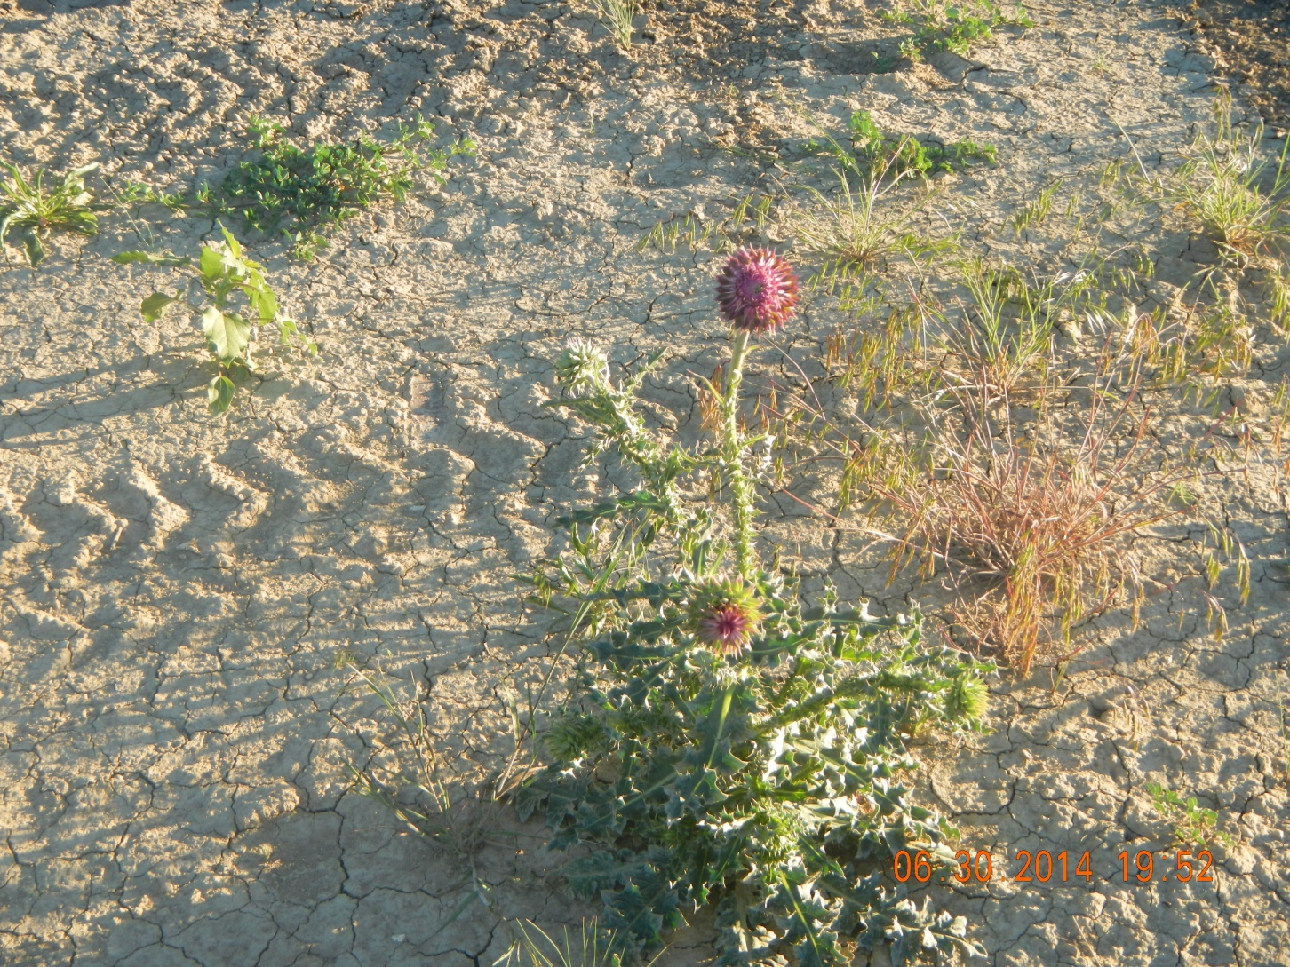
Musk Thistle

