Slide 1
Linn(Berry) Energy
Location # 335991 Open conductors and D/A surface casing

Slide 2
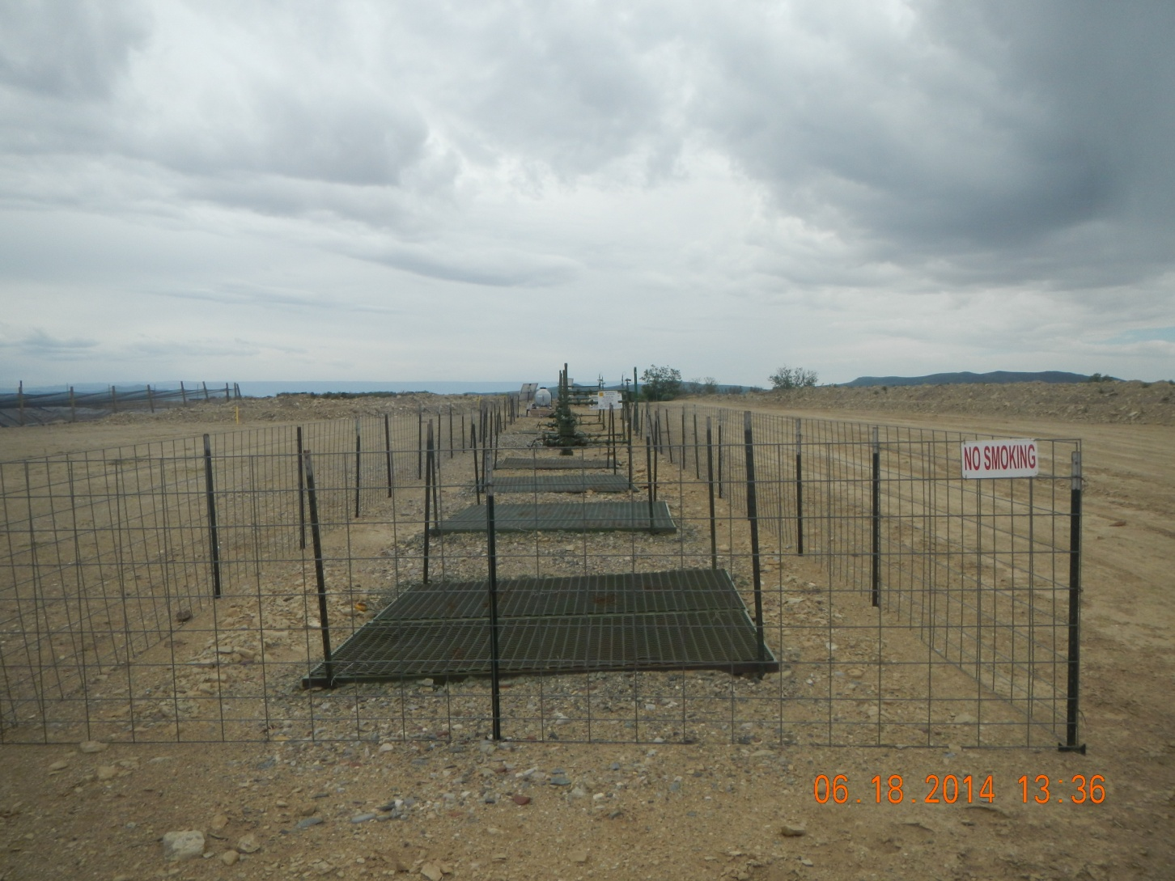

Slide 3
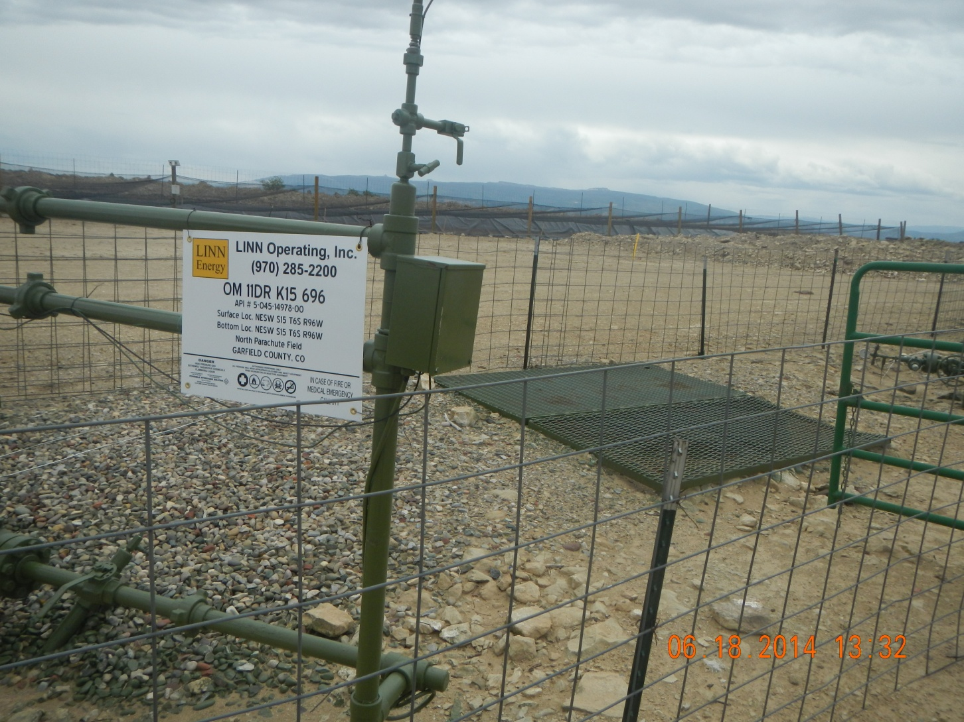

Slide 4
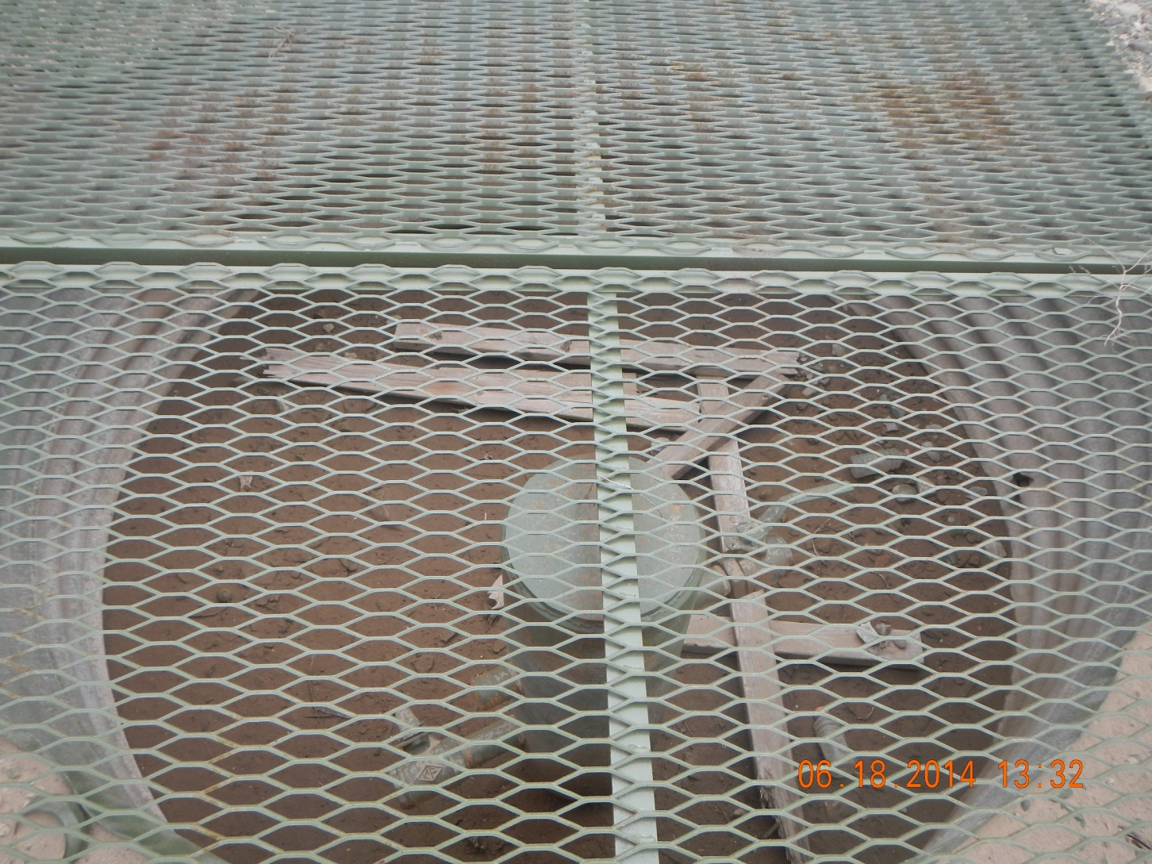
OM 11D Api#05-045-14973

Slide 5
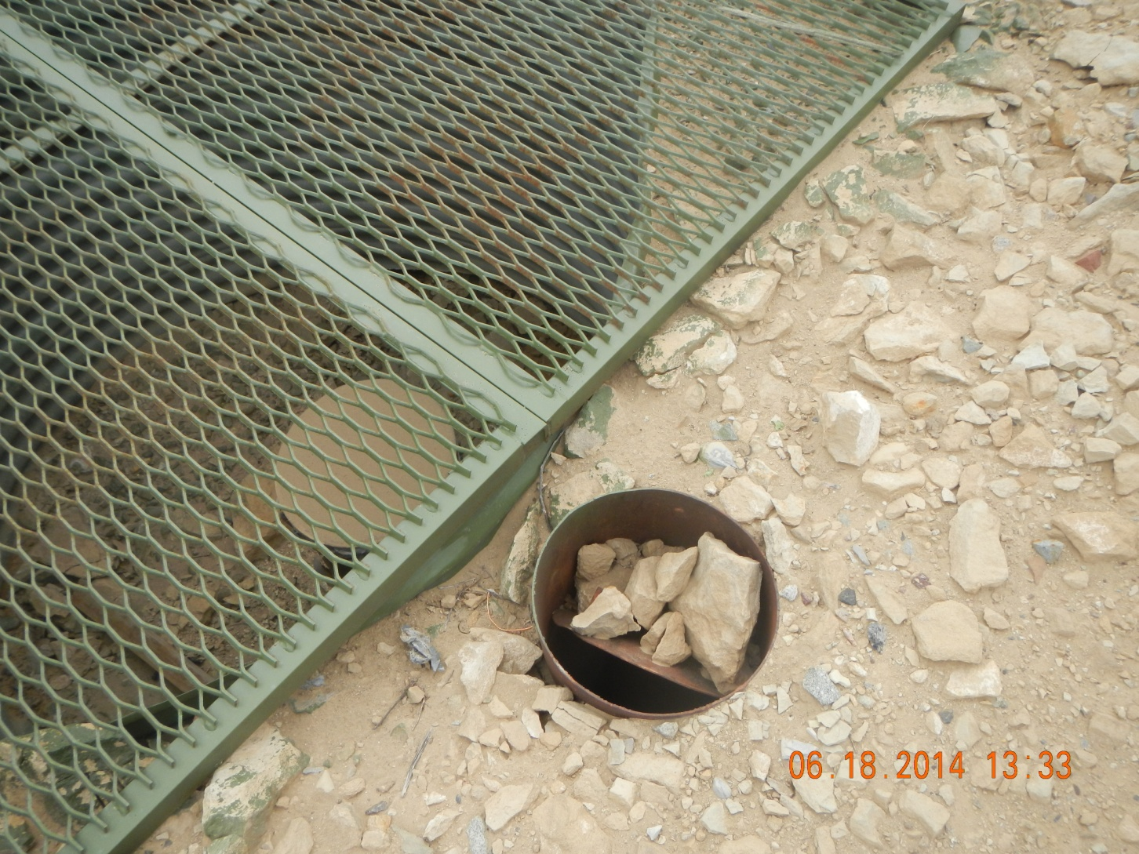

Slide 6


