Slide 1
Non Such
Location 324172

Slide 2
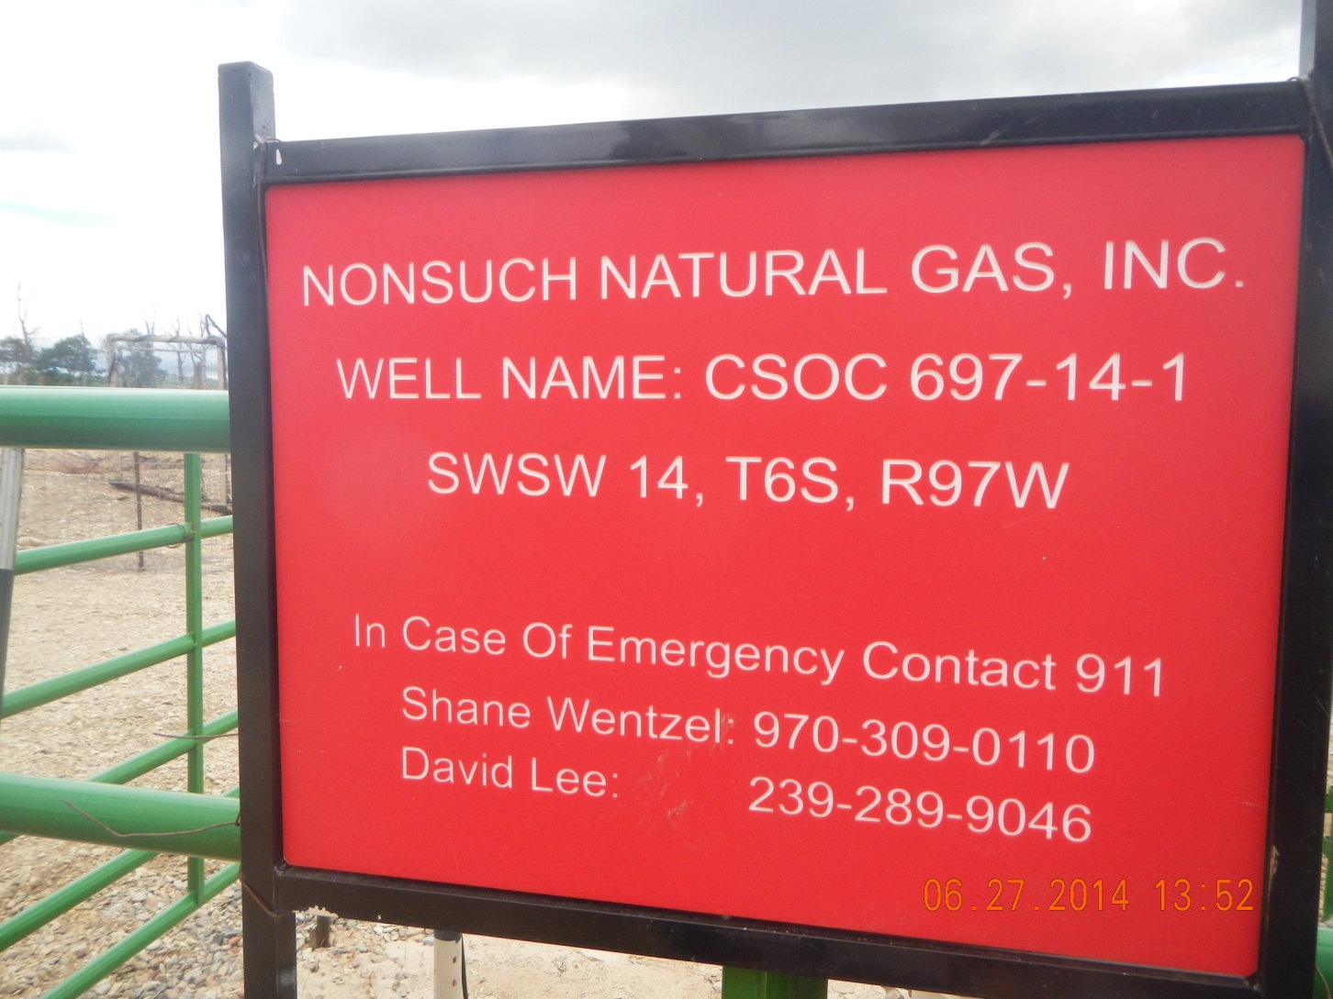

Slide 3
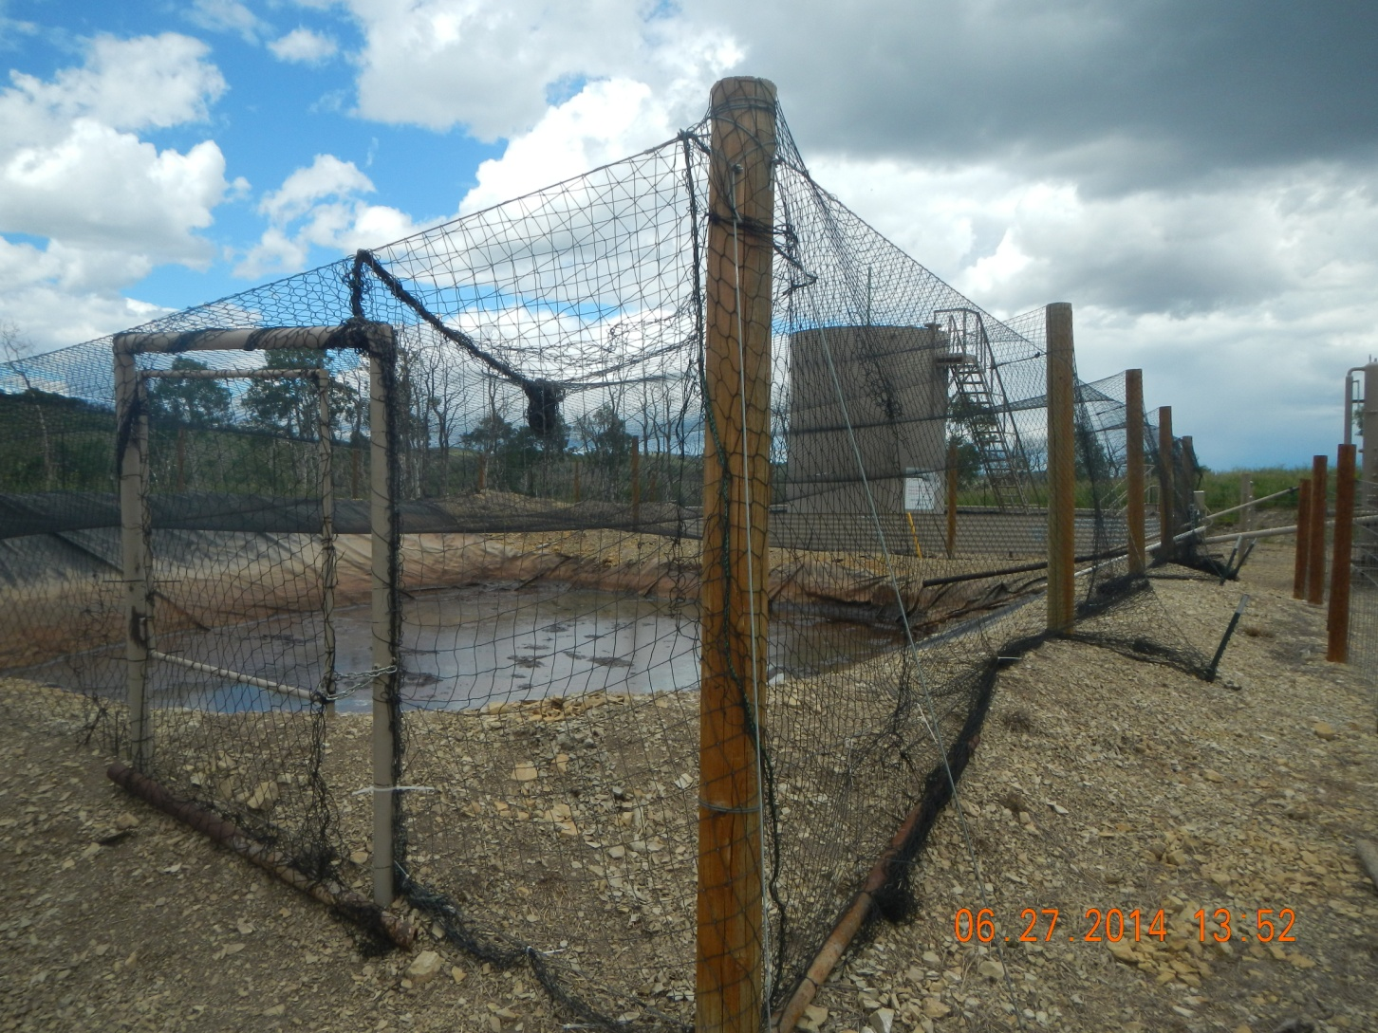
Gap in netting around gate

Slide 4
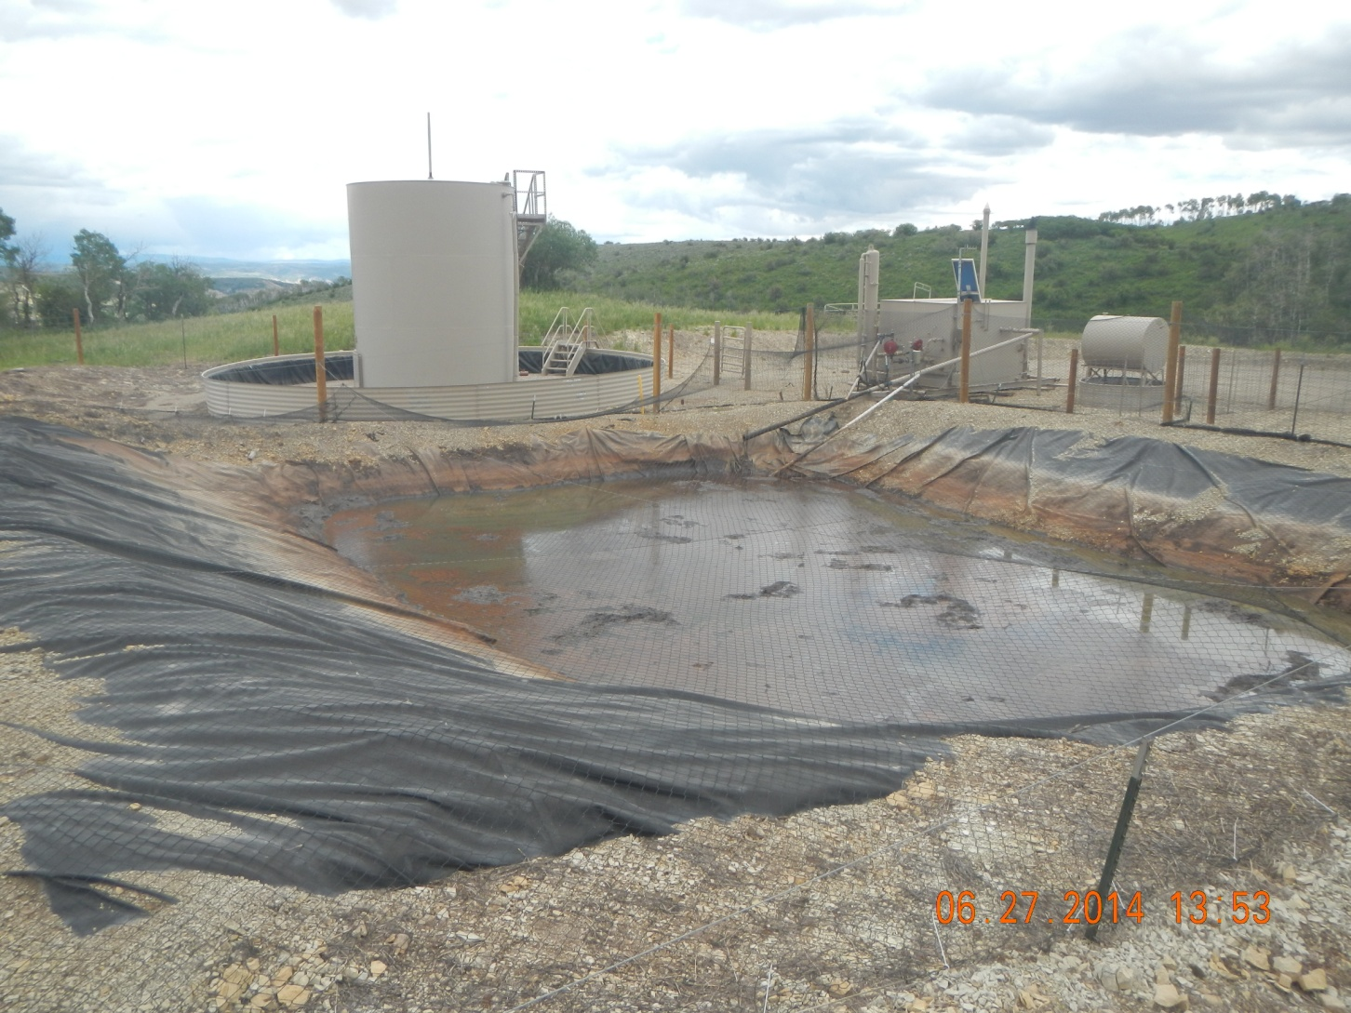
Oil Accumulation

Slide 5
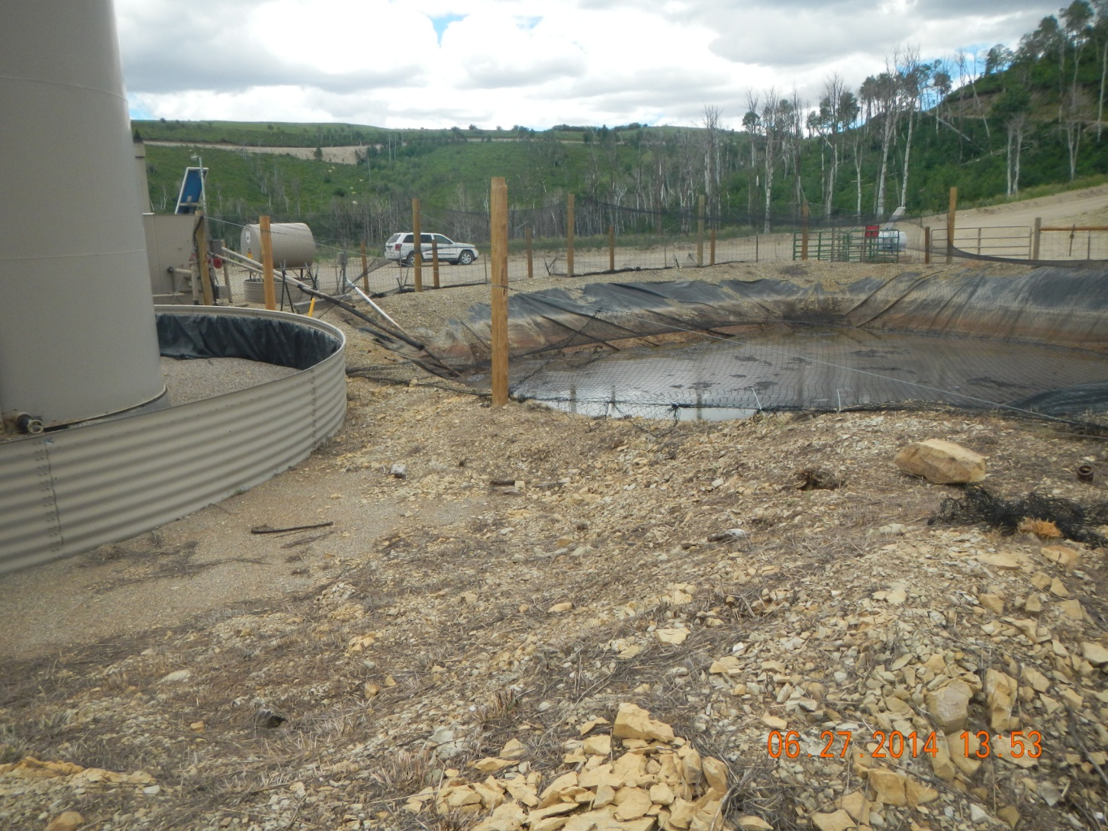
Gap in netting and ground

Slide 6
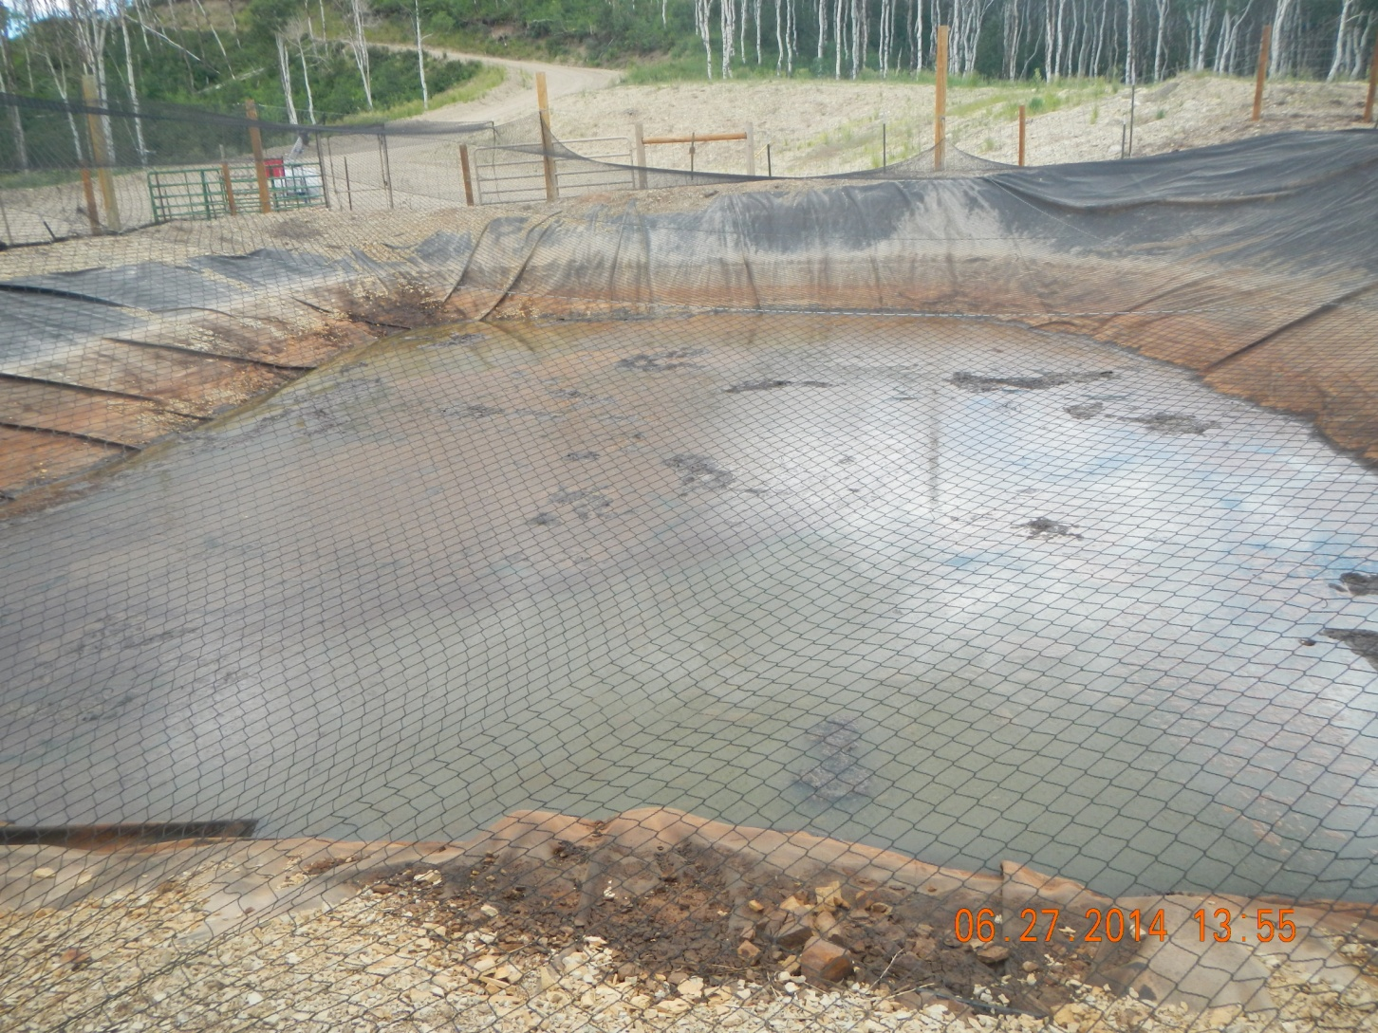
Stained Liner and Accumulation

Slide 7
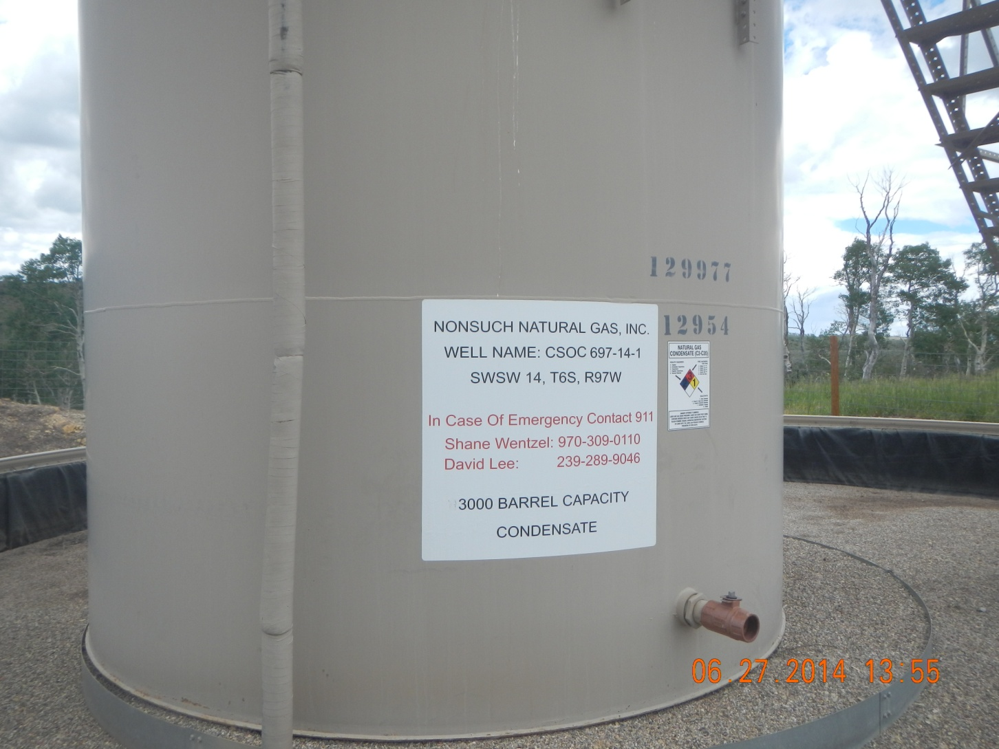
Incorrect volume on label

Slide 8
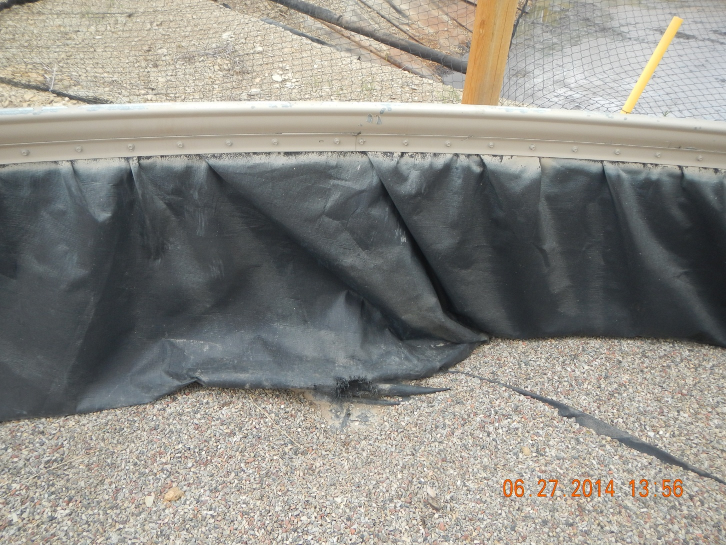
Hole in tank berm liner

