Slide 1
Non Such
Location id. # 324169

Slide 2
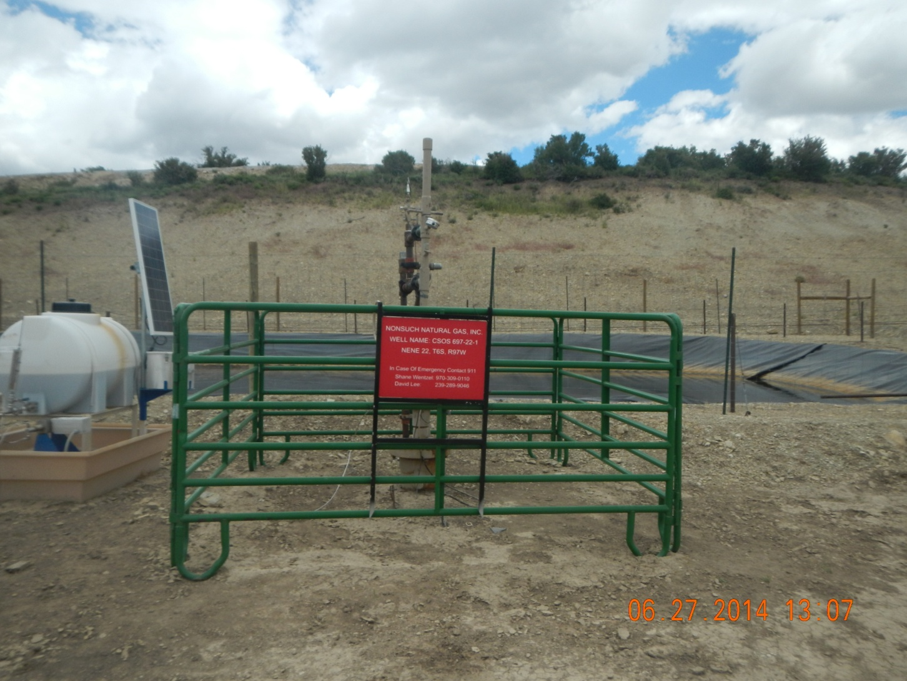

Slide 3
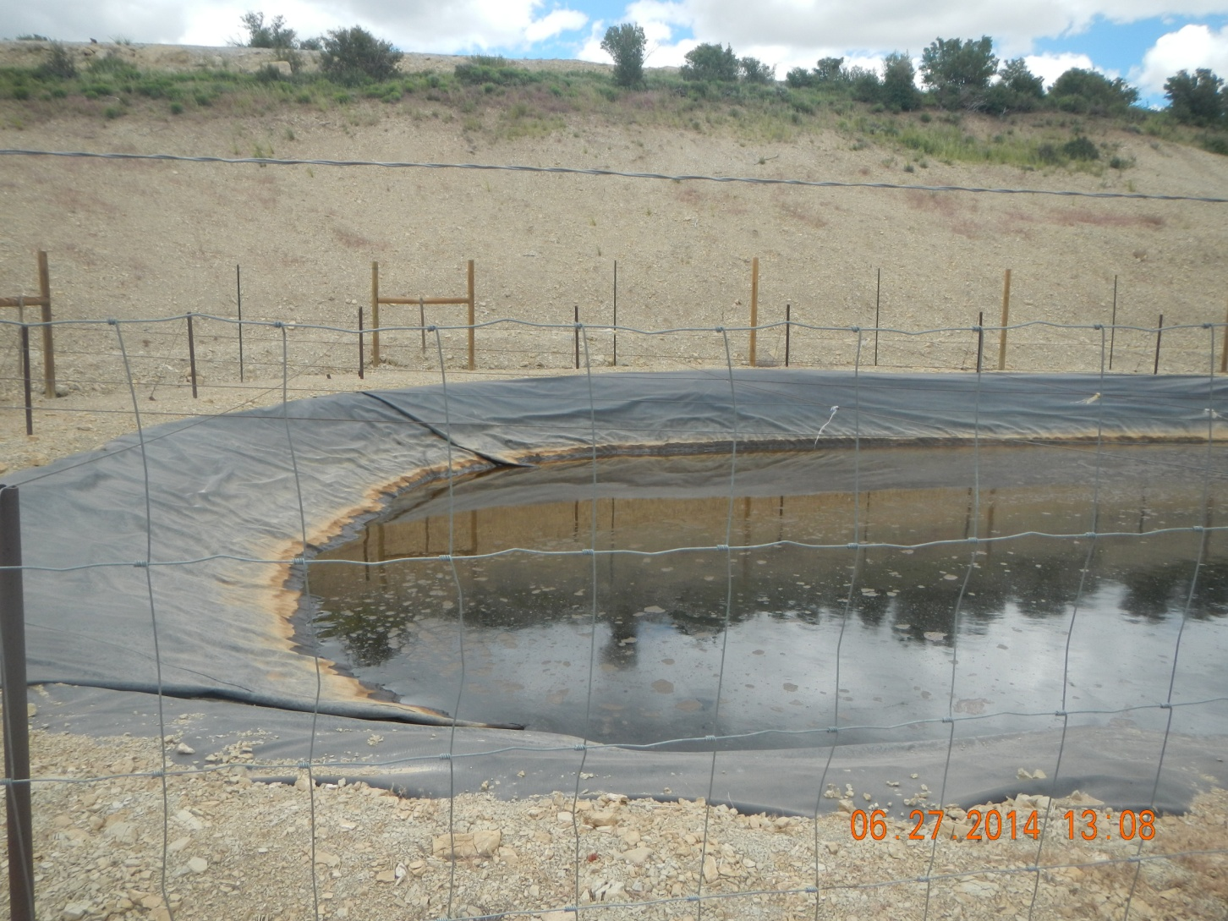
Oil Accumulation

Slide 4
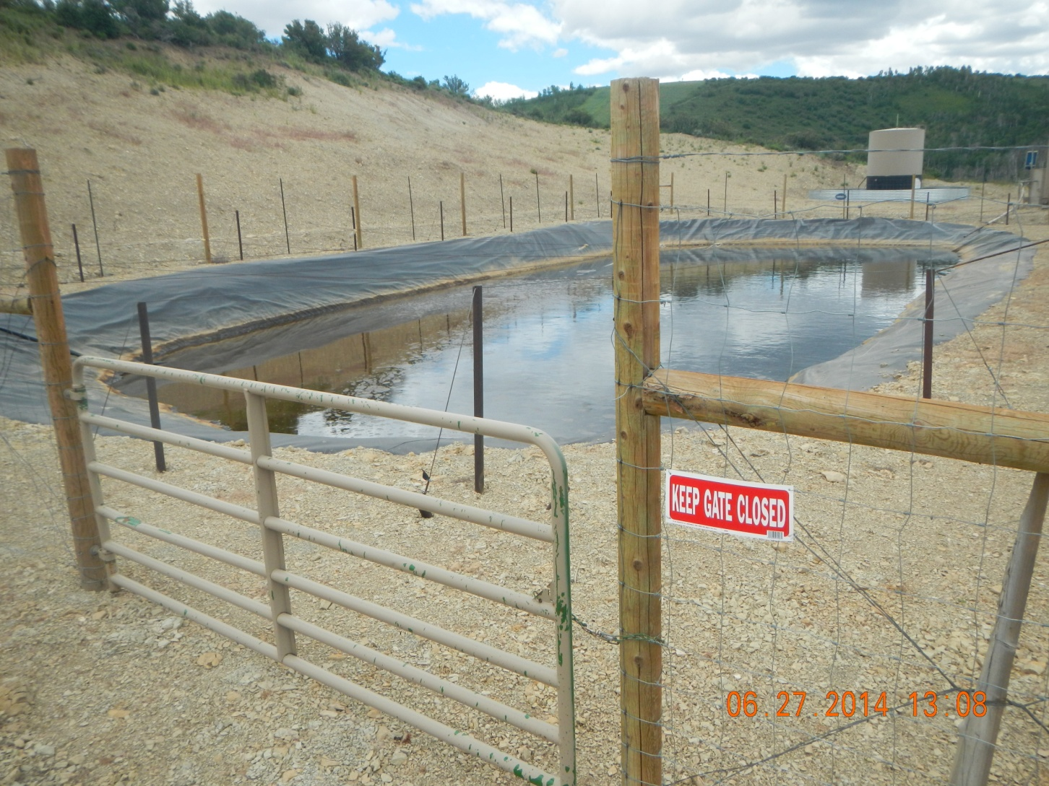
Miss match gate height

Slide 5
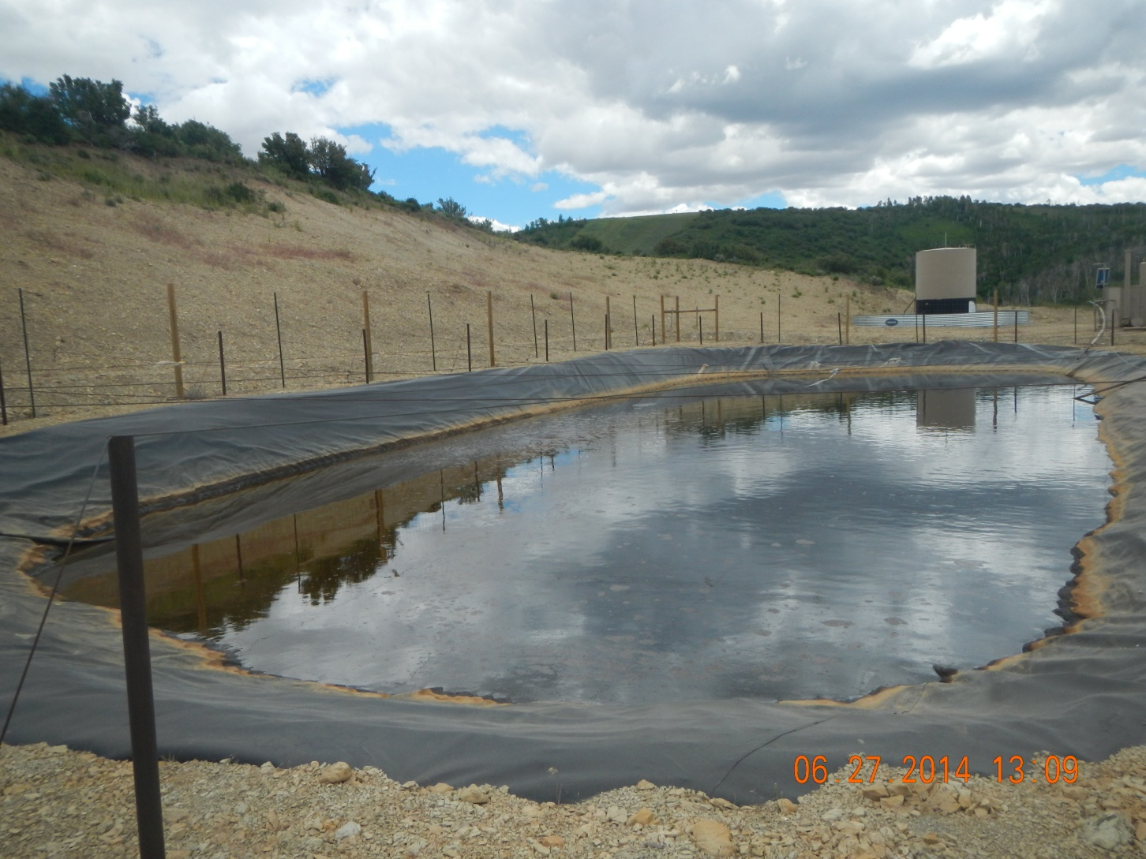
Netting not on pit

Slide 6
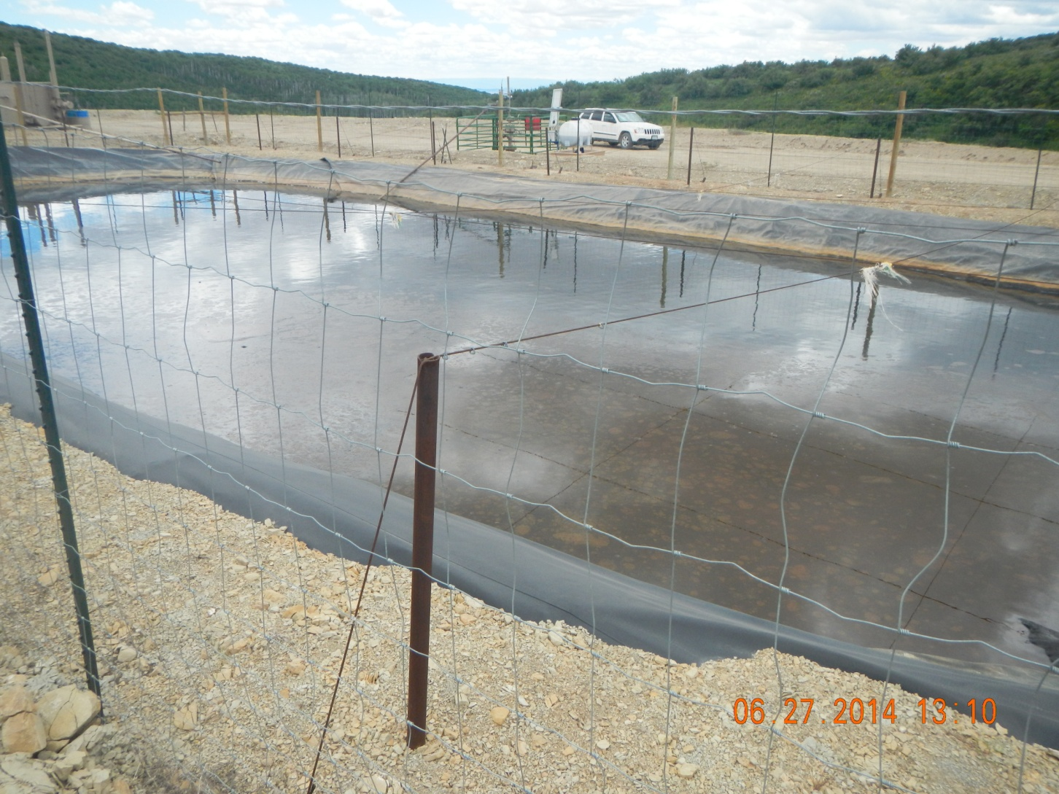
No Netting

Slide 7
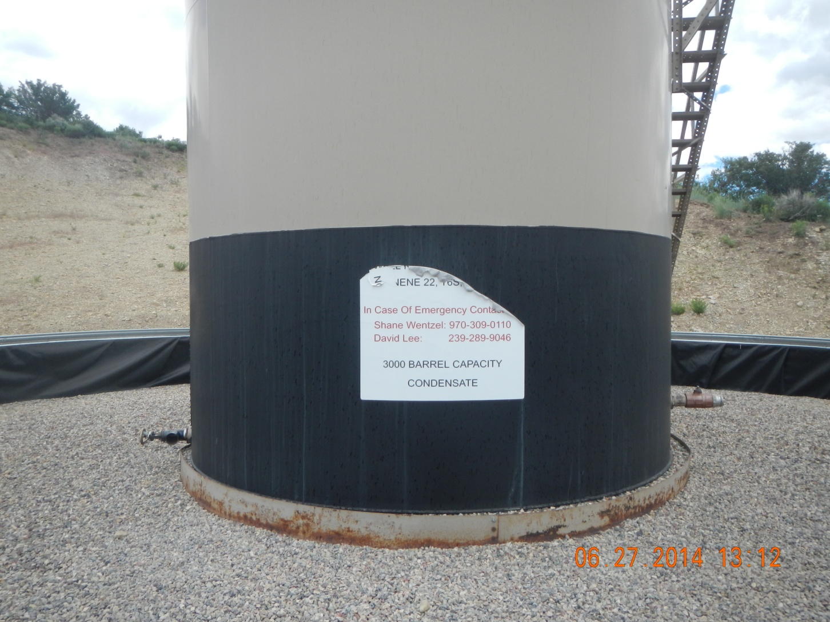
Label peeling and incorrect volume

