Slide 1
Reference Area Photographs
Inspection Conducted on June 02, 2014
Noble
Cass-Garber Pit
Pad 1B
Pit Facility ID # 288684
Location ID # 334129
Spill/Release ID # 437294 (per e-Form 19)
Photos taken by Carlos Lujan

Slide 2
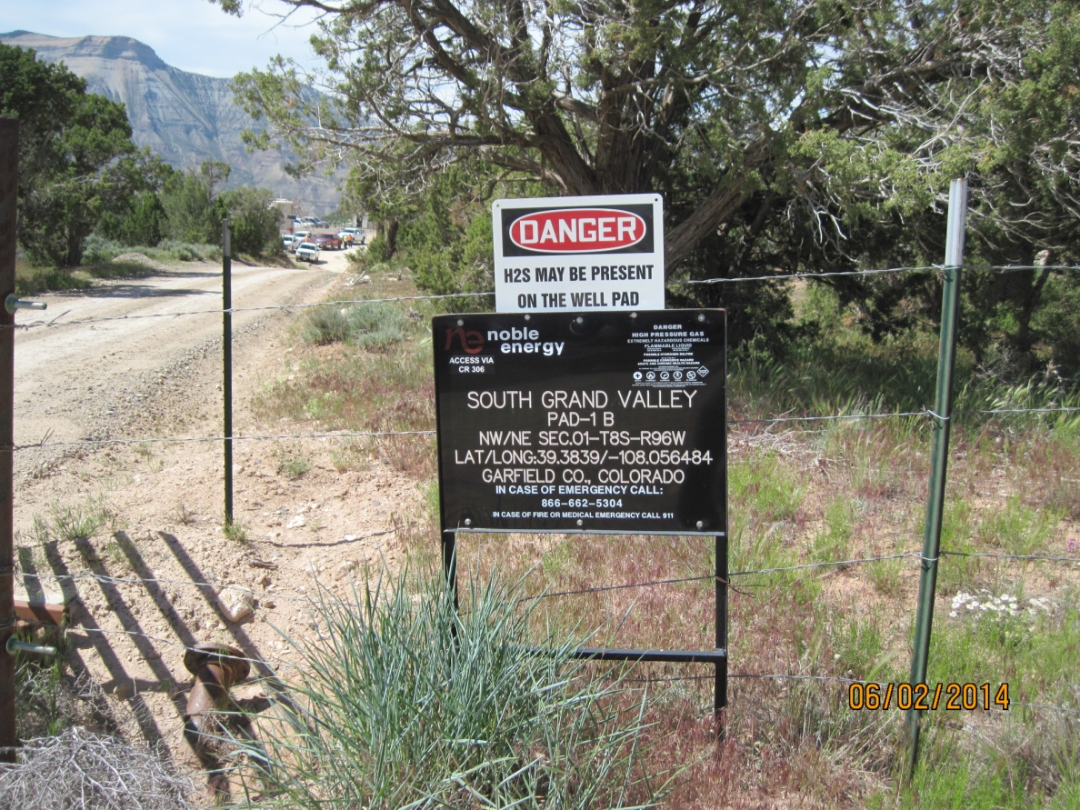
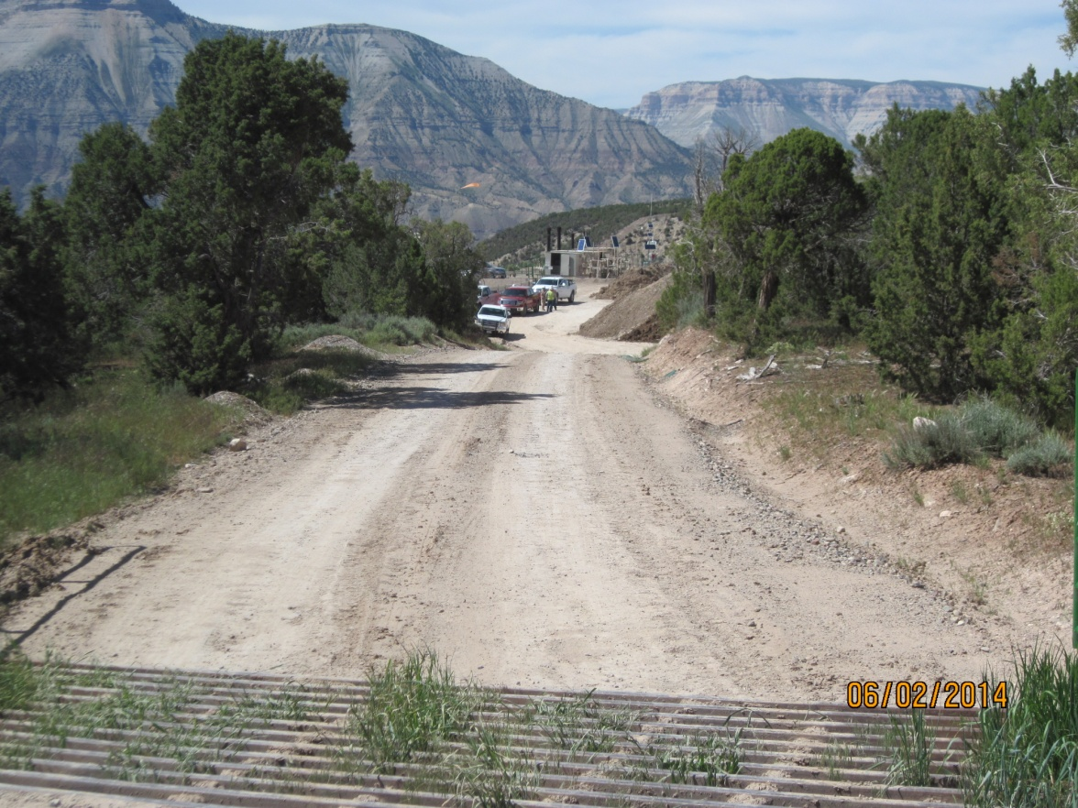
Noble Cass-Garber Pit (Pit Facility ID # 288684)
Sign at the Site Entrance
Access to the Site

Slide 3
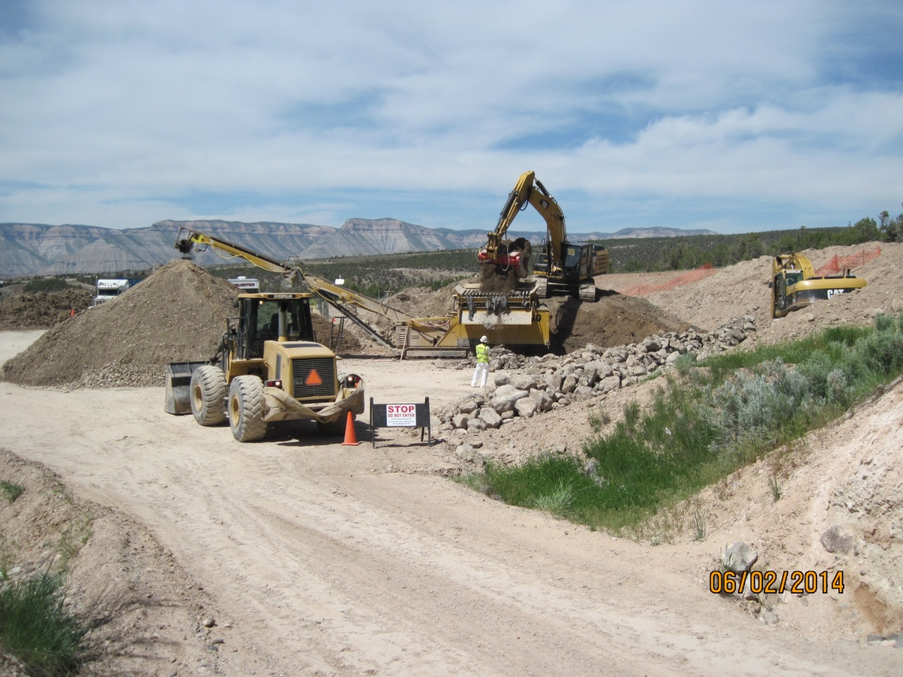
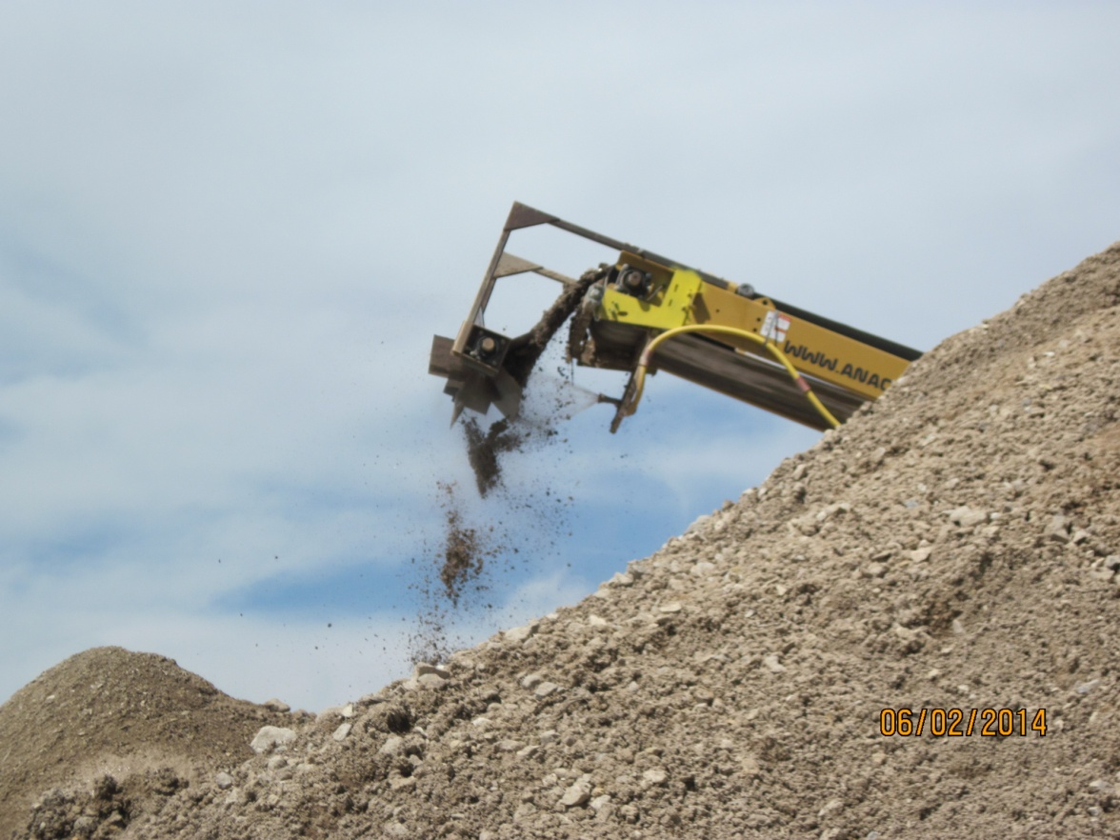
Noble Cass-Garber Pit (Pit Facility ID # 288684)
Sieving material to remove large rocks and pieces of liner
Spraying soil with Hydrogen Peroxide

Slide 4
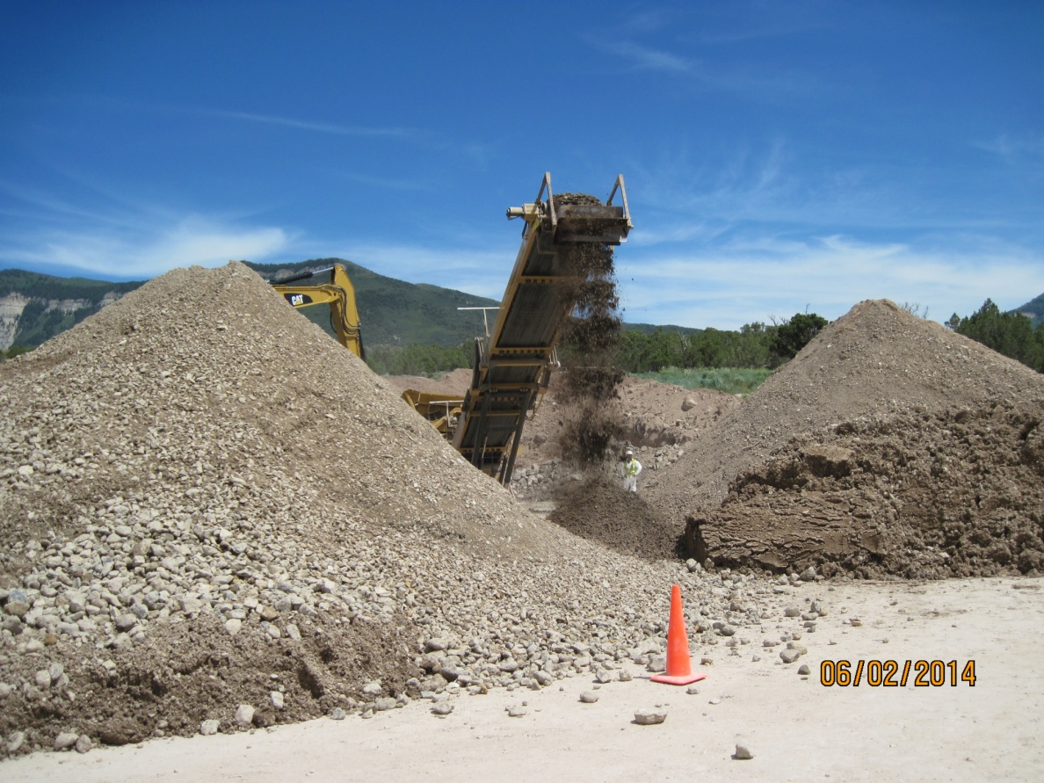
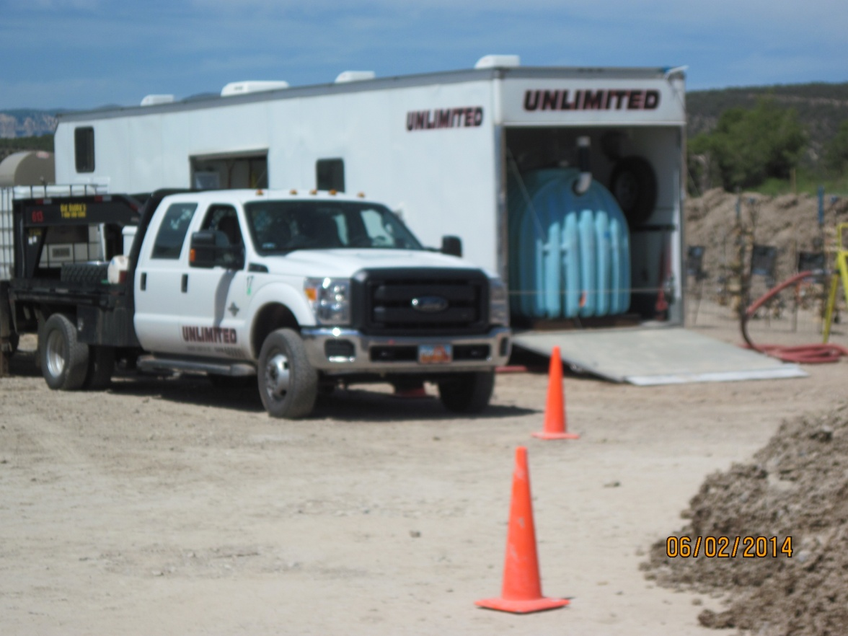
Noble Cass-Garber Pit (Pit Facility ID # 288684)
Stockpiles of treated soil
Two tanks with water and hydrogen peroxide.
Computerized system.

