Slide 1
Reference Area Photographs
Inspection Conducted on May 27, 2014
Oxy Location ID #33404
Photos taken by Stan Spencer

Slide 2
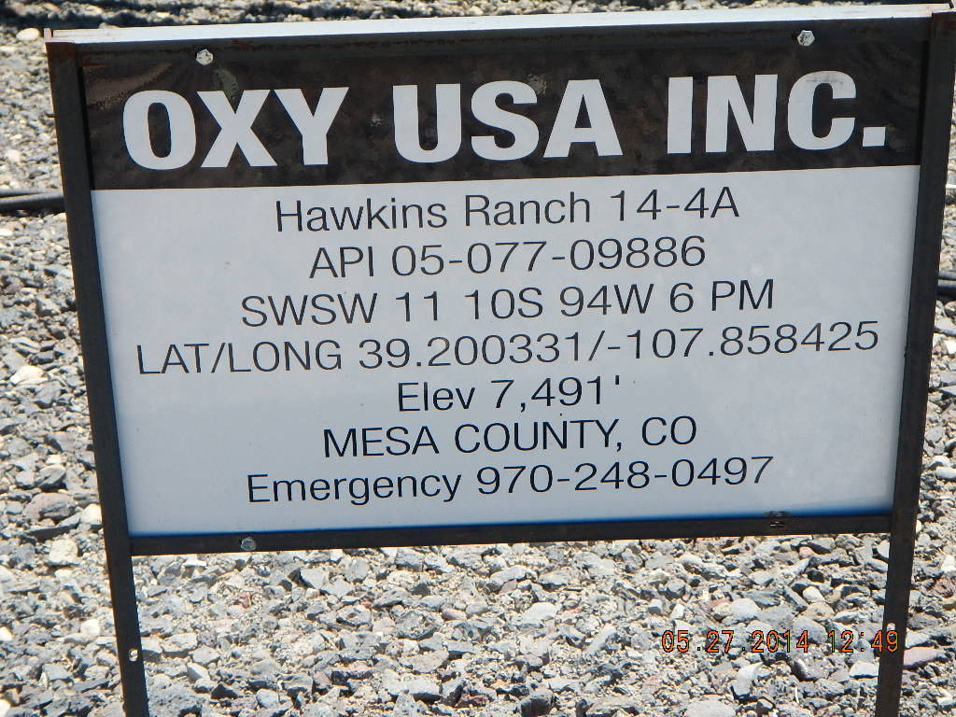
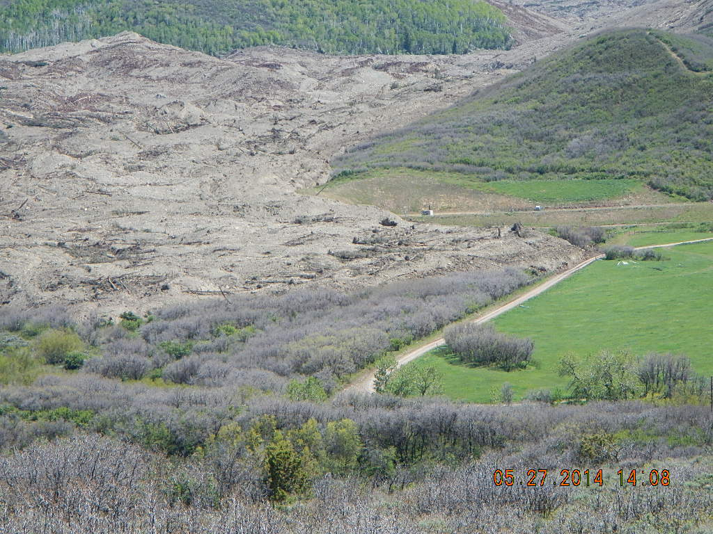
OXY USA Inc.- Location 333404
View of pad from north on center right edge of mudflow.

Slide 3
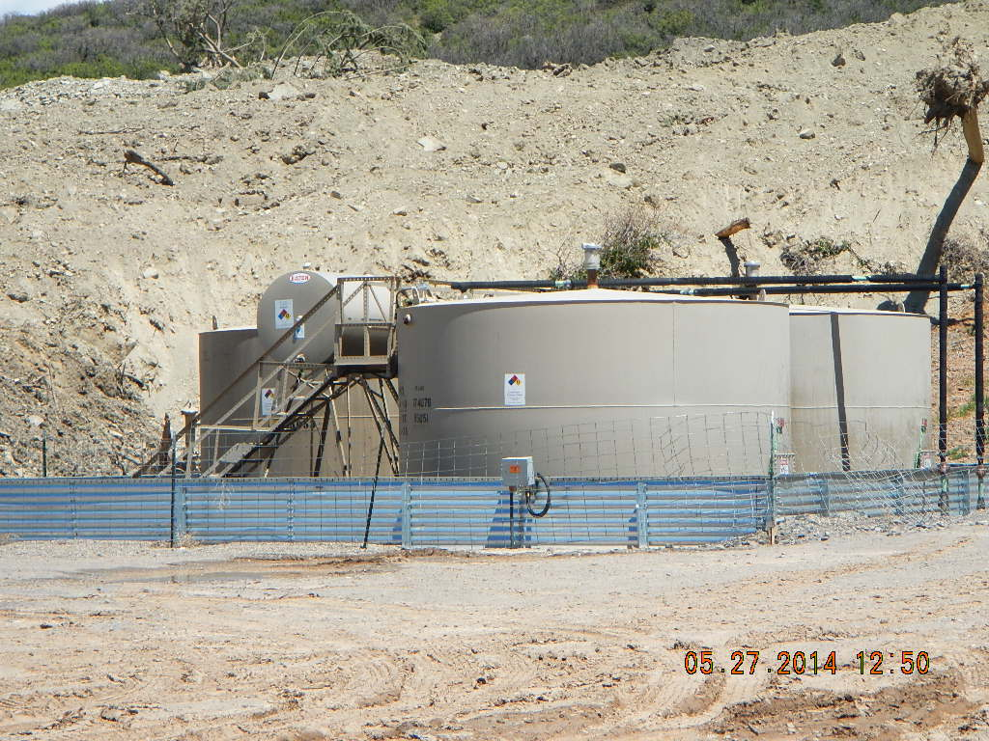
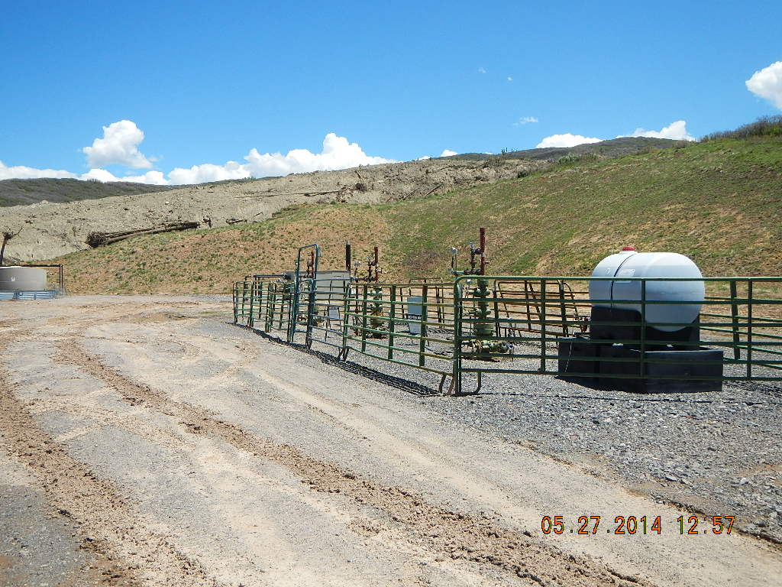
OXY USA Inc.- Location 33404
Looking east at tank battery adjacent to mudflow. Tanks have been drained.
Looking east at wellhead position relative to mudflow. All three wells are shut in.

Slide 4
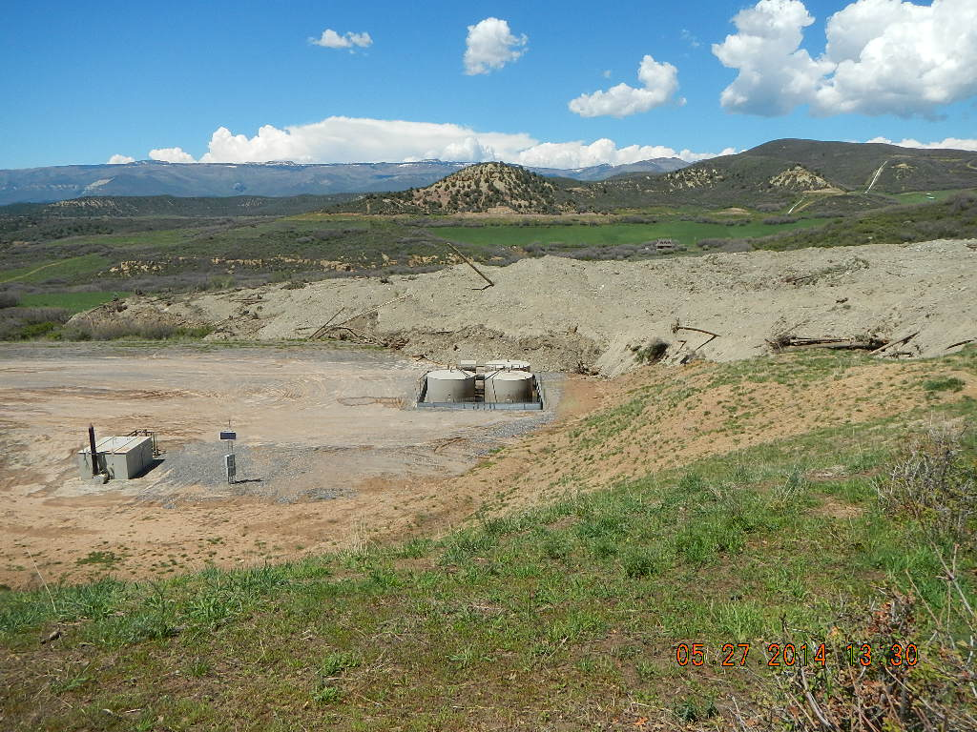
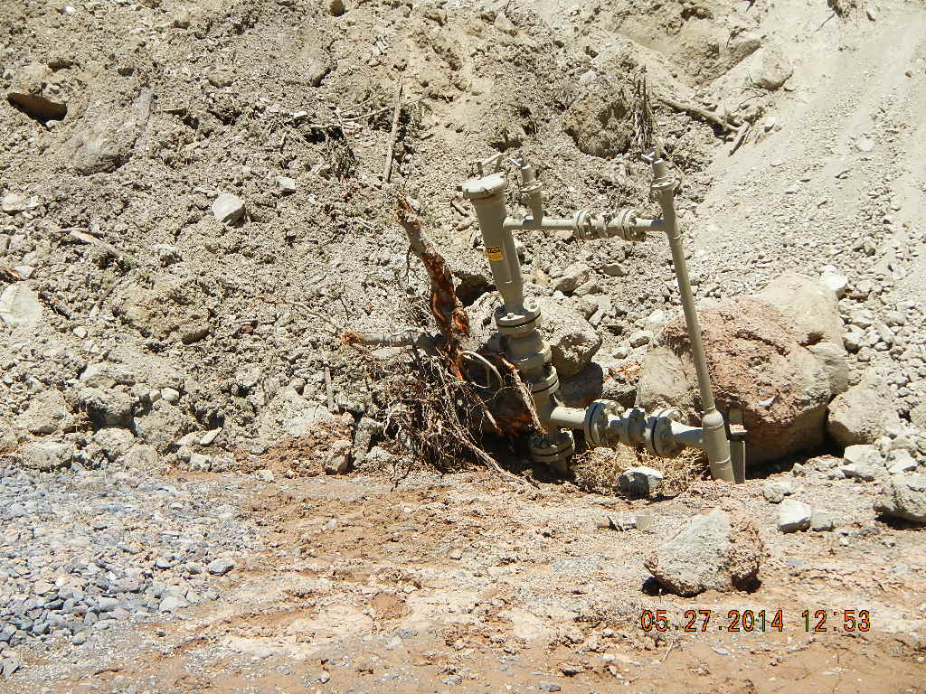
OXY USA Inc.- Location 33404
View of pad from southeast
Damaged pipelineriser terminus at northeast edge of pad. Pipeline has been drained and purged.

