Slide 1
Reference Area Photographs
Inspection Conducted on April 23, 2014
Caerus Piceance LLC
Chevron 41-7D
Parachute Creek Road
Location ID #335652
Photos taken by Carlos Lujan

Slide 2
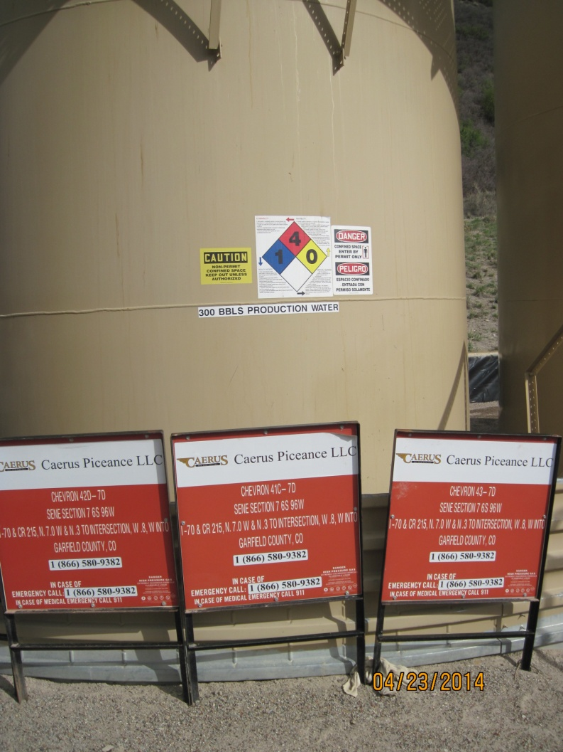
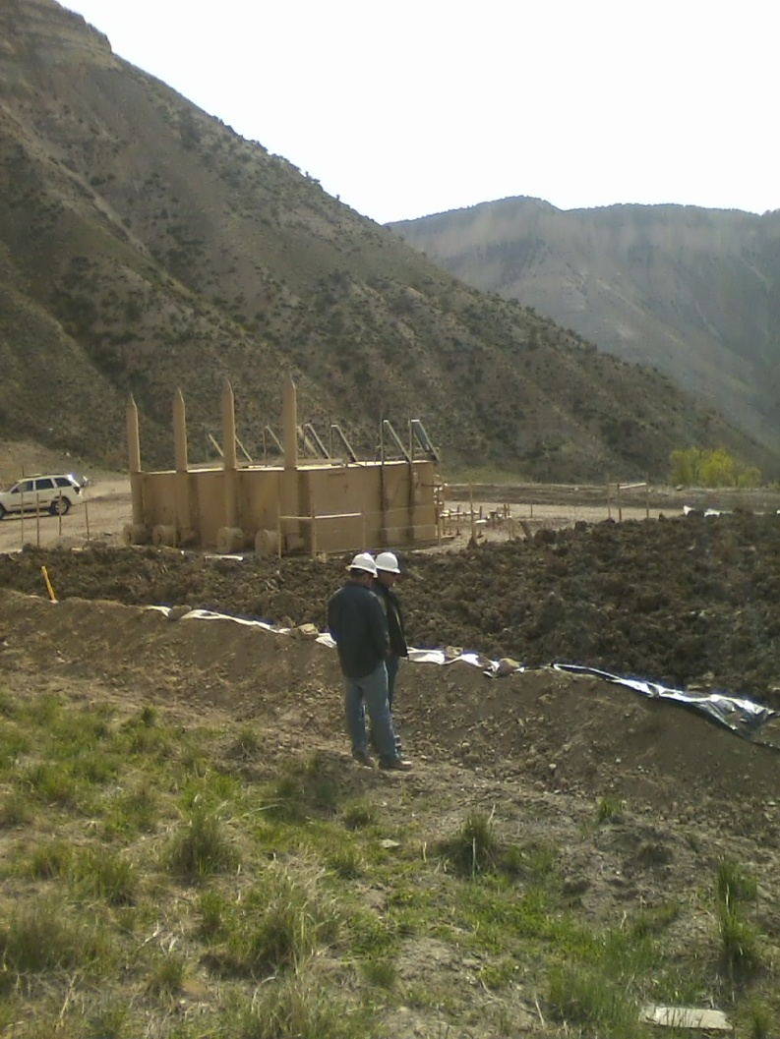
Caerus Chevron 41-7D
Tank Labels and Legal Description
Impacted material spread out in bermed area, about 3 to 4 feet thick.
Liner protection ineeds maintenance.
Berms too close to impacted material.

Slide 3
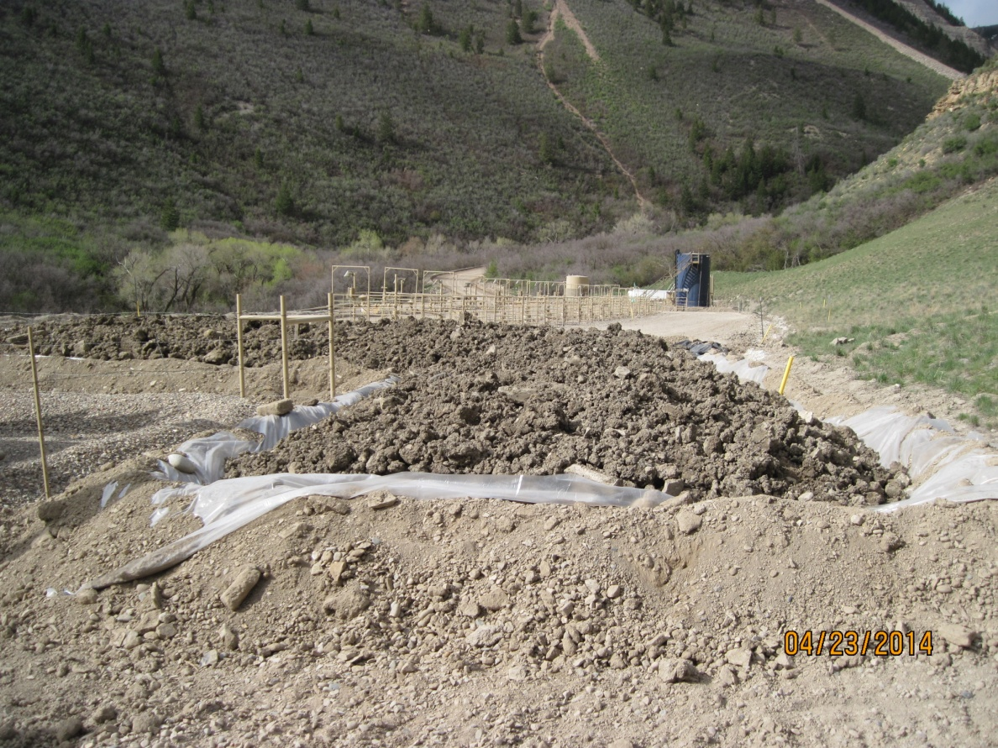
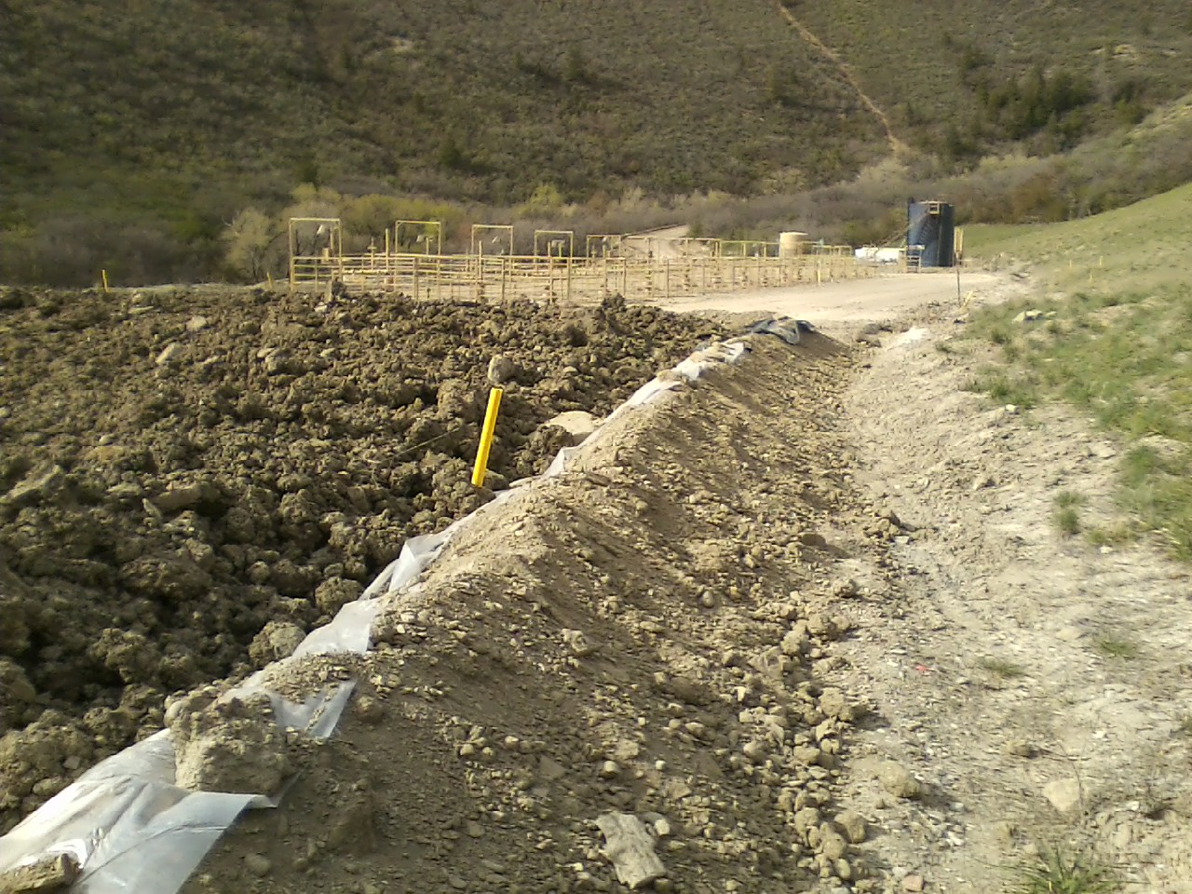
Caerus Chevron 41-7D
Liner needs maintenance. Impacted material spread too thick for effective landfarming.
Berm construction looks insufficient and too close to impacted material. Tilling operation difficult without compromising liner and berms.

Slide 4
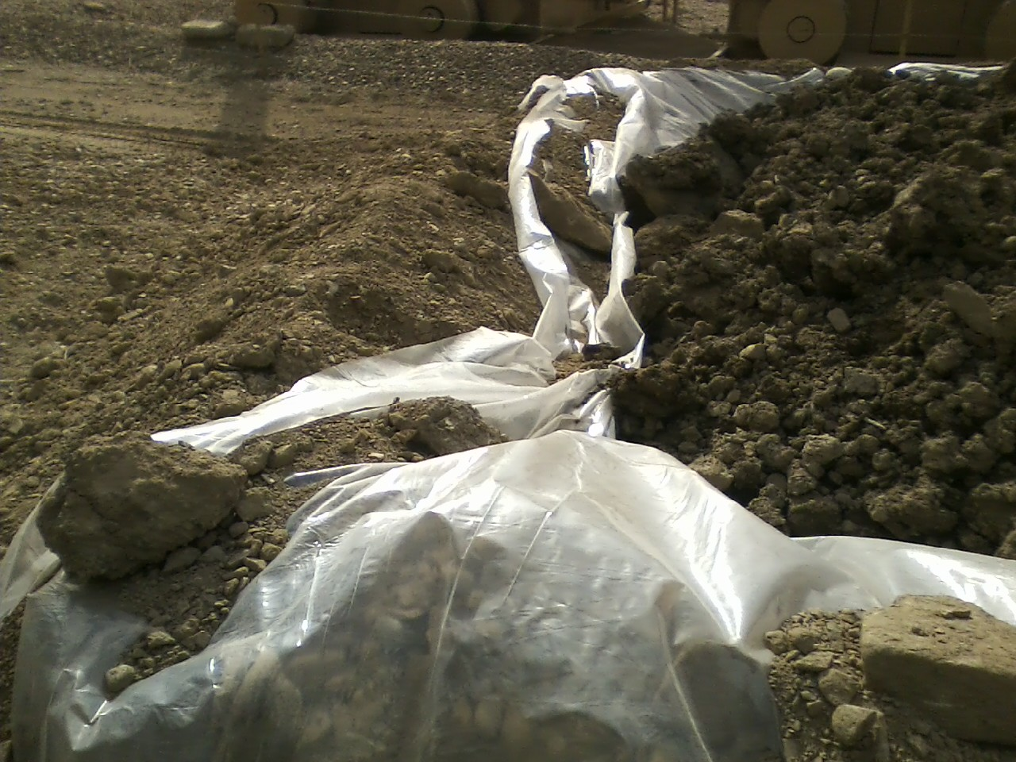
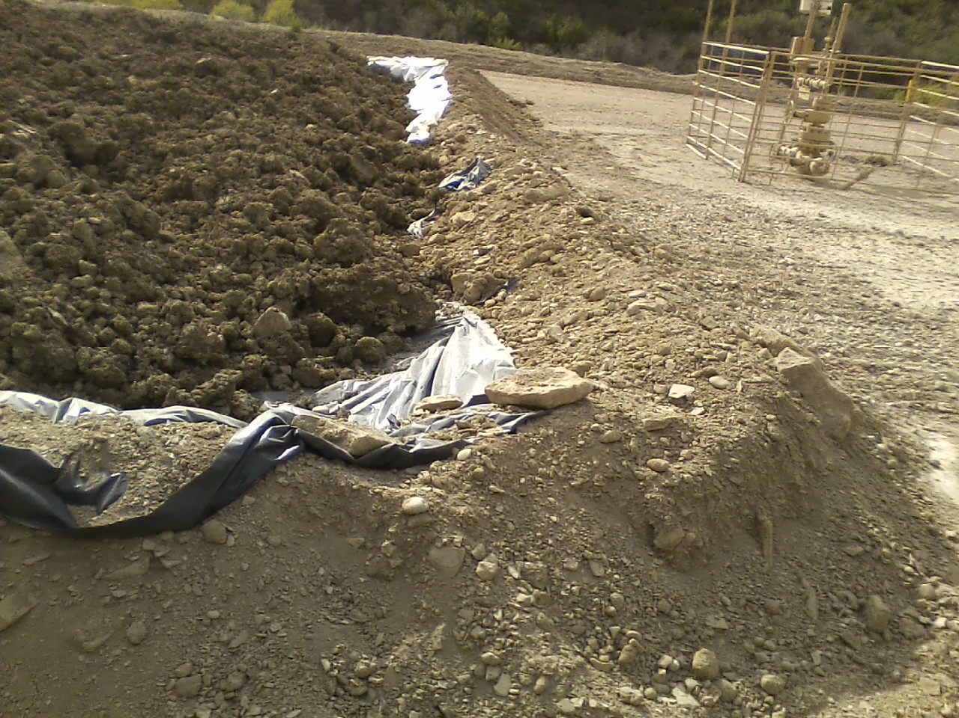
Caerus Chevron 41-7D
Maintenance required
Maintenance required

