Slide 1
Maralex Resources, Inc.
SULFUR GULCH #9-98-2 1
API # 05-077-08709
03/24/2014

Slide 2
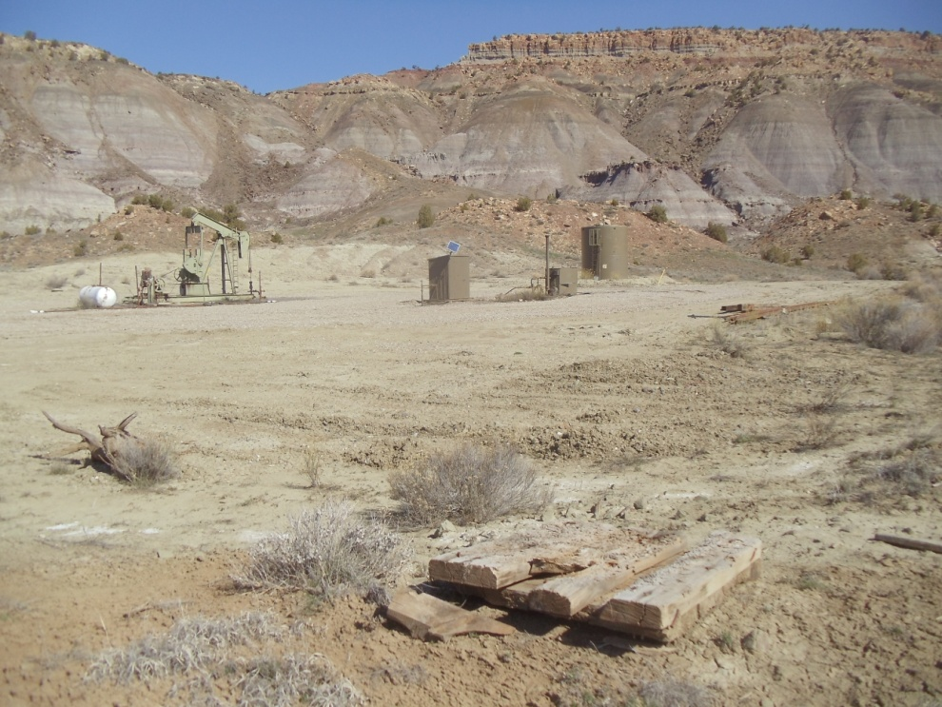
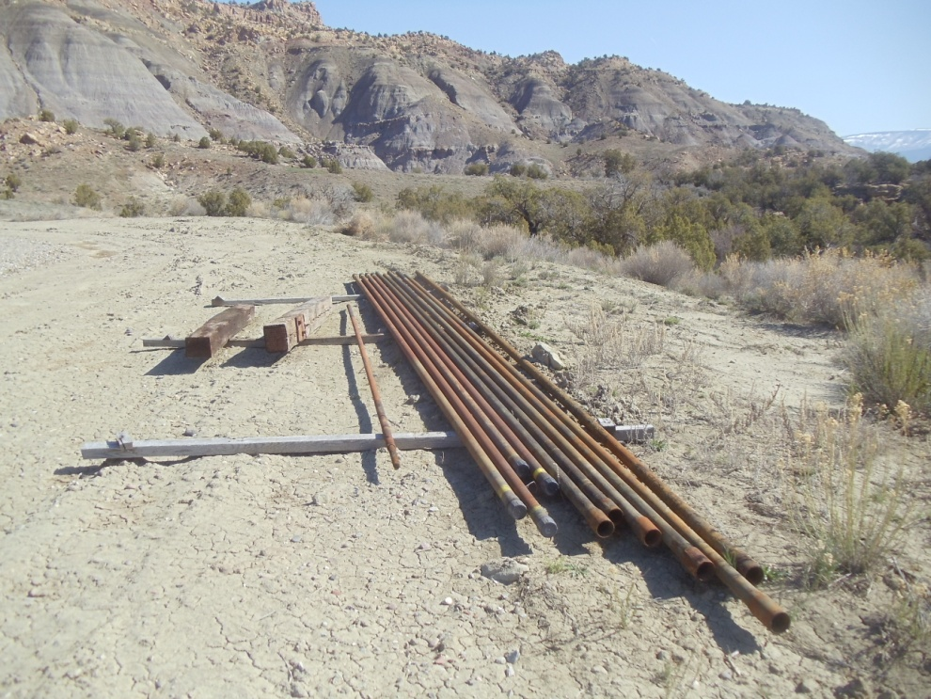
Wood planks
Used tubing & plunger

Slide 3
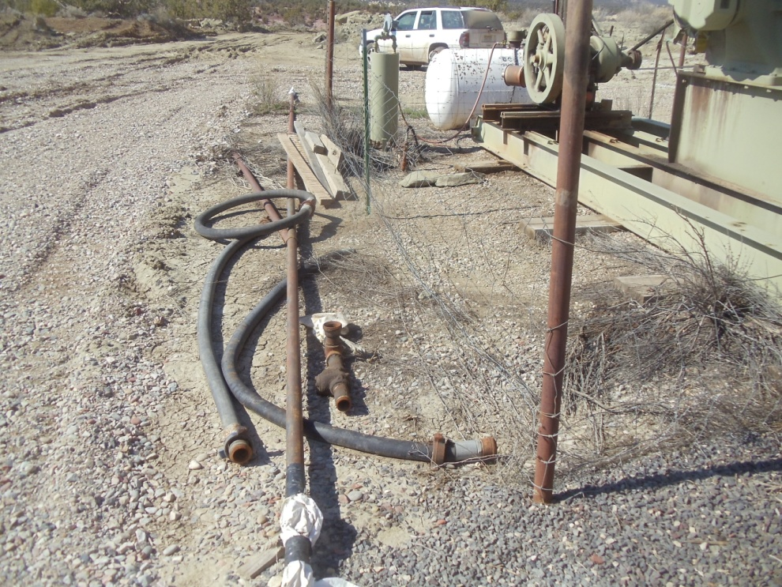
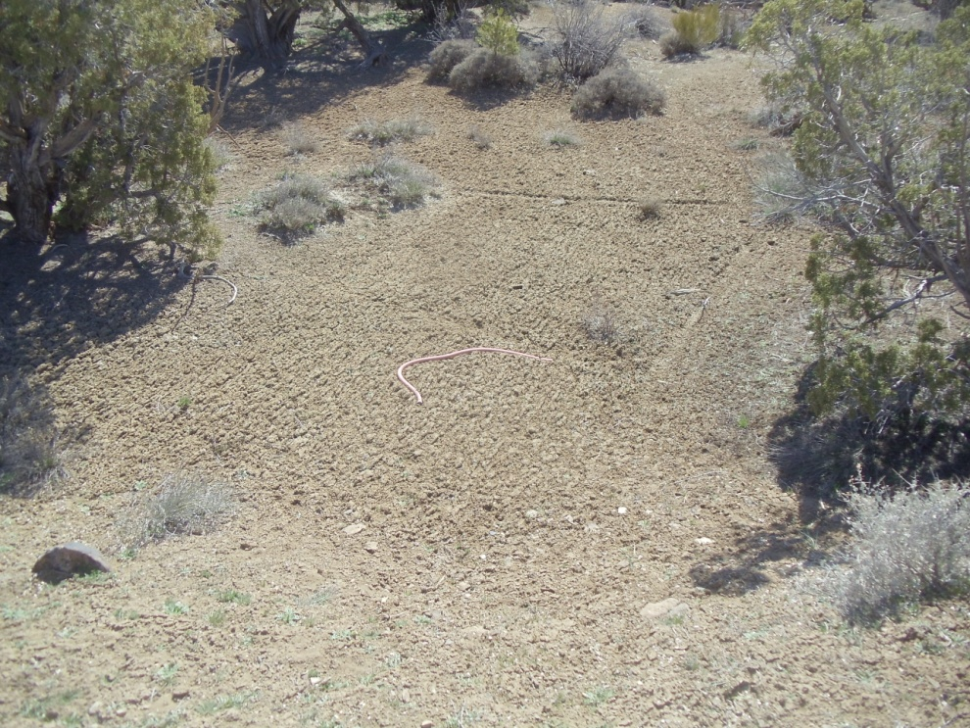
Hoses, planks, tubing,
Trash hose

Slide 4
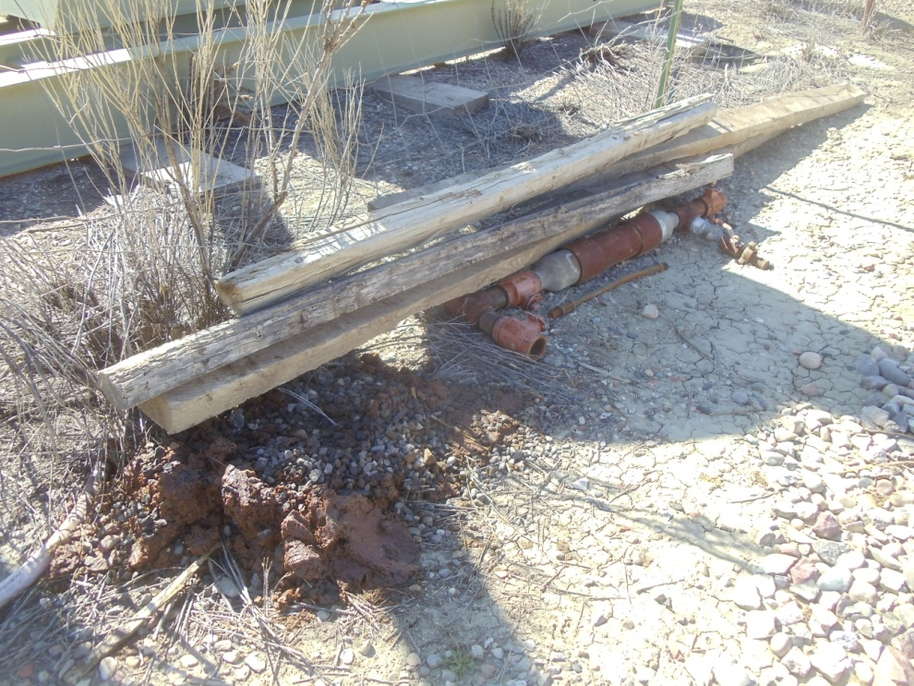
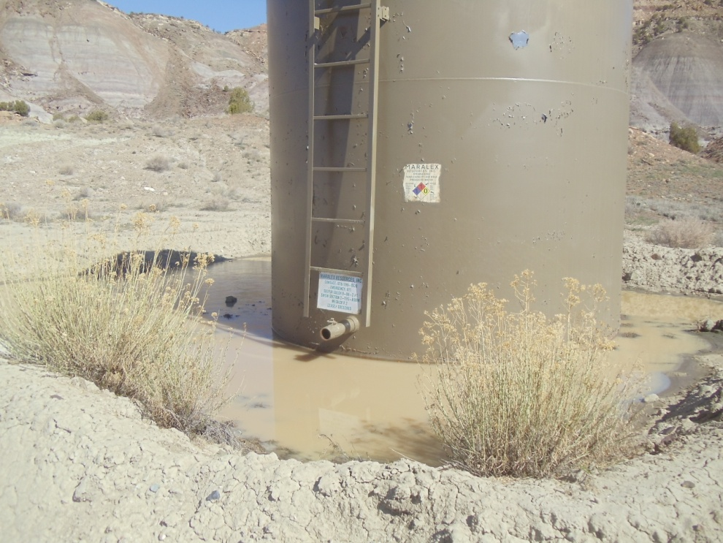
Hydrocarbon sludge, planks, piping
Standing water inside berm.

