Slide 1
Maralex
Sulfur Gulch 9-98-10 #2
Pictures taken
3/20/2012
8/30/2013
2/26/2014

Slide 2
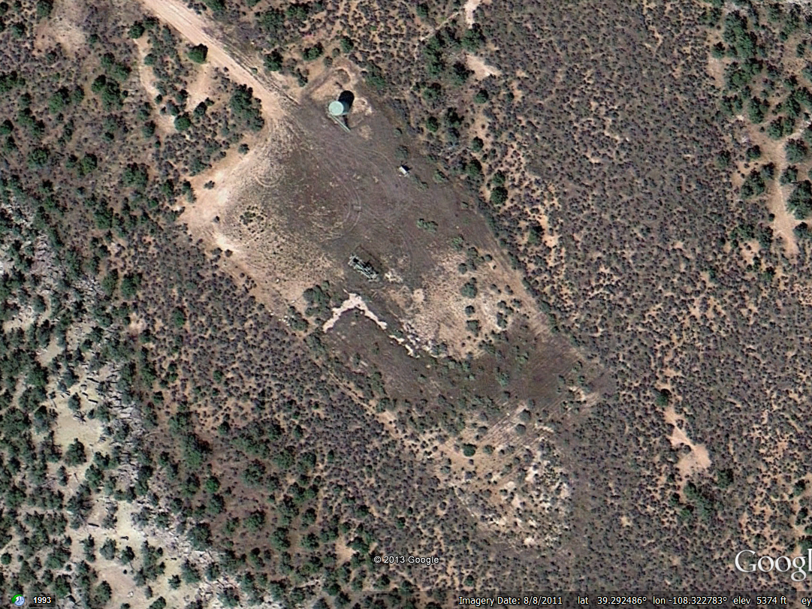
Tank ->
Separator ->
Pump Jack ->
Google Earth Image Date 8/8/2011, showing location and equipment.

Slide 3
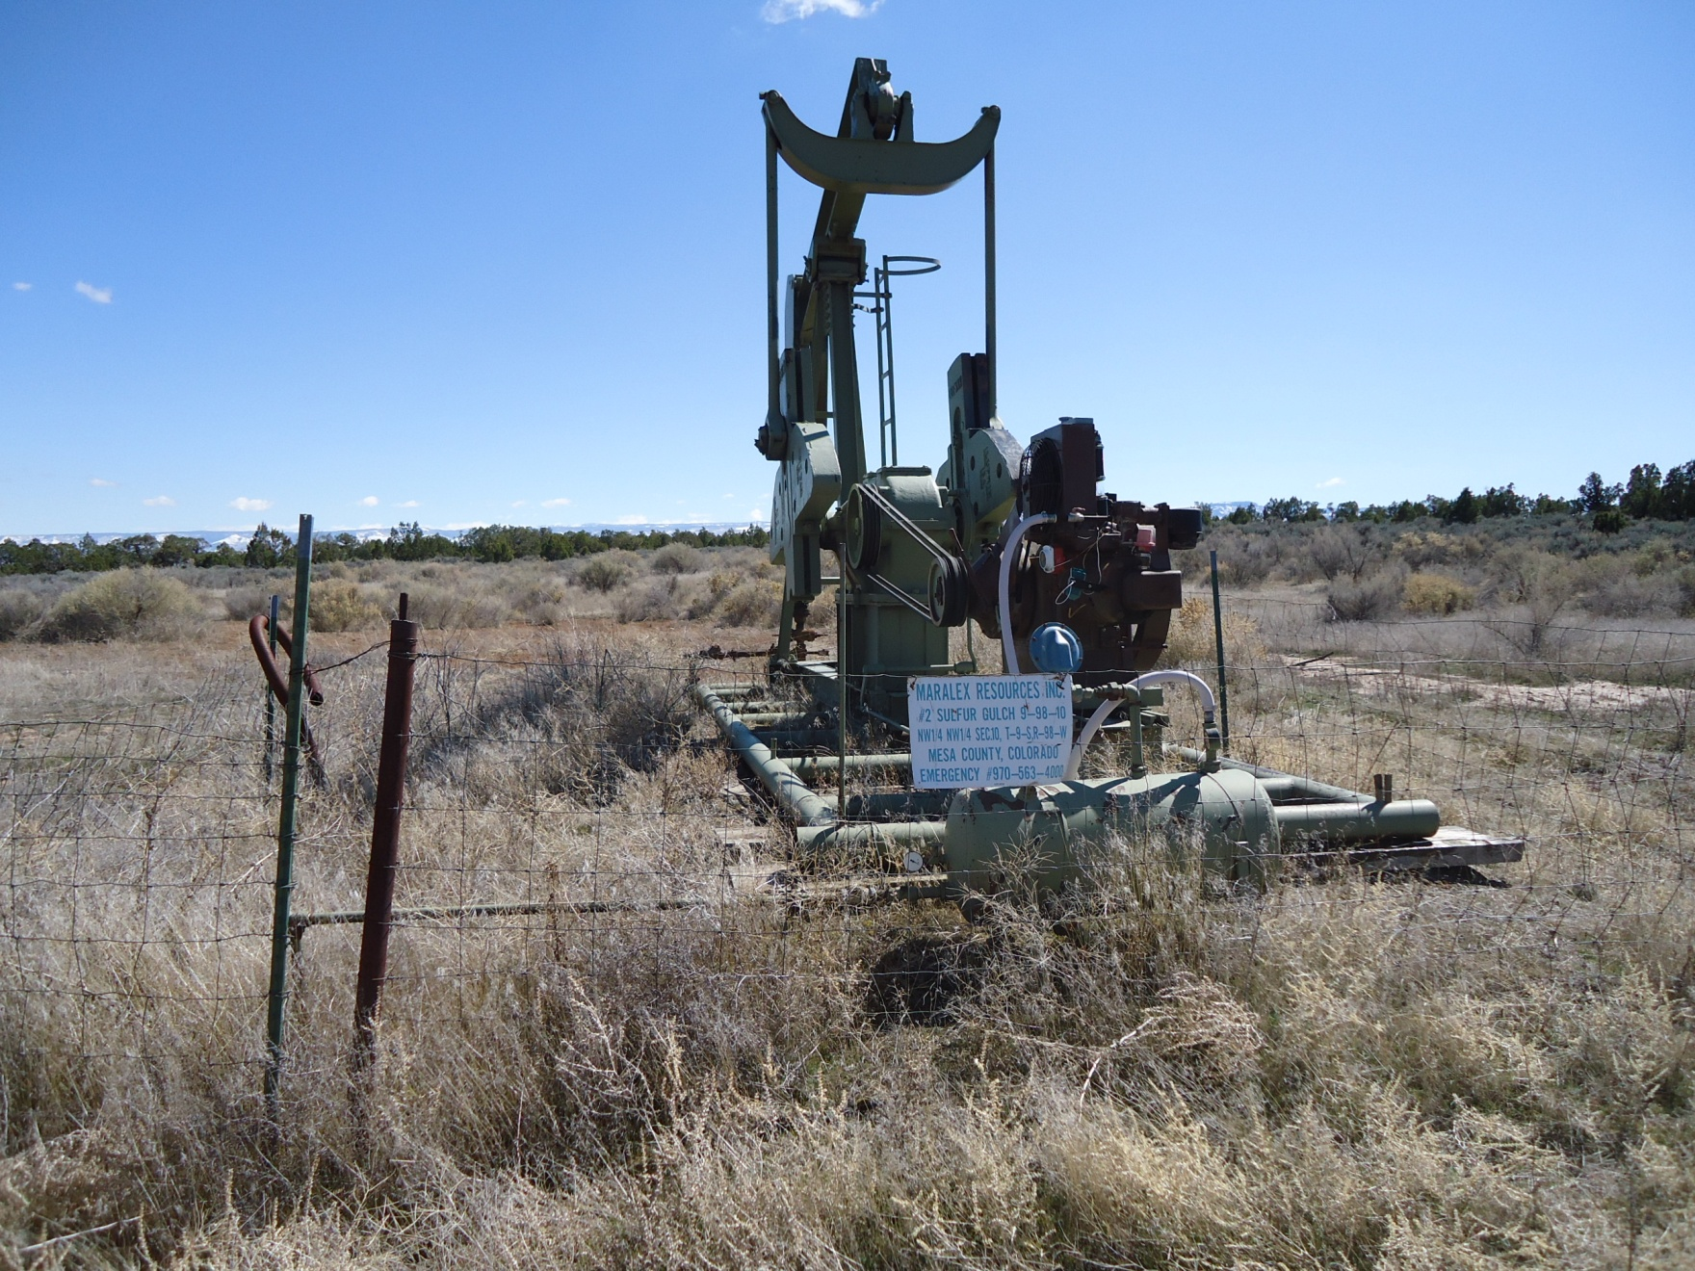
3/20/2012

Slide 4
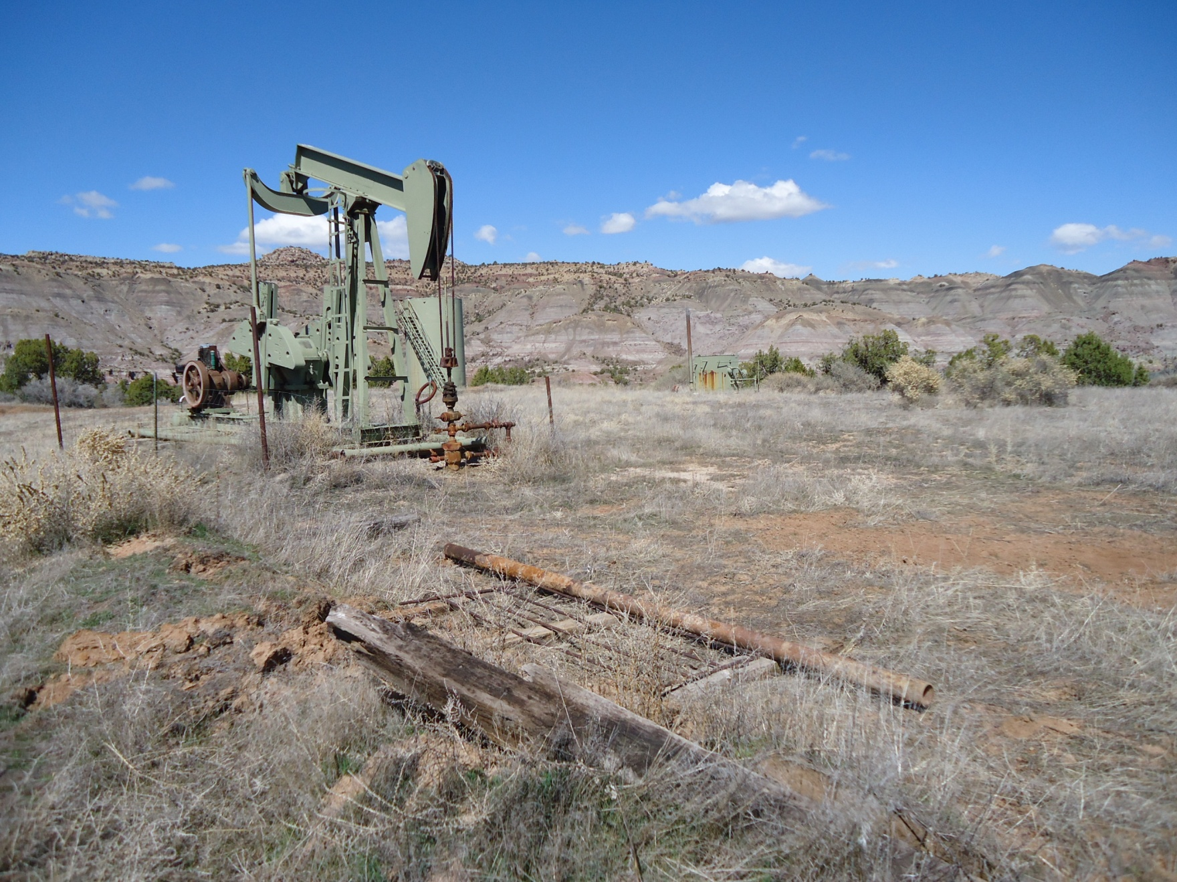
3/20/2012

Slide 5
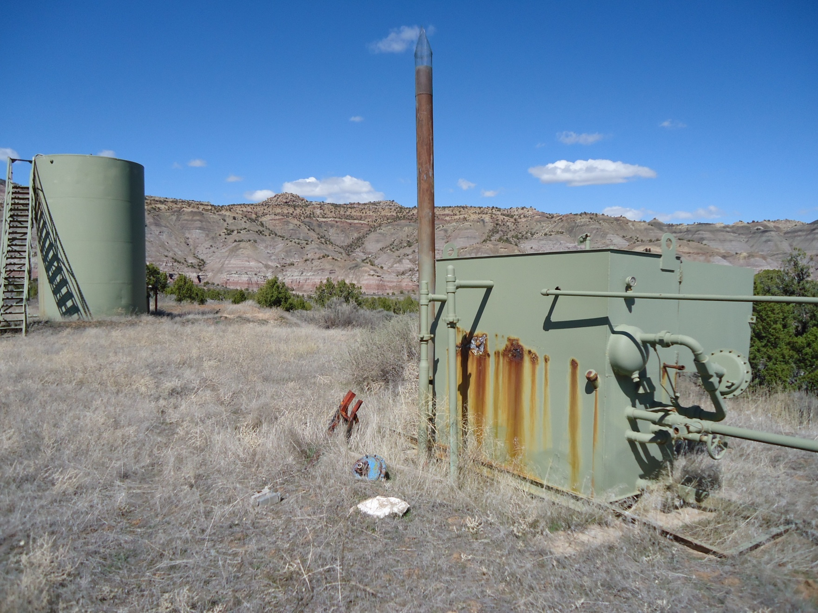
3/20/2012

Slide 6
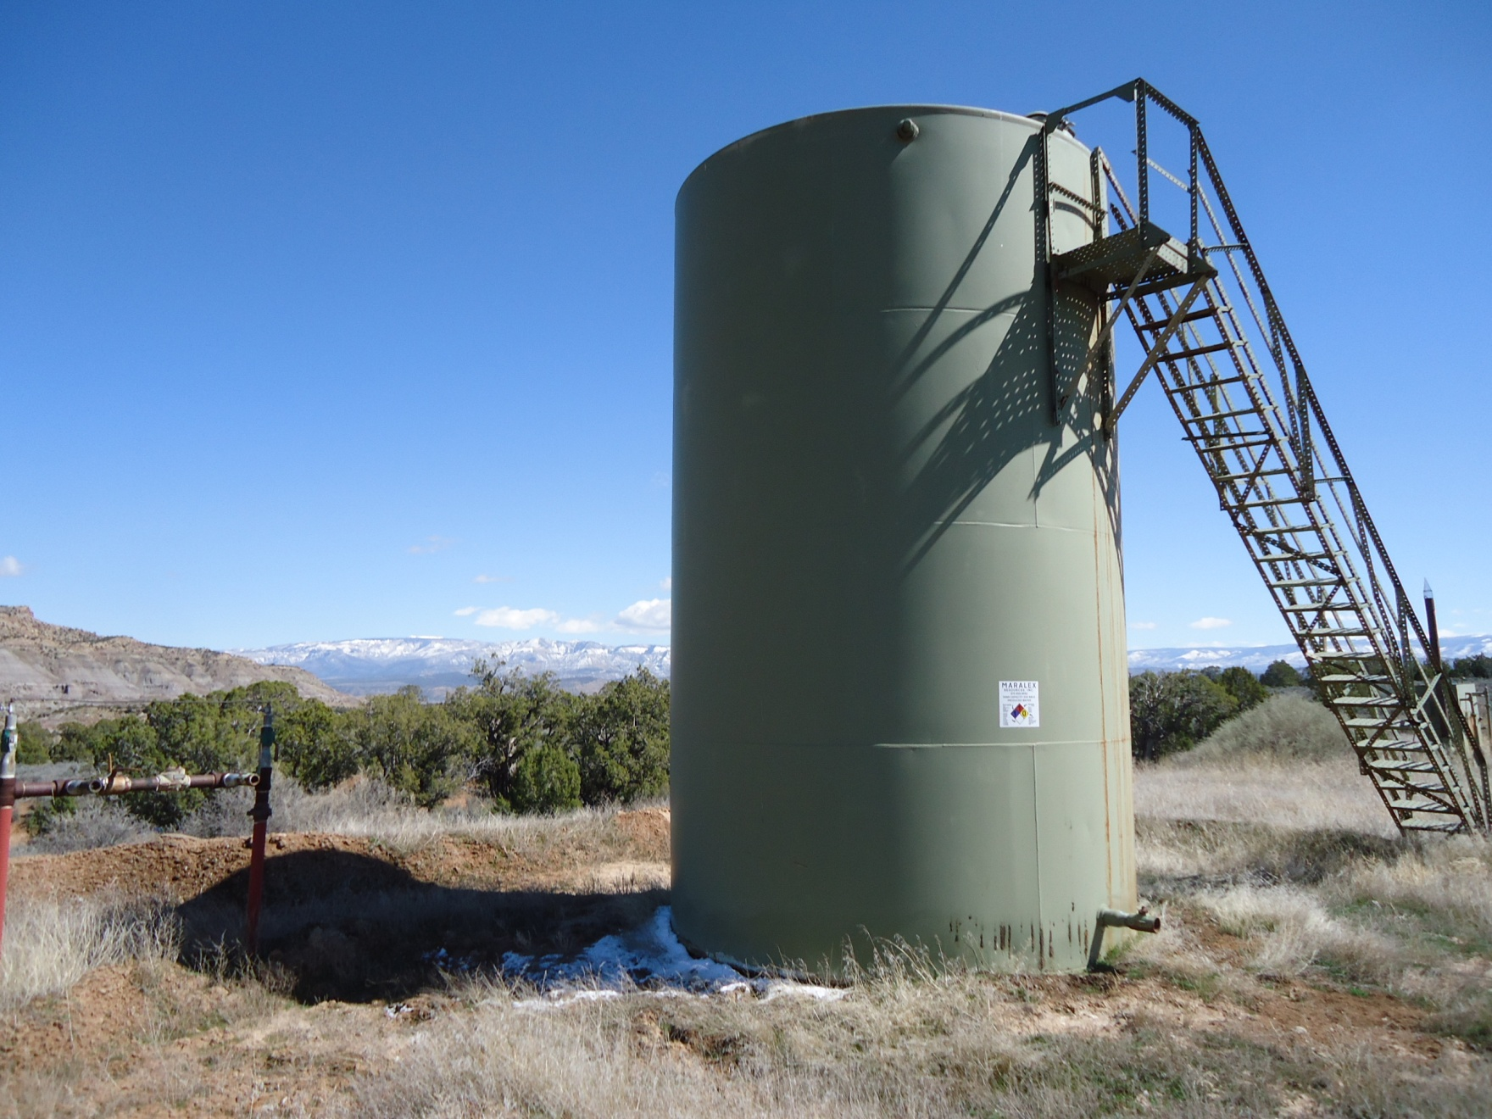
3/20/2012

Slide 7
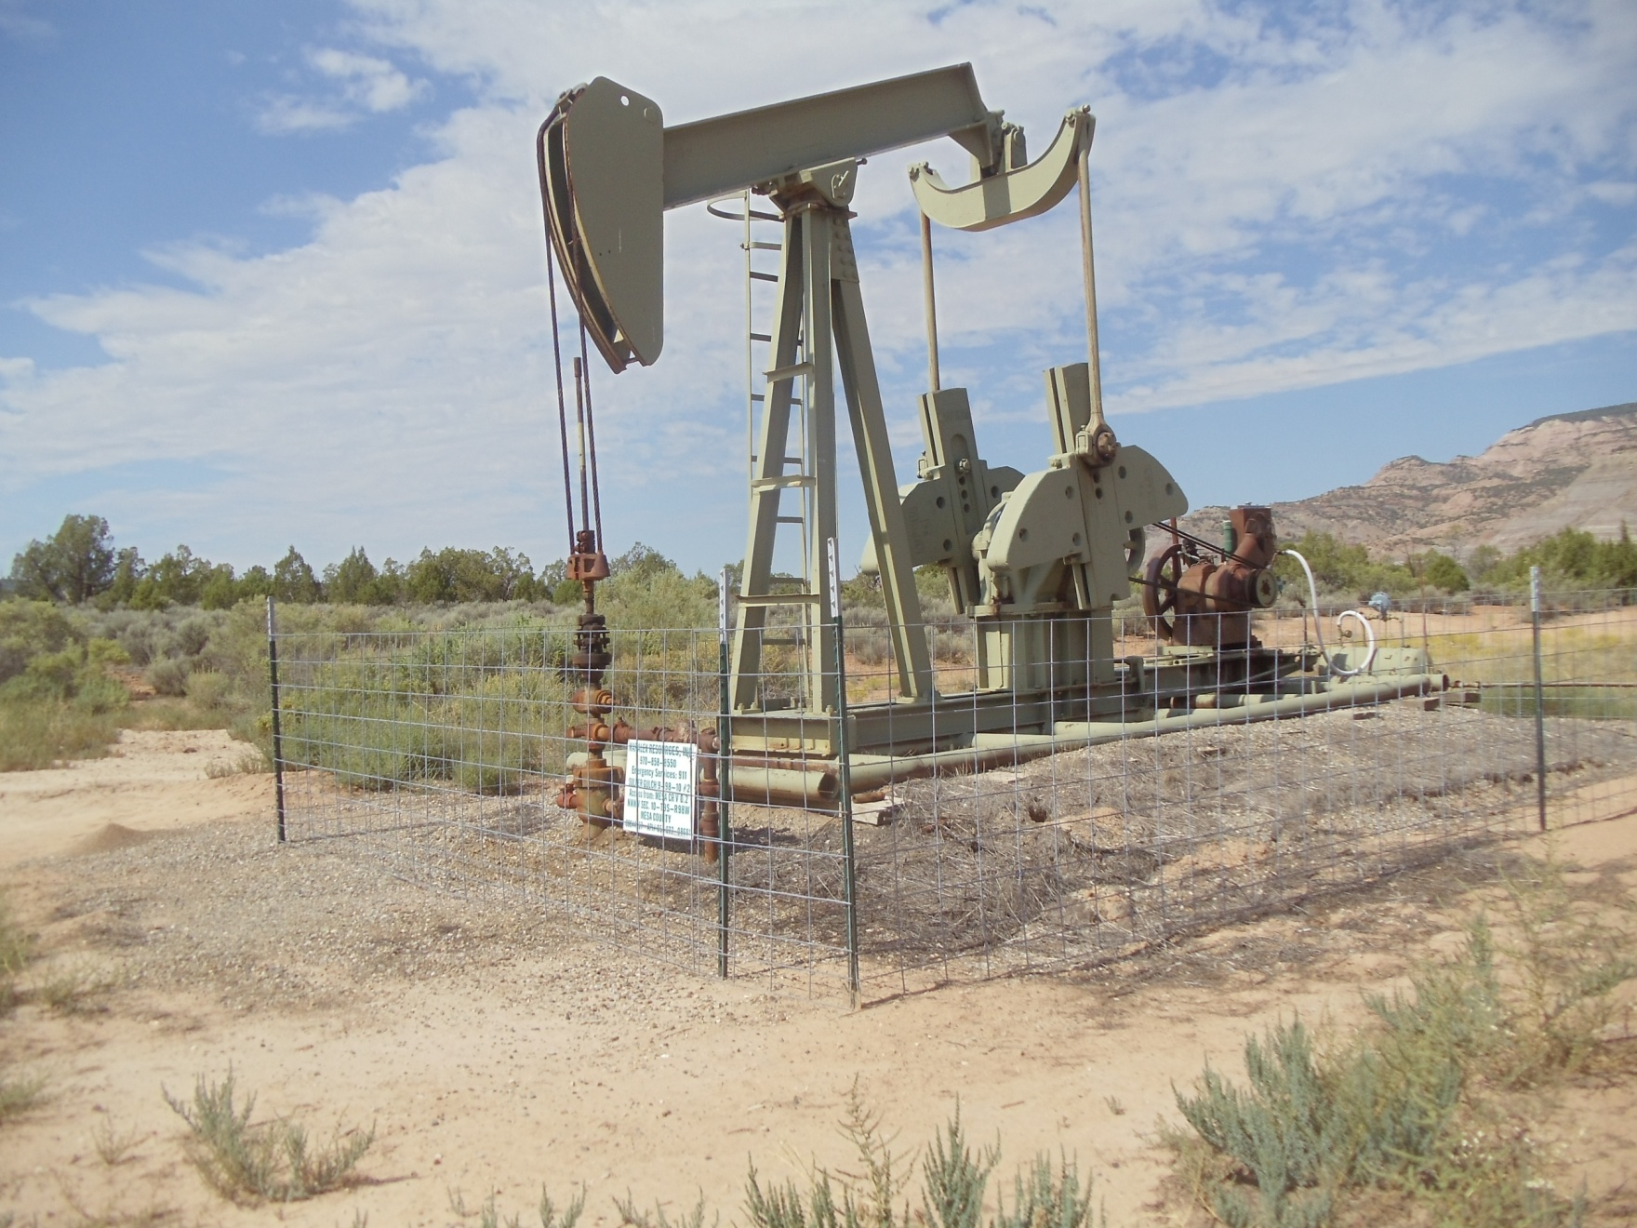
8/30/2013

Slide 8
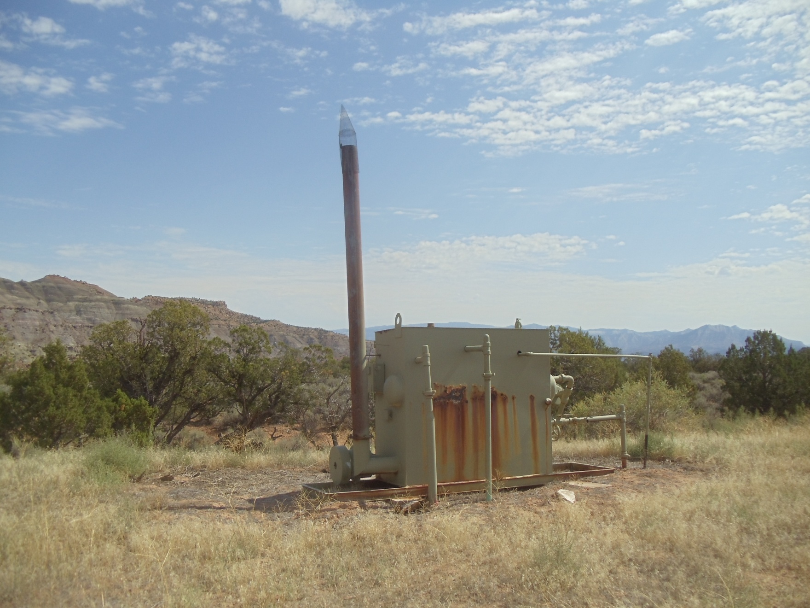
8/30/2013

Slide 9
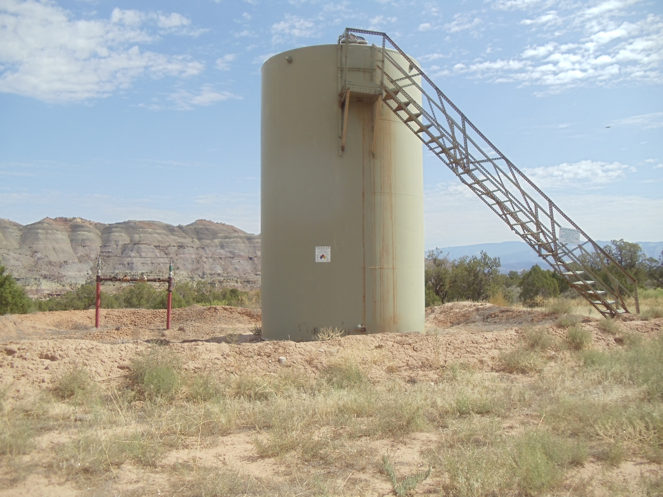
8/30/2013

Slide 10
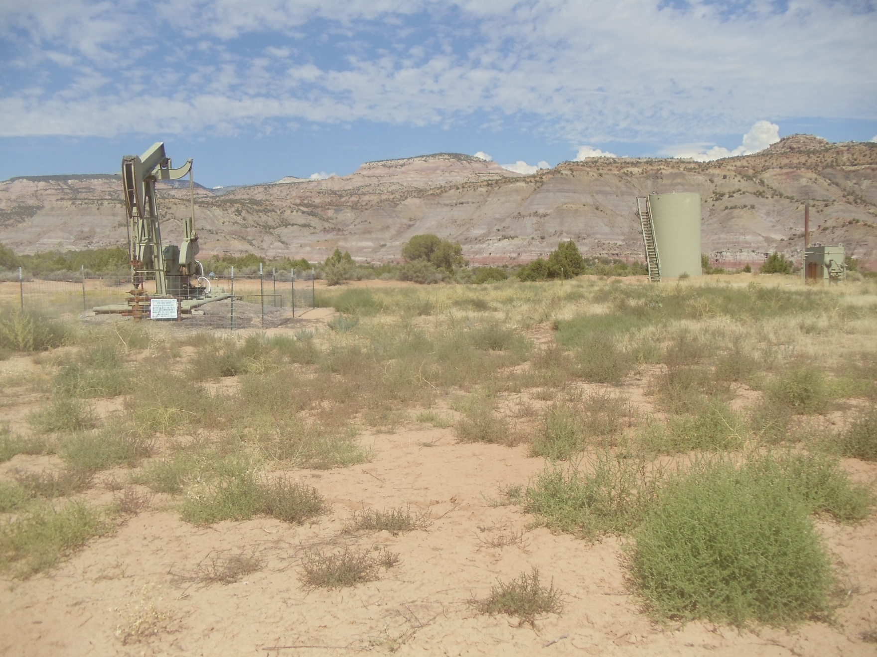
8/30/2013

Slide 11
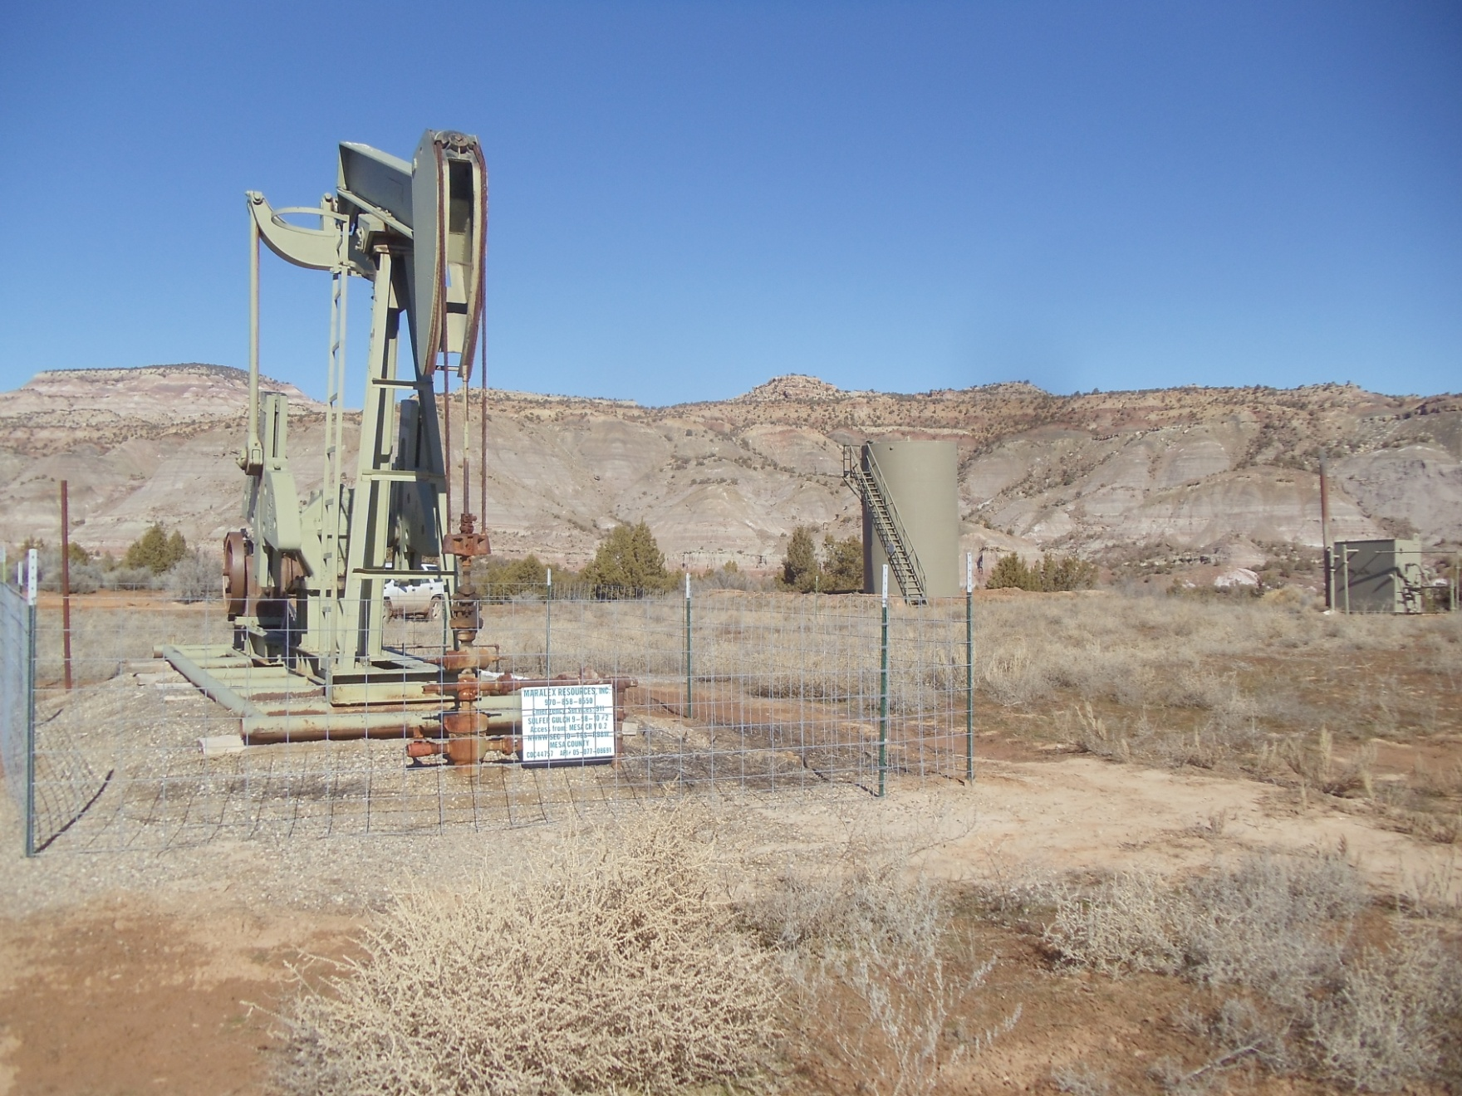
2/26/2014

Slide 12
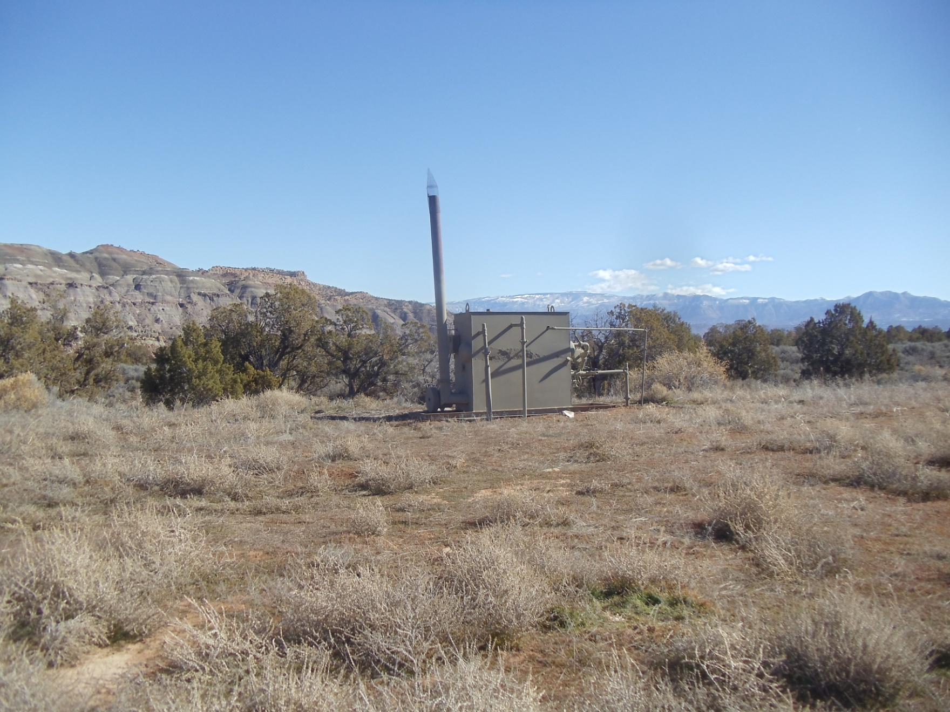
2/26/2014

Slide 13
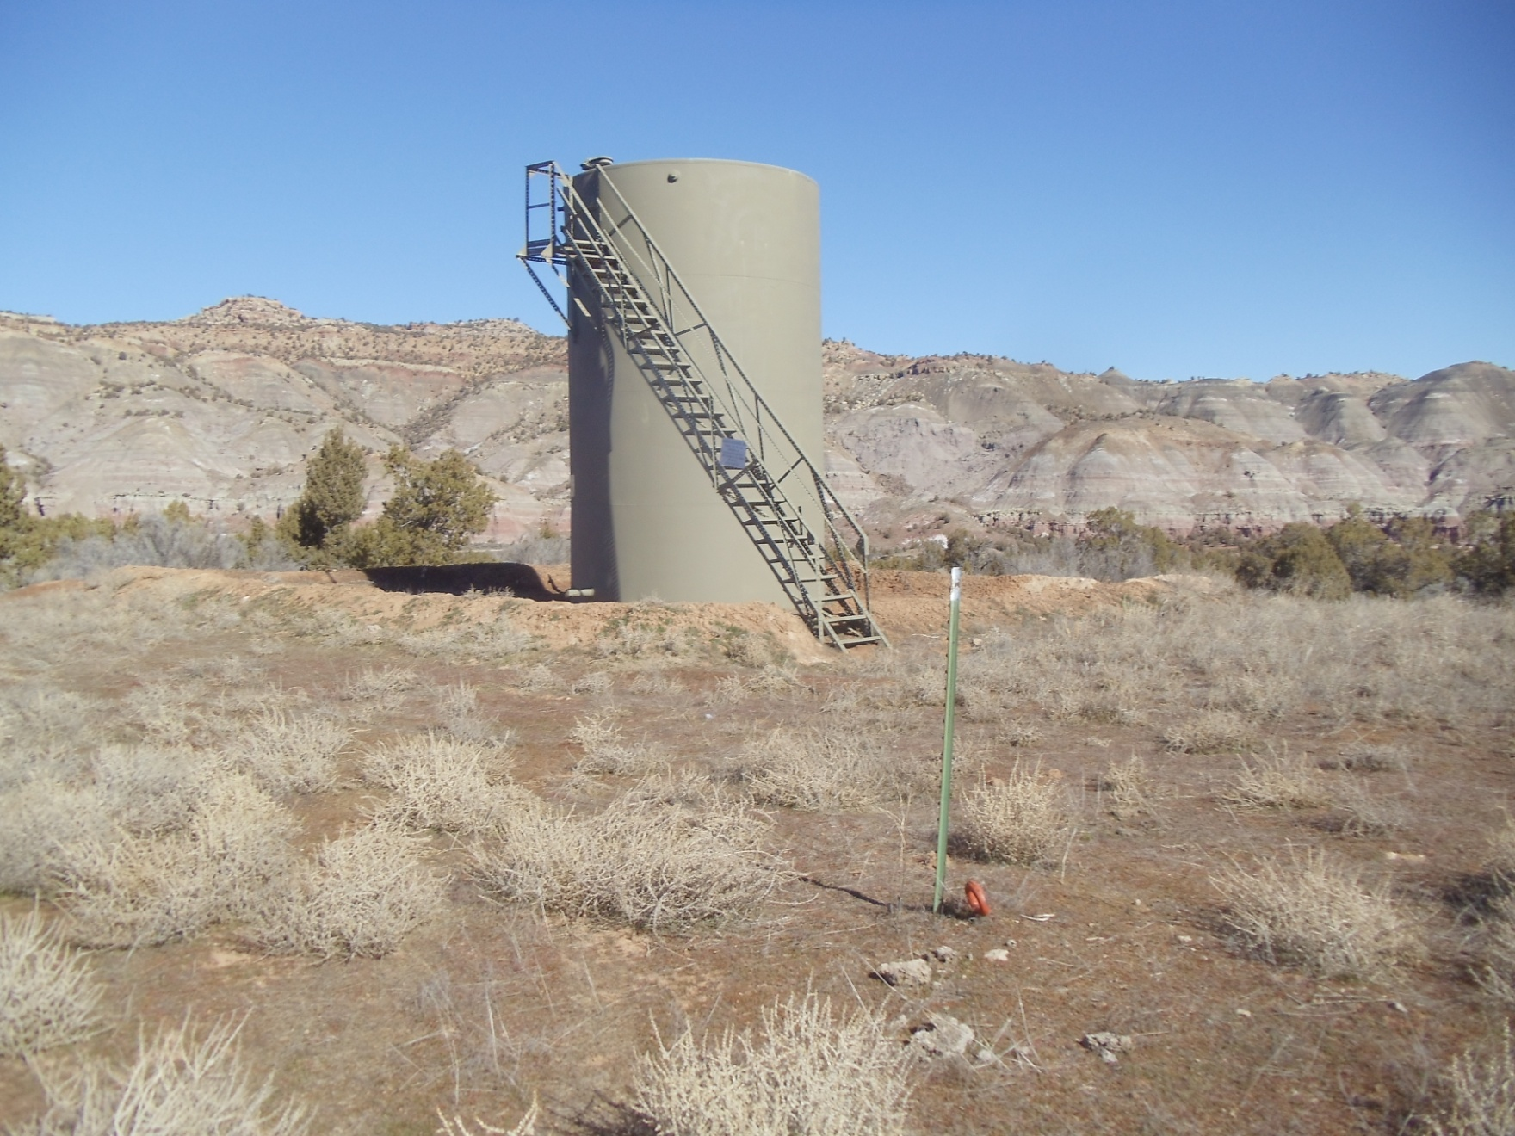
2/26/2014

Slide 14
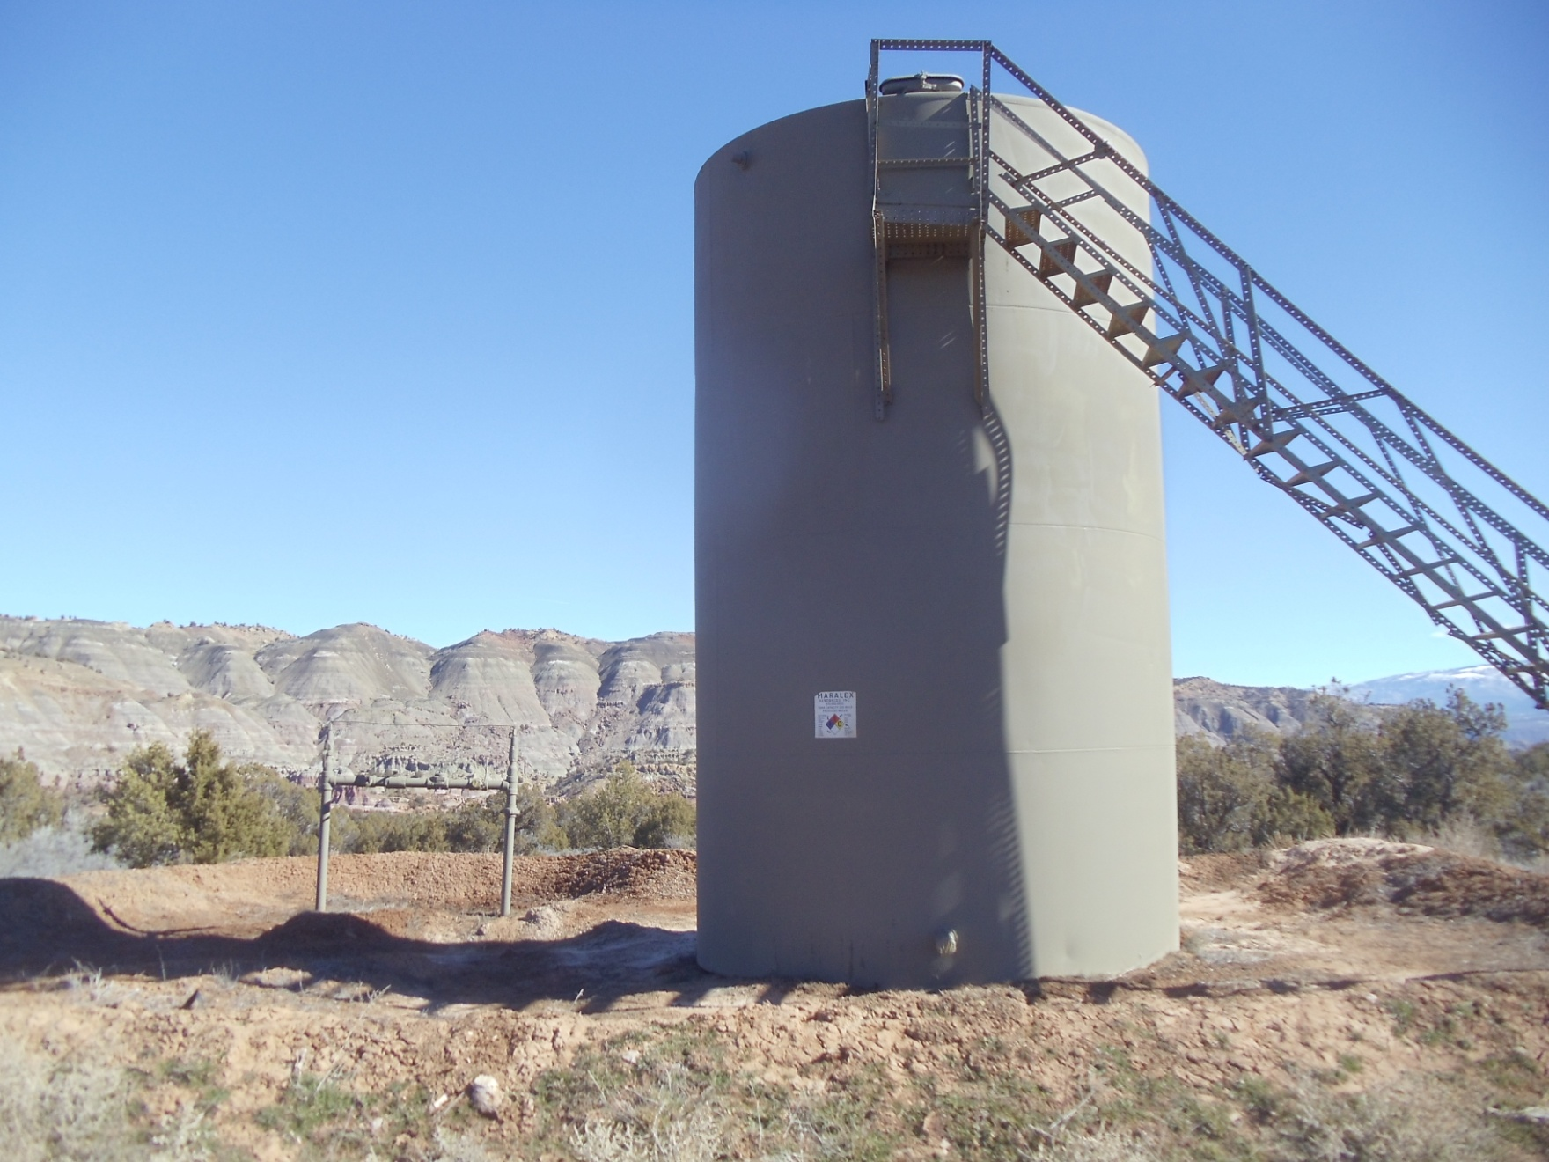
2/26/2014

