Slide 1
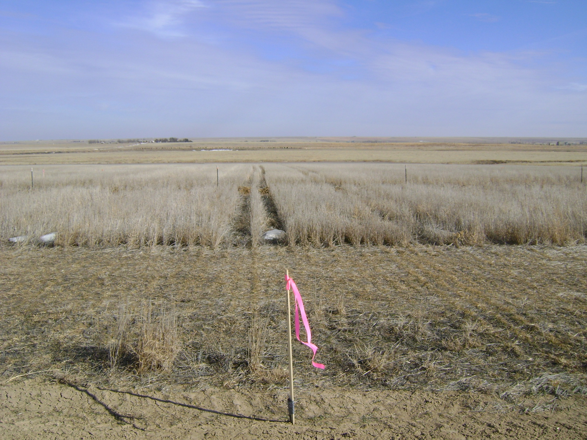
Totem # 7 looking East

Slide 2
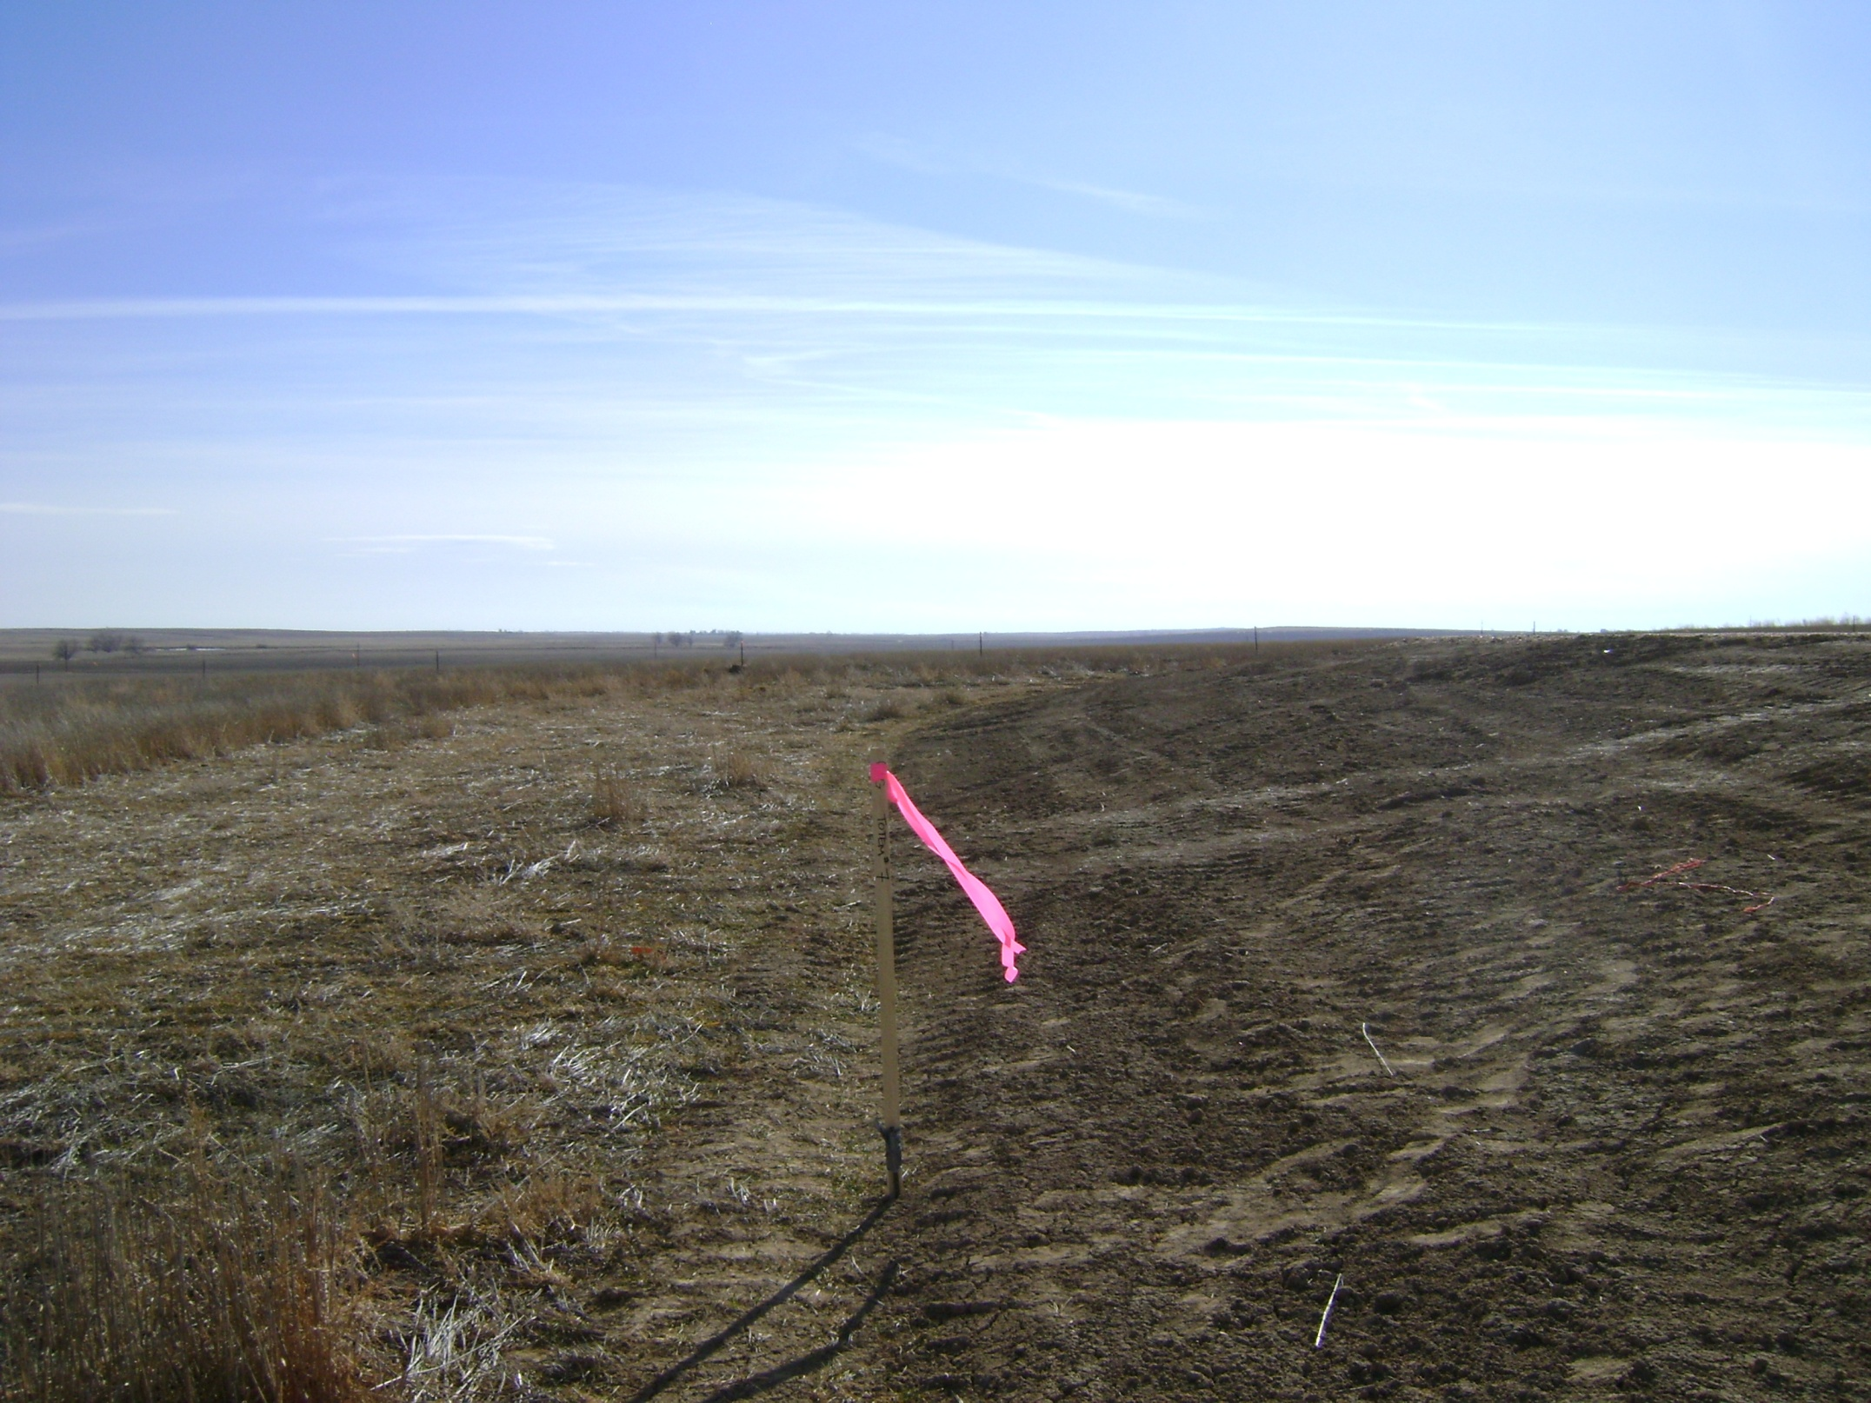
Totem # 7 looking South, access from Totem # 5 location to West

